Slide 1
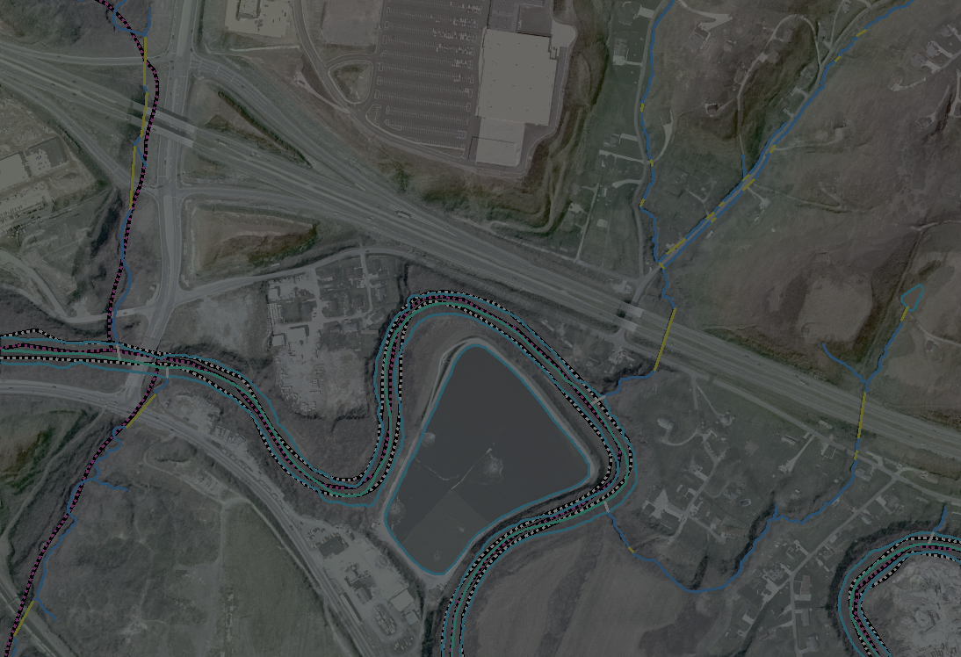
Integrating Hydrography and Lidar Elevation: Fundamentals and Application Issues
USGS Hydrography Seminar Series,
Seminar #8
Thursday, May 19, 2016
H. Karl Heidemann, GISP, CMS
Physical Scientist
U.S. Geological Survey/EROS
U.S. Department of the Interior
U.S. Geological Survey

Slide 2
Lidar Basics
Troublesome Terminology
Bare-Earth Flavors
Hydrographic Breaklines

Slide 3
What Is Lidar?
Light Detection And Ranging
Active airborne* sensor system
Scanning pulsed laser (new technologies on the rise)
High-precision clocks provide the time duration between the emitted pulse and detected reflection
High-precision position and attitude sensors onboard provide a 3D origin point and a vector direction
Speed of Light ⨯ Duration ÷ 2 = Vector Length [sensor to target]
The complete vector (direction and length) allows the xyz location of the 3D reflection point to be computed.
* for our purposes

Slide 4
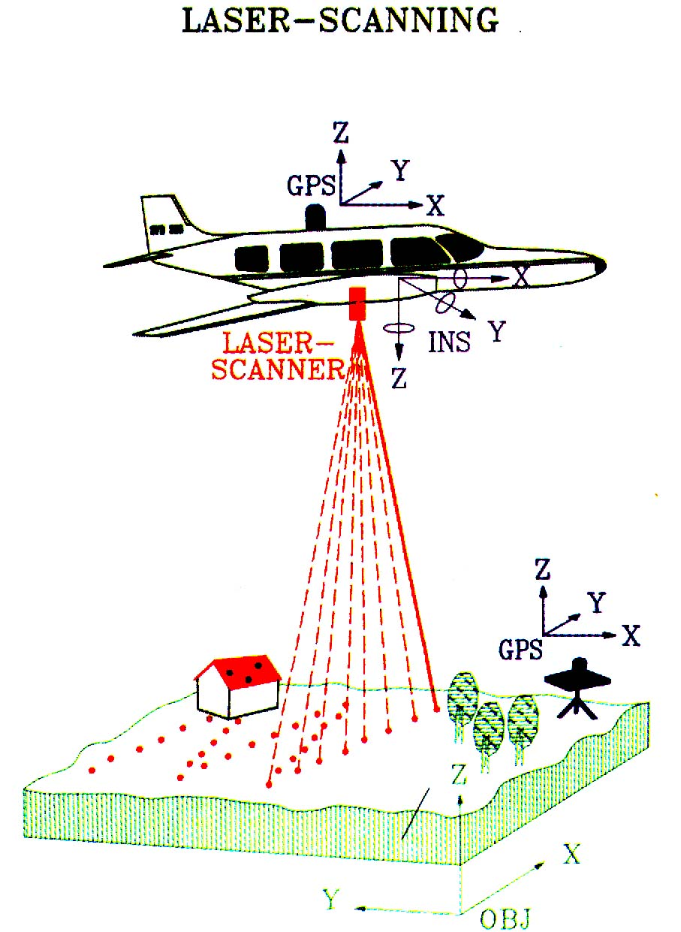
What Is Lidar?

Slide 5
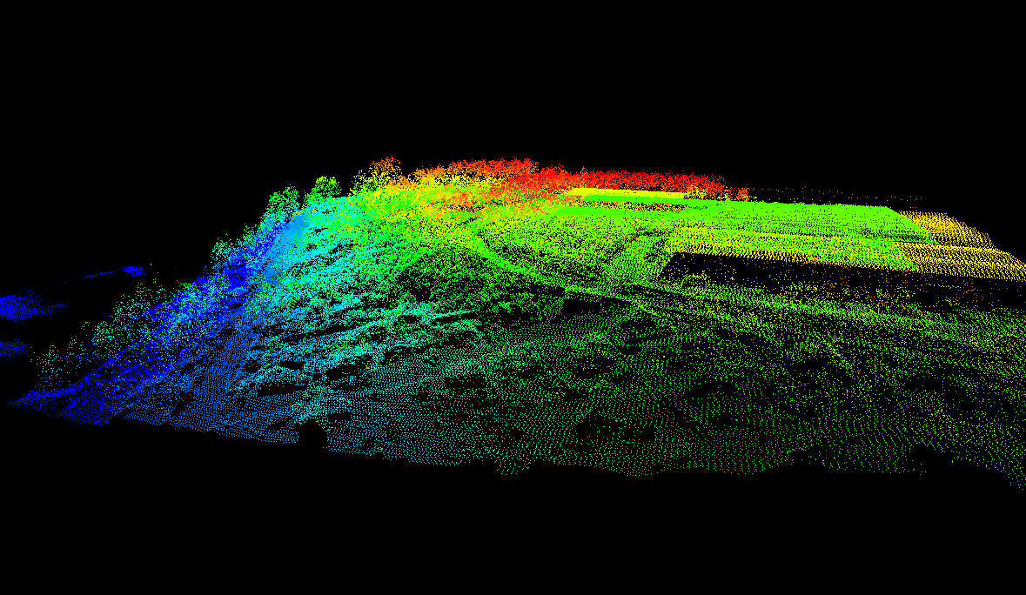
What Is Lidar Data?
Lidar data is a 3D Point Cloud

Slide 6
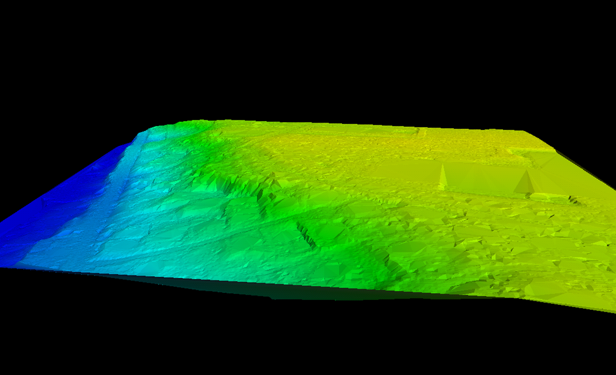
What Is Lidar Data?
I may be lidar-derived, but I’m still just a DEM !
Digital Elevation Models (DEM) and other surfaces are not lidar

Slide 7
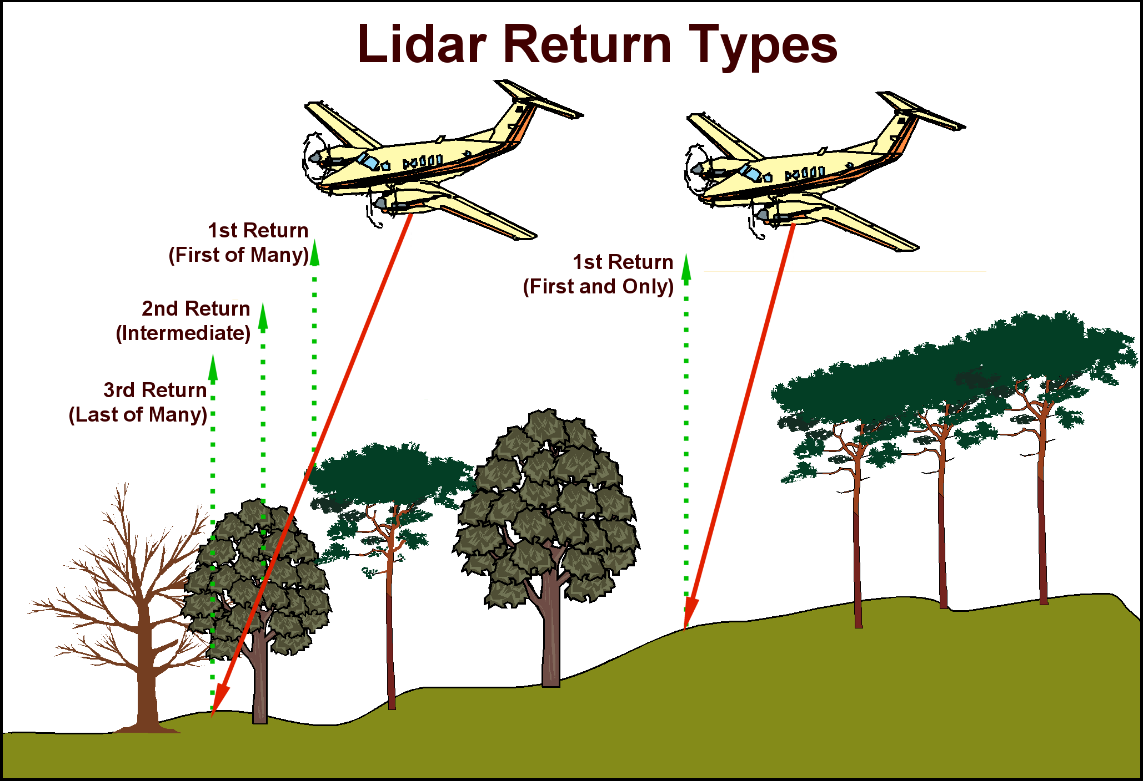
Multiple Return Lidar
Graphic courtesy of EarthData

Slide 8
Multiple Return Schematic
Graphic courtesy of EarthData

Slide 9
Vegetation Penetration
Lidar does not, as people often say, “see through trees”.
Lidar sees around trees, through gaps in the canopy.
If you stand in a forest, look up, and can see the sky, then lidar can likely see and measure you.
If you can’t see the sky, then lidar can’t see you either.
Lidar is less effective at measuring the ground in vegetated areas than it is in open areas.
Fewer ground points, More interpolation.
Less accuracy, Less reliability.
Still, as an active sensor, lidar can map places that traditional photogrammetry cannot.

Slide 10
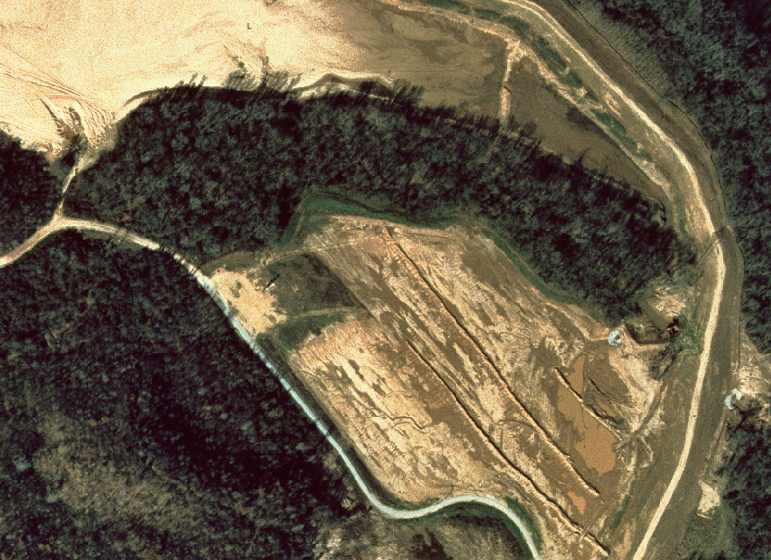
Lidar Vegetation Penetration
Graphic courtesy of EarthData

Slide 11
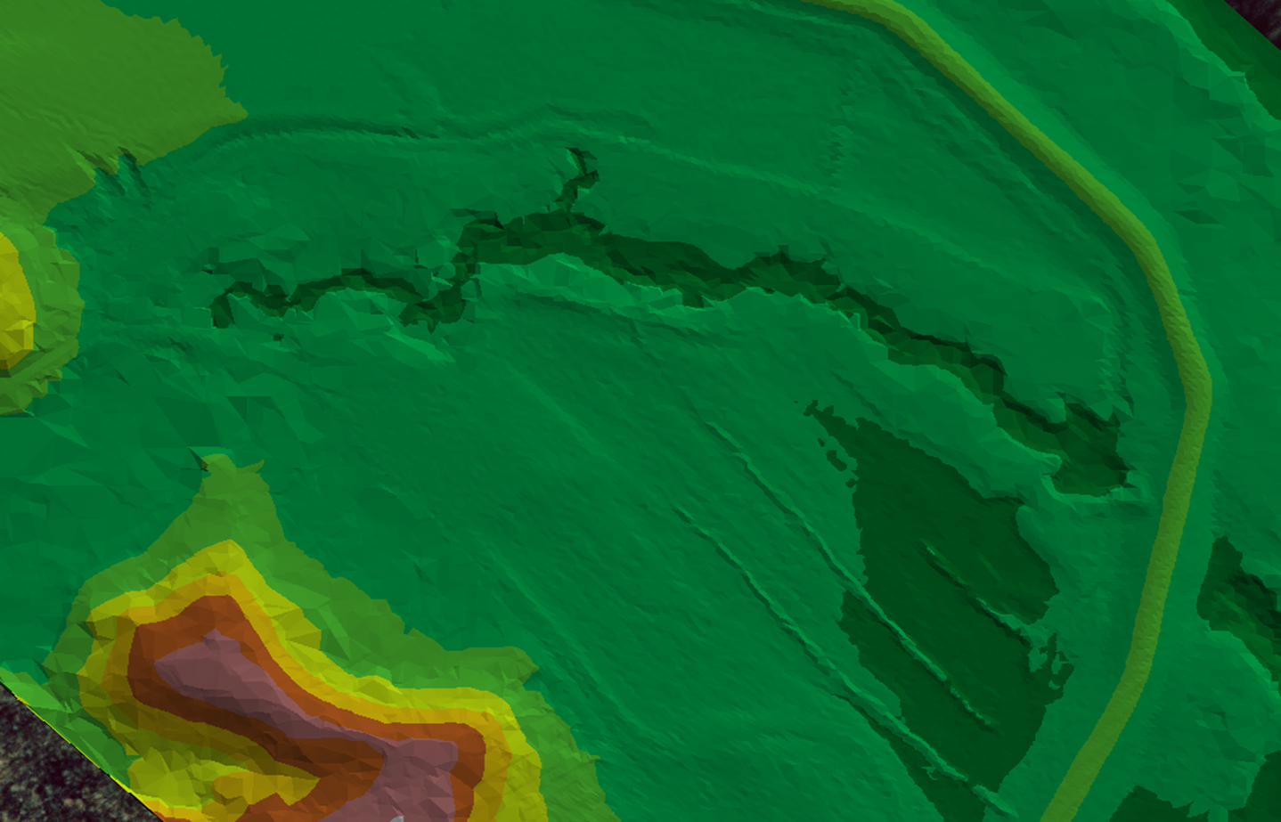
Lidar Vegetation Penetration
Graphic courtesy of EarthData

Slide 12
But …
Unlike photogrammetry, lidar is a user-independent measurement.
In photogrammetry, the operator selects a location for a point or vertex in the image, and then measures the elevation at that point.
Although lidar does acquire data in a semi-regular pattern, the locations of the points are functionally random.
So, lidar by itself cannot trace a stream bank or centerline.
Hydrographic Breaklines are needed to define this detail!
This must be done after the fact by a human operator
Once delineated horizontally, elevations can be conflated to the vertices.
Automatic breakline extraction methods have been researched for years; the search continues …

Slide 13
Some Slippery Terms
(depending on who and where you are)
DTM: Digital Terrain Model
Traditionally, DTMs are the output from stereo compilation of vector masspoints and breaklines.
DTMs would be used to create DEMs, which in turn would be used to create contours.
DEM: Digital Elevation Model
A continuous raster surface model of the “bare-earth surface”
Bare-earth surface can mean many different things
DSM: Digital Surface Model
A continuous raster surface of something other than the bare-earth, e.g., top of canopy.

Slide 14
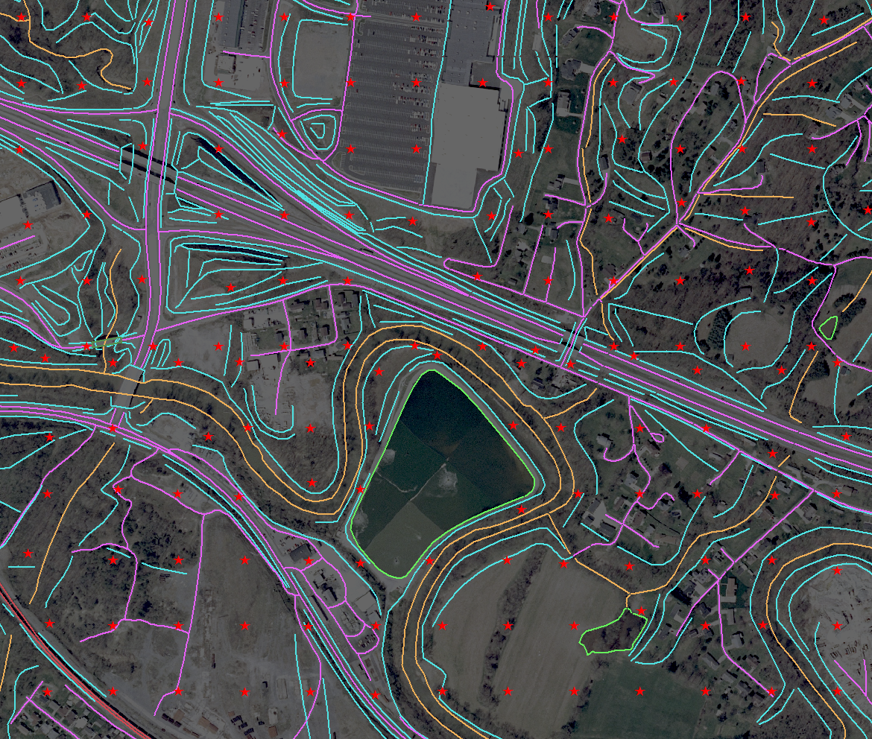
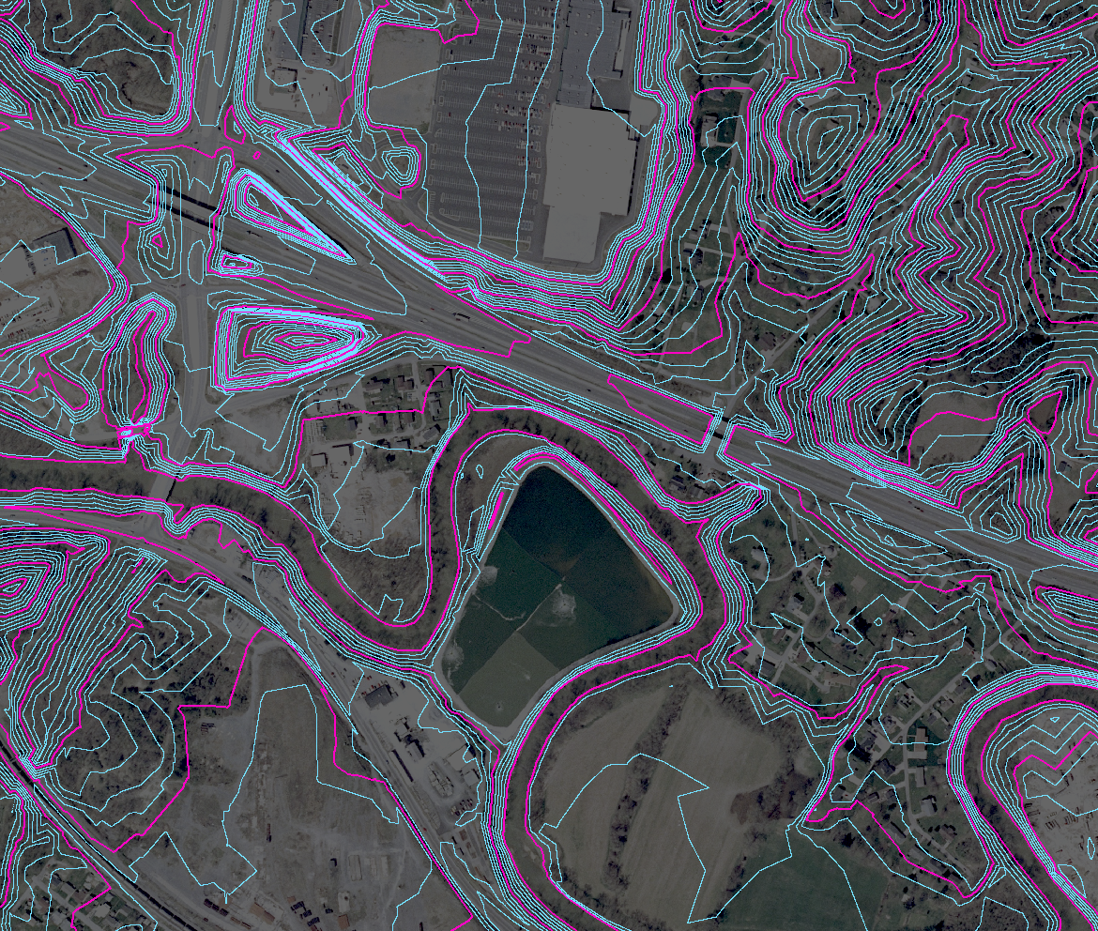
Classic Stereo DTM
Vector masspoints and breaklines: not a surface.
Contours typically derived from the DTM
(Images adapted from Heidemann, 2012)

Slide 15
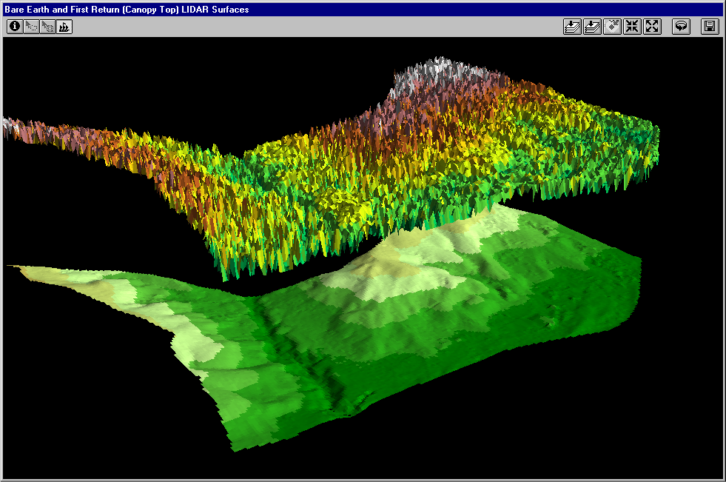
DSM versus DEM
DSM: First-Return Surface Top of Canopy
DEM: Bare-earth Ground Surface
Graphic courtesy of EarthData
Notes:
GRID of the First returns “floated” over the Bare-earth surface. This was to demonstrate that the first-return data has a vertical dimension and can be useful for calculating volume

Slide 16
Different Flavors of DEMs
TOPOGRAPHIC: Mapping
Stereo-derived: masspoints and breaklines
Pure (raw) Lidar: lidar points only
Hydro-Flattened (simple)
Hydro-Flattened (enhanced)
HYDROLOGIC: Modeling
Hydro-Enforced
Hydro-Conditioned

Slide 17
Stereo DTM (Topographic Surface)
Traditional stereo-compiled DTM (reference)
Built from Masspoints and Breaklines
Coarser resolution than lidar
Depicts the familiar, expected character of a topographic DEM
Flat water surfaces
Bridges removed
Road edges defined
Road fills over culverts retained
Stream Waterbody
(Image adapted from Heidemann, 2012)

Slide 18
Pure Lidar (Topographic Surface)
Created solely from bare-earth lidar points.
Water surfaces have triangulation artifacts.
Few, if any, reliable lidar returns from water.
No breaklines to constrain the surface and define the banks.
Most users regard this as cartographically unacceptable.
Contours would require extensive editing.
Tinning across Water Surfaces
(Image adapted from Heidemann, 2012)

Slide 19
Hydro-Flattened (Simple) (Topographic Surface)
A Lidar Base Specification goal.
Supports a consistent topographic surface character across 3DEP, suitable for contour generation.
Removes the most offensive pure lidar artifacts from water surfaces.
Waterbodies have a single elevation.
Streams and rivers are flat bank-to-bank, with monotonic (downhill) flow.
Purely a Cartographic enhancement. Water surface elevations are set to meet cartographic needs.
Stream Waterbody
(Image adapted from Heidemann, 2012)

Slide 20
Hydro-Flattened (Enhanced) (Topographic Surface)
Further refinement of the Hydro-Flattened surface
Refines the delineation of roads, single-line drainages, ridges, bridge crossings, buildings, etc.
Requires a large number of additional detailed breaklines
A higher quality surface, but substantially more expensive.
Not cost effective for 3DEP.
Buildings Roads
(Image adapted from Heidemann, 2012)

Slide 21
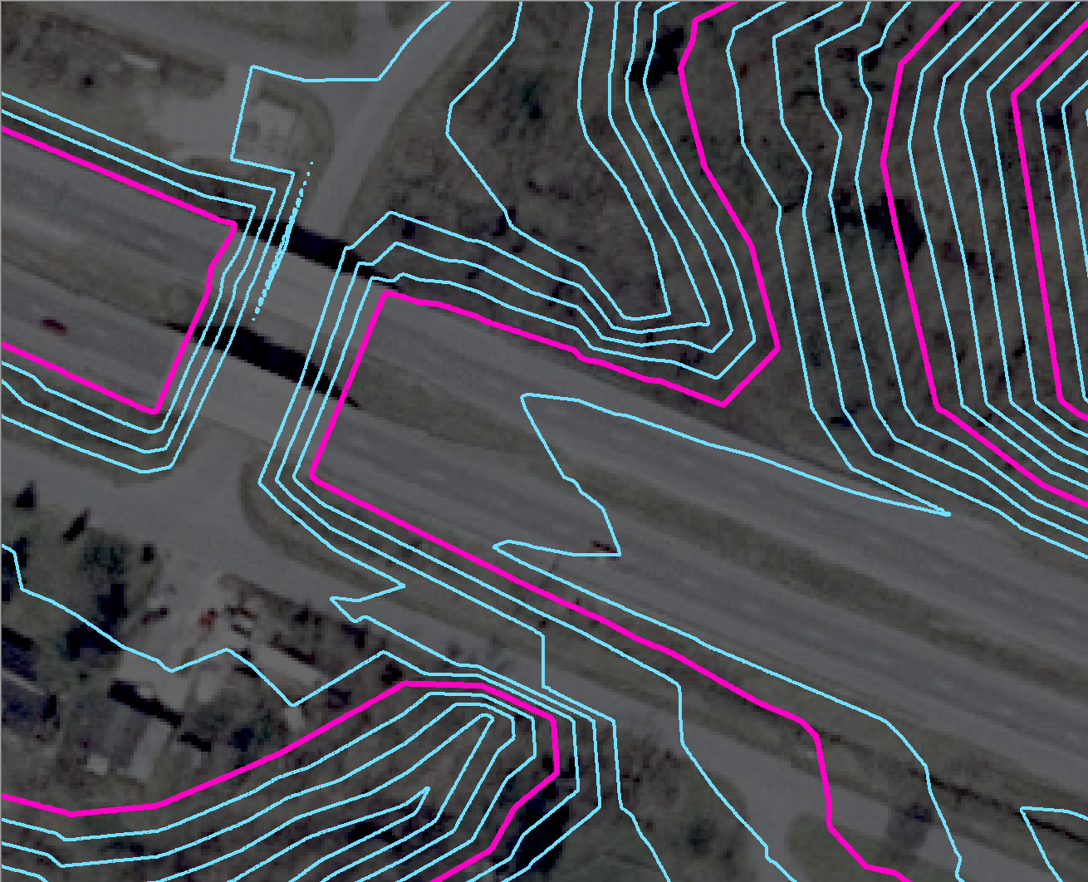
Topographic Contours, Detail
Bridge Deck Removed
Road Surface Intact

Slide 22
Hydro-Enforced (Hydrologic Surface)
Engineering surface for Hydraulic and Hydrologic (H&H) modeling.
Similar to Hydro-Flattened, with additional surface modifications to allow continuous surface water flow.
Water surface elevations may be set at known values.
Most notably, road fills are cut through at culvert locations.
Not useful for traditional mapping or contour development.
Culverts Cut Through Roads
(Image adapted from Heidemann, 2012)

Slide 23
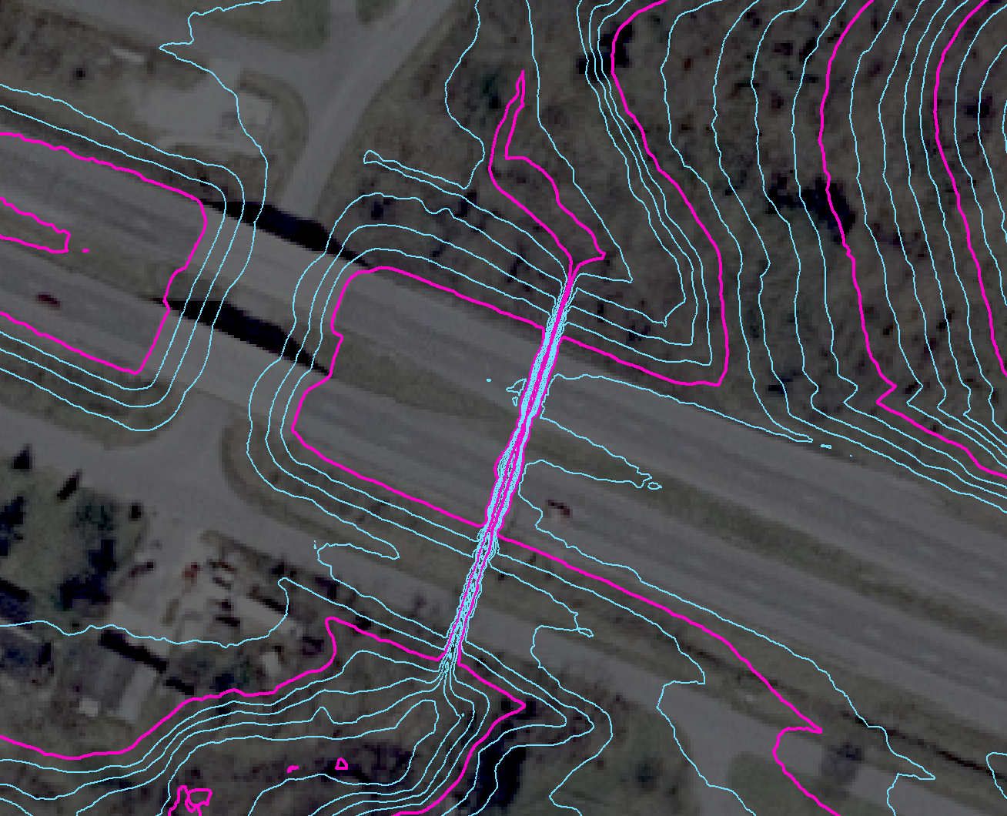
Hydrologic Contours, Detail
Bridge Deck Removed
Road Surface Modified for Hydrologic Flow

Slide 24
Hydro-Conditioned (Hydrologic Surface)
Another type of surface used by engineers for H&H modeling.
Similar to the Hydro-Enforced surface, but now with sinks (areas of internal drainage) filled to their pour point.
Flow is continuous across the entire surface – no areas of internal drainage exist on the surface.
Often developed using tools in ArcGIS Spatial Analyst, ArcHydro, or other raster H&H applications.
Filled Sinks
(Image adapted from Heidemann, 2012)

Slide 25
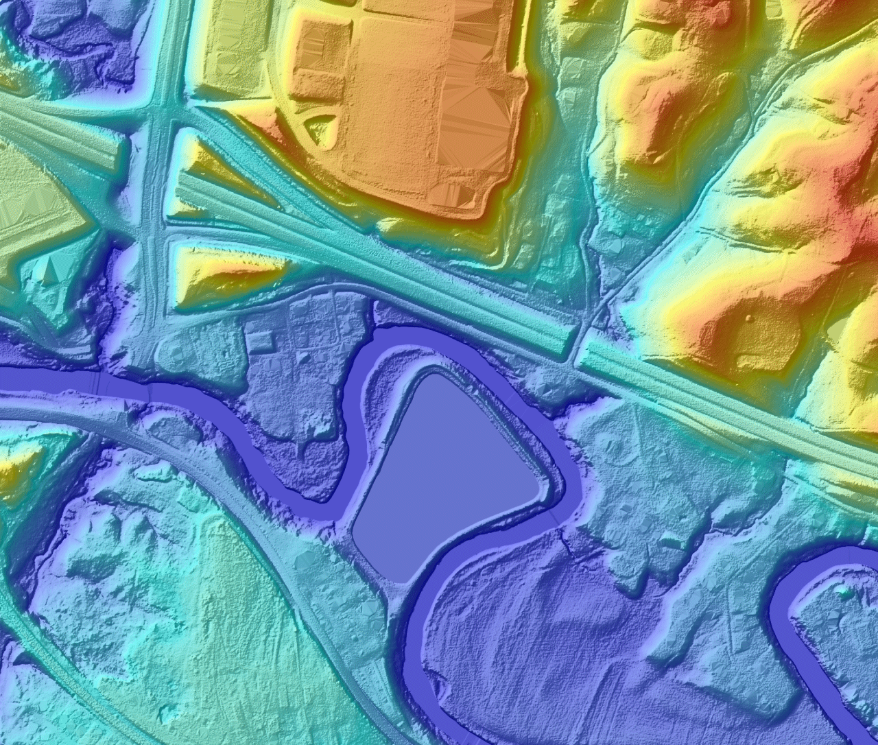
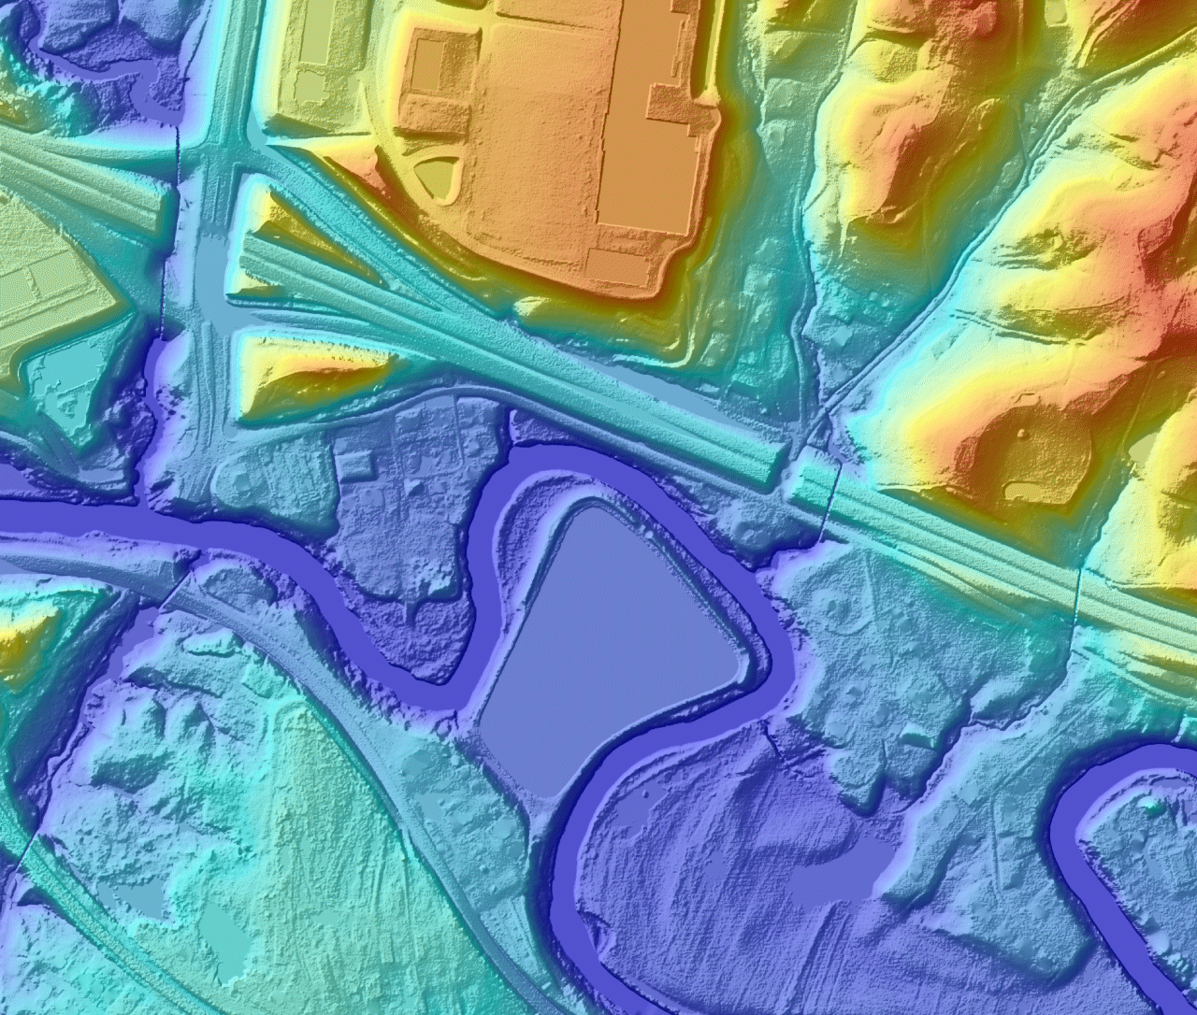
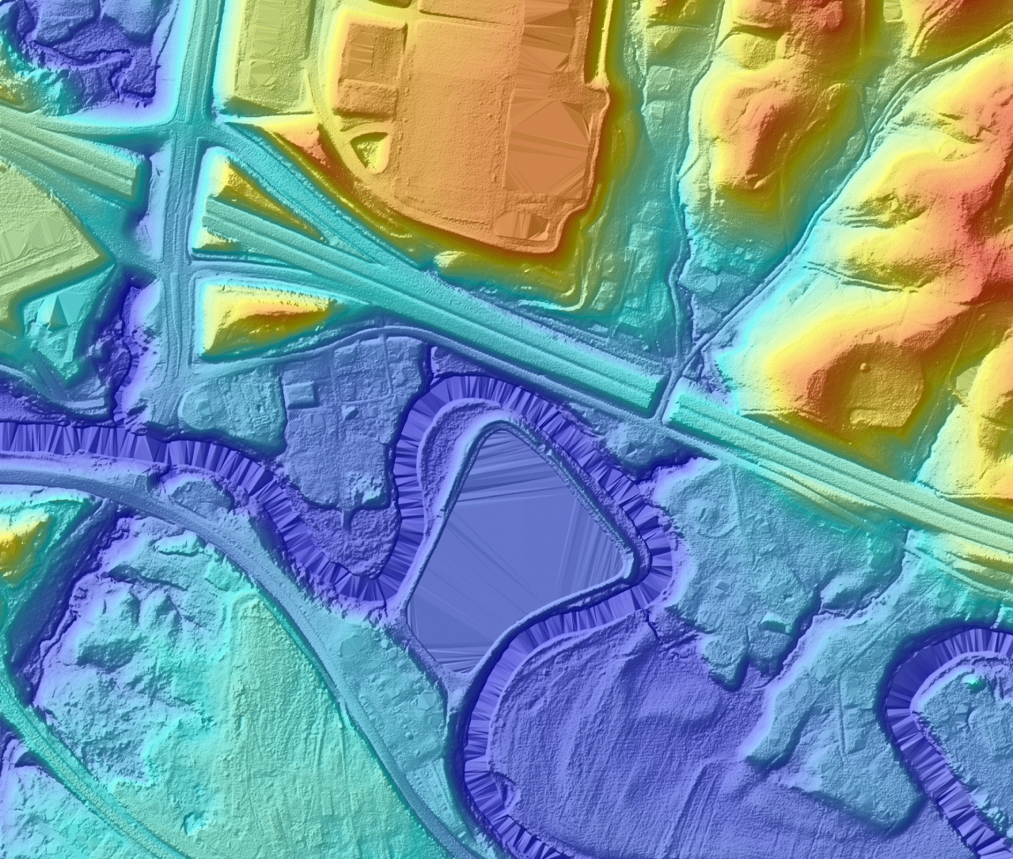
Hydro- Conditioned
Hydro- Enforced
Hydro- Flattened (enhanced)
Hydro- Flattened (simple)
Pure (raw)
Lidar
Stereo DTM Surface (for reference)
Continue

Slide 26
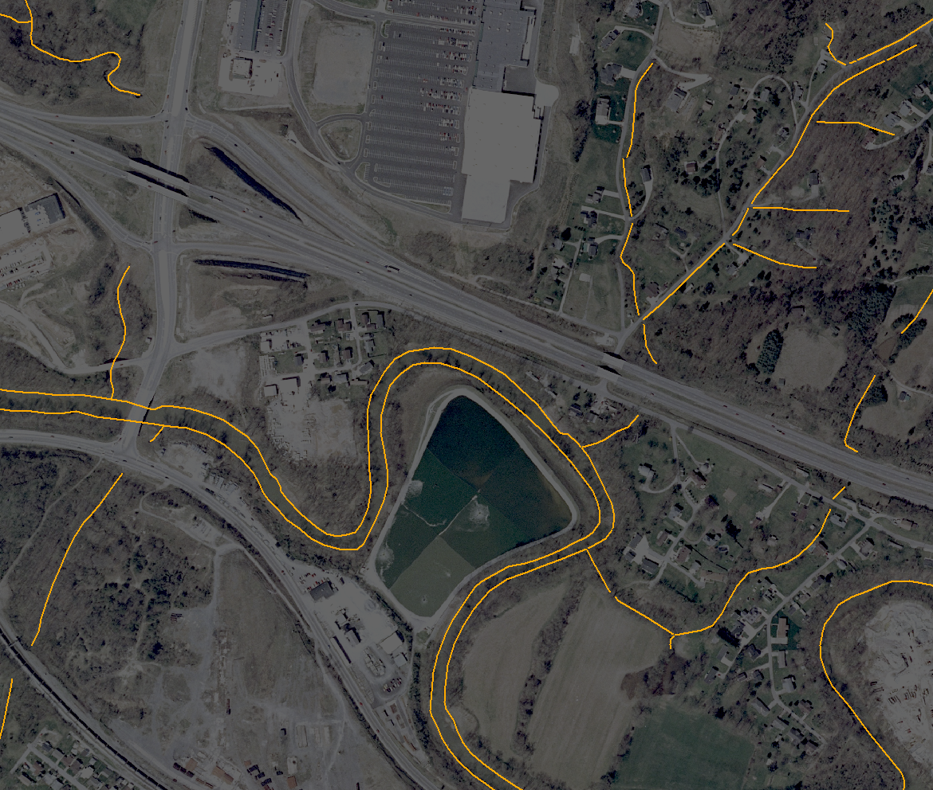
Hydrographic Breaklines, from Stereo
Stereo-compiled hydrographic breaklines
(Image adapted from Heidemann, 2012)

Slide 27
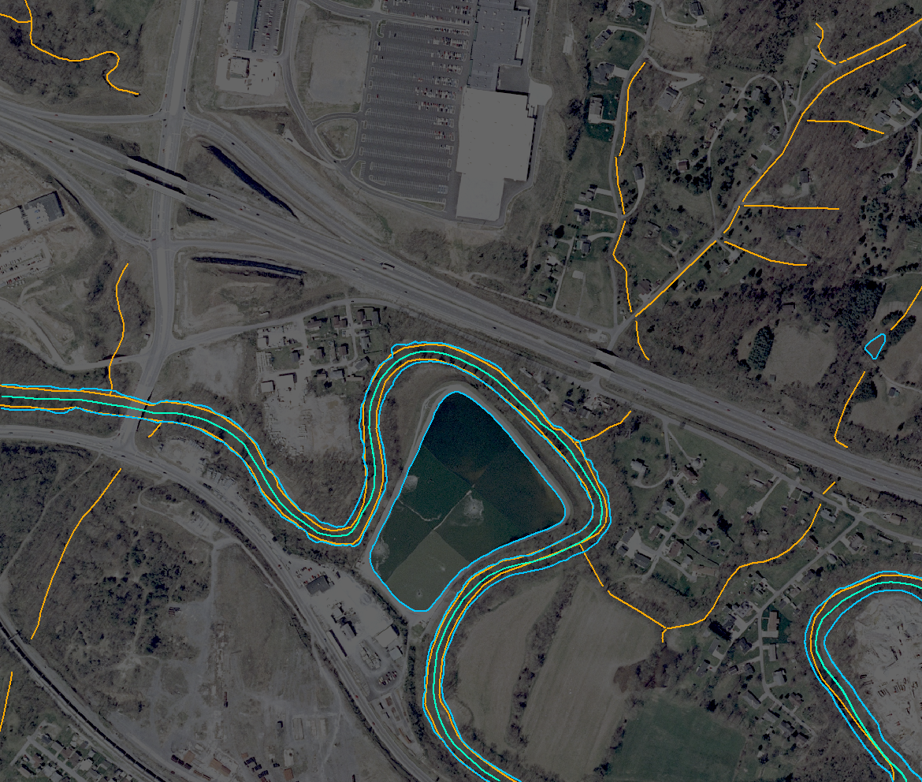
Lidar Hydrographic Breaklines (flattening)
Stereo-compiled hydrographic breaklines
Lidar-derived hydrographic breaklines (hydro-flattening only)
(Image adapted from Heidemann, 2012)

Slide 28
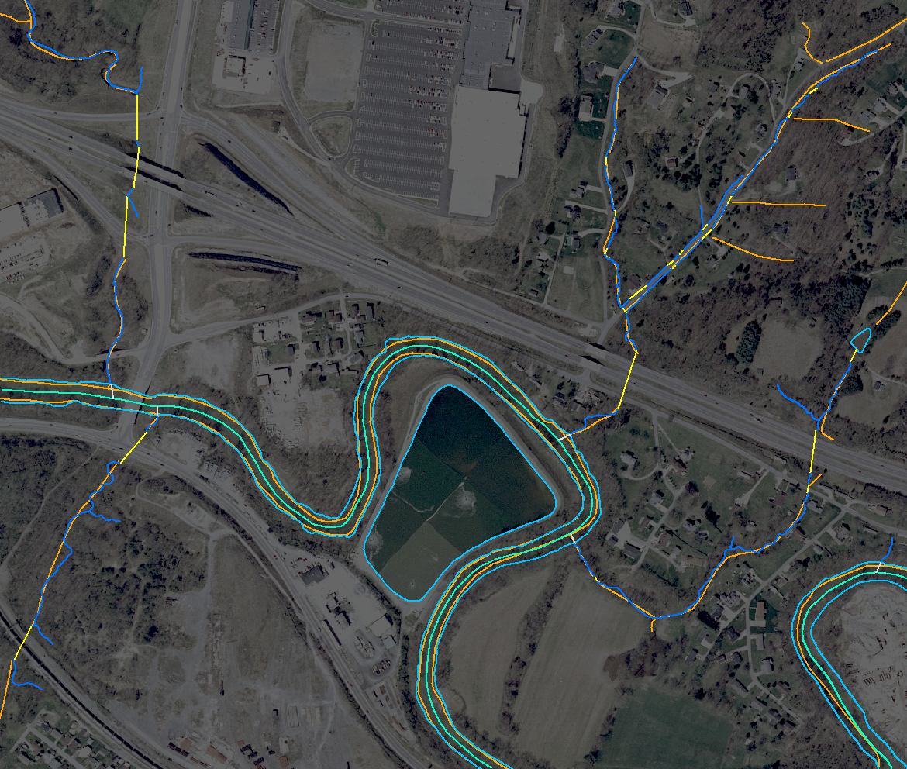
Lidar Hydrographic Breaklines (enforcement)
Stereo-compiled hydrographic breaklines
Lidar-derived hydrographic breaklines (hydro-flattening only)
Lidar-derived hydrographic breaklines (expanded collection)
(Image adapted from Heidemann, 2012)

Slide 29
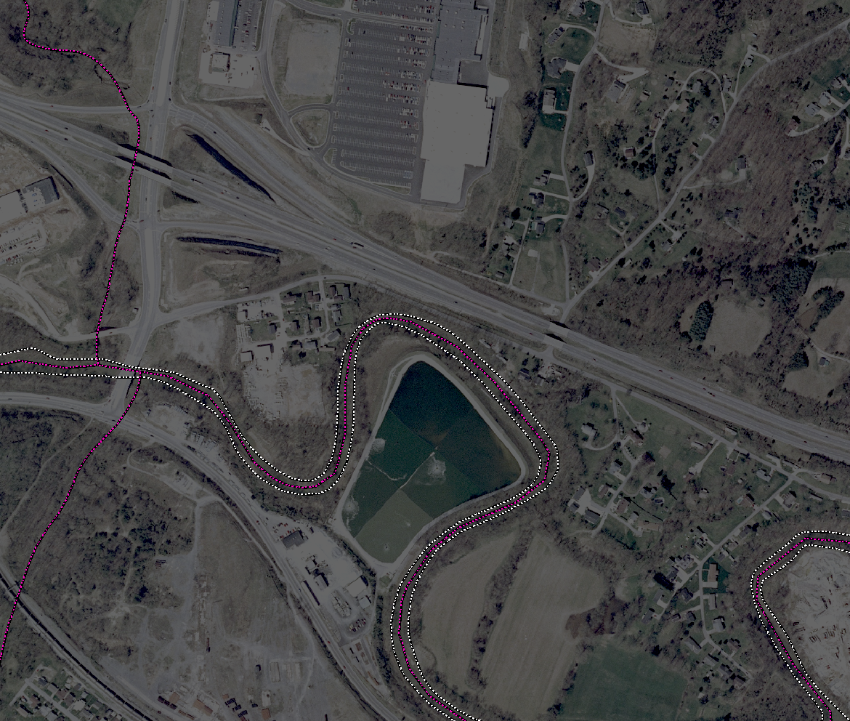
National Hydrography Dataset (NHD)
NHD Flowlines and Area polygons
(Image adapted from Heidemann, 2012)

Slide 30
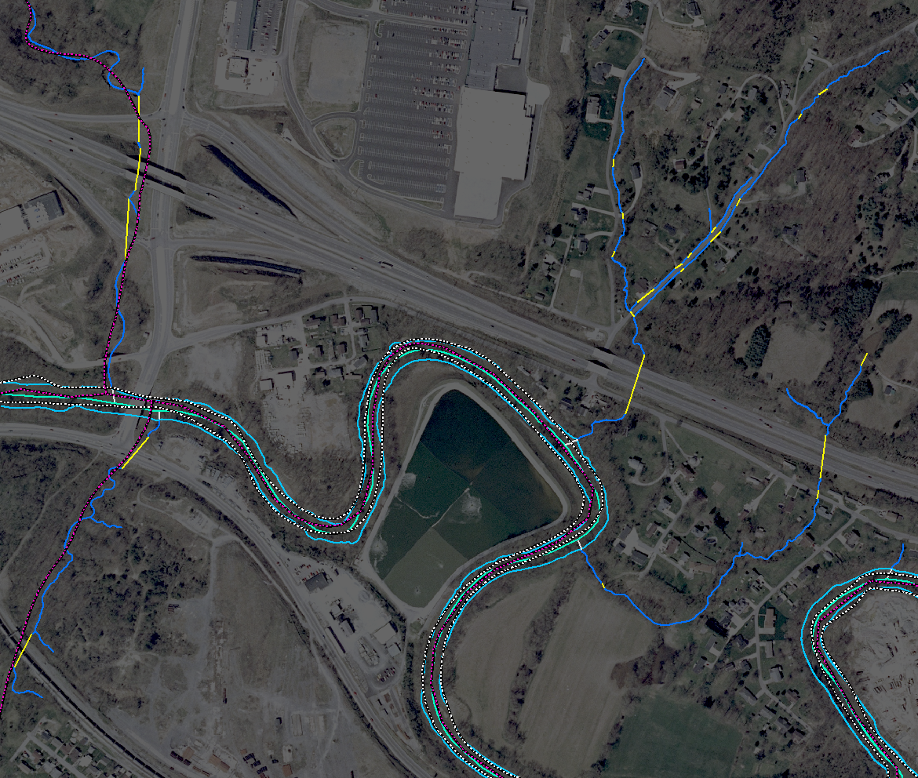
Lidar Breaklines and the NHD
NHD Flowlines and Area polygons
Lidar-derived hydrographic breaklines (expanded collection)
(Image adapted from Heidemann, 2012)

Slide 31
Lidar Breaklines and the NHD
NHD Flowlines and Area polygons
Lidar-derived hydrographic breaklines (expanded collection)
Obvious similarity between these datasets.
(Image adapted from Heidemann, 2012)

Slide 32
Lidar Breaklines and the NHD
Since some of these breaklines are going to be collected anyway:
Can those be used to update and improve the NHD?
Is it worth expanding breakline collection to include single-line features?
Improved and added data for the NHD
Would support production of hydrologic DEMs
(Image adapted from Heidemann, 2012)

Slide 33
Ele-Hydro Integration
Elevation
Steeped in a tradition of Topographic mapping.
Increasing requests for Hydrologic surfaces.
Already collecting limited breaklines for hydro-flattening.
Additional breaklines would improve topographic surfaces, and allow production of requested hydrologic surfaces.
NHD
Always looking to update and improve their data.
Already has a clear and well-defined GIS data dictionary.
Interested in incorporating elevation information in the NHD.
An ideal setting for cooperation and integration!

Slide 34
Ele-Hydro Integration
Initial Steps
Examine the existing NHD Data Dictionary for compatibility and conflicts with Elevation requirements.
Resolve differences between Elevation and NHD needs to produce a single Data Dictionary that supports both programs.
Topology and attribution
Test the new Data Dictionary in-house for functional viability.

Slide 35
Ele-Hydro Data Dictionary (excerpts, draft)
POINTS
Feature Topology | Elevation Description | EClass | EType | SFType | NHD Description | FGroup | FCode
Always Point | Spot Elevation (verified as high accuracy) | 2 | 1001 | 1 | n/a | 0 | 00000
n/a | n/a | 0 | 0000 | 0 | Sink/Rise (Emergence or disappearance of a drainge in karst landscape) | 1 | 45000
Point or Line | Gate (connecting two single-line flows; marks a potential change in flow direction) | 3 | 1003 | tbd | Gate | 1 | 36900
Point, Line, or Polygon | Dam/Weir (connecting two single-line flows; marks a change in WSEL ) | 3 | 1004 | tbd | Dam/Weir | 1 | 34300
Point, Line, or Polygon | Other Topographic Element | 2 | 1303 | tbd | n/a | 0 | 00000

Slide 36
Ele-Hydro Data Dictionary (excerpts, draft)
LINES
Feature Topology | Elevation Description | EClass | EType | SFType | NHD Description | FGroup | FCode
Point or Line | Gate (crossing polygonal water features; marks a potential change in flow direction) | 3 | 1003 | tbd | Gate | 2 | 36900
Point, Line, or Polygon | Dam/Weir (crossing polygonal water features; marks a change in WSEL) | 3 | 1004 | tbd | Dam/Weir | 2 | 34300
Line or Polygon | Stream (narrow; 1D, depicted as singleline; in a braided area, the apparent "Main Channel") | 1 | 1101 | tbd | Stream/River (1D) | 3 | 46000
Line or Polygon | Canal/Ditch (narrow; depicted as singleline) | 1 | 1102 | tbd | Canal/Ditch (1D) | 3 | 33600
Line or Polygon | Culvert (singleline, or centerline of polygonal culvert) | 1 | 1103 | tbd | --> Stream/River | 3 | 46000
 |  |  |  | tbd | --> IF Canal/Ditch | 3 | 33600
 |  |  |  | tbd | --> IF Artificial Path | 3 | 55800
Line or Polygon | Spillway (singleline, or centerline of polygonal spillway) | 1 | 1104 | tbd | --> Stream/River | 3 | 46000
 |  |  |  | tbd | --> IF Canal/Ditch | 3 | 33600
 |  |  |  | tbd | --> IF Artificial Path | 3 | 55800
Always Line | Stream Braid (narrow single-line streams; NOT the apparent "Main Channel") | 1 | 1105 | tbd | Stream/River (1D) | 3 | 46000
Always Line | Centerline (any waterbody) | 1 | 1201 | tbd | Artificial Path | 3 | 55800
Always Line | Link (singleline to centerline) | 1 | 1202 | tbd | Artificial Path | 3 | 55800
Always Line | Elevation Terminus Line (i.e., artificial "centerline" of a boundary waterbody) | 1 | 1203 | tbd | n/a | 0 | 00000
Always Line | Flattener | 1 | 1204 | tbd | n/a | 0 | 00000
Point, Line, or Polygon | Other Topographic Element | 2 | 1303 | tbd | n/a | 0 | 00000
n/a | n/a | 0 | 0000 | 0 | Bridge (WATER conveyance; very rare) | 2 | 31800
n/a | n/a | 0 | 0000 | 0 | Connector | 3 | 33400
n/a | n/a | 0 | 0000 | 0 | Sink/Rise (Emergence or disappearance of a drainge in karst landscape) | 2 | 45000

Slide 37
Ele-Hydro Data Dictionary (excerpts, draft)
POLYGONS
Feature Topology | Elevation Description | EClass | EType | SFType | NHD Description | FGroup | FCode
Point, Line, or Polygon | Dam/Weir (LARGE; also use Centerline as centerline) | 3 | 1004 | tbd | Dam/Weir (LARGE; also use Artificial Path as centerline) | 4 | 34300
Line or Polygon | Canal/Ditch (Wide, depicted as doubleline with centerline) | 1 | 1102 | tbd | Canal/Ditch (Wide, depicted as doubleline with Artificial Path as centerline) | 4 | 33600
Line or Polygon | Spillway (LARGE; also use Spillway Line as centerline) | 1 | 1104 | tbd | Spillway (LARGE; also use Artificial Path as centerline) | 4 | 45500
Always Polygon | Lake/Pond(use Centerline as centerline) | 1 | 1106 | tbd | Lake/Pond (use Artificial Path as centerline) | 5 | 39000
Always Polygon | River (Wide, 2D, depicted as doubleline with centerline) | 1 | 1107 | tbd | Stream/River (Wide, depicted as doubleline with Artificial Path as centerline) | 4 | 46000
 | --> If wide, and braided or with numerous islands, the centerline should follow the apparent "Main Channel" |  |  | tbd | Area of Complex Channel (very complex wide 2D "river"; main channel identified with Artificial Path centerline) | 4 | 53700
Always Polygon | Reservoir (use Centerline as centerline) | 1 | 1108 | tbd | Reservoir (use Artificial Path as centerline) | 5 | 43600
Always Polygon | Boundary Waterbody | 1 | 1111 | tbd | --> IF Sea/Ocean | 4 | 44500
 |  |  |  | tbd | --> IF Stream/River | 4 | 46000
 |  |  |  | tbd | --> IF Lake/Pond | 5 | 39000
Always Polygon | Bridge Deck (ANY TYPE) | 3 | 1301 | tbd | --> IF Bridge (WATER Conveyance; very rare) | 4 | 31800
 |  |  |  | tbd | --> (else, ) | 0 | 00000
Always Polygon | Swamp/Marsh Area (Reference area for Elevation) | 9 | 1401 | tbd | Swamp/Marsh | 5 | 46600
Always Polygon | Braided Stream Area (Reference area for Elevation) (This is NOT the same as the NHD Code 53700) | 9 | 1402 | tbd | n/a | 0 | 00000
Always Polygon | Unusually Inundated Area (Reference area for Elevation) | 9 | 1403 | tbd | n/a | 0 | 00000
Always Polygon | Island/Sandbar-Intermittently/Partially Submerged | 2 | 1404 | tbd | n/a | 0 | 00000
Always Polygon | Low Confidence Area (pre-determined) (Reference area for Elevation) | 9 | 1501 | tbd | n/a | 0 | 00000
Always Polygon | Low Confidence Area (sparse bare-earth) (Reference area for Elevation) | 9 | 1502 | tbd | n/a | 0 | 00000
Line or Polygon | Culvert (LARGE; also use Culvert Line as centerline) (uncommon) | 1 | 1103 | tbd | n/a | 0 | 00000
Point, Line, or Polygon | Other Topographic Element | 2 | 1303 | tbd | n/a | 0 | 00000

Slide 38
Notable Differences
Elevation and NHD databases are very similar, but …
NHD includes many features that are not relevant to elevation surfaces
e.g., well, pipeline, flume
Elevation requires a few features that are irrelevant to the NHD
e.g., “flatteners”
Some features in the NHD need to be topologically subdivided for effective use in elevation applications
e.g., water bodies features passing under bridges
culverts; typically not segmented in the NHD
Although NHD and Elevation data requirements are remarkably similar, the decision was made to use independent attributes and codes to avoid confusion in identifying features of interest between the two primary stakeholders.

Slide 39
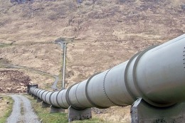
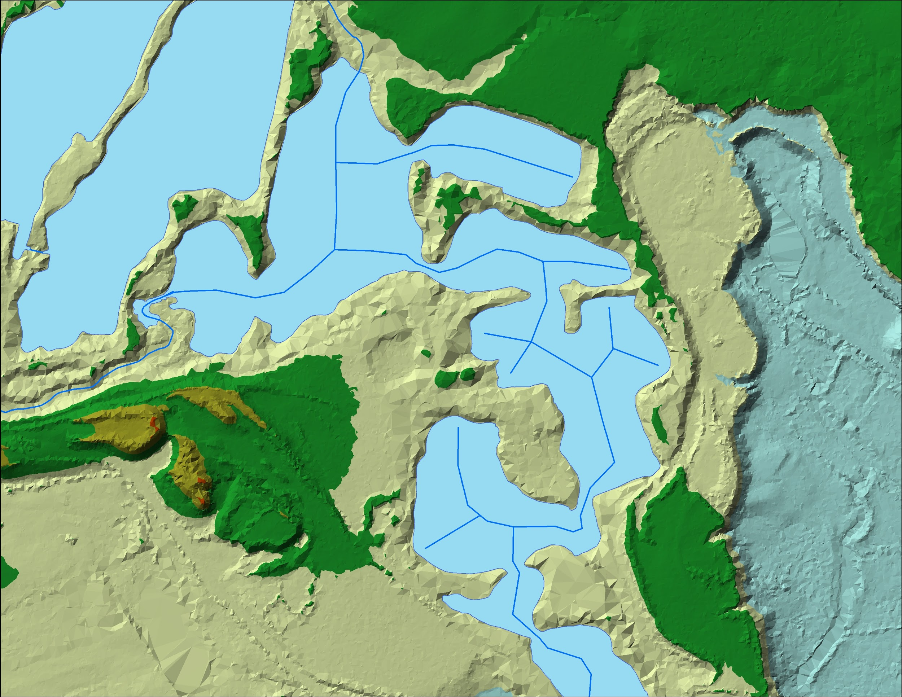
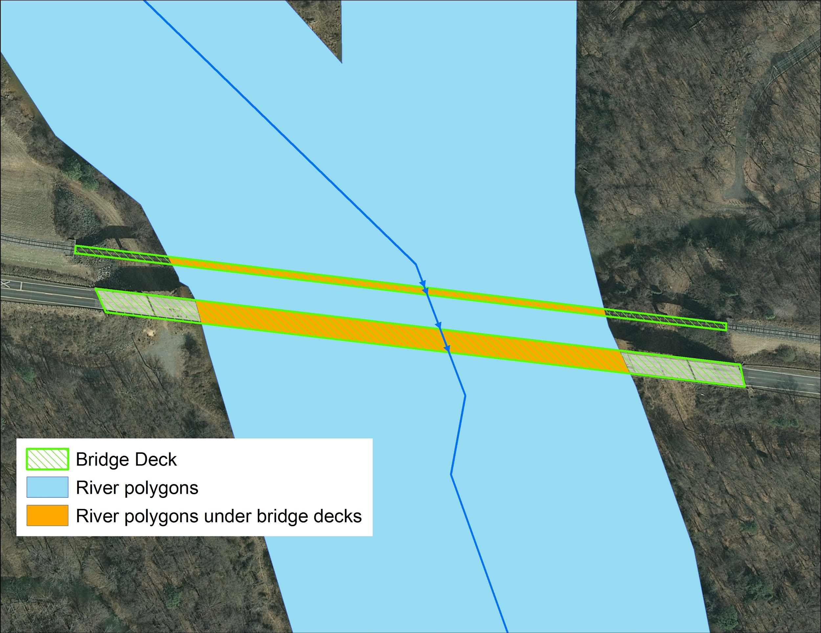
While important to NHD for modeling water flow, pipelines would not be included in a DEM.
“Flatteners” are lines used in elevation to ensure that the surfaces of complex water bodies are set to a consistent elevation. They do not represent flow or hydrographic features.
Culverts must be differentiable from streams in order to create both topographic and hydrologic DEMs.
Elevation needs to remove waterbody segments under bridges; the NHD does not.

Slide 40
Ele-Hydro Integration
Current Activities
Incorporate the Data Dictionary into the upcoming revision of the Lidar Base Specification (version 1.3)
Data STRUCTURE only;
NO capture requirements at this point.
Conduct Pilot Projects with Geospatial Products and Services Contract (GPSC) contractors to:
Gauge costs and quality of additional breakline collection.
Determine the most effective and appropriate extent of collection for integrated breaklines.
Scale and Feature Types

Slide 41
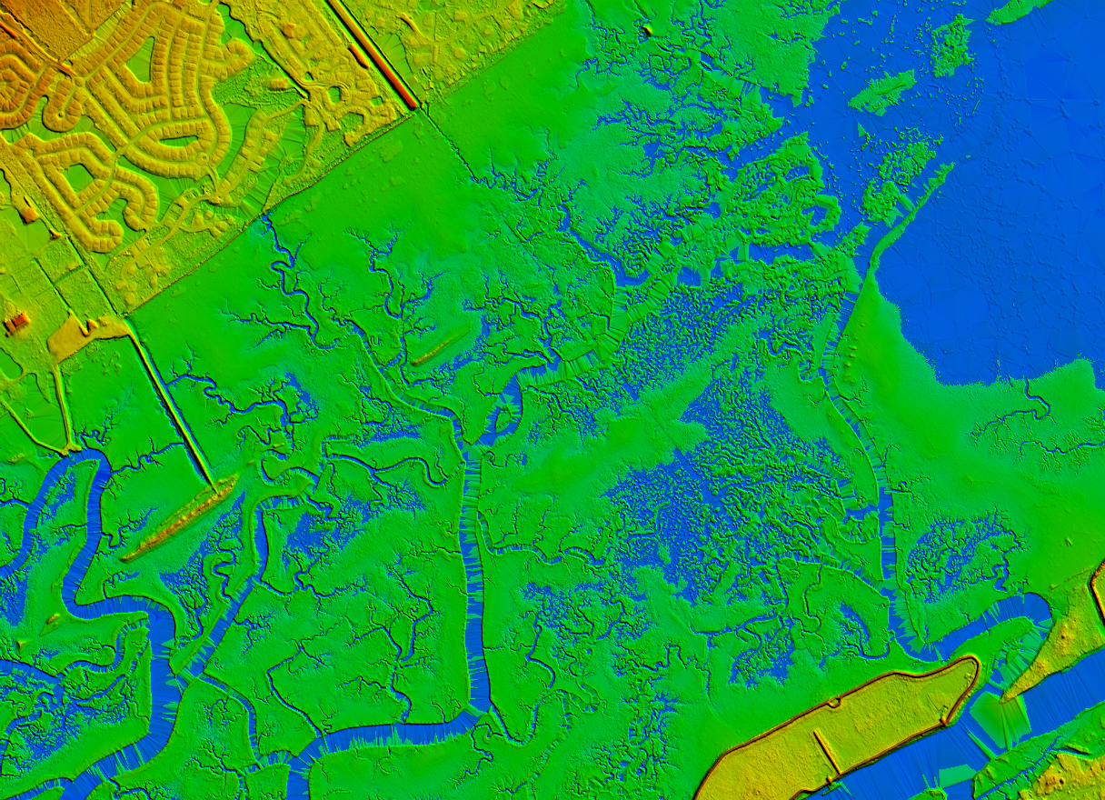
Hydrographic Breaklines can add exceptional value to Elevation products, provide the foundation for NHD update and enhancement, and bring the goal of Ele-Hydro integration from dream to reality.
Graphics courtesy of NOAA

Slide 42
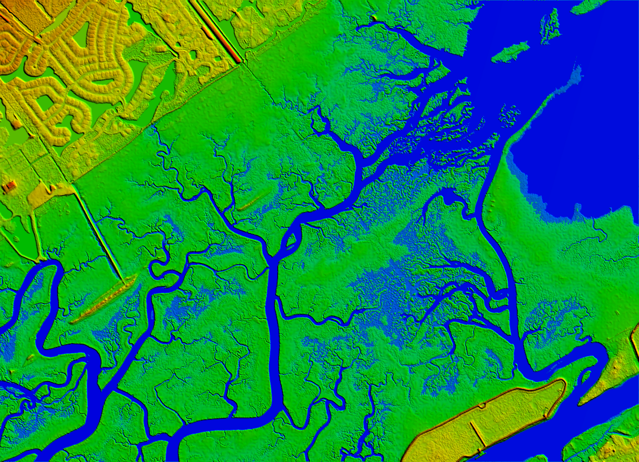
Hydrographic Breaklines can add exceptional value to Elevation products, provide the foundation for NHD update and enhancement, and bring the goal of Ele-Hydro integration from dream to reality.
Graphics courtesy of NOAA

Slide 43
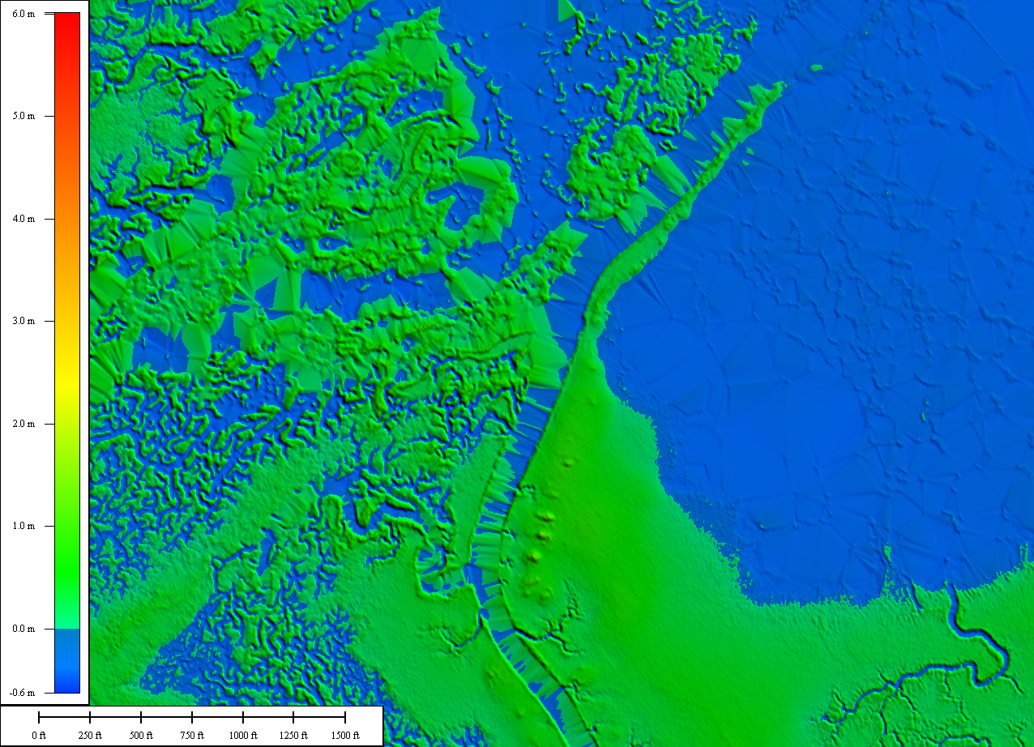
But expectations must be tempered by practicality. How much detail is needed and what costs are reasonable for data at national extents?
Graphics courtesy of NOAA

Slide 44
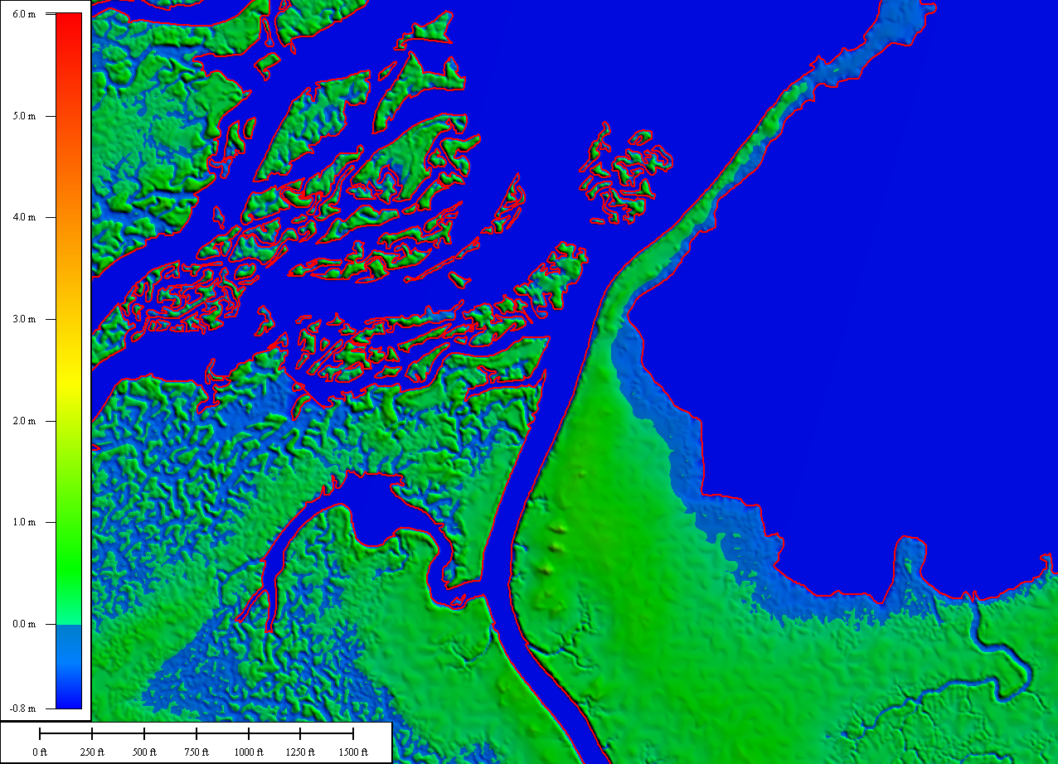
But expectations must be tempered by practicality. How much detail is needed and what costs are reasonable for data at national extents?
Graphics courtesy of NOAA

Slide 45
Ele-Hydro Integration
Future Tasks
Develop internal processes to utilize the additional data.
Introduce capture requirements into the Lidar Base Specification and GPSC Task Orders.
Produce and distribute new and improved Elevation and Hydrographic products.
Conclusion: Elevation and Hydrography, Integrated. Stronger Together. Ele-Hydro!

Slide 46
References
Heidemann, H. Karl, 2012, Digital elevation models sec. 10.1 of Renslow, M.S., ed., Manual of airborne topographic lidar: Bethesda, Md., American Society for Photogrammetry and Remote Sensing, p. 283-310.

Slide 47
Integrating Hydrography and Lidar Topography: Fundamentals and Application Issues
USGS Hydrography Seminar Series,
Seminar #8
Thursday, May 19, 2016
H. Karl Heidemann, GISP, CMS
Physical Scientist
U.S. Geological Survey/EROS
U.S. Department of the Interior
U.S. Geological Survey

