Slide 1
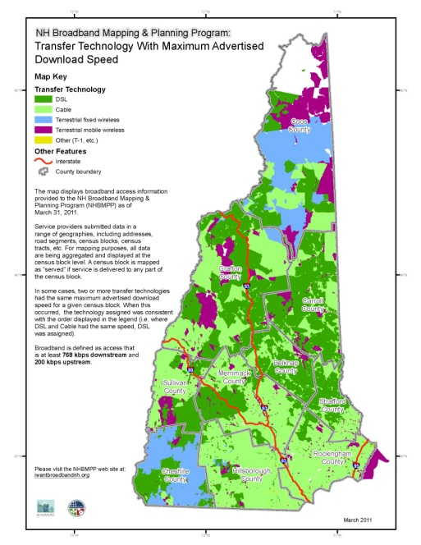
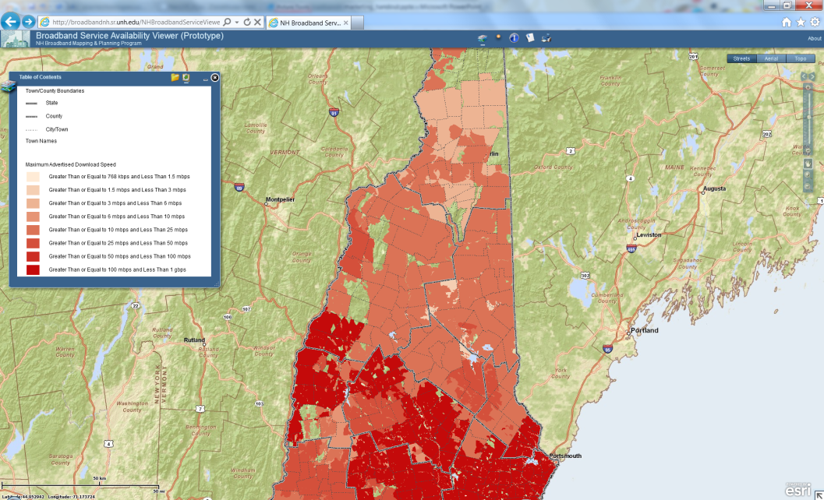
What is the New Hampshire Broadband Mapping & Planning Program (NHBMPP)?
The NHBMPP is a multi-year, multi-agency effort to map areas in the state that are currently served by the state’s 50+ broadband providers. The Program, managed by GRANIT at the Complex Systems Research Center, University of New Hampshire (UNH), is a collaboration between UNH, the nine regional planning agencies in the state, and the NH Department of Resources and Economic Development/Division of Economic Development. The efforts of these organizations, other partners, and input from the public, along with the ongoing cooperation of the active service providers, is yielding a mapped inventory of existing and planned broadband assets, as well as a view of locations in New Hampshire where there is either no coverage or inadequate service.
In addition to the mapping activities, the NHBMPP includes a 4-year planning component that will incorporate the information collected and the momentum generated by the mapping activities into a series of regional and state strategic initiatives. Collectively, these initiatives seek to encourage increased broadband usage and to promote expanded broadband deployment.
Results from the NHBMPP are being integrated into a national broadband availability map, and will provide a solid foundation for future broadband deployment efforts at the state and national levels.
For further information, please contact the NHBMPP at:
contact@iwantbroadbandnh.org
or visit the project web site at:
www.iwantbroadbandnh.org
May, 2011
Program Website:
iwantbroadbandnh.org
Broadband
Availability
Survey
Broadband
Availability
Survey
Broadband
Service
Speed
Test
Broadband Service
Map Gallery
Broadband Service Availability
Online Mapping (prototype)
Program funding provided by:
American Recovery & Reinvestment Act (ARRA) through the
National Telecommunications & Information Administration (NTIA)

