Slide 1
NH STATE BROADBAND INITIATIVE
An Overview of the NH Broadband Mapping & Planning Program
January 13th, 2012

Slide 2
Broadband Funding – American Recovery and Reinvestment Act of 2009
The Recovery Act appropriated $7.2 billion and directed the Department of Agriculture's Rural Utilities Service (RUS) and the Department of Commerce's National Telecommunications and Information Administration (NTIA) to expand broadband access to unserved and underserved communities across the U.S. in order to increase jobs, spur investments in technology and infrastructure, and provide long-term economic benefits.
The result:
RUS Broadband Initiatives Program (BIP) – loans/grants for broadband infrastructure projects in rural areas;
NTIA Broadband Technology Opportunities Program (BTOP) – grants to fund broadband infrastructure, public computer centers and sustainable broadband adoption projects.

Slide 3
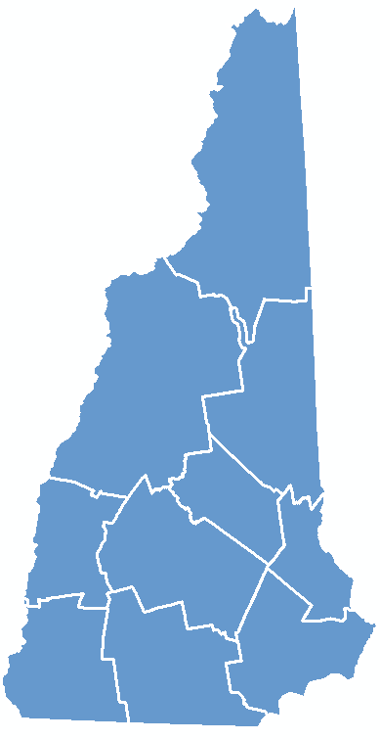
Program Overview
Notes:
NHBMPP: NH implementation of State Broadband Initiative (SBI); administered/managed by UNH.

Slide 4
NHBMPP – Data Availability
The information developed from the NHBMPP data collection process can be found at:
http://www.granit.unh.edu/ as downloadable GIS shapefiles;
Using the Interactive Map Viewer found on the program website at www.iwantbroadbandnh.org, people without GIS software can query and display the various datasets;
Individual town profiles can be reviewed from the www.iwantbroadbandnh.org website and selecting individual towns
Statewide maps of coverage can also be viewed on the www.iwantbroadbandnh.org website
The aggregate datasets of all 56 state broadband initiatives can be viewed on the National Broadband Map, www.broadbandmap.gov

Slide 5
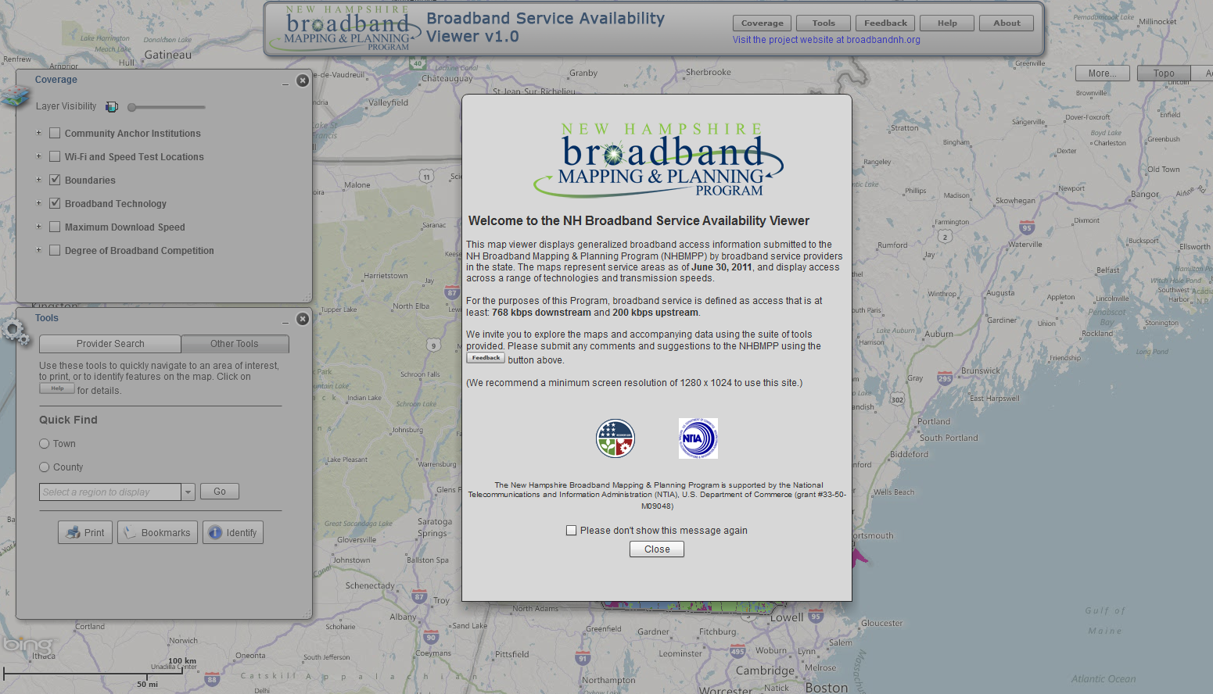
Broadband Availability – Interactive Map Viewer

Slide 6
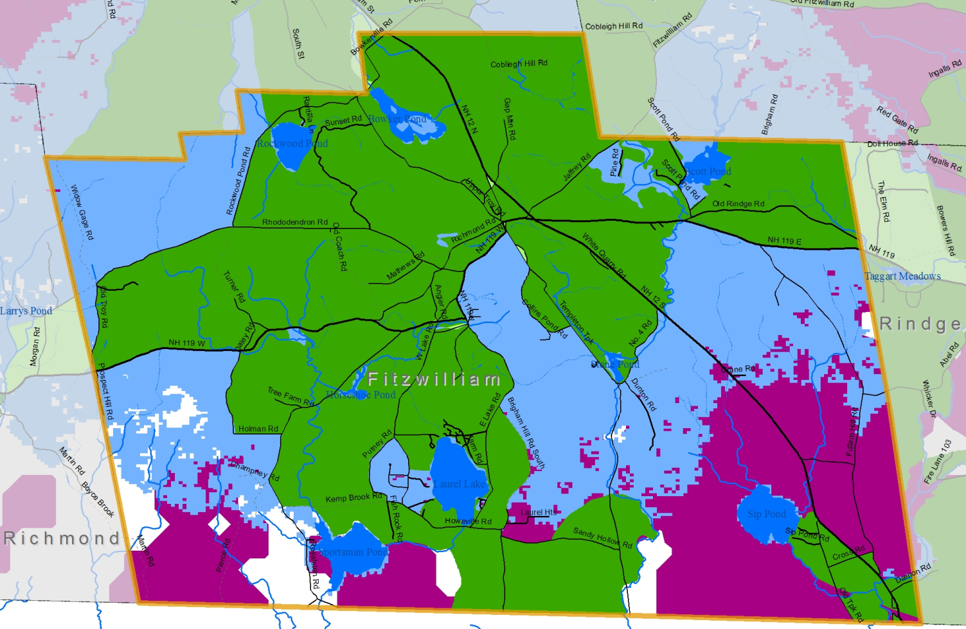
NHBMPP – Broadband Availability
Broadband Availability Profiles – iwantbroadbandnh.org
Notes:
The NHBMPP mapping program has also created community profiles to see broadband availability by census block this is accessible by the website iwantbroadbandnh.org. The maps shows technology with the fastest reported download speed and id what service providers are available.

Slide 7
Broadband Availability – September 2011 Results

Slide 8
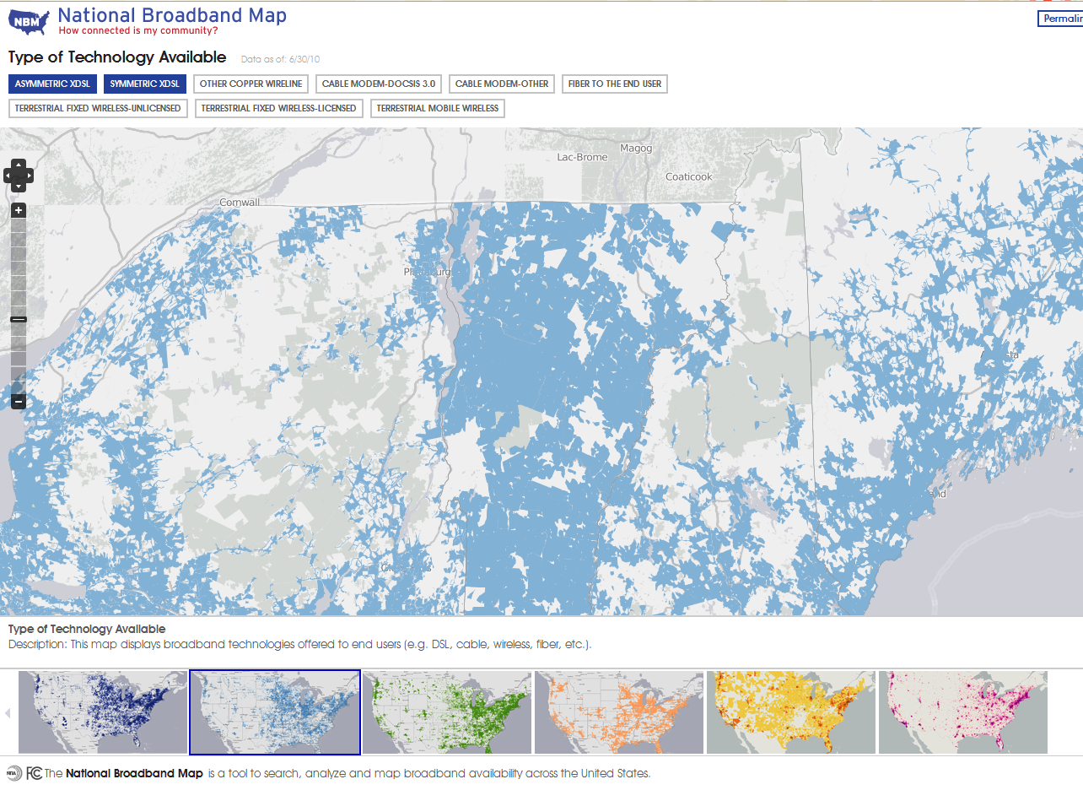
Broadband Availability – National Broadband Map
Launched February 17th, 2011 by NTIA in collaboration with the FCC, and in partnership with the 50 states, five territories and the District of Columbia broadband mapping programs

Slide 9
NHBMPP Strengths & Weaknesses
Strengths of the NHBMPP
Created statewide broadband availability coverage map with speed and technology attributes
The coverage data is managed and updated every 6 months starting in January of 2010
Through the program a strong relationship with internet service providers has been created
The program has extensively used GIS technology to map the service as well as conduct various spatial analyses
Areas of the state which are unserved have been exposed
Using various data sources, including the service areas, measurement of underserved areas can be conducted
Built a broadband community by encouraging public engagement in the issues revolving broadband availability
Previous broadband mapping efforts focused on Town and/or Census tract level mapping versus Census blocks making it impossible to identify “gaps” in service

Slide 10
NHBMPP Strengths & Weaknesses
Strengths of the NHBMPP - continued
Using a variety of verification methodologies (user surveys, user speed tests, commercial datasets, direct user feedback), coverage areas are being reviewed for complete service availability and where reports indicate no service, a degree of service is being developed.
For locations that have reports of no service, direct contact with providers is being conducted and in some cases service has been able to be achieved due to the interaction
The development of the community anchor institution locations and their access and use of broadband service was provided as a critical dataset in the NH Network NH Now BTOP application
The ongoing development of new broadband availability datasets, such as public WiFi locations, and the inventory of cable franchise agreements
Using GIS technologies, the combining disparate data sets into a single composite can be accomplished

Slide 11
NHBMPP Strengths & Weaknesses
Strengths of the NHBMPP - continued
Following a National data model, the mapping results can be aggregated with the other 55 state broadband mapping initiatives to create a national broadband availability map.
These data can then be used to view service availability across state boundaries and has led to enhanced cooperation
The various broadband initiatives in the state are working in a collaborative framework, where data and knowledge sharing is occurring as it pertains to expansion efforts
There is public awareness of the program initiatives and gratitude that the broadband expansion issues are being addressed
Knowledge capacity related to broadband technologies and barriers to expansion and adoption are being built at the regional level
A publically available rural address dataset is being developed that will have utility beyond broadband mapping efforts

Slide 12
NHBMPP Strengths & Weaknesses
Strengths of the NHBMPP - continued
An interactive map viewer has been created for non-GIS individuals to review and analyze the broadband availability information generated through the program
Utilizing social media, greater reach of marketing the program’s efforts can be made to the layperson
Utilizing mobile technologies, creative data collection opportunities are being used

Slide 13
NHBMPP Strengths & Weaknesses
Weaknesses of the NHBMPP
The availability information is being mapped to the Census block level. The aggregate may show service available in areas where the entire block may not be served. Example, block showing 6 Mbps/3 Mbps DSL service available, however in reviewing user surveys one house gets that service, but their two neighbors DSL service is unavailable and those houses have resorted to cellular or satellite service
Not all internet service providers are participating in the program and there are no incentives for them to participate, other than being mutualistic
Mapping the coverage to the block may overstate coverage and/or maximum available speed, which may invalidate the results due to public perception that the information collected is incorrect if they have direct knowledge that service is unavailable or available at lesser speeds

Slide 14
NHBMPP Strengths & Weaknesses
Weaknesses of the NHBMPP
Rural blocks are to be mapped to the road versus block. When providers submit block level information the total road network may be presented as served, whereas the service may only be available on a portion of the rural roadways
Providers may submit data in a variety of formats from Census blocks, Census tracts, roads served, customer addresses, GIS datasets, and the combining of these data into a single composite has inherent inaccuracies
The frequency of updating the coverage every 6 months may result in areas identified as unserved or underserved, whereas service has recently been added
There are no formal mechanisms to identify missing or new providers that offer service in the state
Broadband service mapped does not include pricing information for service in a given area using a given technology with speed

Slide 15
NHBMPP Partners

Slide 16
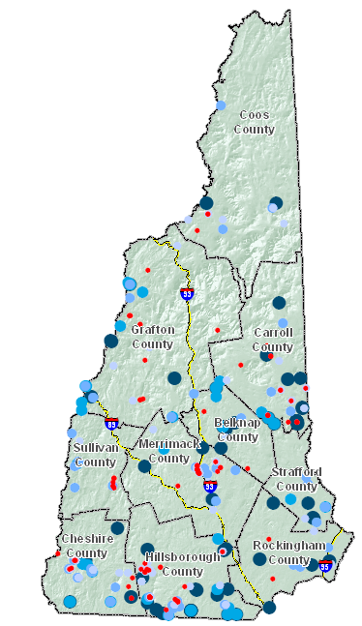
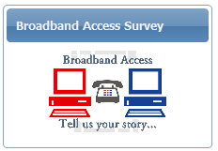
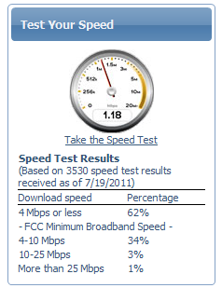
Broadband Availability – Data Validation
Consumer Surveys
Speed Tests
Satellite Dish Inventory
Others Data Sources
Commercial data sets
Data reported to FCC
Community forums

Slide 17
Broadband Availability – Supplemental Activities
Public WiFi location mapping
Municipal cable franchise agreement inventory
Enhancement of CAI data collection for additional category types
Development of telecommunications model application for municipal implementation
Development of broadband master plan model and completion of chapter development in a select number of pilot communities
Cell tower location updating
Notes:
Supplemental activities being undertaken by various RPC partners to enhance/extend our mapping and therefore our understanding of broadband availability in the state.

Slide 18
Community Anchor Institutions - Overview
Goal – statewide layer of community anchor institutions (CAIs) with associated broadband access information
Mapping in 7 CAI categories:
~ 3,700 points collected as of September, 2011
Six-month update/verification cycle; continuing “gap” analysis to identify new CAIs
Data collection/maintenance coordinated by Upper Valley Lake Sunapee Regional Planning Commission
School K-12
Library
Medical/healthcare
Public safety
University, college, other post-secondary
Other community support - government
Other community support - nongovernmental

Slide 19
Rural Addressing - Overview
Goal – statewide GIS point file of addresses in NTIA-designated rural census blocks (2+ sq mi)
Currently ~40,000 households in rural blocks (Census 2010)
Existing datasets either incomplete, or unavailable to the public
Data collected at the RPC level and coordinated by Nashua Regional Planning Commission and UNH

Slide 20
Rural Addressing - Tasks
Obtain existing data from commercial and municipal sources
Develop data model and assign subcontract tasks to RPCs
Organize volunteers, acquire equipment, and conduct trainings
Collect data (GPS and on-screen point creation)
Verify data and integrate with SBI mapping data

Slide 21
Rural Addressing - Benefits
Contribution to broadband efforts
Crowdsourcing to help verify
Ability to identify service areas and those in need
Leads to a complete statewide layer (rural and urban) available to the public
Volunteer component
Community buy-in and involvement
GPS training opportunities for underserved areas

Slide 22
Project Contacts
Fay Rubin, Project Director
University of New Hampshire
fay.rubin@unh.edu
Michael Blair, Project Coordinator University of New Hampshire
michael.blair@unh.edu

