Slide 1
NH STATE BROADBAND INITIATIVE
An Overview of the NH Broadband Mapping & Planning Program
May 2, 2012
This presentation is funded under grant # 33-50-M09048 from the US Dept. of Commerce to the University of New Hampshire.

Slide 2
Broadband Funding – American Recovery and Reinvestment Act of 2009
“The U.S. Congress has appropriated $4.7 billion to establish Broadband Technology Opportunities Program for awards to eligible entities to develop and expand broadband services to rural and underserved areas and improve access to broadband by public safety agencies …”
$ 3.9 billion - for broadband expansion
$250 million – innovative programs that encourage sustainable adoption of broadband services
$200 million – build capacity at public computing centers, including community colleges and public libraries
$10 million - transfer to the Office of Inspector General for the purposes of BTOP audits and oversight
$350 million - development and maintenance of statewide broadband inventory maps.

Slide 3
New Hampshire Broadband Mapping & Planning Program
NHBMPP is part of national effort to understand current broadband landscape and encourage expanded broadband adoption and utilization
NTIA projects funded in each state, 5 territories, District of Columbia. NH project awarded to University of New Hampshire.
In NH, recognition that residents, businesses, and institutions require broadband access to promote economic development, quality education, energy efficiency, adequate health care, overall quality of life
Therefore, two primary focus areas:
Mapping: Collecting accurate data on the current availability, speed, and location of broadband services
Planning: Supporting the efficient and creative use of broadband technologies to better compete in the digital economy

Slide 4
NHBMPP Components
Mapping (January 2010 – December 2014)
Broadband Availability, UNH
Community Anchor Institutions, UVLSRPC w/ NH RPCs & UNH
Rural Addressing, NRPC w/ NH RPCs & UNH
Planning and Technical Assistance (January 2011 – December 2014)
Broadband Technology, NH DRED
Broadband Capacity Building, NH DRED, NCIC
Broadband Technical Assistance Training, UNH CE & NH OEP
Regional Broadband Planning, SWRPC w/ NH RPCs & NH OEP

Slide 5
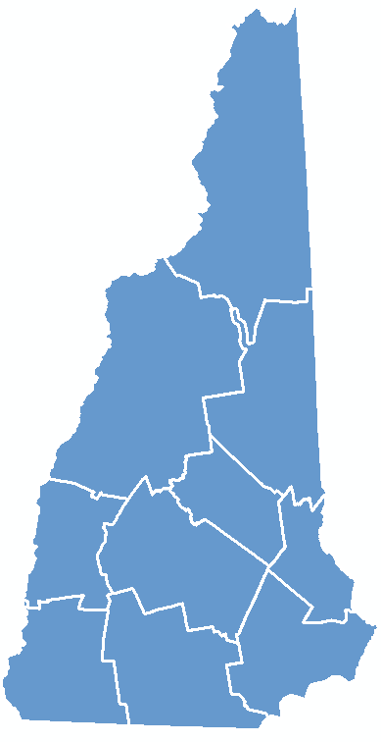
Mapping
Component:
Broadband
Availability

Slide 6
Broadband Availability - Overview
Goal – map broadband availability by type of technology and speed, in order to identify areas served/unserved/underserved in the state
Broadband defined by NTIA as 768 kbps downstream and 200 kbps upstream
Based on data submitted by the 60+ active providers in the state – technology and transmission speed
Data aggregated to census block geography for analysis and display
Multi-source data verification methodology utilized
Data collected and processed by UNH; submitted to NTIA on a 6-month cycle (March 31, September 30) for inclusion in the National Broadband Map (http://broadbandmap.gov)

Slide 7
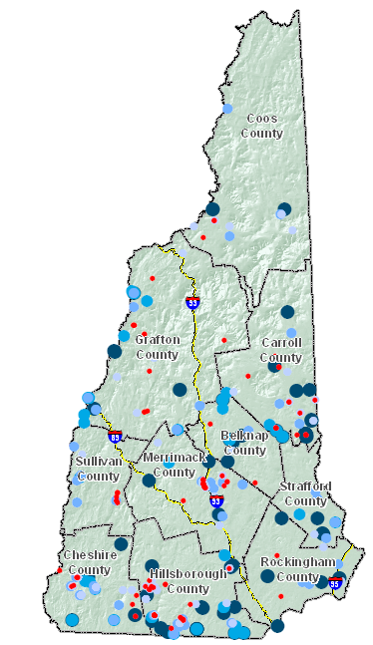
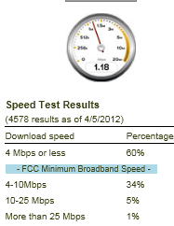
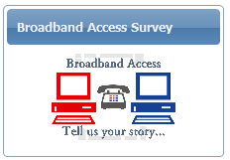
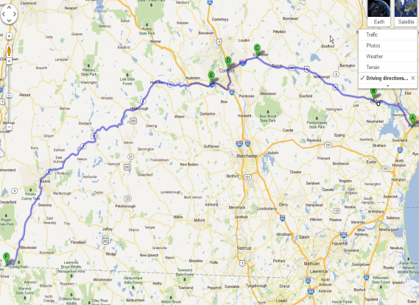
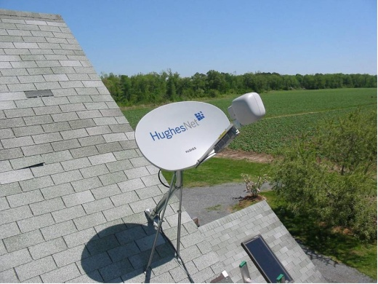
Broadband Availability – Data Validation
Consumer Surveys
Speed Tests
Drive Tests
Satellite Dish
Inventory
Others Data Sources
Commercial data sets
Data reported to FCC
Community forums

Slide 8
Broadband Availability – September 2011 Results

Slide 9
Cable Service Broadband Availability – September 2011 Results

Slide 10
Fixed-Wireless Service Broadband Availability – September 2011 Results

Slide 11
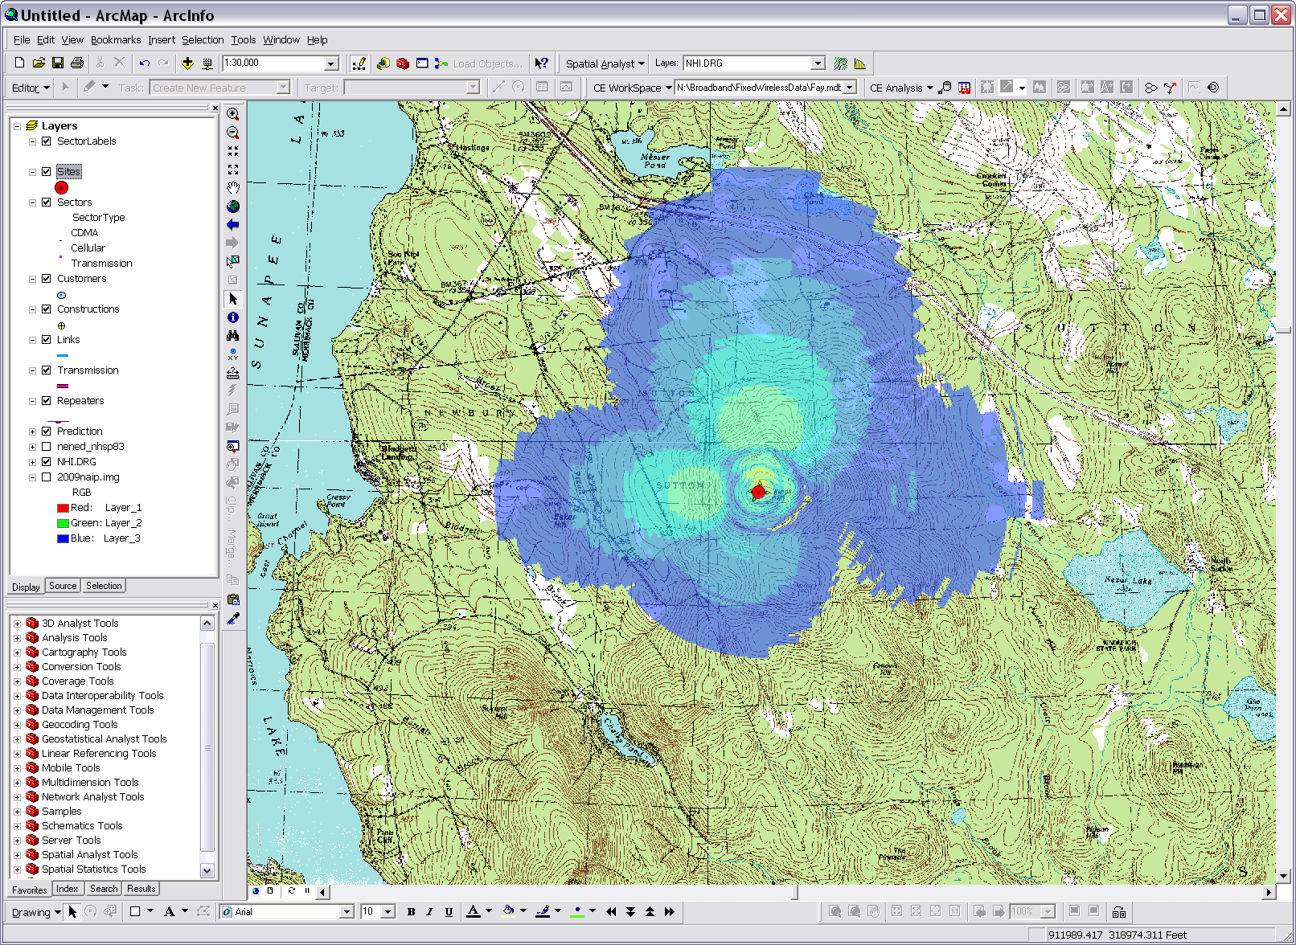
Broadband Availability – Signal Propagation Modeling
Using Cellular Expert software (www.cellular-expert.com) to predict signal strength. Note: This data was generated for display purposes only, and does not represent the actual coverage area of any service provider.

Slide 12
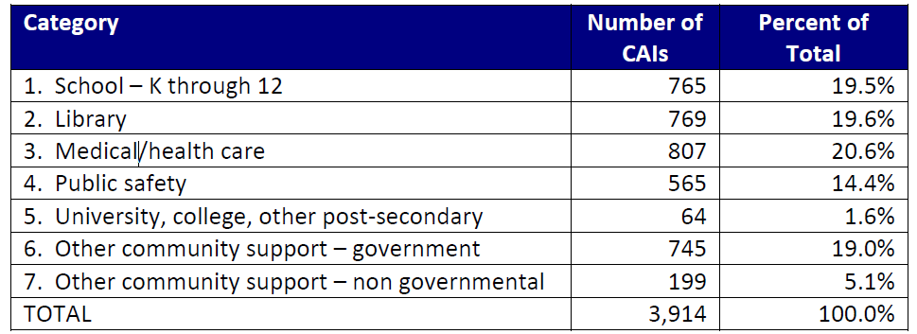
Community Anchor Institutions - Overview
Goal – statewide layer of community anchor institutions (CAIs) with associated broadband access information
Six-month update/verification cycle; continuing “gap” analysis to identify new CAIs
Data collection/maintenance coordinated by Upper Valley Lake Sunapee Regional Planning Commission

Slide 13
Community Anchor Institutions

Slide 14
Broadband Availability – Supplemental Activities
Public WiFi location mapping
Municipal cable franchise agreement inventory
Development of telecommunications model application for municipal implementation
Development of broadband master plan model and completion of chapter development in a select number of pilot communities
Cell tower location updating

Slide 15
NHBMPP – Data Availability
The information developed from the NHBMPP data collection process can be found at:
http://www.granit.unh.edu/ as downloadable GIS shapefiles;
Using the Interactive Map Viewer found on the program website at www.iwantbroadbandnh.org, people without GIS software can query and display the various datasets;
Individual town profiles can be reviewed from the www.iwantbroadbandnh.org website and selecting individual towns
Statewide maps of coverage can also be viewed on the www.iwantbroadbandnh.org website
The aggregate datasets of all 56 state broadband initiatives can be viewed on the National Broadband Map, www.broadbandmap.gov

Slide 16
NHBMPP – Data Availability
www.iwantbroadbandnh.org

Slide 17
NHBMPP – Broadband Availability
Broadband Availability Profiles – iwantbroadbandnh.org

Slide 18
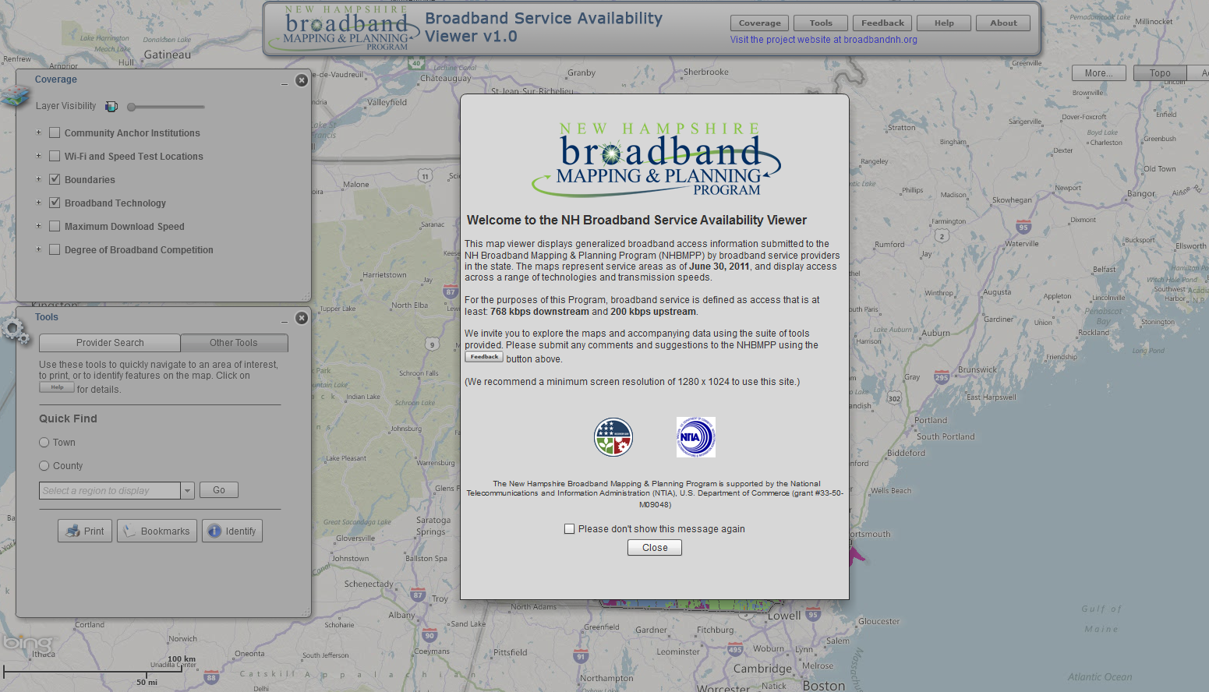
Broadband Availability – Interactive Map Viewer

Slide 19
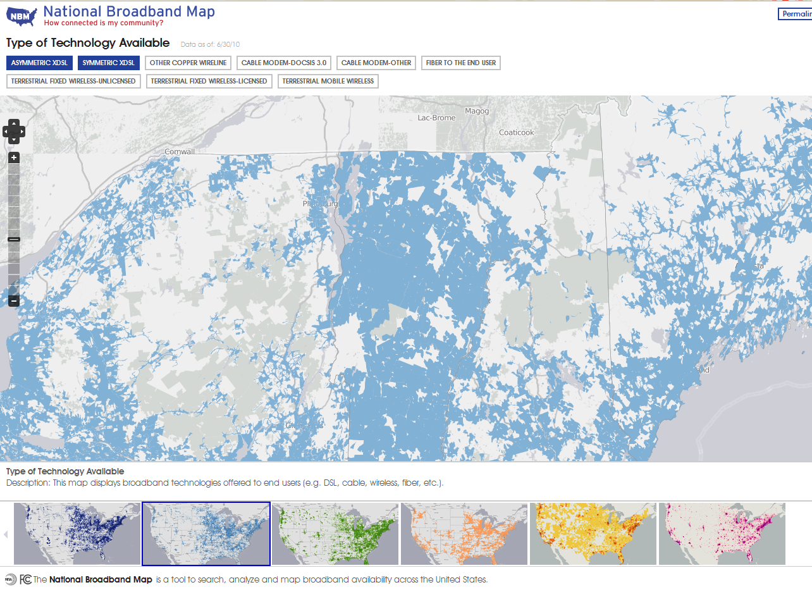
Broadband Availability – National Broadband Map
Launched February 17th, 2011 by NTIA in collaboration with the FCC, and in partnership with the 50 states, five territories and the District of Columbia broadband mapping programs

Slide 20
Mapping
Component:
Rural Addressing

Slide 21
Rural Addressing - Overview
Goal – statewide GIS point file of addresses in NTIA-designated rural census blocks (2+ sq mi)
Currently ~40,000 households in rural blocks (Census 2010)
Existing datasets either incomplete, or unavailable to the public
Data collected at the RPC level and coordinated by Nashua Regional Planning Commission and UNH

Slide 22
Rural Addressing - Benefits
Contribution to broadband efforts
Crowdsourcing to help verify
Ability to identify service areas and those in need
Leads to a complete statewide layer (rural and urban) available to the public
Volunteer component
Community buy-in and involvement
GPS training opportunities for underserved areas

Slide 23
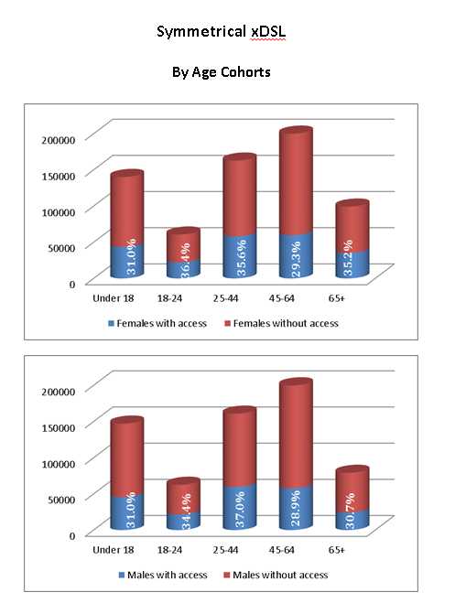
“Scorecard” Analysis
Report template to evaluate access
to broadband technologies by:
Age cohort
Educational attainment
Income
Race
Other socioeconomic data sets

Slide 24
Data Analysis

Slide 25
Planning/Non-Mapping Components

Slide 26
Broadband Technology
Leadership Role to increase broadband adoption and deployment on a
targeted community-by-community basis collaborating to create best
case practices in:
Policy
Management
Financial Resources
Advocacy for Business and Residential Broadband

Slide 27
Broadband Capacity Building
Work with Northern Community Investment Corporation (NCIC) to develop tools to assist other communities in their development of broadband projects by creating:
Resource Panel (legal, financial, and technical)
Demand/Aggregation/Planning Tools for Municipalities
Model Broadband Implementation Business Plan

Slide 28
Technical Assistance & Training (TAT)
Begins in calendar year 2011 and extends through 2014
Assess broadband technical needs of stakeholder groups including educational institutions, small businesses, local government and non-profits
Develop tools and learning modules
Deliver technical assistance and training to stakeholder groups

Slide 29
Technical Assistance & Training (TAT)
Stakeholder Groups
TAT
Organizations
non-profits, foundations, health care providers, etc.
Small Business
agriculture, seafood, arts, and tourism
Municipalities
local officials, boards, and service providers
Institutions
schools, colleges, libraries, hospitals, etc.

Slide 30
Regional Planning - Overview
Utilizes the data development, inventory and mapping components of the NHBMPP
Begins in calendar year 2011 and extends through 2014
Makes use of Regional Broadband Stakeholder Groups (BSG)
Coordinated by NH’s RPCs

Slide 31
Regional Planning - Tasks
Form Regional Broadband Stakeholder Groups (BSG)
Conduct meetings and provide staff support to BSGs
Conduct Regional Broadband Public Forums
Coordinate/integrate other NHBMPP activities
Develop Regional Broadband Planning Documents

Slide 32
Regional Broadband
Stakeholder Groups (BSGs)
BSG
Citizens
Libraries
Chambers
Recreation & Tourism
Municipalities
Media
Com / Econ Dev
Telecommunications
Medical
Internet Service Providers
Culture / Arts
Education
Emergency Management
Realtors

Slide 33
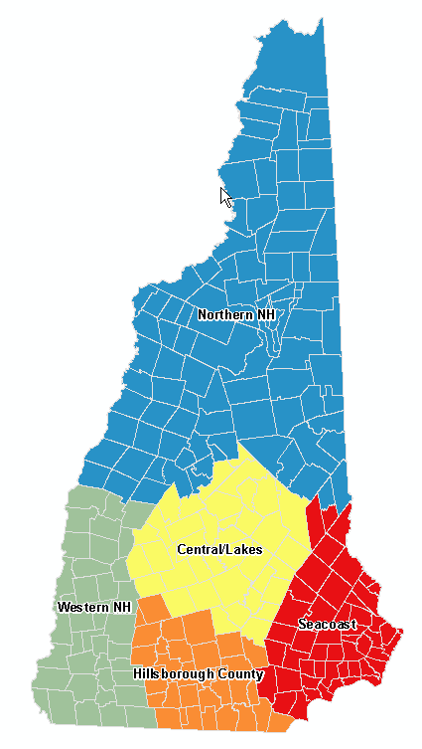
Granite State Poll, April 2012
N=538
Region | Percent with Internet access | Type of Internet Access
Western New Hampshire | 89.6% | Dial-up or Satellite – 38% Broadband – 62%
Northern New Hampshire | 85.6% | Dial-up or Satellite – 31% Broadband – 69%
Central NH/ Lakes Region | 83.4% | Dial-up or Satellite – 30% Broadband – 70%
Seacoast Region | 86.1% | Dial-up or Satellite – 25% Broadband – 75%
Hillsborough County | 84.0% | Dial-up or Satellite – 17% Broadband – 83%
Poll conducted by UNH Survey Center, April 9-11, 2012.

Slide 34
Project Contacts
Fay Rubin, Project Director
University of New Hampshire
fay.rubin@unh.edu
Michael Blair, Project Coordinator University of New Hampshire
michael.blair@unh.edu
David Foote, Planning & Technical Assistance Coordinator
University of New Hampshire
david.foote@unh.edu

