Slide 1
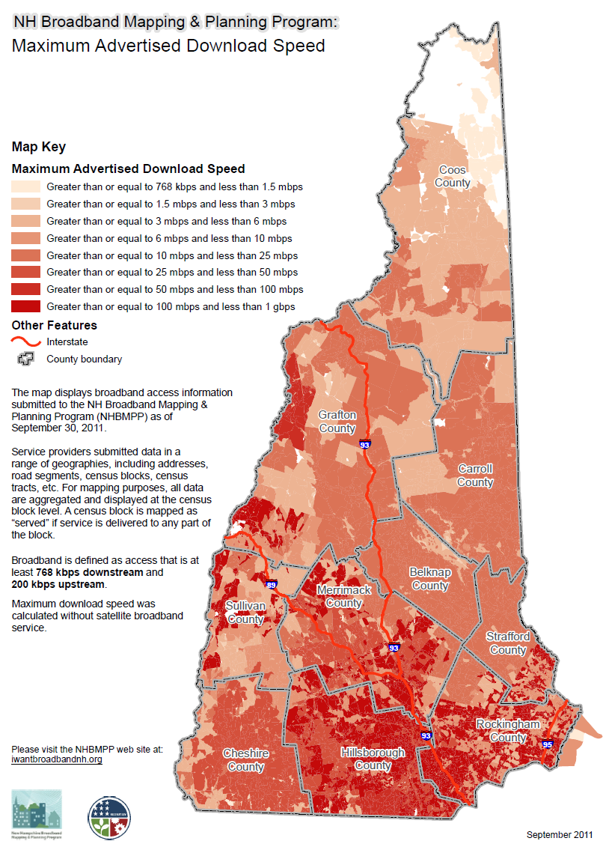
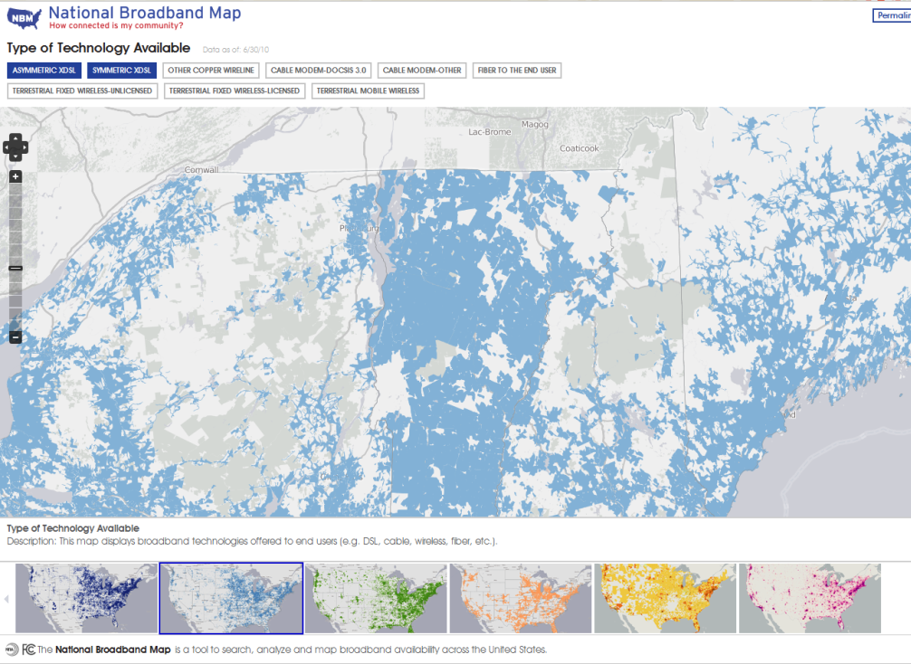
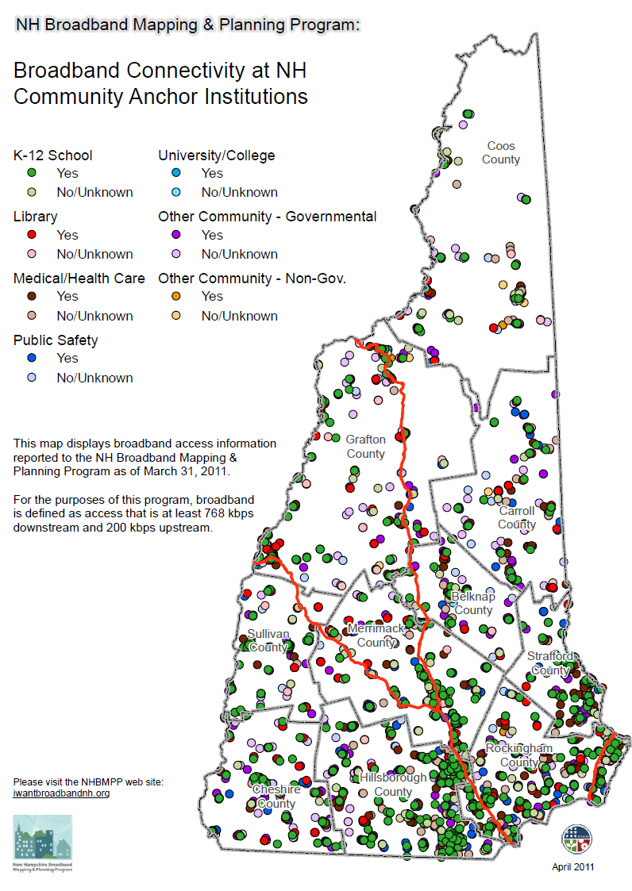
OVERVIEW
The New Hampshire Broadband Mapping and Planning Program (NHBMPP) is a comprehensive program that seeks to understand where broadband is currently available in NH and how it can be made more widely available in the future. The NHBMPP comprises two main components:
A broadband availability inventory and mapping effort
A suite of planning and technical assistance initiatives
Both components are part of a national effort to expand broadband access and adoption through improved data collection and broadband planning.
More information on the NHBMPP can be found at www.iwantbroadbandnh.org
The National Broadband Map was Launched February 17th, 2011 by National Telecommunications Information Administration (NTIA) in collaboration with the Federal Communications Commission (FCC), and in partnership with the 50 states, five territories and the District of Columbia broadband mapping programs
Broadband Availability in New Hampshire (Based on Data Reported as of March 2012)
BROADBAND MAPPING
The primary goal of the Broadband Mapping program is to map broadband availability by type of technology and speed, in order to identify areas served, unserved, and underserved in the state.
BROADBAND PLANNING
The focus of the Regional Broadband Planning program is to develop nine regional broadband plans that will be aggregated into one statewide broadband plan. Each region will establish and work with broadband stakeholder groups to help facilitate the process for developing the regional plans.
Community Anchor Institution Broadband Availability (Based on Data Reported March 2011)
Broadband Stakeholder Group
Citizens
Libraries
Chambers
Recreation & Tourism
Municipalities
Media
Community / Economic Development
Telecommunications
Medical
Internet Service Providers
Culture / Arts
Education
Emergency Management
Realtors
As of September 2011, over 3700 Community Anchor Institutions have been mapped and surveyed.
The graphic above highlights the diverse representation of stakeholders serving on regional broadband stakeholder groups.
GRANIT System, Earth Systems Research Center UNH

