Slide 1
PROGRAM OVERVIEW
October 4, 2012

Slide 2
American Recovery and Reinvestment Act of 2009
Appropriated $7.2 billion to expand broadband access to unserved and underserved communities across the U.S. to increase jobs, spur investments in technology and infrastructure, and provide long-term economic benefits.
Two programs established:
Dept. of Agriculture, RUS Broadband Initiatives Program (BIP) – loans/grants for broadband infrastructure projects in rural areas
Dept. of Commerce, NTIA Broadband Technology Opportunities Program (BTOP) – grants to fund broadband infrastructure, public computer centers and sustainable broadband adoption projects.

Slide 3
Broadband Technology Opportunities Progam (BTOP)
$4.7 billion - to develop and expand broadband services to rural and underserved areas and improve access to broadband by public safety agencies
$ 3.9 billion - broadband expansion
$250 million – innovative programs that encourage sustainable adoption of broadband services
$200 million – build capacity at public computing centers
$10 million - to the Office of Inspector General for audits & oversight
$350 million - development and maintenance of statewide broadband inventory maps. (Grants to all 50 states, 5 territories, and District of Columbia. Total allocation $103 million round 1; $190 million allocated in supplemental award.)

Slide 4
NHBMPP - Rationale
NHBMPP is part of national effort to understand current broadband landscape and encourage expanded broadband adoption and utilization
NTIA projects funded in each state, 5 territories, District of Columbia
In NH, recognition that residents, businesses, and institutions require broadband access to promote economic development, quality education, energy efficiency, adequate health care, overall quality of life
Therefore, two primary focus areas:
Collecting accurate data on the current availability, speed, and location of broadband services
Supporting the efficient and creative use of broadband technologies to better compete in the digital economy
Notes:
NTIA has awarded total of $293 million to 56 grantees
Comprehensive program to integrate broadband and information technology into state, regional, and local economies

Slide 5
NHBMPP Components
Mapping (January 2010 – December 2014)
Broadband Availability, UNH
Community Anchor Institutions, UVLSRPC w/ NH RPCs & UNH
Rural Addressing, NRPC w/ NH RPCs & UNH
Non-Mapping (January 2011 – December 2014)
Broadband Technology, NH DRED
Broadband Capacity Building, NH CDFA
Broadband Technical Assistance Training, UNH CE & NH OEP
Regional Broadband Planning, SWRPC w/ NH RPCs & NH OEP

Slide 6
NHBMPP Partners

Slide 7
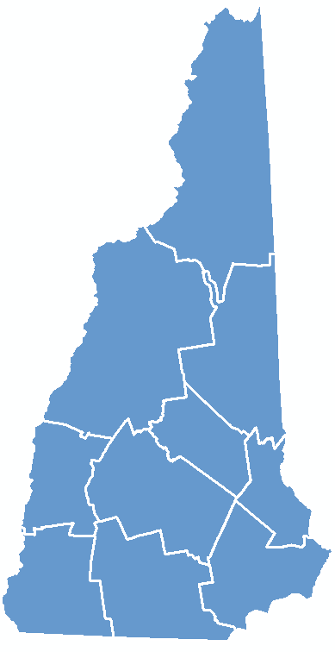
NH Broadband Mapping & Planning Program
Mapping
Component:
Broadband
Availability
Notes:
NHBMPP: NH implementation of State Broadband Initiative (SBI); administered/managed by UNH.

Slide 8
Are you served by broadband?
Notes:
Note key definition of broadband – 768 kbps down and 200 kbps up
Broadband availability as reported by providers – provider either currently delivers access or can deliver access within 10 business days

Slide 9
Broadband Speed Ranges
Download time comparisons
To download/copy a Movie DVD (4.7 gig)

Slide 10
NNHN Program Overview
NNHN Program Overview
4 components, managed by partners within the grant program
Program Component | Description | Program Partners
Middle Mile Fiber | Assemble and construct a fiber network that expands the availability, capability and capacity of network services in NH. Includes all 10 counties. | UNH IT, NH DRED, New Hampshire Optical Systems (NHOS), other partners
Microwave Wireless (NHSafeNet) | Upgrade and expand NH’s wireless public television and safety network | NHPTV, State Police, National Guard, NHDOT and other public safety entities
Last Mile NHFastRoads | Construct a “fiber to the premises” (FTTP) network in 2 NH communities: Rindge and Enfield | NH FastRoads (a wholly owned subsidiary of Monadnock Economic Development Corporation), other partners
NHDOT ITS Network | Underground fiber between Manchester and Concord in support of intelligent transportation systems (ITS) | New Hampshire Department of Transportation (DOT), other partners

Slide 11
Broadband Availability - Overview
Goal – map broadband availability by type of technology and speed, in order to identify areas served/unserved/underserved in the state
Broadband defined by NTIA as 768 kbps downstream and 200 kbps upstream
Based on data submitted by the 60+ active providers in the state
Data aggregated to census block geography for analysis and display
Multi-source data verification methodology utilized
Data collected and processed by UNH; submitted to NTIA on a 6-month cycle (March 31, September 30) for inclusion in the National Broadband Map (http://broadbandmap.gov)
Notes:
Note key definition of broadband – 768 kbps down and 200 kbps up
Broadband availability as reported by providers – provider either currently delivers access or can deliver access within 10 business days

Slide 12
Broadband Availability – September 2011 Results

Slide 13
Cable Service Broadband Availability – September 2011 Results

Slide 14
DSL Service Broadband Availability – September 2011 Results

Slide 15
Cellular Service Broadband Availability – September 2011 Results

Slide 16
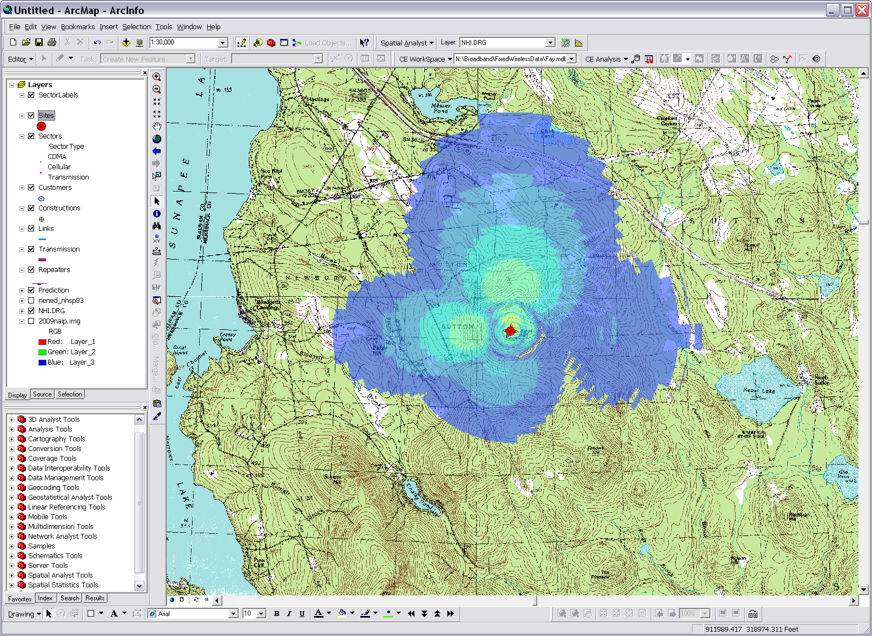
Broadband Availability – Signal Propagation Modeling
Using Cellular Expert software (www.cellular-expert.com) to predict signal strength. Note: This data was generated for display purposes only, and does not represent the actual coverage area of any service provider.

Slide 17
Fixed-Wireless Service Broadband Availability – September 2011 Results

Slide 18
NHBMPP – Data Availability
The information developed from the NHBMPP data collection process can be found at:
http://www.granit.unh.edu/ as downloadable GIS shapefiles;
Using the Interactive Map Viewer found on the program website at www.iwantbroadbandnh.org, people without GIS software can query and display the various datasets;
Individual town profiles can be reviewed from the www.iwantbroadbandnh.org website and selecting individual towns
Statewide maps of coverage can also be viewed on the www.iwantbroadbandnh.org website
The aggregate datasets of all 56 state broadband initiatives can be viewed on the National Broadband Map, www.broadbandmap.gov

Slide 19
NHBMPP – Data Availability
www.iwantbroadbandnh.org

Slide 20
NHBMPP – Broadband Availability
Broadband Availability Profiles – iwantbroadbandnh.org
Notes:
The NHBMPP mapping program has also created community profiles to see broadband availability by census block this is accessible by the website iwantbroadbandnh.org. The maps shows technology with the fastest reported download speed and id what service providers are available.

Slide 21
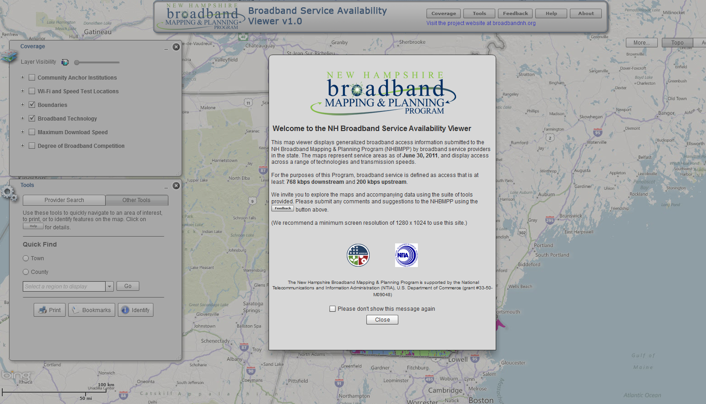
Broadband Availability – Interactive Map Viewer

Slide 22
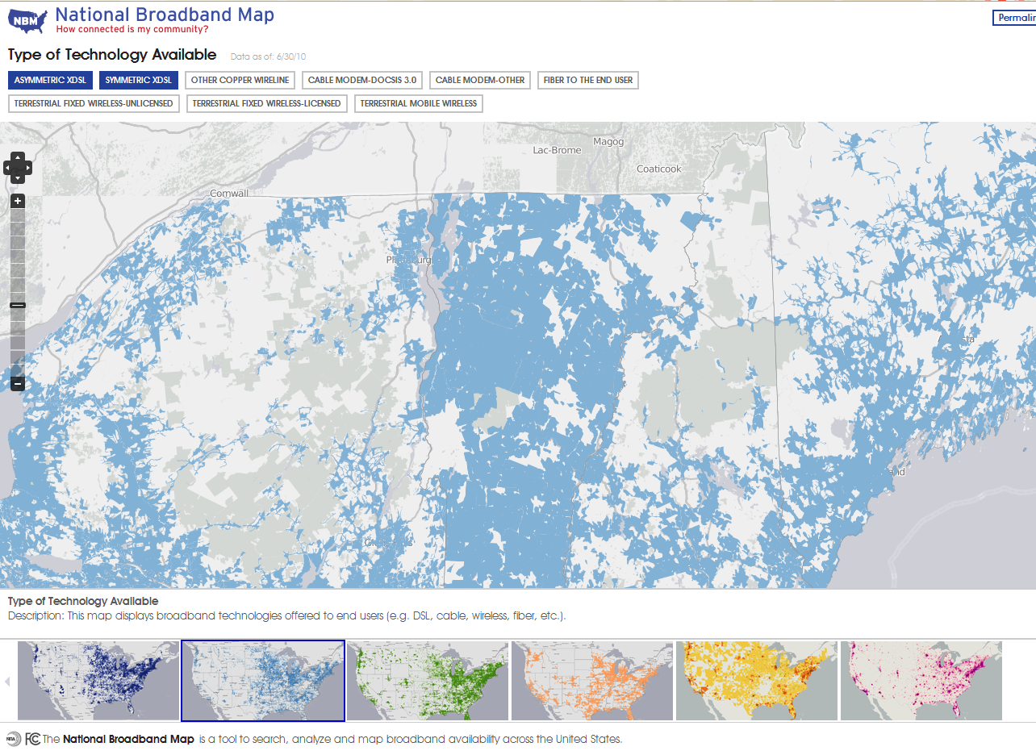
Broadband Availability – National Broadband Map
Launched February 17th, 2011 by NTIA in collaboration with the FCC, and in partnership with the 50 states, five territories and the District of Columbia broadband mapping programs

Slide 23
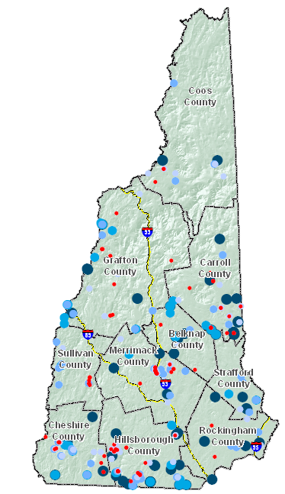
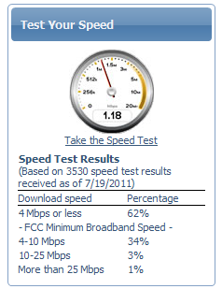
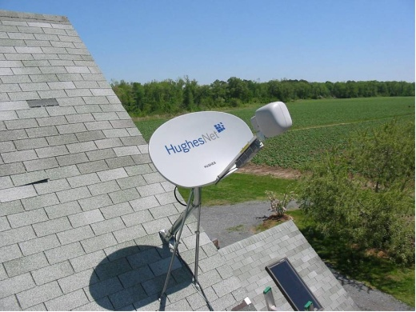
Broadband Availability – Data Validation
Consumer Surveys
Speed Tests
Satellite Dish Inventory
Others Data Sources
Commercial data sets
Data reported to FCC
Community forums

Slide 24
Broadband Availability – Supplemental Activities
Public WiFi location mapping
Municipal cable franchise agreement inventory
Enhancement of CAI data collection for additional category types
Development of telecommunications model application for municipal implementation
Development of broadband master plan model and completion of chapter development in a select number of pilot communities
Cell tower location updating
Notes:
Supplemental activities being undertaken by various RPC partners to enhance/extend our mapping and therefore our understanding of broadband availability in the state.

Slide 25
NHBMPP Strengths & Weaknesses
Strengths of the NHBMPP
Created statewide broadband availability coverage map with speed and technology attributes
The coverage data is managed and updated every 6 months starting in January of 2010
Through the program a strong relationship with internet service providers has been created
The program has extensively used GIS technology to map the service as well as conduct various spatial analyses
Areas of the state which are unserved have been exposed
Using various data sources, including the service areas, measurement of underserved areas can be conducted
Built a broadband community by encouraging public engagement in the issues revolving broadband availability
Previous broadband mapping efforts focused on Town and/or Census tract level mapping versus Census blocks making it impossible to identify “gaps” in service

Slide 26
NHBMPP Strengths & Weaknesses
Strengths of the NHBMPP - continued
Using a variety of verification methodologies (user surveys, user speed tests, commercial datasets, direct user feedback), coverage areas are being reviewed for complete service availability and where reports indicate no service, a degree of service is being developed.
For locations that have reports of no service, direct contact with providers is being conducted and in some cases service has been able to be achieved due to the interaction
The development of the community anchor institution locations and their access and use of broadband service was provided as a critical dataset in the NH Network NH Now BTOP application
The ongoing development of new broadband availability datasets, such as public WiFi locations, and the inventory of cable franchise agreements
Using GIS technologies, the combining disparate data sets into a single composite can be accomplished

Slide 27
NHBMPP Strengths & Weaknesses
Strengths of the NHBMPP - continued
Following a National data model, the mapping results can be aggregated with the other 55 state broadband mapping initiatives to create a national broadband availability map.
These data can then be used to view service availability across state boundaries and has led to enhanced cooperation
The various broadband initativies in the state are working in a collaborative framework, where data and knowledge sharing is occurring as it pertains to expansion efforts
There is public awareness of the program initiatives and gratitude that the broadband expansion issues are being addressed
Knowledge capacity related to broadband technologies and barriers to expansion and adoption are being built at the regional level
A publically available rural address dataset is being developed that will have utility beyond broadband mapping efforts

Slide 28
NHBMPP Strengths & Weaknesses
Strengths of the NHBMPP - continued
An interactive map viewer has been created for non-GIS individuals to review and analyze the broadband availability information generated through the program
Utilizing social media, greater reach of marketing the program’s efforts can be made to the layperson
Utilizing mobile technologies, creative data collection opportunities are being used

Slide 29
NHBMPP Strengths & Weaknesses
Weaknesses of the NHBMPP
The availability information is being mapped to the Census block level. The aggregate may show service available in areas where the entire block may not be served. Example, block showing 6 Mbps/3 Mbps DSL service available, however in reviewing user surveys one house gets that service, but their two neighbors DSL service is unavailable and those houses have resorted to cellular or satellite service
Not all internet service providers are participating in the program and there are no incentives for them to participate, other than being mutualistic
Mapping the coverage to the block may overstate coverage and/or maximum available speed, which may invalidate the results due to public perception that the information collected is incorrect if they have direct knowledge that service is unavailable or available at lesser speeds

Slide 30
NHBMPP Strengths & Weaknesses
Weaknesses of the NHBMPP
Rural blocks are to be mapped to the road versus block. When providers submit block level information the total road network may be presented as served, whereas the service may only be available on a portion of the rural roadways
Providers may submit data in a variety of formats from Census blocks, Census tracts, roads served, customer addresses, GIS datasets, and the combining of these data into a single composite has inherent inaccuracies
The frequency of updating the coverage every 6 months may result in areas identified as unserved or underserved, whereas service has recently been added
There are no formal mechanisms to identify missing or new providers that offer service in the state
Broadband service mapped does not include pricing information for service in a given area using a given technology with speed

Slide 31
Project Contacts
Fay Rubin, Project Director
University of New Hampshire
fay.rubin@unh.edu
Michael Blair, Project Coordinator University of New Hampshire
michael.blair@unh.edu

Slide 32
NH Broadband Mapping & Planning Program
Mapping
Component:
Community Anchor Institutions
Notes:
NHBMPP: NH implementation of State Broadband Initiative (SBI); administered/managed by UNH.

Slide 33
Community Anchor Institutions - Overview
Goal – statewide layer of community anchor institutions (CAIs) with associated broadband access information
Mapping in 7 CAI categories:
~ 3,700 points collected as of September, 2011
Six-month update/verification cycle; continuing “gap” analysis to identify new CAIs
Data collection/maintenance coordinated by Upper Valley Lake Sunapee Regional Planning Commission
School K-12
Library
Medical/healthcare
Public safety
University, college, other post-secondary
Other community support - government
Other community support - nongovernmental

Slide 34
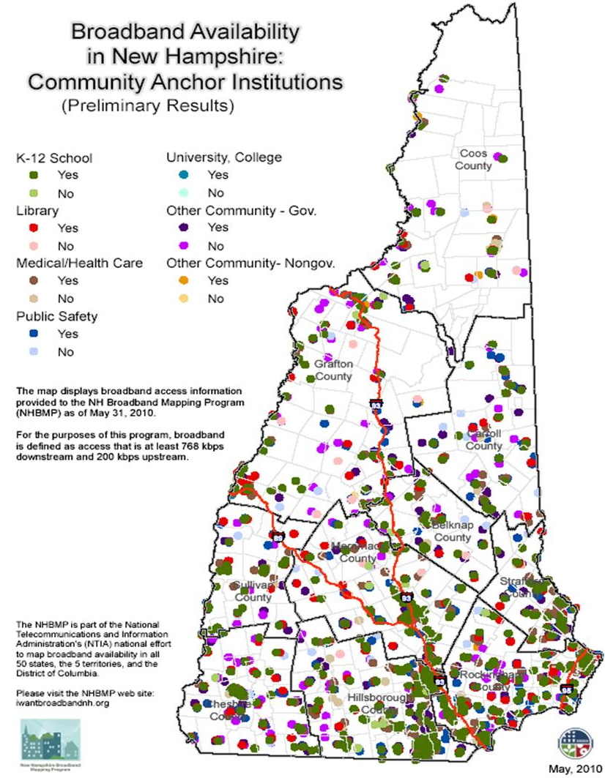
NHBMPP - Community Anchor Institutions
Notes:
This map shows broadband access info provided as of May 31 2010 - Darker colors shows that an institutions has access to broadband which is defined as 768 kbps down and 200 kbps up and the lighter colors are those that do not have access to broadband.

Slide 35
Community Anchor Institutions – March 2011 Results

Slide 36
Project Contacts
Rachel Ruppel, GIS Analyst / Planner
Upper Valley Lake Sunapee Regional Planning Commission
rruppel@uvlsrpc.org
Fay Rubin, Project Director
University of New Hampshire
fay.rubin@unh.edu
Michael Blair, Project Coordinator University of New Hampshire
michael.blair@unh.edu

Slide 37
NH Broadband Mapping & Planning Program
Mapping
Component:
Rural Addressing
Notes:
NHBMPP: NH implementation of State Broadband Initiative (SBI); administered/managed by UNH.

Slide 38
Rural Addressing - Overview
Goal – statewide GIS point file of addresses in NTIA-designated rural census blocks (2+ sq mi)
Currently ~40,000 households in rural blocks (Census 2010)
Existing datasets either incomplete, or unavailable to the public
Data collected at the RPC level and coordinated by Nashua Regional Planning Commission and UNH

Slide 39
Rural Addressing - Tasks
Obtain existing data from commercial and municipal sources
Develop data model and assign subcontract tasks to RPCs
Organize volunteers, acquire equipment, and conduct trainings
Collect data (GPS and on-screen point creation)
Verify data and integrate with SBI mapping data

Slide 40
Rural Addressing - Benefits
Contribution to broadband efforts
Crowdsourcing to help verify
Ability to identify service areas and those in need
Leads to a complete statewide layer (rural and urban) available to the public
Volunteer component
Community buy-in and involvement
GPS training opportunities for underserved areas

Slide 41
For More Information …
www.iwantbroadbandnh.org
Notes:
Visit project web site for information, for project results, for resources, etc. Current focus is on mapping activities, but will be expanded as the non-mapping components evolve.

Slide 42
Project Contacts
Ryan Friedman, Senior GIS Planner
Nashua Region Planning Commission ryanF@nashuarpc.org
Fay Rubin, Project Director
University of New Hampshire
fay.rubin@unh.edu
Michael Blair, Project Coordinator University of New Hampshire
michael.blair@unh.edu

Slide 43
NH Broadband Mapping & Planning Program
Non-Mapping Component: Broadband Technology
Notes:
NHBMPP: NH implementation of State Broadband Initiative (SBI); administered/managed by UNH.

Slide 44
Broadband Technology
Leadership Role to increase broadband adoption and deployment on a
targeted community-by-community basis collaborating to create best
case practices in:
Policy
Management
Financial Resources
Advocacy for Business and Residential Broadband

Slide 45
Project Contacts
Carol Miller, Director of Broadband Technologies
NH Department of Resources and Economic Development
Carol.miller@dred.state.nh.us
www.iwantbroadbandnh.org

Slide 46
NH Broadband Mapping & Planning Program
Non-Mapping Component: Capacity Building
Notes:
NHBMPP: NH implementation of State Broadband Initiative (SBI); administered/managed by UNH.

Slide 47
Broadband Capacity Building
Work with Northern Community Investment Corporation (NCIC) to develop tools to assist other communities in their development of broadband projects by creating:
Resource Panel (legal, financial, and technical)
Demand/Aggregation/Planning Tools for Municipalities
Model Broadband Implementation Business Plan

Slide 48
Project Contacts
Carol Miller, Director of Broadband Technologies
NH Department of Resources and Economic Development
Carol.miller@dred.state.nh.us
Alice Veenstra, Chief Community Development Officer NH Community Development Finance Authority
aveenstra@nhcdfa.org
www.iwantbroadbandnh.org

Slide 49
NH Broadband Mapping & Planning Program
Non-Mapping Component: Technical Assistance & Training
Notes:
NHBMPP: NH implementation of State Broadband Initiative (SBI); administered/managed by UNH.

Slide 50
Technical Assistance & Training (TAT)
Begins in calendar year 2011 and extends through 2014
Assess broadband technical needs of stakeholder groups including educational institutions, small businesses, local government and non-profits
Develop tools and learning modules
Deliver technical assistance and training to stakeholder groups

Slide 51
Technical Assistance & Training (TAT)
Stakeholder Groups
TAT
Organizations
non-profits, foundations, health care providers, etc.
Small Business
agriculture, seafood, arts, and tourism
Municipalities
local officials, boards, and service providers
Institutions
schools, colleges, libraries, hospitals, etc.

Slide 52
Tech. Asst. & Training Logic Model
Small Businesses (agriculture, seafood, arts, and tourism)
Program Activities
Needs Assessment
Outcomes
Strong businesses, municipalities, organizations and institutions
Audience
Technical Assistance
Development of On-line Resources
Development of selected Value-added Software Applications
Municipalities (local officials, boards, and municipal service providers)
Organizations (non-profits, foundations, health care providers, etc.)
Better access to information critical to decision-making
Effective communication of products, services, and/or functions
Enhanced knowledge and understanding of broadband capacity and opportunities
Trainings & Workshops
Institutions (schools, colleges, libraries, hospitals, etc.)

Slide 53
Technical Assistance & Training (TAT) - PRIMARY MILESTONES
Q 1 | Q 2 | Q3 | Q4 | Q 1 | Q 2 | Q3 | Q4 | Q 1 | Q 2 | Q3 | Q4 | Q 1 | Q 2 | Q3 | Q4
 | Stakeholder needs identified
 |  |  |  | Curriculum Developed
 |  |  |  |  |  | Training for Stakeholder Groups
 |  |  |  |  |  |  |  | Technical Assistance for Stakeholder Groups
 |  |  |  |  |  |  |  |  |  | Training and Assistance Gap Analysis
 |  |  |  |  |  |  |  |  |  |  | Curriculum & materials modified
 |  |  |  |  |  |  |  |  |  |  |  |  | Stakeholder follow-up and evaluation
Year 2 (2011)
Year 3 (2012)
Year 4 (2013)
Year 5 (2014)

Slide 54
Project Contacts
Charlie French, Associate Professor / Extension Specialist
University of New Hampshire Cooperative Extension
charlie.french@unh.edu
David Foote, Director Communications and Information Technology
University of New Hampshire Cooperative Extension
David.Foote@unh.edu
www.iwantbroadbandnh.org

Slide 55
NH Broadband Mapping & Planning Program
Non-Mapping Component: Regional
Planning
Notes:
NHBMPP: NH implementation of State Broadband Initiative (SBI); administered/managed by UNH.

Slide 56
Regional Planning - Overview
Utilizes the data development, inventory and mapping components of the NHBMPP
Begins in calendar year 2011 and extends through 2014
Makes use of Regional Broadband Stakeholder Groups (BSG)
Coordinated by NH’s RPCs

Slide 57
Regional Planning - Tasks
Form Regional Broadband Stakeholder Groups (BSG)
Conduct meetings and provide staff support to BSGs
Conduct Regional Broadband Public Forums
Coordinate/integrate other NHBMPP activities
Develop Regional Broadband Planning Documents

Slide 58
Regional Planning - BSG Activities
Determine and prioritize need for Broadband services
BSG
ID and propose solutions to barriers for Broadband deployment
Foster collaboration among government officials, business leaders, institutions, ISPs
Consider Broadband as basic infrastructure

Slide 59
Regional Broadband
Stakeholder Groups (BSGs)
BSG
Citizens
Libraries
Chambers
Recreation & Tourism
Municipalities
Media
Com / Econ Dev
Telecommunications
Medical
Internet Service Providers
Culture / Arts
Education
Emergency Management
Realtors

Slide 60
NHBMPP REGIONAL PLANNING COMPONENT PRIMARY MILESTONES
Q 1 | Q 2 | Q3 | Q4 | Q 1 | Q 2 | Q3 | Q4 | Q 1 | Q 2 | Q3 | Q4 | Q 1 | Q 2 | Q3 | Q4
 |  | Form BSG
 |  | Conduct Quarterly BSG Meetings
 |  | Data Collection & Analysis *Sector ID & Analysis *NHBMPP Mapping Data Review/Assessment
 |  |  | Evaluate / Prioritize Need
 |  |  | ID Barriers
 |  |  |  |  |  | Propose Solutions to Barriers
 |  |  |  |  |  | Forum #1
 |  |  |  |  |  |  | Prepare Draft Reg Plan
 |  |  |  |  |  |  |  |  |  | Forum #2
 |  |  |  |  |  |  |  |  |  |  | Finalize Plan
 |  |  |  |  |  |  |  |  |  |  |  |  |  | Forum #3
 |  |  |  |  |  |  |  |  |  |  |  | Coordination w/ OEP
Year 2 (2011)
Year 3 (2012)
Year 4 (2013)
Year 5 (2014)

Slide 61
Project Contacts
Tim Murphy, Executive Director
Southwest Region Planning Commission
tmurphy@swrpc.org
Tara Germond, Planner
Southwest Region Planning Commission
tgermond@swrpc.org
www.iwantbroadbandnh.org

Slide 62
Program Overview
Notes:
NHBMPP: NH implementation of State Broadband Initiative (SBI); administered/managed by UNH.

