Slide 1
Leveraging Broadband to Promote Economic Development
University
of New Hampshire
NH Local Government Center
Annual Conference
November 17, 2011
This presentation is partially funded under grants from the US Dept. of Commerce # NT10BIX5570082 and # 33-50-M09048 to the University of New Hampshire.

Slide 2
Session Outline
Broadband Activity driven by BTOP funds
Broadband Mapping and Planning
Broadband’s Connection to Economic Development
Opportunities for Community Leadership and Involvement
Discussion and Contacts

Slide 3
What is Broadband?
The FCC defines Broadband as, “high-speed Internet access that is always on and faster than the traditional dial-up access”
Broadband speeds are defined as (at least) 768 kbps downstream and 200 kbps upstream
Notes:
??

Slide 4
Broadband Speed Ranges
Download time comparisons
To download/copy a Movie DVD (4.7 gig)

Slide 5
NNHN Program Overview
4 components, managed by partners within the grant program
Program Component | Description | Program Partners
Middle Mile Fiber | Assemble and construct a fiber network that expands the availability, capability and capacity of network services in NH. Includes all 10 counties. | UNH IT, NH DRED, New Hampshire Optical Systems (NHOS), other partners
Microwave Wireless (NHSafeNet) | Upgrade and expand NH’s wireless public television and safety network | NHPTV, State Police, National Guard, NHDOT and other public safety entities
Last Mile NHFastRoads | Construct a “fiber to the premises” (FTTP) network in 2 NH communities: Rindge and Enfield | NH FastRoads (a wholly owned subsidiary of Monadnock Economic Development Corporation), other partners
NHDOT ITS Network | Underground fiber between Manchester and Concord in support of intelligent transportation systems (ITS) | New Hampshire Department of Transportation (DOT), other partners

Slide 6
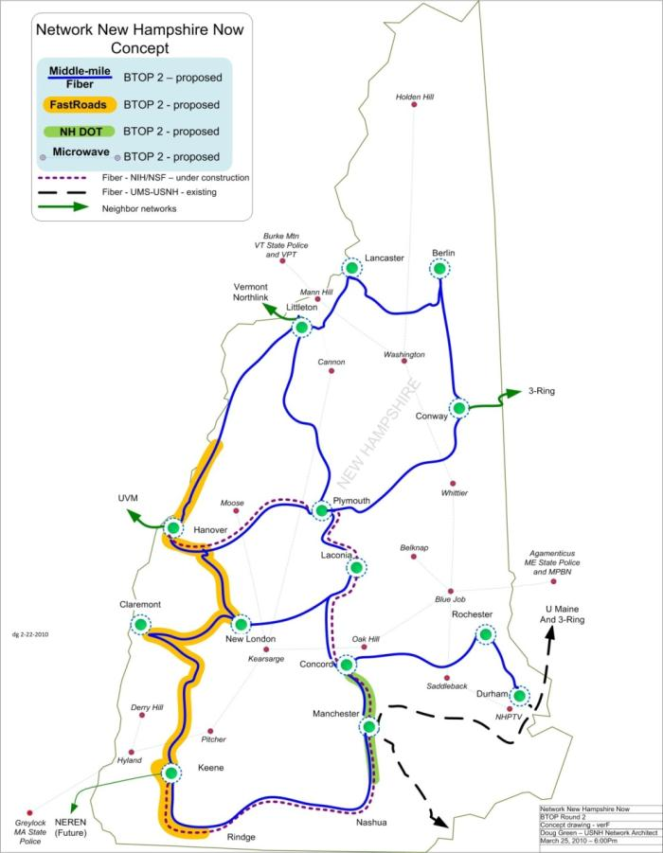
Middle Mile Fiber
Developing Next Generation fiber network to connect Community Anchor Institutions (CAI) in New Hampshire
The Middle Mile fiber routes are being constructed through New Hampshire Optical Systems (NHOS) and Waveguide

Slide 7
Middle Mile Fiber
The DOT route is designed & under DOT jurisdiction as part of statewide, comprehensive Intelligent Transportation System (ITS)
Nearly all of the 16,000 poles have been submitted for pole attachment licenses, and 10% have been licensed – Expect to have Make-Ready complete by summer 2012

Slide 8
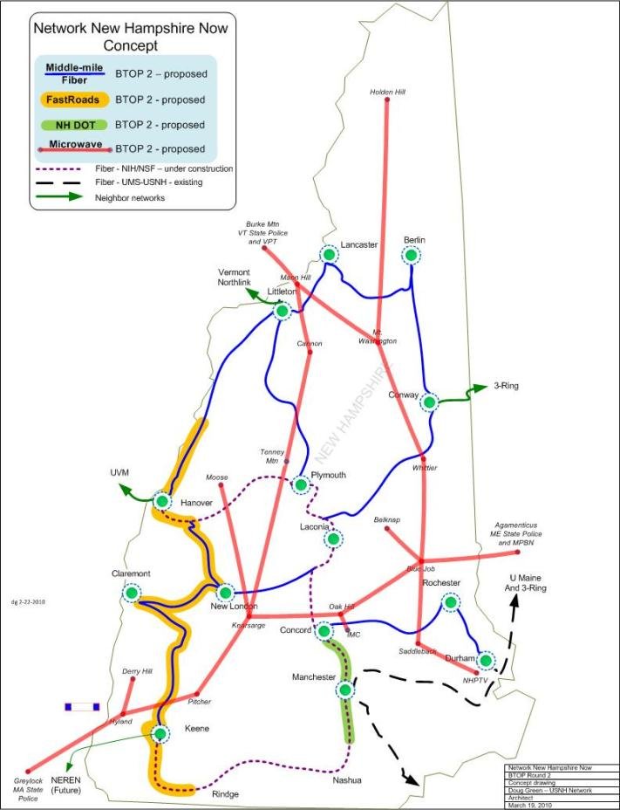
Wireless Network
Collapses existing parallel networks into a single high speed, fault tolerant public safety network
Shared by State Agencies, New Hampshire Public Television, and the NH National Guard
Constructed on existing NHPTV and State of NH-owned towers

Slide 9
Wireless Network
Once completed, will free up space on congested towers for commercial broadband providers
Green Mountain Communications is completing the construction work and will be done in 2012

Slide 10
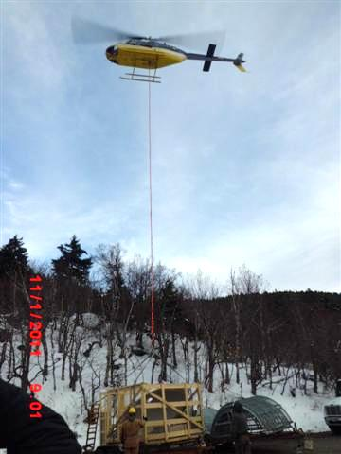
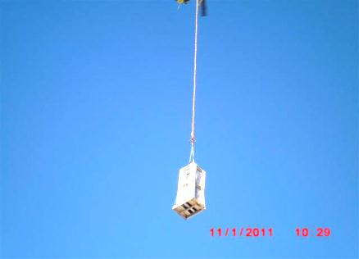
Equipment Installation
Placement on Mt. Kearsarge

Slide 11
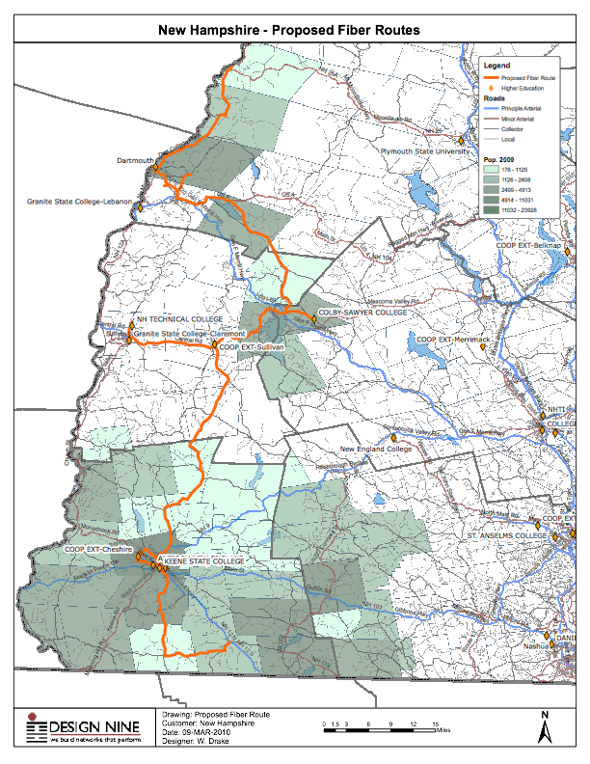
NH FastRoads
FastRoads is a wholly-owned subsidiary of the Monadnock Economic Development Corp (MEDC)
Will manage and operate fiber to the home (FTTH) services in western NH
Initial projects in Enfield and Rindge

Slide 12
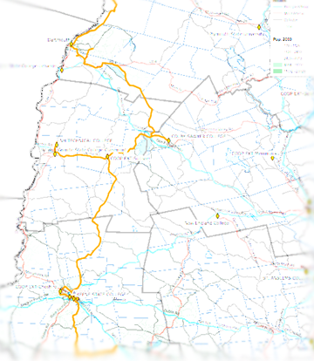
NHBMPP Program Objectives
Mapping:
Identify areas of NH served by current broadband infrastructure – by type of technology and speed of transmission
Use the data to identify areas that are unserved or underserved
Map and inventory community anchor institutions in the state

Slide 13
NHBMPP Program Objectives
Planning:
Undertake suite of activities to understand barriers to broadband adoption, to promote increased broadband deployment, and to encourage increased broadband usage:
Broadband capacity building statewide
Broadband stakeholder groups leading to regional/statewide strategic plans
Business models to guide broadband deployment
Web-based training module(s)
Sector-based and/or application-based technical assistance

Slide 14
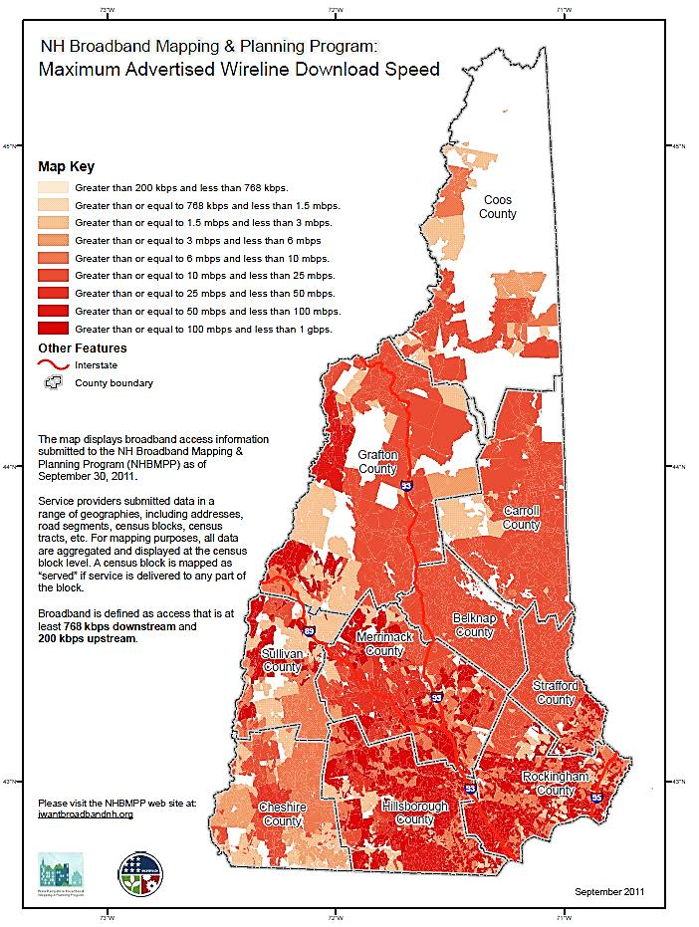
Broadband Availability: September 2011
Broadband coverage as of June 30, 2011
Based on data submitted by 39 providers
Data aggregated to 2010 census blocks for analysis/display

Slide 15
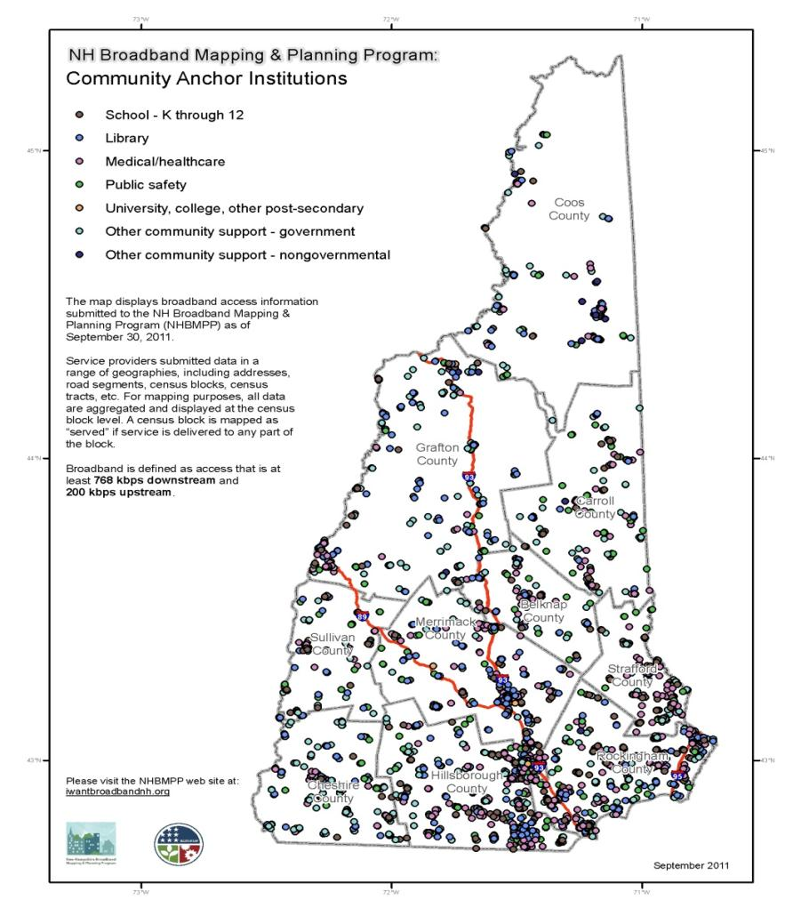
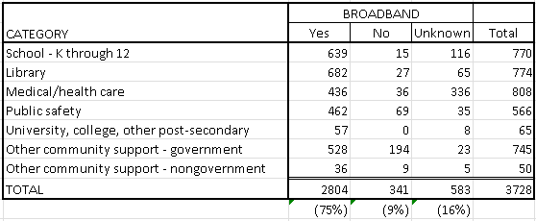
Community Anchor Institutions: September 2011

Slide 16
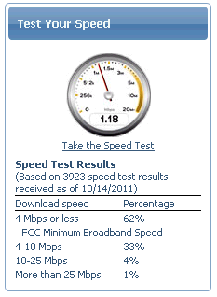
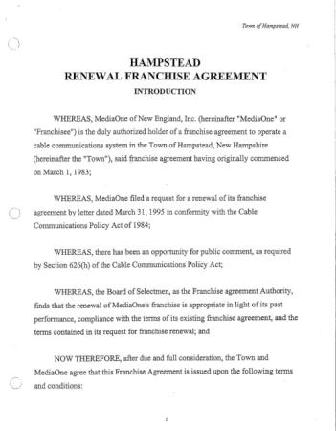
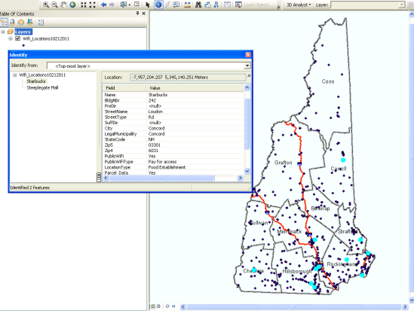
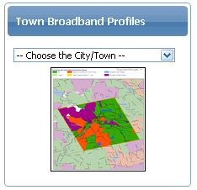
Other Resources: www.broadbandnh.org
Cable Franchise
Agreements Inventory
Project Speed Tests
Broadband Access Surveys
Public Wi-Fi Locations
Municipal Coverage Footprints
Notes:
Data collected for variety of reasons: to assist in verifying broadband coverage data (speed tests, surveys, satellite dish locations), to inventory other resources (wi-fi locations), to provide references for municipalities (e.g. broadband coverage footprints, cable franchise agreements), etc.

Slide 17
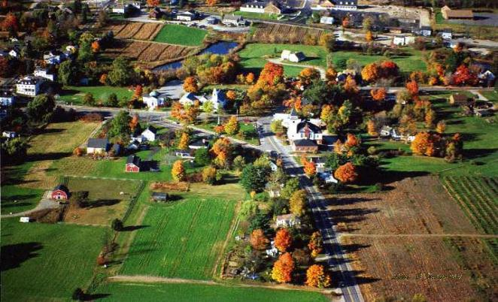
What is Economic Development?
Building a community or region’s capacity to improve its economic future and quality of life. It is a process by which public, business and non-governmental sector partners work collectively to create better conditions for economic growth and employment generation
Notes:
World Bank Definition

Slide 18
Broadband Economics
For each $1.00 invested in BB, the economy benefits nearly $3.00 (BEA)
For every 1% increase in BB penetration, employment will increase by .2 – .3% per year (Brookings)
Employment in manufacturing, financial services, education, and health are all correlated to BB access (Brookings)
Health benefits to people 65 years and older estimated at $927 billion (Litan, 2008)
Notes:
But unless a private communications provider can gain the lion‘s share of that economic benefit, its incentive will be to under-invest in broadband infrastructure.
study by Robert E. Litan estimated the economic benefits from the use of broadband technologies for Americans who are over 65, or who have disabilities. In the study, Dr. Litan estimated that the net present value of total benefits for this sub-group will be $927 billion in 2005 dollars over the next 25 years. These benefits include ―lower medical costs; delay of institutionalized living; and additional output

Slide 19
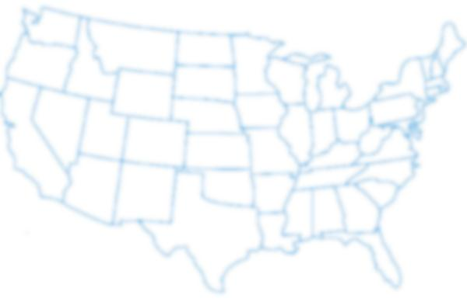
National Impacts Broadband Investment
2003 2004 2005 2006 2007 2008 2009
Jobs Created (thous.) 282 329 431 500 526 495 475
Econ. Output (bill.) $52.6 $61.3 $80.6 $92.6 $96.8 $90.3 $87.2
Penetration Rate 17% 25% 34% 43% 51% 58% 59%
Source: Crandall, R., Singer, H. 2010. The Economic Impact of Broadband Investment. National Cable and Telecommunications Association.

Slide 20
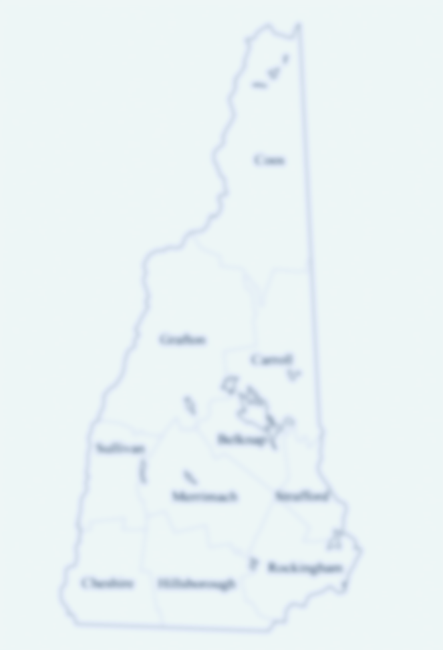
NH Impacts Broadband Investments
In 2011, NH had a 73% penetration rate
Total Economic impact of Broadband estimated at $634 million
11,000 net new jobs created as a result of expanded Broadband infrastructure in 2010
Source: Crandall, R., Singer, H. 2010. The Economic Impact of Broadband Investment. National Cable and Telecommunications Association.

Slide 21
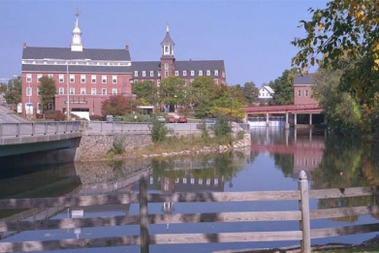
Implications for Municipalities
Improved ability to recruit and retain business
Increased profitability
Greater efficiency of municipal services

Slide 22
Implications for Municipalities
Faster emergency response
Stronger educational attainment
BB infrastructure needed to attract ‘creative class’

Slide 23
Opportunities for Municipalities
Streamlined processes (permitting, billing, registration, applications, etc.)
Teleworking
Meeting accessibility
Communication

Slide 24
Opportunities for Municipalities
Operational Efficiency (dispatch, irrigation, etc.)
Public Safety (monitoring parolees, floor plans, emergency routing, etc.)
Education (Library access, schools, lifelong learning, etc.)

Slide 25
Common Challenges
Laws prohibiting municipal utilities from offering telecommunications or broadband services
Providing Access to Underserved Areas
Forging Public-Private Partnerships

Slide 26
Broadband Application Examples
E-Care
Franklin County, VA: Broadband Economic Development
E-Government

Slide 27
e-Care: Aging in Place
Video consultation services make specialty services available to rural and other underserved areas, improving health care quality and reducing disparities while also increasing convenience for patients. Nearly 50 million people living in rural areas face challenges accessing needed health care today

Slide 28
e-Care: Aging in Place
Home monitoring can place daily metrics of patients’ health—weight, blood pressure and other vital measures—in patients’ and providers’ hands, improving chronic care management and patient engagement. Early detection of problems made possible with real time information, but not imaginable through office visits at six-month intervals, can help avoid unneeded hospitalizations for patients with heart failure and other chronic conditions

Slide 29
e-Care: Aging in Place
Secure sharing and remote reading of patient information such as radiographic images on high speed channels can improve care coordination and reduce the risk of medical errors.

Slide 30
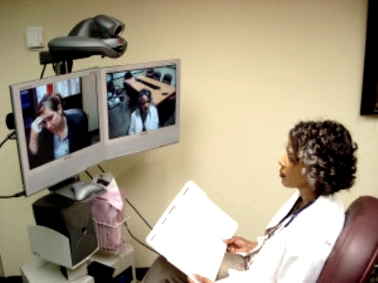
e-Care: ConnectNH
ConnectNH Telehealth Network
Provides rural communities with two-way interactive video psychiatric services via UNH broadband network

Slide 31
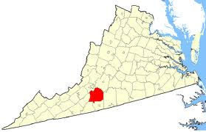
Franklin County, VA: Boosting Economic Development with High Speed Wireless
Notes:
Most case studies regarding expanding broadband access focus on MWNs, or municipal wireless networks. Very little has been written up about expanding access in rural areas. Rural areas pose a lot of challenges to broadband:
Dispersed population
Lack of infrastructure
Socioeconomic factors
Yet, broadband access can be expanded in rural areas to great success. Take Franklin County, a rural county of 721 acres in South Central Virginia, in the heart of the Blue Ridge Mountains. In many respects, it looks much like New Hampshire demographically. Parts of the county are resource dependent and have disperse populations. Five years ago, only a few percentage of the rural residents outside of the downtown had access to high speed internet, let alone internet at all.
The challenge: County was not able to attract new businesses or grow local businesses due to lack of internet connectivity, in spite of the natural beauty of the area.

Slide 32
How did Franklin County do it?
Public-private partnership
Private Investment by local ISP
$83,000 in County Investment
$50,000 in Federal Grants
Leveraging existing infrastructure
Working with landowners to site new towers
Notes:
Partnership was necessary due to the risk that private sector would otherwise have borne on its own – county invested in exchange for reduced rate and not revenue.
They utilized existing infrastructures including several existing towers and water tanks, street and traffic lights, etc.
Willing landowners were given reduced rates and service and NOT cash payments in exchange for siting new towers.

Slide 33
Outcomes of Partnership
From 1 tower to 20 towers Countywide
150 new businesses and 1,500 residences served
16 fire & EMS stations on-line
Library and public buildings connected
Reduced municipal expenses
Several new businesses located in town
ROI achieved in 16 months
Notes:
Emergency response times reduced
Reduced municipal and county costs for telephone, billing, etc.

Slide 34
Lessons Learned
Don’t go it alone!
Leverage existing infrastructure
Local government CAN partner to expand broadband
http://www.yesfranklincountyva.org/bb_assets/pdf/franklin_county_wireless_internet.pdf

Slide 35
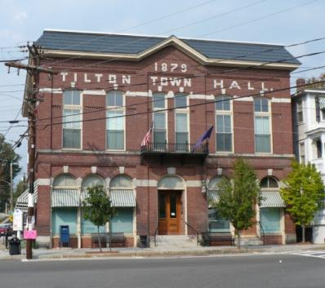
e-Government
The use of information and communication technologies to achieve better government and for delivering information and services to citizens

Slide 36
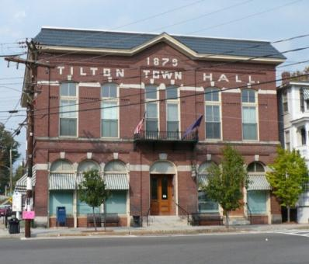
e-Government
Using Broadband applications for Government-to-Citizen (G2C) services
License renewals
Obtaining permits
Paying water/sewer bills
Accessing policy and regulation information
Streaming Council Meetings
Notes:
The four types of e-government services are Government-to-Citizen (G2C), Government-to-Business (G2B), Government-to-Employee (G2E), and Government-to-Government (G2G).
G2C includes information dissemination to the public, basic citizen services such as license renewals, ordering of birth/death/marriage certificates and filing of income taxes, as well as citizen assistance for such basic services as education, health care, hospital information, libraries, and the like.
G2B transactions include various services exchanged between government and the business community, including dissemination of policies, memos, rules and regulations. Business services offered include obtaining current business information, downloading application forms, renewing licenses, registering businesses, obtaining permits, and payment of taxes. The services offered through G2B transactions also assist in business development, specifically the development of small and medium enterprises. Simplifying application procedures that would facilitate the approval process for SME requests would encourage business development.
On a higher level, G2B services include e-procurement, an online government-supplier exchange for the purchase of goods and services by government. Typically, e-procurement Web sites allow qualified and registered users to look for buyers or sellers of goods and services. Depending on the approach, buyers or sellers may specify prices or invite bids. e-Procurement makes the bidding process transparent and enables smaller businesses to bid for big government procurement projects. The system also helps government generate bigger savings, as costs from middlemen are shaved off and purchasing agents’ overhead is reduced.
One area of e-government under much discussion and debate is finding a way to implement electronic voting on everything from public measures to the election of representatives. Security concerns and a lack of universal access to technology have slowed the implementation of e-voting, but many advocates hold that it is simply a matter of time before these concerns are sufficiently addressed and e-voting becomes a standard

Slide 37
e-Government
e-Democracy electronic decision making and/or voting on everything from public measures to the election of representatives
Security concerns and a lack of universal access to technology have slowed implementation
Ottawa e-Democracy leader in citizen communications and decision making using the web for input and voting

Slide 38
Questions and Answers
Audience response system

Slide 39
What best represents the organization for which you work?
Town
City
District
County
Region/State
Other

Slide 40
Does the organization for which you work have Broadband access?
Yes
No
Don’t know
Broadband >= 768 kbps down; 200kbps up; DSL or better

Slide 41
Do you have Broadband access at home?
Yes
No
Don’t know
Broadband >= 768 kbps down; 200kbps up; DSL or better

Slide 42
Do you have a smartphone or other wireless device with access to the Internet?
Yes
No
Don’t know

Slide 43
Does your town/city have a cable franchise agreement (CFA) ?
Yes
No
Don’t know

Slide 44
What best represents the advertised download speed your organization pays for or receives in-kind?
Dialup 512 kbps
DSL 768 kbps
T1/Cable 1.5 mbps
OC3/Fiber 155 mbps
Other
Don’t know

Slide 45
To what extent do you agree “Broadband connectivity is important to the economic future of my town/city”?
Strongly Agree
Agree
Neutral
Disagree
Strongly Disagree

Slide 46
To what extent do you agree “I am interested in Broadband training for my organization”?
Strongly Agree
Agree
Neutral
Disagree
Strongly Disagree

Slide 47
What is the biggest impediment to your community’s Broadband implementation efforts?
Lack of leadership
Lack of funding
Lack of need/interest
Lack of knowledge/training
Other

Slide 48
Questions and Answers
Dr. Charlie French, UNH Cooperative Extension Charlie.French@unh.edu
Fay Rubin, UNH Earth Systems Research Center Fay.Rubin@unh.edu
Scott Valcourt, UNH Information Technology Scott.Valcourt@unh.edu
David Foote, UNH Information Technology David.Foote@unh.edu

