Slide 1
State Broadband Initiative NTIA Webinar
Mike Ratcliffe
Vince Osier
Jennifer Holland
US Census Bureau

Slide 2
Overview
Geographic changes – Census 2000 to the 2010 Census
Tools & Resources for dealing with the change in geography
TIGER/Line Shapefiles

Slide 3
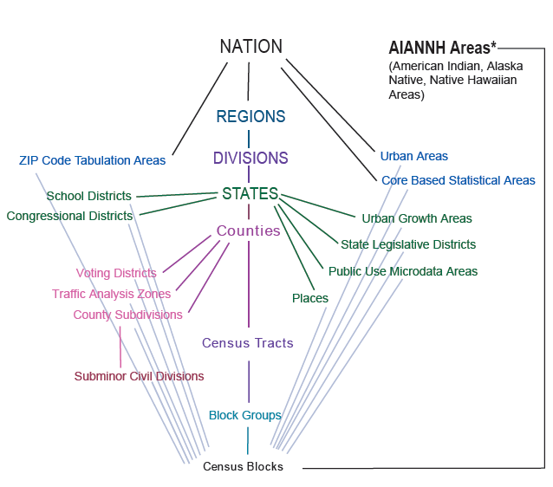
Census Geographic Hierarchy
http://www.census.gov/geo/www/geodiagram.pdf

Slide 4
Census Blocks - Changes
Census 2000 – 8.2 million blocks
2010 Census – 11.1 million blocks
35% increase in the number of blocks nationwide
Changes in Census Blocks explanation - http://www.census.gov/geo/www/2010census/changes_census_blocks_2000_2010.pdf
Block numbering is not consistent from census to census. The algorithm to number the blocks is the same but the block numbers are not held from decade to decade.
In some areas we ran out of census block numbers (there can only be 1,000 blocks per block group) and it resulted in some typical features not being used as census block boundaries & larger blocks in these areas.

Slide 5
General Goals of Census Block Delineation
A census block generally is bounded by roads, as well as other visible features.
Non-visible boundaries of higher-level geographic entities always form census block boundaries.
Wherever possible, features suggested by state redistricting officials as “must-hold” boundaries are held as census block boundaries.
In suburban and rural areas without a highly developed road network, the census block delineation methodology may use landscape features that otherwise might not have formed block boundaries.

Slide 6
Contributing Factors to Increase in Number of Census Blocks
Increase in Features in the MAF/TIGER database
Addition of non-visible lines to define geographic areas
Increase in geographic entities
Elimination of water-only block merging
No more suppression of roads within Military and National Park Areas
“Participant Must Hold” Features

Slide 7
Census Blocks - Resources
Block Relationship Files – http://www.census.gov/geo/www/2010census/rel_blk.html
Use the Census 2000 Tabulation Block to 2010 Census Tabulation Block relationship file (one per state)
Files indicate whether the relationship from Census 2000 to the 2010 Census is one-to-one, many-to-one, one-to-many, or many-to-many by the part flag.
Fields for the Census 2000 area, 2010 Census area, and the area that overlaps between the two areas (all in square meters).
Tallies of Blocks by State - http://www.census.gov/geo/www/2010census/census_block_tally.html
Block Assignment Files - http://www.census.gov/geo/www/2010census/baf/baf_main.html
Census block Maps - http://www.census.gov/geo/www/maps/DC10_GUBlkMap/dc10blk_main.html

Slide 8
Block Groups
No significant change in the criteria for definition between Census 2000 and 2010 Census.
Minimum Population 600 or 240 Housing Units
Maximum Population 3,000 or 1,200 Housing Units
Participants (such as local planning offices) provide recommendations for boundaries
There are 1-9 block groups per census tract
Lowest geographic level that the American Community Survey data are available at (socioeconomic data equivalent to Census 2000 Summary File 3)
Resources
There are no relationship files specifically for block groups – you can use the block relationship files to determine the relationships as the first number of the census block is the block group number.

Slide 9
Census Tracts
Minimum population threshold was lowered for the 2010 Census
Minimum Population 1,200 or 480 housing units
Maximum Population 8,000 or 3,200 housing units
Optimum Population 4,000 or 1,600 housing units
Census tracts are merged or split, not redefined to meet thresholds
Numbered consistently from decade to decade for data comparability
When census tracts are split a 2-digit suffix is added
As the tract continues to split the suffix is retired
Maricopa County, AZ has run out of suffixes in 2 areas so the census tracts were renumbered (they expect additional areas to run out of numbers in 2020)
Partners recommend the boundary changes to the Census Bureau prior to the decennial census

Slide 10
Census Tracts - Resources
Census Tract Relationship Files – compare Census 2000 to 2010 Census
http://www.census.gov/geo/www/2010census/tract_rel/tract_rel.html
Contains Population & Area affected by change
Census Tract Maps
http://www.census.gov/geo/www/maps/pl10_map_suite/tract.html
Tally of Census Tracts by state
http://www.census.gov/geo/www/2010census/geo_tallies/tractblock.html

Slide 11
County Subdivisions
Provide Wall-to-Wall coverage of the nation
Minor Civil Divisions –
Legally defined boundaries
29 states, the District of Columbia, and Puerto Rico
In 12 strong MCD states (mostly in the Northeast and Midwest) these serve as general-purpose local governments that can perform the same governmental functions as incorporated places
Census County Divisions –
Statistical areas, defined through partners
20 states
Census Subareas
Statistical areas in Alaska
Tennessee changed from a CCD to MCD state between Census 2000 and the 2010 Census

Slide 12
Counties
Generally Stable Boundaries
Substantial County Changes - http://www.census.gov/geo/www/tiger/ctychng.html
Three Census areas in Alaska were deleted and replaced by 5 county equivalents – 2007 – 2008
One county added in Colorado – 2001
One county equivalent in Virginia merged into surrounding county – 2001
One county in Virginia exchanged territory with independent city (county equivalent) – 2007

Slide 13
Places
Incorporated Places
Legally defined places
Census Designated Places
Statistical entities that are generally recognized as places but aren’t legally recognized by the state
Updated once a decade
Starting in Census 2000 no minimum population threshold
Significant increase in the number between Census 2000 and the 2010 Census
Place Comparability File
http://www.census.gov/geo/www/2010census/places/allplaces.html

Slide 14
Geography – How we update
Legal Geography
Annually through the Boundary and Annexation Survey
Our products show geography as of January 1st of a given year
Approximately 44,000 legally recognized entities
Statistical Geography
Updated once a decade (unless a surrounding legal area has caused a change)
Boundaries are provided by partners
Blocks
May be suffixed annually to ensure they are still the building block of all other geography, e.g. if an incorporated place annexes territory that does not contain whole blocks the affected blocks will be split and suffixed so you can still trace the original block number

Slide 15
TIGER/Line Shapefiles
http://www.census.gov/geo/www/tiger/index.html
Produced Annually
New since 2007 to correspond with the annual release of the American Community Survey
2010 Census TIGER/Line Shapefiles available for all geographic areas, including the Island Areas
New in the past month are 2010 Census block shapefiles with population and housing unit counts available for whole states
Technical Documentation & User Notes
http://www.census.gov/geo/www/tiger/tgrshp2010/documentation.html
GIS –ready files

Slide 16
Our Contact Information
Mike Ratcliffe
Michael.R.Ratcliffe@census.gov
Vince Osier
Vincent.Osier@census.gov
Jennifer Holland
Jennifer.L.Holland@census.gov
General Geography Questions
Geo.Geography@census.gov

