Slide 1

^{New Hampshire}
^{Strategic Highway}
^{Safety Plan}
^{Driving Toward Zero Deaths}
²⁰¹²⁻²⁰¹⁶

Slide 2

New Hampshire's SHSP
GOAL
CHALLENGE
OUR
  In 2007, New Hampshire created their first Strategic Highway Safety Plan in response to the Safe, Accountable, Flexible, Efficient Transportation Equity Act
  Goal
  Reduce the number of fatalities/year on New Hampshire roadways to below 100 by 2010
  Good News
  From 2007 to 2010 there was an 11.8% reduction in fatalities.
  … In 2011 there were less than 100 fatalities.

Slide 3
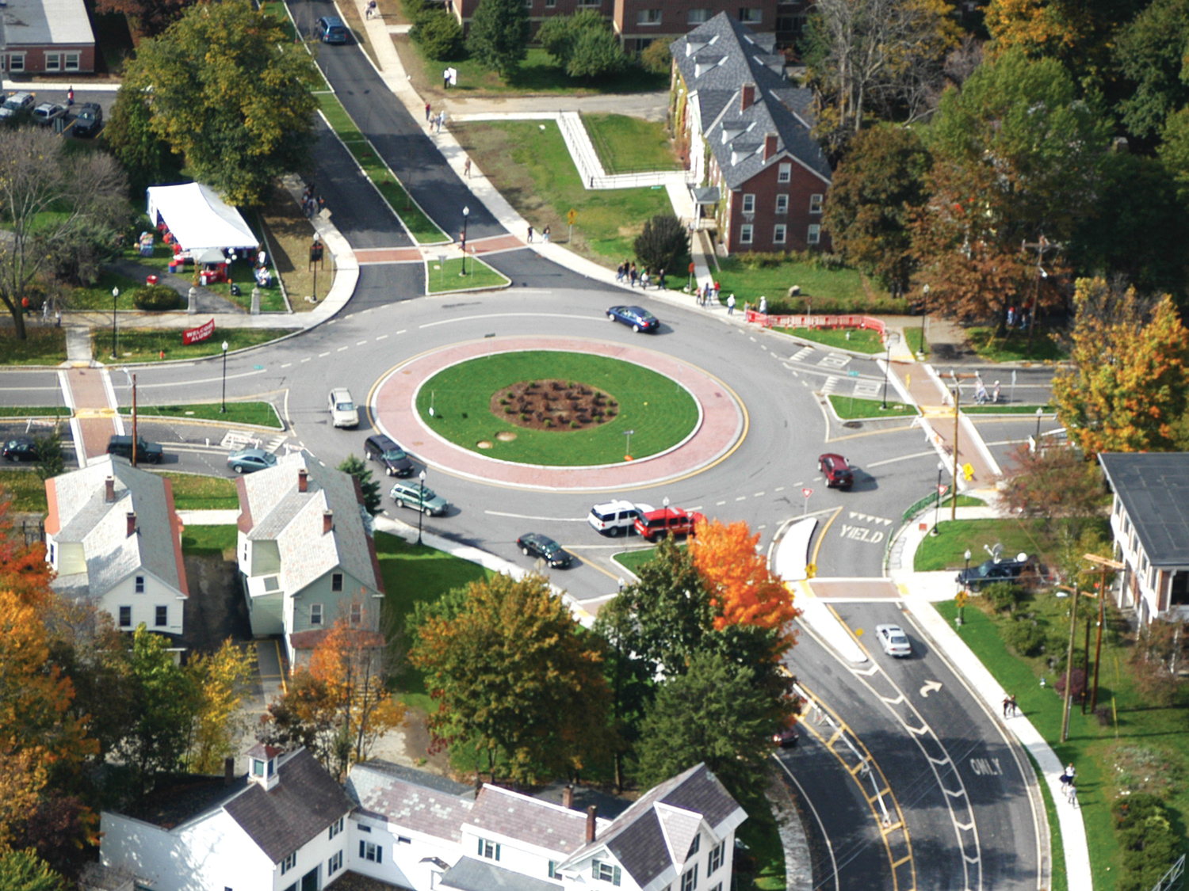

OUR GOAL AND MISSION - 2012
ZERO FATALITIES…a safety culture

Slide 4
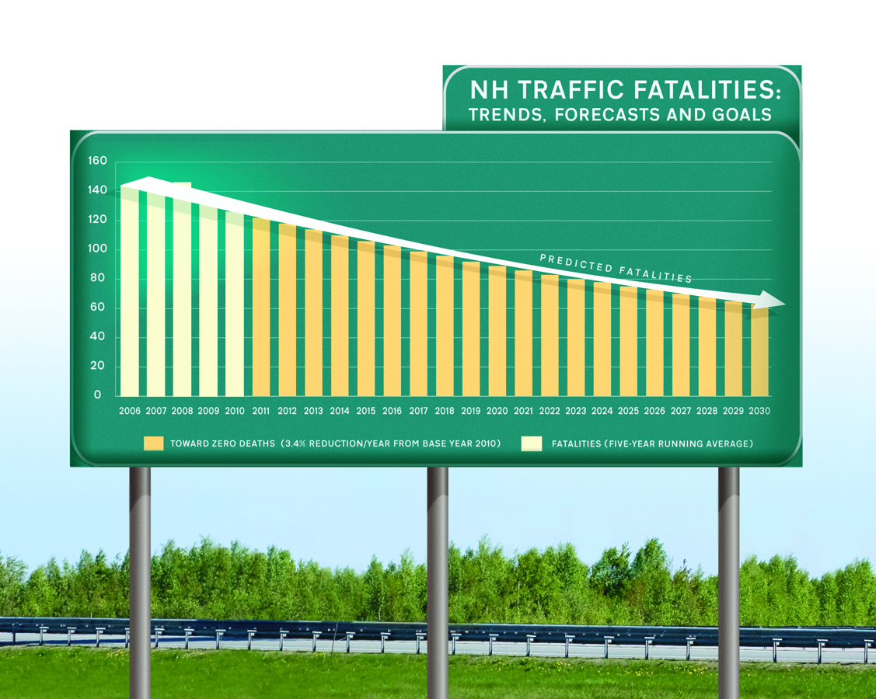
Our TARGET
Fifty percent reduction in fatalities by 2030

Slide 5
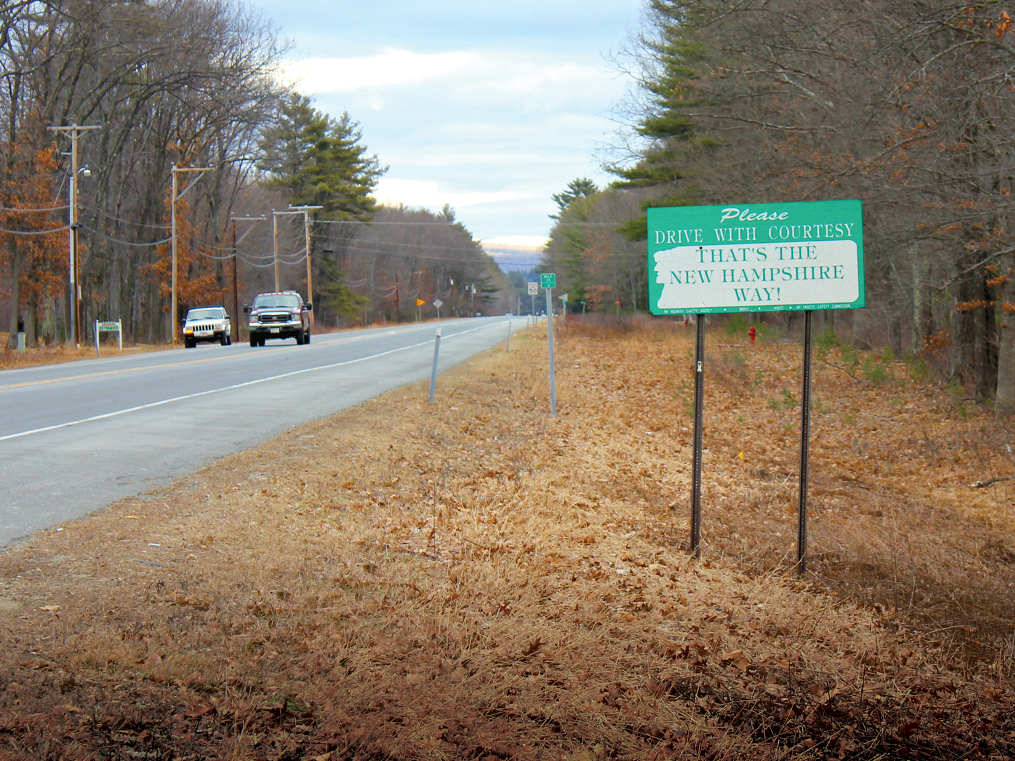
General strategies
IDENTIFY CRITICAL EMPHASIS AREAS
DEVELOP EMPHASIS AREA ACTION PLANS
LINK TRANSPORTATION PLANS
COMMUNICATION AND OUTREACH
TARGETED MESSAGING AND ENFORCEMENT
EVALUATION

Slide 6
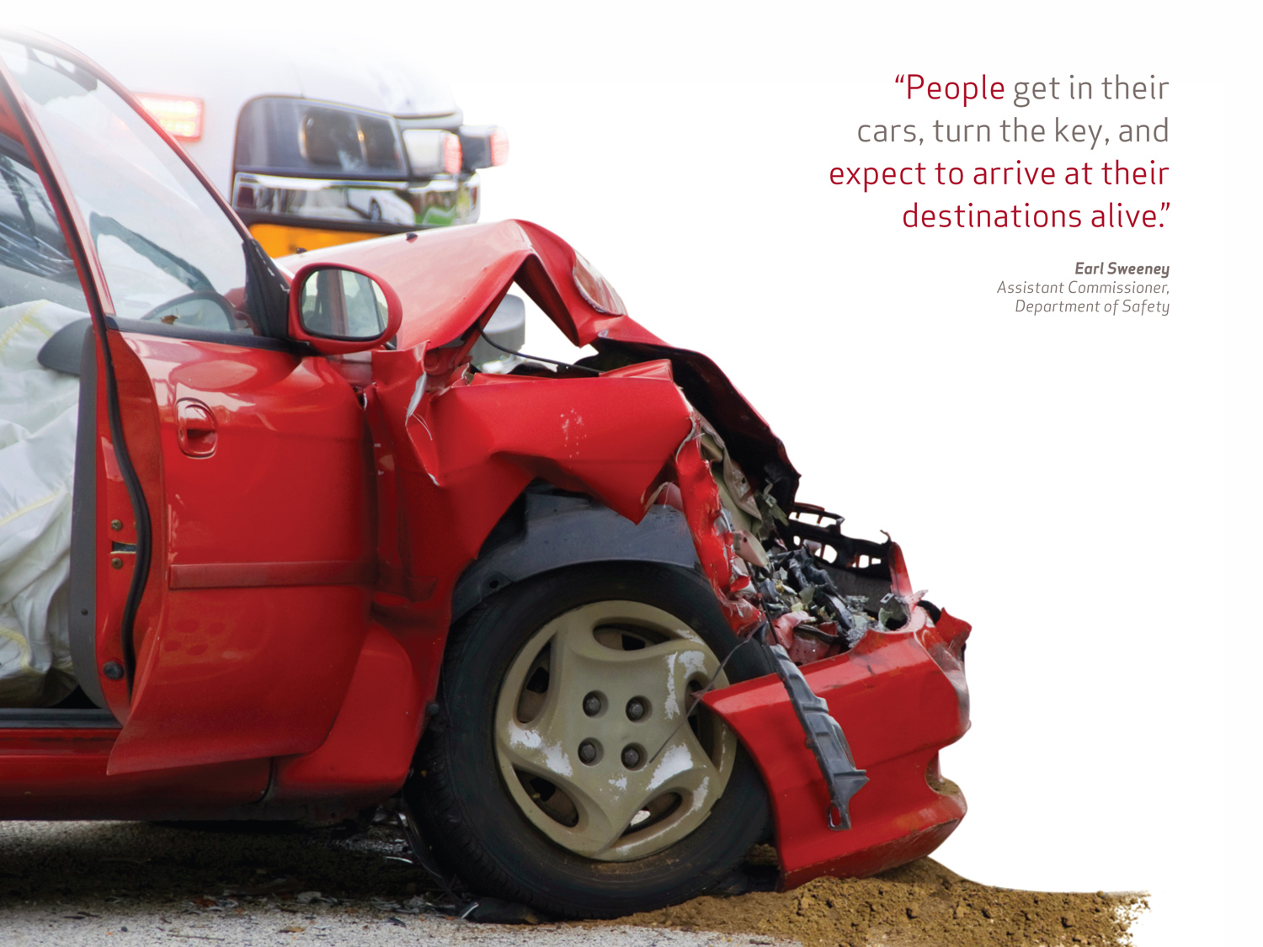

Marketing and Communication Plan
Confirmed Media Partners
Josh Judge – WMUR Meteorologist
Tracy Caruso – WZID Radio Host
Scott Spradling – Former Radio & Television Reporter

Slide 7


Branding

Slide 8

Challenges
Lack of coordination among agencies
Number of disparate audiences (from youth to older drivers, lawmakers to general public, urban to country)
General lack of acknowledgement that road crashes are a problem
General lack of accountability by roadway users
General lack of accountability of drivers for passengers and passengers for drivers
Disregard for law enforcement of those who exhibit at risk behavior
Budgetary constraints

Slide 9
Opportunities
Emotional, personal message
Positive Community Norms
Coordinate efforts among all participating agencies
Potential partnerships
Pooling resources
Campaign Media Partnerships
Grassroots public relations approach
Optimized use of social media

Slide 10
STRATEGY
Mass Media – Radio/Print
Public Relations
  Frame the story
  Engage on an emotional level/personalize the story
  Pitch stories for earned media
  Raise awareness for legislative and enforcement updates
  Foster stakeholder support
  Create awareness of personal responsibility for roadway safety

Slide 11
STRATEGY
Social Media
  Online public relations
  Community building
  Cultivate loyalty
  Engage the audience
  Start a conversation-speak to them where they are
  Advertise on a very personal and social level
    Web Page: www.nhdtz.com
    Facebook nhdtz
    Twitter @nhdtz

Slide 12
Did you know?
There are more than 800 million users of Facebook, with more than 200 million added in 2011 (socialmediaexaminer.com)
Twitter has 100 million users (businessinsider.com)
YouTube gets 3 billion video views per day (thenextweb.com)

Slide 13
STRATEGY
Digital Advertising
  Google
  Facebook
  Targeted banner ads
Website
  Videos
  Live Statistics Map
  Resources
  Memory Wall
Experiential
  Day of No Distractions

Slide 14

Education
Awareness
Acceptance

Slide 15
CRITICAL EMPHASIS AREAS
Impaired Driving,
Distracted Driving,
Speeding,
Vehicle Occupant Protection,
Adolescent Drivers,
Older Drivers,
Crash Locations,
Vulnerable Roadway Users, and
Comprehensive Safety Data

Slide 16

Impaired driving
OUR
CHALLENGE
41% of all fatal crashes included alcohol or drug use (2009-2011, all hours of the day)

Slide 17
STRATEGIES
OUR
Better job of messaging combined with enforcement
Better collaboration between agencies
PDMP to reduce drug diversion and DUI-D
Driving Under Influence of Drugs bill
Better Control of synthetic drugs
Continued training to include: DRE, DUI-D, and Intoxilizer
Expanded use of interlock devices

Slide 18

DISTRACTED DRIVING
OUR
CHALLENGE
Distracted driving is growing problem
Distraction can be classified as visual, manual, cognitive, and drowsiness

Slide 19
STRATEGIES
OUR
Promote strong laws, enforcement, and education based on data and research
Support the development and implementation of new technologies that alert drivers to hazards on the road
Install shoulder and centerline rumble strips where possible

Slide 20

SPEEDING
OUR
CHALLENGE
Contributing factor in 240 fatalities, 2006 to 2010
70% on curves, 65% town roads, 25% at intersections, 45% included alcohol

Slide 21
STRATEGIES
OUR
Educate public as to the dangers and consequences of speeding
Provide for law enforcement operations in the design, construction, and maintenance of roadways

Slide 22

VEHICLE OCCUPANT PROTECTION
OUR
CHALLENGE
Below national average of seat belt use

Slide 23
STRATEGIES
OUR
Enhanced education, enforcement, and legislation
Child occupant protection
Coordinate with BUNH

Slide 24

ADOLESCENT DRIVERS
OUR
CHALLENGE
Over representation of novice drivers in crashes
Speed and inexperience are major contributing factors

Slide 25
STRATEGIES
OUR
Graduated drivers license
Increase community and parental involvement
Increase teen seat belt use

Slide 26

OLDER DRIVERS
OUR
CHALLENGE
Rapidly aging population – Nationally and locally
By 2030, approximately 500,000 NH residents, or 30% of the population will be 65 or older

Slide 27
STRATEGIES
OUR
Formalize and convene a State Older Driver Task Force
Engage the New Hampshire Medical Advisory Board
Consider older drivers in highway design and maintenance
Enhance screening tools used in licensing
Provide immunity for health care providers who refer at risk drivers
Incorporate older driver content on DMV website
Expand public transportation and travel training programs
Promote self assessment and self reporting
Develop targeted educational and outreach materials

Slide 28

CRASH LOCATIONS
OUR
CHALLENGE
Fatal and severe intersection related crashes
Fatal and severe lane departure crashes

Slide 29
STRATEGIES
OUR
Intersections
Install roundabouts where warranted
Improve driver awareness of intersections, intersection visibility
Lane Departures
Install and maintain centerline and edge line rumble strips where possible
Evaluate, standardize, and install delineation, signing, and marking on curves

Slide 30

VULNERABLE USERS
OUR
CHALLENGE
Reduce motorcycle crashes
Reduce pedestrian/bicycle crashes

Slide 31
STRATEGIES
OUR
Improve motorcycle rider training
Create events with dealers/public using SMARTrainer
Dealer/rider voucher program for returning riders
Improve web site
Add additional curriculum for returning riders (age 40 to 60)
Identify opportunities to improve existing MC/bike/ped laws

Slide 32

Comprehensive data improvement
OUR
CHALLENGE
To Improve data and information systems that support SHSP
Various methods of data collection, storage processing, and reporting of safety data
Resource to sustain and manage data

Slide 33
STRATEGIES
OUR
Continue projects support: CRMS, GIS – State and Local
Identify data gaps between existing performance and desired
Identify champions for each data system
Identify performance measures, set targets, evaluate
Re-establish CODES (Crash Outcome Data Evaluation System)

Slide 34
OUR
STRATEGIES
FARS
Improve data sharing between local, state and federal agencies
Increase data sets collected
Expand data collected from EMS
Provide information and training back to local officials
Promote the distribution and use of our data

Slide 35
PERFORMANCE MEASURES
Leading Indicators
Increase in the percentage of occupant seat belt use
Increase in the percentage of motorcycle helmet use
Model performance measures for state traffic records system
Lagging Indicators
Number of traffic fatalities – five year average
Number of severe injuries
Number of fatalities per vehicle mile traveled

Slide 36

New Hampshire Department of Transportation
7 Hazen Drive, Concord, NH
603.271.3734
NHDrivingTowardsZero.com
Nh.gov/dot

