Slide 1
Intersection Safety Implementation Plans
Workshop
for New Hampshire DOT
Concord, NH
July 24, 2012

Slide 2

Welcome to our Workshop…
Please introduce yourself…
  Name
  Role
  Outcomes

Slide 3
Workshop Agenda
9:00AM Welcome and Introductions
Workshop Goals, Objectives, and Outcomes
Module 1: Background
9:15AM Linking to the SHSP Vision, Mission, and Goals
9:30AM FHWA ISIP Perspective and Resources
9:45AM Results of the Data Analysis
100 Intersection Study
NHDOT Intersection Analysis Findings
10:15AM Appropriate Intersection Countermeasures
10:45AM Break

Slide 4
Workshop Agenda
Module 2: Putting it all Together
11:00AM Review and Fine-tune Proposed NHDOT ISIP Approach
Review Countermeasures, Deployment, Costs, and Severe Crash Reductions
Concurrence on ISIP Approach
12:15 PM Lunch
Module 3: Strategic Implementation
1:15 PM Identify Barriers to success

Slide 5
Workshop Agenda
Module 4: Actions to Improve Intersection Safety
1:45 PM Propose Key Steps to Implement ISIP
2:30 PM Establish Key Performance Measures
3:00 PM Break
3:15 PM Wrap-up / Next Steps
3:30 PM Adjourn

Slide 6
Workshop Goals
Examine the systemic approaches to reducing severe intersection crashes
Identify acceptable, cost effective countermeasure packages for deployment to achieve safety vision
Identify strategic directions and steps needed to successfully implement the countermeasures

Slide 7
Workshop Products
Develop a preliminary set of intersection safety countermeasures, deployment levels, and cost to cost effectively reduce severe intersection crashes.
Draft Intersection Safety Implementation Plan

Slide 8
Intersections in New Hampshire
40,291 intersection crashes from 2006 to 2010 caused:
  Cost $3.6 Billion
  7,382 intersections had an intersection crash
    57% involved a State road
    43% involved local intersections
  7,122 deaths and serious injuries
    94% of the total intersection cost
    Located 5,462 severe crashes
    66% urban environment (Hillsborough / Rockingham Counties)

Slide 9
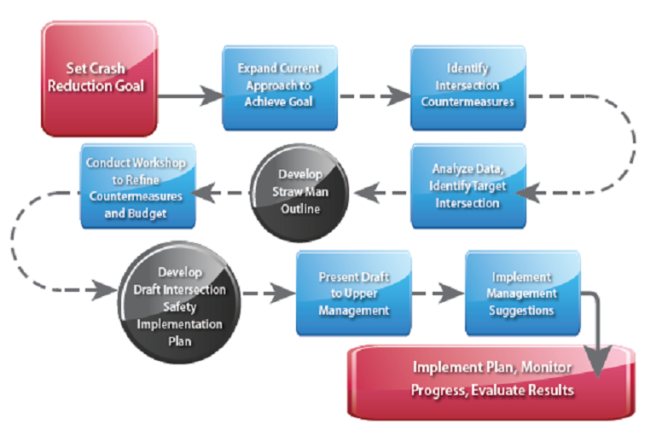
Reference Point

Slide 10
Module 1: Goals, analysis, and Countermeasures that work
Intersection Safety Implementation Plans

Slide 11

SHSP Vision and Mission Statement
The vision of the Strategic Highway Safety Plan is to have ZERO Traffic Deaths on New Hampshire roadways.
Though our overall goal is to realize zero fatalities, we have set a plan goal of reducing the number of fatalities and severe injuries by 50 percent by the year 2030.

Slide 12
SHSP Emphasis Areas
Impaired Driving;
Distracted Driving;
Speeding;
Vehicle Occupant Protection;
Adolescent Drivers;
Older Drivers;
Crash Locations;
Motorcycles and Vulnerable Roadway Users; and
Comprehensive Safety Data.

Slide 13
General SHSP Strategies
Develop emphasis area action plans.
Link with other transportation plans.
Develop a communication plan.
Create targeted messaging and high visibility enforcement.

Slide 14
Intersection Focus Strategies
Improve driver awareness of intersections, intersection visibility, and sight distance.
  “Driver awareness at intersections refers to the advance notice of upcoming intersections and existing signing and signals. Recognizing the approach to an intersection prepares the driver for changing traffic patterns and conflicting movements. Clearing vegetation and removing roadside objects and other obstructions at intersection approaches improves intersection sight distance by improving sight triangles. This is a critical issue among motorcycles, bicycles, older drivers, and pedestrians.”

Slide 15
Actions that connect the SHSP to ISIP
Proposed SHSP Actions
  Install approach rumble strips where warranted.
  Install flashing beacons where warranted.
  Implement Statewide Intersection Safety Improvement Plan.
  Install roundabouts where warranted.
  Install offset turn lanes where warranted.
  Install flashing yellow arrows or left turn signals where warranted.
  Consider driveway relocations and closures within 250 ft. of intersections or implement driveway turn restrictions

Slide 16
SHSP Performance Measure Evaluation
Assess progress:
  In each Critical Emphasis Area Action Plan.
  By stakeholders
  Of aligning with mission, vision and goals of SHSP.
Assess appropriate use of available funding.
Assess integration with other plans.

Slide 17
Intersection Emphasis Area
In New Hampshire, one in 10 fatal crashes and three in 10 severe injury crashes occur at intersections.
Improve driver awareness of intersections, intersection visibility, and sight distance.
Crashes from 2006 to 2010
  156,762 crashes were reported
  40,291 crashes (or 26 percent) at intersections.

Slide 18
FHWA Perspective and resources
Intersection Safety Implementation Plans

Slide 19
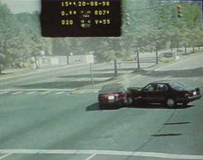
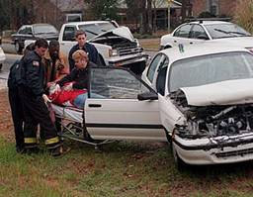
Why Intersection Safety?
A small part of overall highway system, but
In 2009 – 7,043 fatalities related to intersections
(21% of Total Highway Fatalities)
Each year more than 3 million intersection crashes occur (≈ 55% of all reported crashes)
Notes:
Key Message: Statistics on intersection crashes in the US.
Est. Presentation Time: 1 min.
Explanation of Cues/Builds: Lines build to allow instructor to first ask the question then provide the supporting facts
Suggested Comments:
Suggested Questions: none
Additional Information: Although there is no inventory, it is estimated that there are approximately 3 million intersections in the US. About 2.7 million are unsignalized.
Possible Problems: none

Slide 20
Number of Intersection Fatalities – 2009
104
25
28
25
13
16
59
134
77
30
19
142
408
9
218
241
16
66
96
47
72
238
227
213
51
192
689
95
16
135
102
148
26
102
100
147
197
159
124
12 (DC)
10
98
146
136
108
309
550
10
113
751
30
X = # of fatal crashes in 2009 (Preliminary)
classified as intersection or intersection-related
Notes:
KEY MESSAGE:
This map indicates the number of fatal crashes (not individual fatalities) that occurred in each state that were classified as either “intersection” or “intersection-related” in the 2009 FARS database. PRELIMINARY
Darker shades indicate higher numbers of crashes, lighter shades indicate fewer crashes.

Slide 21
US Intersection Crash Data
Over 50% of all urban crashes occur at intersections
Over 30% of all rural crashes occur at intersections
Notes:
Key Message: Statistics intersection crashes in the US. Previous statistics dealt with all crashes.
Est. Presentation Time: 1 min.
Explanation of Cues/Builds: None.
Suggested Comments: Almost ¼ of all fatalities occur at intersections.
Suggested Questions: none
Additional Information: none
Possible Problems: none

Slide 22
2008 US Total Crash Characteristics
Crash Type | Total Crashes |  | Fatal/Injury Crashes
 | Number | % | Number | %
Non Intersection | 2,638,000 | 45% | 722,680 | 43%
Stop/No control Intersection | 984,000 | 17% | 321,520 | 19%
Signalized Intersection | 1,182,000 | 20% | 380,511 | 23%
Unclassified | 1,005,000 | 17% | 240,306 | 14%
Total | 5,801,228 | 100% | 1,637,476 | 100%
55%
57%
Source: USDOT Traffic Safety Facts 2008 Early Edition, A Compilation of motor vehicle crash data from FARS and GES, Table 29, Page 52
Notes:
Total crashes. Intersection vs. segment and Fatal/injury vs PDO

Slide 23
Severity Index
Severity index (SI) is the ratio of crashes involving an injury or fatality to total crashes
Accident Severity | Proportion of Total Crashes Segments Intersections
Fatal & Injury | 0.321 | 0.397
PDO | 0.679 | 0.603
TOTAL | 1.000 | 1.000
Source: Default distribution for crash severity NCHRP 486
Notes:
Severity Index from this table from page 37 of NCHRP 486 is 32% SI for Roadway Segments and 40% for intersections (rounded)

Slide 24
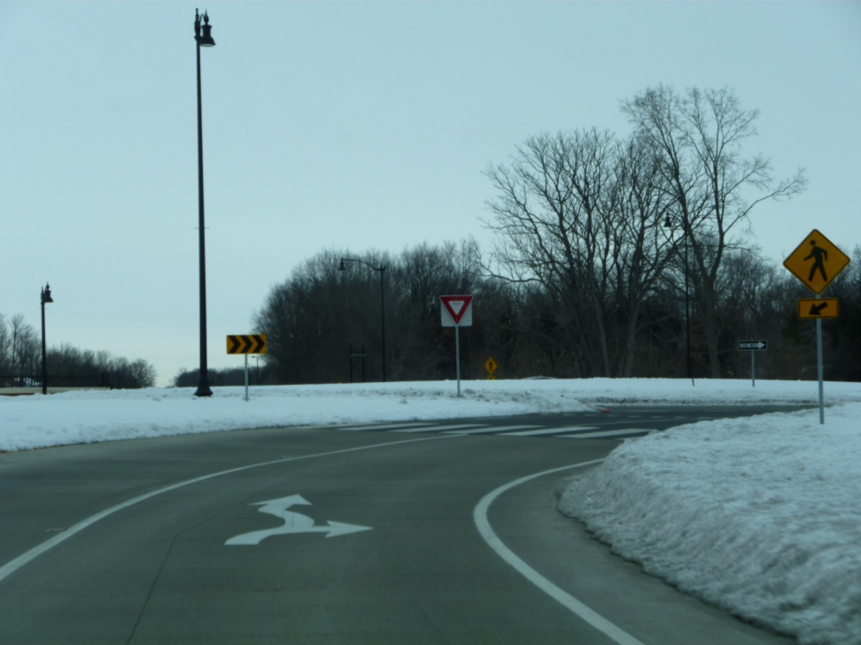
Making Intersections Safer
X
X
x
x
x
x
Increase visibility of intersections and traffic control devices
Increase awareness of intersections
Improve the design of intersections to reduce conflicts
Improve driver comprehension to reduce confusion
Improve the operations of intersections
Improve sight distance at intersections
Improve driver compliance with traffic control devices
Focused Approach Targets these…

Slide 25
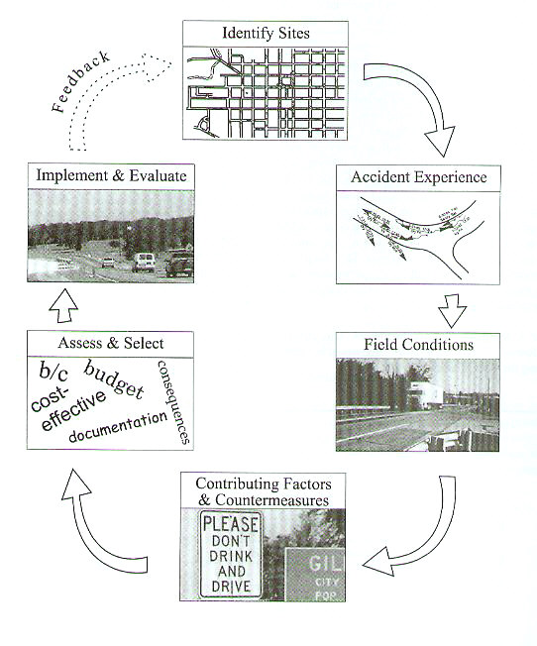
Six-Step Intersection Safety Process
Identify sites with potential safety problems
Characterize the crash experience
Examine field conditions
Identify contributing factors
Assess and select countermeasures
Implement countermeasures and evaluate effectiveness
Source: NCHRP 440
Notes:
Key Message: Introduce the steps that go into a typical process for identifying high crash intersections and determining appropriate countermeasures
Suggested Comments:
Process and chart come from Chapter 2 of NCHRP 440.
The crash mitigation process is divided into 6 steps as shown in the figure

Slide 26
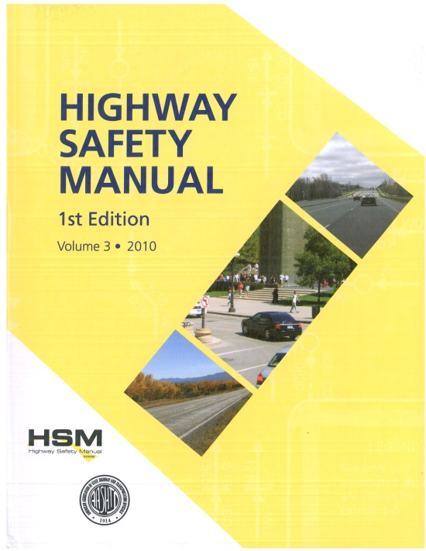
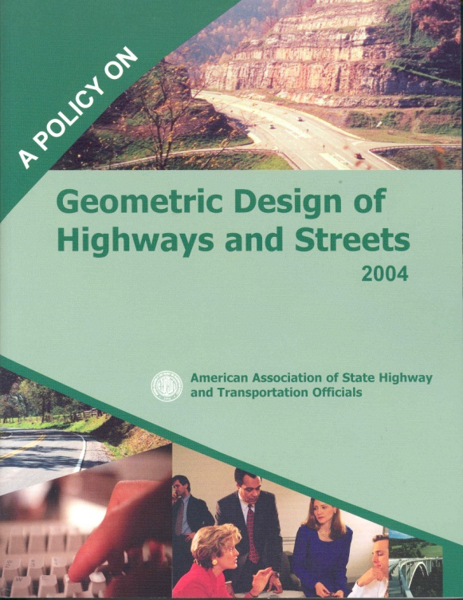
Approaches for Considering Safety
‘nominal safety’ refers to adherence to applicable design criteria and standards
‘substantive safety’ refers to the actual (or predicted) safety performance of a highway or proposed design; also indicates action taken above the standard or nominal requirements
Notes:
Comparison of nominal vs substantive safety. Substantive safety has two definitions:
The actual or predicted crash frequency and severity and
The steps or actions taken which are above the nominal or standard applications of geometric or traffic control device application

Slide 27

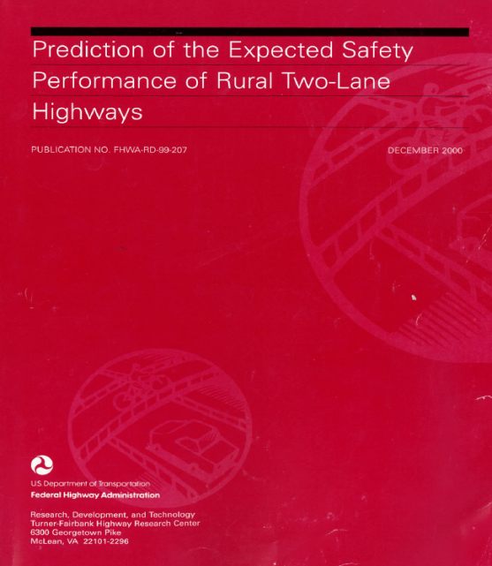
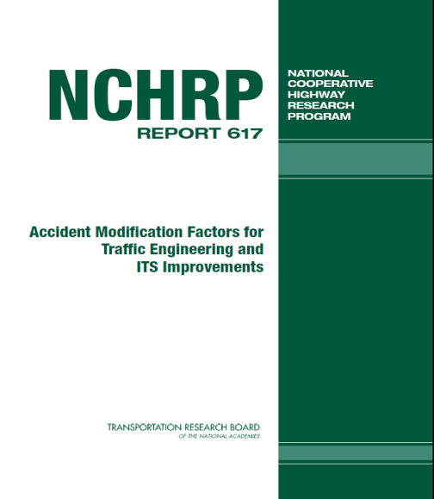
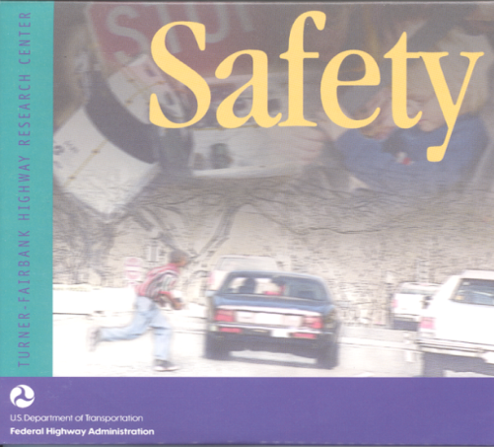
THE HSM CONTAINS BEST
SCIENCE & RESEARCH
Synthesis of previous research
New research commissioned by AASHTO and FHWA
Notes:
There are numerous publications, references and tools (some relatively new, others available) that can be used to address substantive safety.
The purpose for a HSM is to provide the best factual information and tools in a useful form to facilitate roadway planning, design, operations, and maintenance decisions based on explicit consideration of their safety consequences.
The message is that highway engineers need to get familiar with this stuff and understand the implications

Slide 28
Substantive Safety Based on Research
AASHTO Strategic Safety Plan Guidebooks:
http://safety.transportation.org/
Notes:
Major research and analysis of large crash data bases over the past 20 years have quantified the linkage of geometric design features and traffic measures to the frequency of crashes.
The results of these research projects are available to engineers to assist in operational improvements with positive safety benefits.
The 4th component of the FHWA Perspective is the deployment of “Best Practices”
FHWA perspective:
Safety is one of the Vital Few
Intersection Safety is one of the three safety emphasis areas
Focused Approach to the 20 states with the highest fatalities, Illinois is one
Deployment of best practices for intersection safety

Slide 29
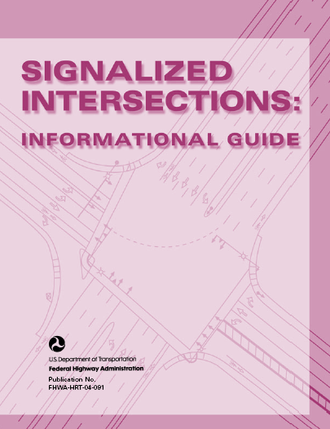
Signalized Intersections:
Informational Guide
Safety Tools
1994 comprehensive document for evaluating safety and operations of signalized intersections
Now Under Contract to Update Spring 2013
Tools to remedy deficiencies
Holistic approach to signalized intersections for all users
Notes:
KEY MESSAGE:
This guide is under contract to be updated. Anticipated early 2013.
It provides a single, comprehensive document with methods for evaluating the safety and operations of signalized intersections and tools to remedy deficiencies. The treatments in this guide range from low-cost measures such as improvements to signal timing and signage, to high-cost measures such as intersection reconstruction or grade separation. While some treatments apply only to higher volume intersections, much of this guide is applicable to signalized intersections of all volume levels.
The guide takes a holistic approach to signalized intersections and considers the safety and operational implications of a particular treatment on all system users (motorists, pedestrians, bicyclists, transit users).
Practitioners will find the tools and information necessary to make insightful intersection assessments and to understand the tradeoffs of potential improvement measures. The information here is based on the latest research available and includes examples of novel treatments as well as best practices in use by jurisdictions across the United States. Additional resources and references are highlighted for the practitioner who wishes to learn more about a particular subject.

Slide 30
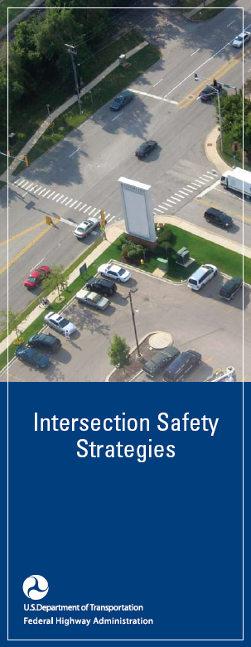
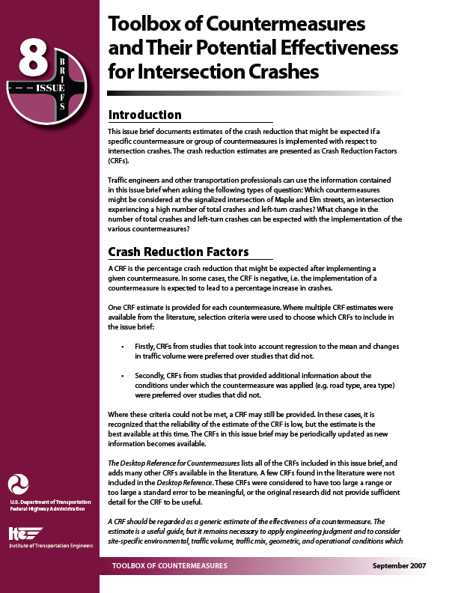
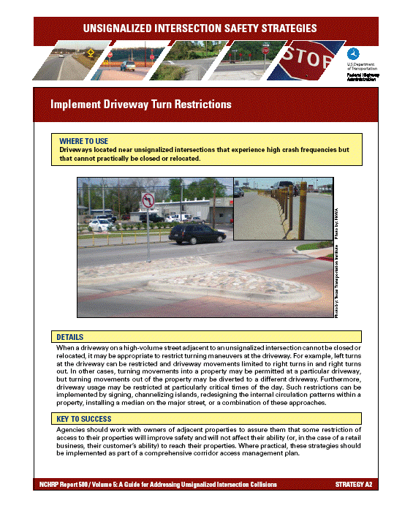
Intersection Safety Guidance
Toolboxes
Guide sheets
Safety Strategies brochure
Notes:
Major Points to Make:
FHWA has numerous resources available to help traffic and transportation engineers analyze intersections from a safety viewpoint.
Web sites will be shown at the end of the presentation.
Many are free to download from the Internet.
Another document that is nearing completion that will help identifying low cost countermeasures is: Low-Cost Countermeasures to Deploy at Stop-Controlled and Signalized Intersections Experiencing Crashes. This document is currently anticipated to be complete and posted on the FHWA Office of Safety web site in the Spring of 2009.
30

Slide 31
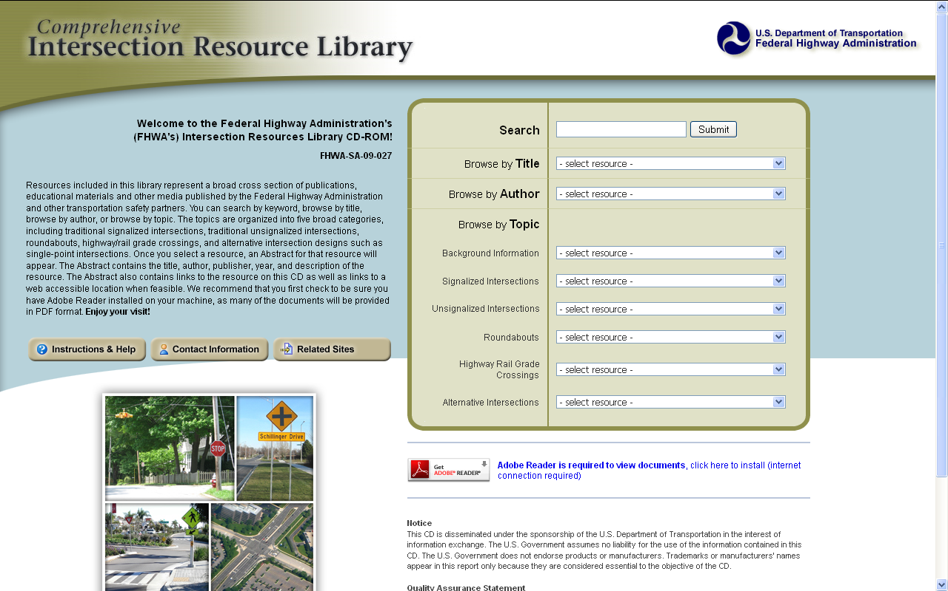
FHWA Intersection Resources Library
http://safety.fhwa.dot.gov/intersection/resources/fhwasa09027/

Slide 32
Tools and Resources
“Low Cost Safety Enhancements for Stop Controlled and Signalized Intersections” FHWA-SA-09-020
Systemic Approach or Focused Approach to Intersection Safety
Signalized | Basic Set $5-30K CRF=40% | Crash Thresholds 20 in 5 yrs urban 10 in 5 yrs rural
Notes:
The Basic Set is about $5-8K with anticipated benefits of CRF=40%
Thresholds are 10 crashes in 5 years urban, 4-5 crashes in 5 years rural

Slide 33
Background: Approaches to saving lives at intersections
Intersection Safety Implementation Plans

Slide 34
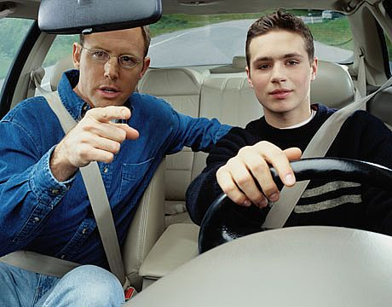
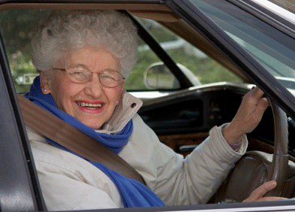
Crash Severity is Random
It just takes a slight change in the driver, vehicle, and roadway to make an injury become a fatality and vice-versa

Slide 35
What makes an intersection crash severe?
Speed
Type of crash
Point of Impact
Type and mass of involved vehicle(s)
Safety belt usage
Type of highway
Weather and surface conditions
Time of day
Type of traffic control
Crash location – urban or rural
Age and health of drivers and occupants
EMS capabilities
Distance to nearest hospital
Other variables

Slide 36
Crash Types are Predictable
A wide, multi-lane urban intersection that has four approaches all of which are State routes will yield a high severe, angle crash exposure.
The first signalized intersection from a limited access freeway or a major bridge crossing will yield high severe turning movement crash exposure.

Slide 37
Our Focused Approach
The Team recommends focusing on the predictable.
From the recent transportation reauthorization bill (MAP-21):
  “The term ‘systemic safety improvement’ means an improvement that is widely implemented based on high risk roadway features that are correlated with particular crash types, rather than crash frequency.”

Slide 38
Approaches to Saving Lives and
Preventing Serious Injuries
Traditional
Systemic
Comprehensive
Policy
Culture

Slide 39
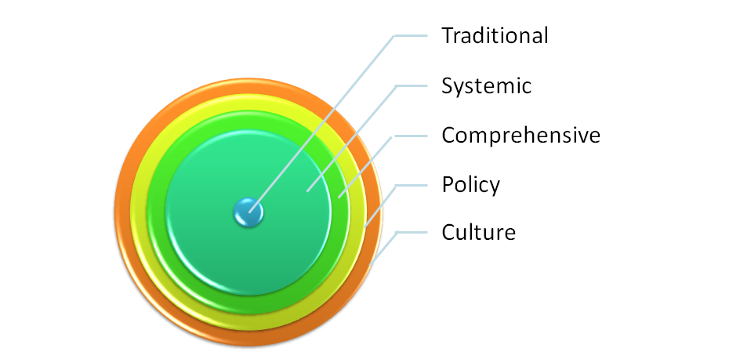
Culture-Based Approach
Family
Neighborhood
Community
Workplace

Slide 40
Policy-Based Approach
Long-term gains through standards
Cements agency’s safety culture to be multi-generational
Progress from project to program to policy
Expands effective strategies to Statewide policy and standards.
Example: One Signal Head Per Lane
  Project: Try it once at a problem intersection
  Program: Add to the ISIP
  Policy: Head-Per-Lane at every new signal

Slide 41
Comprehensive Approach
Coordinated efforts
  Education
  Enforcement
  Engineering

Slide 42
Traditional Approach
Minimal statewide impact
Focuses on High-crash locations
Higher Cost Solutions
  Reconstruction
  Lane additions
Individual intersection analyses required
Relatively few improvement projects (< 50 per year)
Takes longer to impact severe crashes

Slide 43
Systemic Approach
Reverse of the traditional approach
  Start with effective, low-cost countermeasures
  Find intersections with targeted crash types
  Install at numerous intersections
  Not limited to the highest crash intersections
5% of intersections = 20% of the statewide problem
Wider reduction of intersection fatalities and serious injuries

Slide 44
New hampshire’s data analysis
Intersection Safety Implementation Plans

Slide 45
Data Issues
Some crashes were not geocoded (23%)
A manual intersection inventory was developed for fatal and severe injury crashes (severity 1, 2 or 3)
Each intersection was assigned a unique intersection identification number.
The manual intersection inventory was developed prior to receiving the local intersection node database, and therefore included many crashes already assigned to local intersections (using GIS and radial distance).
Notes:
Some crashes were not geocoded, or they were geocoded to the center of the locality where the crash occurred.
A manual intersection inventory was developed for these intersections from the crash data for fatal and severe injury crashes (severity 1, 2 or 3) occurring at or near intersections (location of first harmful event 1 or 2).
Each intersection that experienced one or more crashes in the five-year period fitting these conditions was assigned a unique intersection identification number.
The manual intersection inventory was developed prior to receiving the local intersection node database, and therefore included many crashes already assigned to local intersections (using GIS and radial distance). To eliminate duplication, intersections from the manual inventory were matched with intersections from New Hampshire’s database where both intersections had matching associated crash numbers. By matching the two inventories, some of the crashes that were not geolocated were able to be assigned to an intersection.

Slide 46
General Overview of Intersections in New Hampshire
Year | Intersection Crashes by Severity |  |  |  |  |  |  | Total | KAB Crash Total
 | K | A | B | C | PDO | Unknown | Blank
2006 | 15 | 127 | 1,403 | 505 | 4,874 | 171 | 844 | 7,939 | 1,545
2007 | 16 | 106 | 1,349 | 490 | 5,084 | 147 | 1,277 | 8,469 | 1,474
2008 | 11 | 99 | 1,211 | 474 | 5,262 | 102 | 730 | 7,889 | 1,321
2009 | 12 | 136 | 1,306 | 530 | 5,272 | 112 | 812 | 8,180 | 1,454
2010 | 13 | 116 | 1,202 | 532 | 5,364 | 122 | 465 | 7,814 | 1,331
Total | 67 | 584 | 6,471 | 2,531 | 25,856 | 654 | 4,128 | 40,291 | 7,122

Slide 47
Intersections and Severe Crashes
The total cost of intersection crashes in New Hampshire is estimated to be $3.6 billion over a five-year period or $720 million annually.
Severe intersection crashes accounted for:
  18 % of all intersection or intersection-related crashes
  94 % of the total cost of intersection crashes
  Rural areas accounted for approximately 28 % of the cost.
  Urban areas accounted for approximately 66 % of the cost.

Slide 48
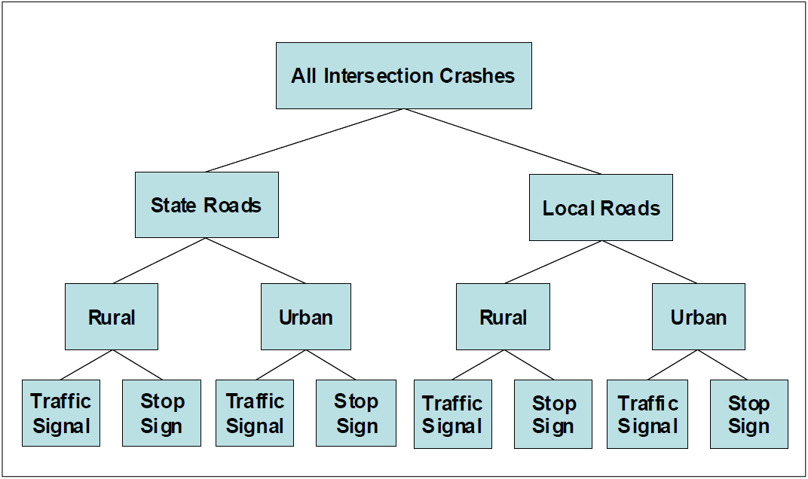
Intersection Types

Slide 49
Intersection Crashes by Traffic Control Device
Area Type | Intersection type | Traffic control | Severe Crashes | Percent | Total Crashes | Percent | Intersections | Percent
Urban | 3 Legs | Signalized | 407 | 7.5% | 2,321 | 8.3% | 208 | 1.5%
 |  | Unsignalized | 1,054 | 19.3% | 5,710 | 20.4% | 3,582 | 26.5%
 | 4 Legs | Signalized | 931 | 17.1% | 5,030 | 18.0% | 281 | 2.1%
 |  | Unsignalized | 668 | 12.2% | 3,076 | 11.0% | 609 | 4.5%
 | Multi-Leg | Signalized | 37 | 0.7% | 302 | 1.1% | 18 | 0.1%
 |  | Unsignalized | 20 | 0.4% | 116 | 0.4% | 14 | 0.1%
Rural | 3 Legs | Signalized | 27 | 0.5% | 165 | 0.6% | 28 | 0.2%
 |  | Unsignalized | 430 | 7.9% | 2,067 | 7.4% | 4,796 | 35.5%
 | 4 Legs | Signalized | 53 | 1.0% | 402 | 1.4% | 31 | 0.2%
 |  | Unsignalized | 268 | 4.9% | 1,104 | 3.9% | 741 | 5.5%
 | Multi-Leg | Signalized | 2 | 0.0% | 33 | 0.1% | 1 | 0.0%
 |  | Unsignalized | 8 | 0.1% | 33 | 0.1% | 10 | 0.1%
Undefined | Undefined | Signalized | 364 | 6.7% | 1,750 | 6.2% | 294 | 2.2%
 |  | Unsignalized | 1,192 | 21.8% | 5,912 | 21.1% | 2,910 | 21.5%
Total |  |  | 5,458 | 100% | 28,021 | 100% | 13,523 | 100%
^{[1]} Severe crashes result in an occupant injury condition of 1, 2, or 3 as defined by the New Hampshire crash report form.
^{[2]} For locally-maintain intersections, the area type and intersection type were unavailable for analysis. Also, the total number of intersections is for only intersections that had at least one crash in the five-year period.

Slide 50
Intersection Types Selected
Analyzing the top ten percent of severe crash intersections reveals the top intersection types as follows:
  All URBAN intersections, excluding unsignalized 3-leg intersections.
  All SIGNALIZED intersections (rural, urban, and unspecified).
These intersections comprise 1,336 intersections, or 18% of all the intersections analyzed, and combine for over 2,500 severe crashes or 45% of the total severe intersection crashes.

Slide 51
Approaches to Saving Lives and
Preventing Serious Injuries

Slide 52
Key Systemic Countermeasures
Stop-Controlled Intersections
  Basic set of sign and marking improvements
  Improve sight distance for speed limits
Signalized Intersections
  Basic set of sign and marking improvements
  Protected-only left turn phases
  Install one signal head per lane
  Retime Traffic Signals including change intervals
Both Stop-Controlled and Signalized Intersections
  Access management of high volume driveways within 50-100 feet
  Delineate or remove fixed objects at intersections

Slide 53
Key Systemic Countermeasures
It is estimated that these countermeasures will cost $16.8M and prevent 1,879 fatalities and serious injuries over a five year period.
Using a severity relationship, implementing these systemic measure would save:
  28 lives
  740 incapacitating injuries
  1110 non-incapacitating injuries
The benefit to cost ratio would be approximately 30:1
Key countermeasures are demonstrated to be some of the most cost effective countermeasures to implement and are identified by New Hampshire DOT for widespread use

Slide 54
Other Recommended Treatments
Install advanced signal ahead warning sign
Install Flashing Yellow Left Turn Arrow
3-E area-wide intersection safety initiatives
Advanced intersection warning signs with speed advisory plate

Slide 55
Signalized intersections
Intersection Safety Implementation Plans

Slide 56
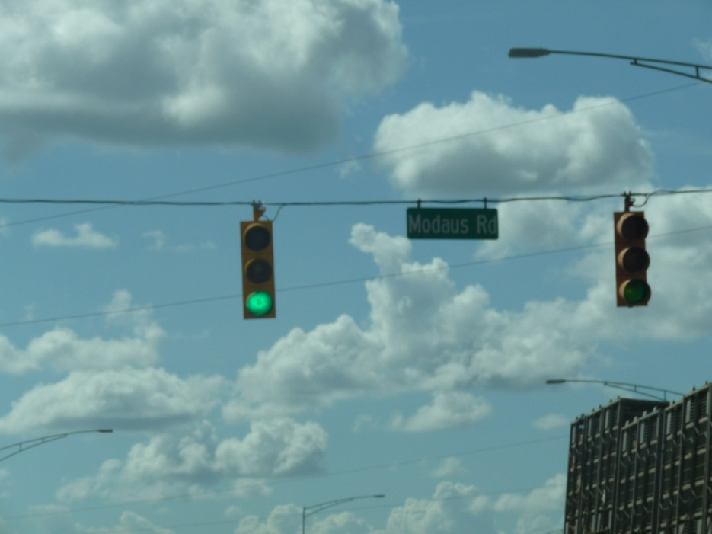
Basic Set of Traffic Signal Countermeasures:
12” LED lenses
Add Back Plates
One Signal Head per lane
Update Yellow Clearance timing
Add All-Red Clearance phase
Change Late Night Yellow/Red Flash to Full Time Signal
Notes:
Basic set of countermeasures recommended by the Focus Approach to Safety to have the greater benefit to cost ratios. Benefits to design ops, and safety.

Slide 57
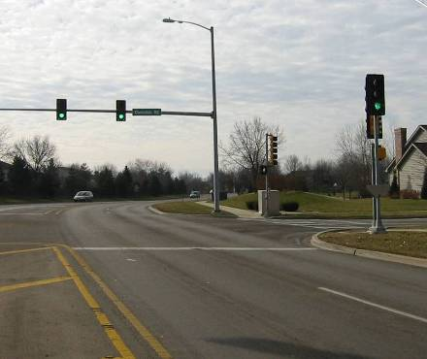
12” LED Signal Indications
Increasing indications from 8” to 12”
CRF = 11% total crashes
CRF = 46% right angle crashes
*NCHRP 500, Strategy 17.2 D2: Improve Visibility of Signals
Notes:
Improving visibility of signals by use 12” lens and additional heads reduces related crashes by 24% for 38 locations and 47% for right angle crashes, by Polanis (1998) per Signalized Intersections Guidebook, 2004, Table 96
Winston Salem NC data for 8” to 12” heads; Polanis SF (1998) “Do 12“ Signal Lenses Reduce Angle Crashes?”, ITE Annual Meeting,
Compendium of Papers CD-ROM, Toronto, Ontario. Polanis SF (2002) “Right-angle Crashes and Late-night/Early-morning Flashing
Operation: 19 Case Studies”, ITE Journal, Institute of Transportation Engineers, Washington, DC, pp.26-28.
Bonneson, August 2002, Engineering Countermeasures to Reduce Red-Light-Running, Report 4027-2, reports 33 to 47% CRF in Table 6-2, page 6-7.
ITE/FHWA Toolbox of Countermeasures Briefing Sheet #8

Slide 58
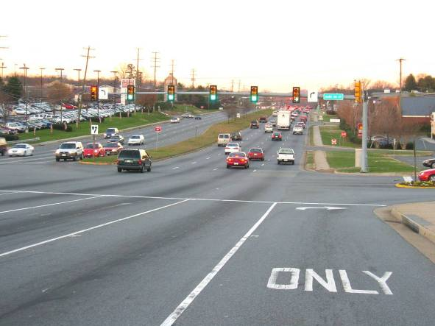
One Signal Head per Lane
1 head for 1 Rt lane
1 head for 1 Lt lane
4 heads for 4 lanes
CRF = 7% total crashes
CRF = 46% right angle crashes
NCHRP 500, Strategy 17.2
D2: Improve Visibility of Signals
Notes:
Animated slide showing how the number of heads equals the number of lanes

Slide 59
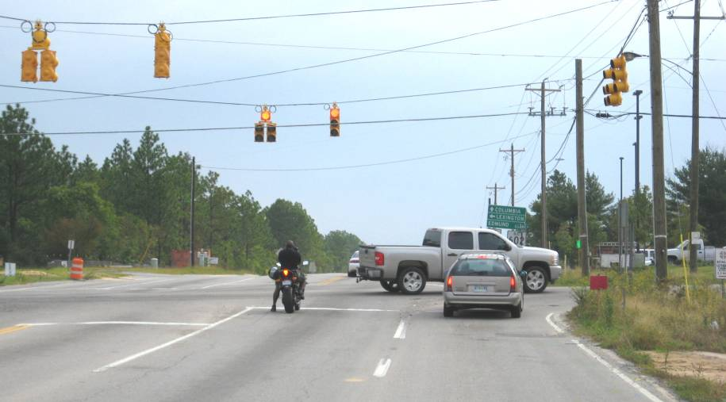
One Signal Head per Lane
1
2
3 -
# of lanes
Notes:
Photo is from Charlottesville, VA.
The animation here shows that even though two faces were provided and met requirements, adding a head over the outside lane is recommended.

Slide 60
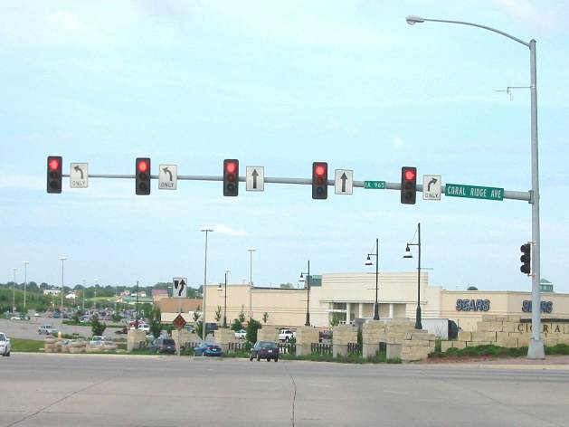
One Signal Head per Lane, and Back Plates

Slide 61
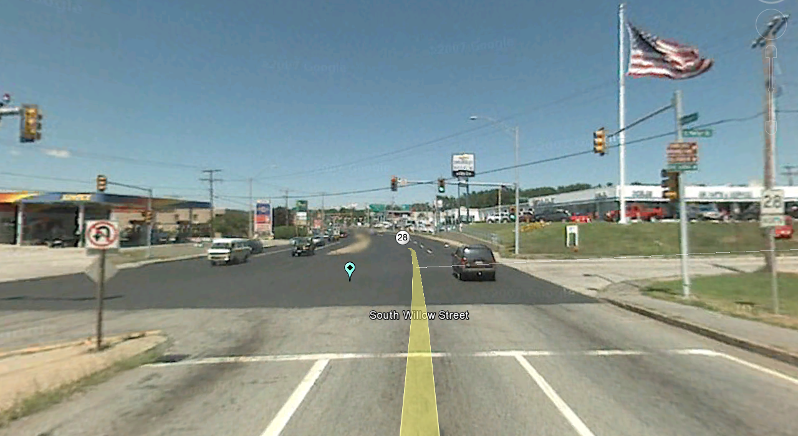
Install Additional Signal Heads per Approach
Manchester, NH
139 Intersections @ $10k = $1.39M yields 184 KABs

Slide 62
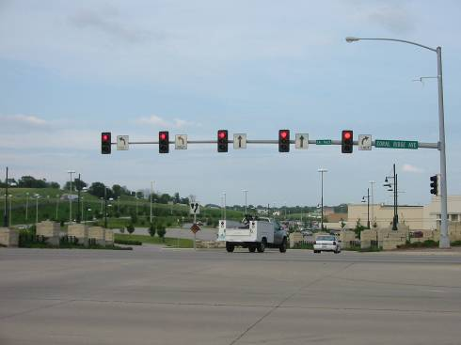
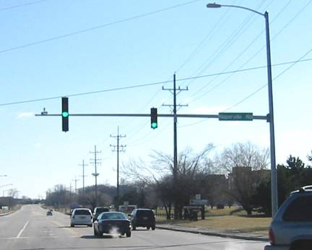
Add Back Plates
CRF = 13% total crashes
CRF = 50% right angle crashes
Back Plates
No Back Plates
Notes:
Briefing Sheet#8
Bonneson reported a 25% reduction in RLR attributable to use of back plates and an associated reduction of 32 percent in related crashes.
Please keep in mind that the relationship between crash rate and the rate of RLR on an intersection approach has been documented; that a 50% decrease in RLR frequency yield a 25% decrease in crashes. A 100% increase in RLR yields a 30% increase in related crashes.
Bonneson, TTI reported a 50% reduction in RLR by use of back plates and an associated reduction of 32 percent in related crashes.
Winston-Salem NC reports 53% reduction
Bonneson, August 2002, ‘Engineering Countermeasures to Reduce Red-Light Running, Table 6-2, page 6-7

Slide 63
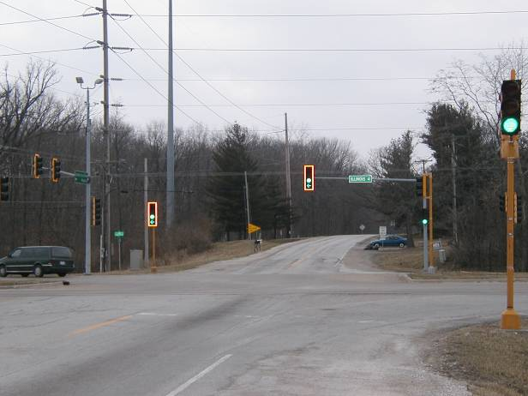
Add Back Plates (shown w/ reflectorized borders)
Notes:
From Briefing Sheet #8, Table 1
Canadian Study
Phase 1: New Signal Design
Phase 1of this project was to field test and review a new signal design consisting of 3 - 300mm signal lenses and a backboard with an additional 75mm reflective border. The objective was to determine if the new signal design caused a reduction in driver’s reaction times, resulting in a reduction in traffic accidents at signalized intersections. The new signal design is expected to be effective in reducing rear-end accidents and, to a lesser degree, right angle and other miscellaneous intersection accident types. Ten intersections on major highway corridors in Burnaby, Maple Ridge, and Saanich were selected as test sites. The installation of the new traffic signals was completed on April 1, 1994. A safety performance evaluation of the effectiveness of the new signals was completed in 1996 and again in 1997. The results of Phase 1 of this project are as follows:
⬥ A simple before and after analysis of safety performance was completed for the test sites. The results of this analysis indicated a 32% reduction in total accidents and a 21% reduction in severe accidents (injury and fatal).
A more detailed subsequent safety study which utilized the empirical bayes analysis technique, resulted in a reduction of 24% in the total number of accidents at the test sites and a 16% reduction in injury and fatal accidents.
Details of this study have been published at the 77th Annual Meeting of the TRB (Jan 11th – 15th, 1998), Paper No. 980206, authored by Sayed et al..
⬥ The results of this study contributed to the new standard signal design in BC, consisting of 3 - 300 mm lenses, rather than the 300 - 200 -200 mm design, used previous to this study.

Slide 64
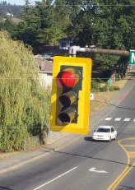
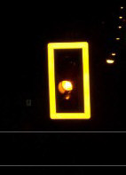
Add Back Plates shown w/ reflectorized borders
Notes:
See Table 102 from 2004 Signalized Intersection Handbook
Bonneson reported a 25% reduction in RLR attributable to use of back plates and an associated reduction of 32 percent in related crashes.
Canadian Study
Phase 1: New Signal Design
Phase 1of this project was to field test and review a new signal design consisting of 3 - 300mm signal lenses and a backboard with an additional 75mm reflective border. The objective was to determine if the new signal design caused a reduction in driver’s reaction times, resulting in a reduction in traffic accidents at signalized intersections. The new signal design is expected to be effective in reducing rear-end accidents and, to a lesser degree, right angle and other miscellaneous intersection accident types. Ten intersections on major highway corridors in Burnaby, Maple Ridge, and Saanich were selected as test sites. The installation of the new traffic signals was completed on April 1, 1994. A safety performance evaluation of the effectiveness of the new signals was completed in 1996 and again in 1997. The results of Phase 1 of this project are as follows:
⬥ A simple before and after analysis of safety performance was completed for the test sites. The results of this analysis indicated a 32% reduction in total accidents and a 21% reduction in severe accidents (injury and fatal).
A more detailed subsequent safety study which utilized the empirical bayes analysis technique, resulted in a reduction of 24% in the total number of accidents at the test sites and a 16% reduction in injury and fatal accidents.
Details of this study have been published at the 77th Annual Meeting of the TRB (Jan 11th – 15th, 1998), Paper No. 980206, authored by Sayed et al..
⬥ The results of this study contributed to the new standard signal design in BC, consisting of 3 - 300 mm lenses, rather than the 300 - 200 -200 mm design, used previous to this study.

Slide 65
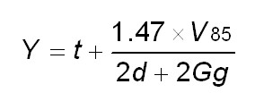
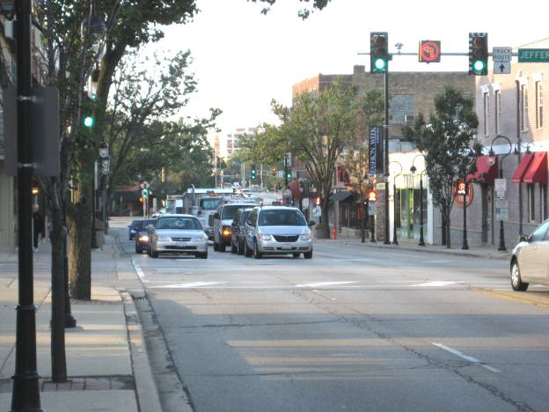
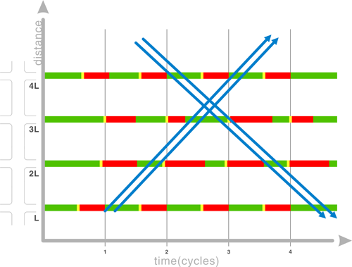
Re-Time traffic signals
Y = yellow duration in seconds
T = reaction time = 1s
V₈₅ = 85th percentile speed in mi/h
d = deceleration = 10 ft/s²
G = grade in ft/ft
g = acceleration due to gravity = 32.2 ft/s²

Slide 66
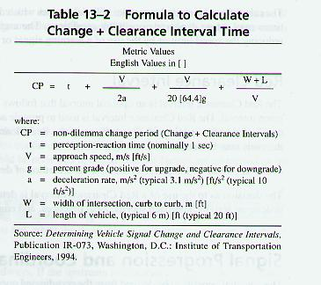
Update Yellow Clearance Interval
NY study: 9% decrease in multi-vehicle crashes
CRF = 8% total crashes
CRF = 12% injury crashes
CRF = 39% ped crashes
Yellow Time
All-Red Time
*NCHRP 500, Objective 17.2 A2 – Optimize Clearance Intervals
Notes:
From the ITE Traffic Engineering Handbook, 5th Edition, the recommended practice for timing of yellow clearance interval and the all-red change interval.
Strategy 17.2 A2: Optimize Clearance Intervals (P)
General Description
The clearance interval is the portion of a signal cycle between the end of a green phase and the beginning of the next green phase for a conflicting movement. Clearance times provide safe, orderly transitions in ROW assignment between conflicting streams of traffic. The clearance interval can include both yellow and all-red time between conflicting green phases.
There is no standardized method for determining clearance intervals. Clearance intervals are a function of operating speed, the width of the intersection area, lengths of vehicles, and driver operational parameters such as reaction, braking, and decision-making time. ITE has developed an equation for determining the length of the yellow change interval. Many agencies use rule-of-thumb methods as well. See Appendix 2 for more information on establishing clearance intervals.
Clearance intervals that are too short in duration can contribute to rear-end crashes related to drivers stopping abruptly and right-angle crashes resulting from signal violations. One study showed clearance intervals shorter than those calculated using the ITE equation have higher rear-end and right-angle crash rates than intersections with timings that exceed the ITE value (Zador et al., 1985). In the extreme, a too-short interval can result in drivers operating at the legal speed limit being forced to violate the red phase. A study by Retting et al. (2000) noted that signal intervals that are considered too short are associated with vehicle conflicts and red-light running.
Increasing clearance intervals may improve safety at signalized intersections where the
existing yellow (or yellow plus red) change intervals do not allow drivers adequate time to react to the reassignment of ROW. Longer clearance intervals may also be effective at
intersections with significant physical size, to allow drivers to clear the intersection before
the opposing traffic enters. See Appendix 2 for more information on establishing clearance intervals. A detailed discussion on yellow and all-red intervals is provided in Making Intersections Safer: A Toolbox of Engineering Countermeasures to Reduce Red-Light Running (McGee, 2003; available online at http://www.ite.org/library/redlight/MakingInt_
Safer.pdf).
This strategy is proven effective in reducing multi vehicle crashes at signalized
intersections. A study of signalized intersections in one city in New York found a
9-percent reduction in multivehicle and a 12-percent reduction in injury crashes at
intersections where the duration of the change intervals was lengthened to meet ITE
recommendations. The crash risk for rear-end and angle crashes did not change
significantly. The same study showed a 37-percent reduction in crashes involving
pedestrians or bicyclists. The authors explained that pedestrian- and bicycle-related
crashes may be more affected by changes in clearance interval timing because many
pedestrians and bicyclists will enter the intersection during the change interval before
they are given a walk signal. (Retting et al., 2000).
The 2009 MUTCD Standard is:
Section 4D.26 Yellow Change and Red Clearance Intervals
Standard:
A steady yellow signal indication shall be displayed following every CIRCULAR
GREEN or GREEN ARROW signal indication and following every flashing YELLOW ARROW or flashing RED ARROW signal indication displayed as a part of a steady mode operation. (Paragraph 01)
The Manual provides guidance on ranges of times for intervals but states as a requirement that “engineering practices” be used to determine the times (Section 4D.26, paragraphs 03, 06, 14.

Slide 67
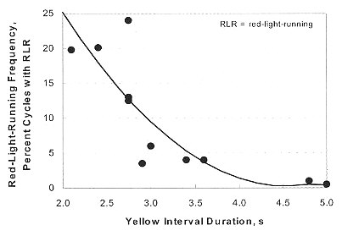
Update Yellow Clearance Interval
CRF = 15% total crashes
CRF = 30% right angle crashes
*TTI, Bonneson, 2003
*NCHRP 500, Objective 17.2 A2 – Optimize Clearance Intervals
Notes:
Increasing the yellow interval duration was reported by Bonneson to reduce RLR frequency by 50 to 70%.

Slide 68
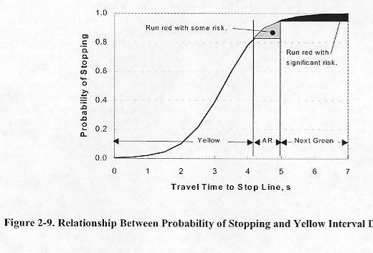
Update Yellow Clearance Interval
reduces RLR frequency by 50-70%
CMF = 0.92 Total Crashes
CMF = 0.96 Right Angle Crashes
CMF = 0.63 Ped/Cyclist Crashes
*TTI, Bonneson, 2003
Notes:
Bonneson found that the typical intersection approach experiences from 3.0 to 5.0 red-light-runners per 1000 vehicles and 1.0 red-light-runners per 10,000 vehicle-cycles where cycles represents the average number of cycles per hour. Increasing the yellow interval duration was reported by Bonneson to reduce RLR frequency by 50 to 70%.
Research Digest 299 Retting, Chapline & Williams 2002 study of 40 treatment intersections and 56 control intersections in Nassau and Suffolk County NY
ITE/FHWA Toolbox of Countermeasures, 2004, Briefing Sheet #8, Ref#1, 9,10
NCHRP 500 Vol 12, Strategy 17.2 A2: Optimized Clearance Intervals (P)
Clearance intervals that are too short in duration can contribute to rear-end crashes related
to drivers stopping abruptly and right-angle crashes resulting from signal violations. One
study showed clearance intervals shorter than those calculated using the ITE equation have
higher rear-end and right-angle crash rates than intersections with timings that exceed the
ITE value (Zador et al., 1985). In the extreme, a too-short interval can result in drivers
operating at the legal speed limit being forced to violate the red phase. A study by Retting
et al. (2000) noted that signal intervals that are considered too short are associated with
vehicle conflicts and red-light running.
C = annual crash frequency (right-angle + left-turn-related) for an intersection approach = 0.00278 ADT^{0.614} RLR^{0.387}

Slide 69
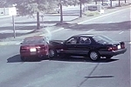
Add All-Red Clearance Interval
ITE Traffic Engineering Handbook – All-Red Clearance Interval
All red = ( W + L) / V
Example: 85th speed=45mph, W=36, curb radius=50’, L=20’
All-Red Time
= (W+L)/V = (50 + 36 + 20)/45*88/60
= 106/66 = 1.61seconds
Notes:
Example of calculation of all-red interval for a main road of 85th percentile speed of 45 mph with 50 foot curb radius (radius is distance of near edge of intersecting roadway back to stop bar, width of the intersected minor road of 35 foot collector street and for a passenger car of 20 feet in length.
Alternate forms of this equation for all-red are:
R= (W + L)/V R= P/V R=(P+L)/v
r = red clearance interval (sec)
w = intersection width (near-side stop bar to far edge of farthest lane)
P = intersection width (near-side stop bar to far edge of farthest crosswalk)
L = length of vehicle (ft)
v = speed of vehicle through the intersection (ft/sec)
Bhesania 1991 for addition of 1.0 seconds of all-red to five signals in Kansas City Missouri reported CMF of 0.75 or CRF of 25% in combination with replacing post mounted signals with mast arm signals
Souleyrette, O’Brien, McDonald, Preston, and Storm report in MN/RC-2004-25 dated May 2004 studied low speed urban 4 approach signalized intersections in the City of Minneapolis that all-red phase does not have a lasting safety effect; only short term. This research evaluates the safety effect of all-red clearance intervals at low speed urban 4 way intersections in the City of Minneapolis. The study includes a review of literature and assessment of Midwestern state and local practice related to the use of all-red phasing. A cross-section analysis using four years of data is presented, which does not substantiate any safety benefit of all-red phasing at study area intersections. Several regression models (generalized linear mixed models with Poisson error distribution and log link function and linear mixed models with transformed data) are also presented. The models also point to no safety benefit. A before and after analysis using 11 years of data was conducted to evaluate both short and long term effects. While results indicate short-term reductions in crash rates (approximately one year after the implementation), long-term reductions are not observed.
2006 March ITE Journal – Richard Retting of IIHS - defined RLR as: 1) the crash must have occurred at a traffic signal controlled intersection or interchange, and 2) either a driver was charged by police with failing to stop for a red signal or a driver was coded as having failed to obey a traffic device (presumed to be a signal) and that the driver was going straight at the time of the crash. 2004 data yields 854 fatal crashes with 940 fatalities and 196,00 total crashes and 106,000 injury crashes with 188,000 persons injured.

Slide 70
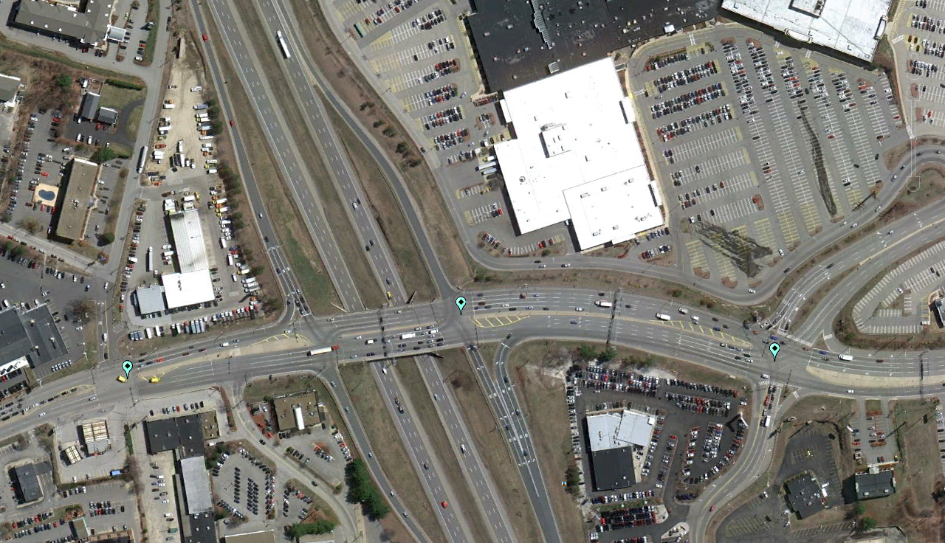
Re-Time traffic signals for better coordination and for proper red and amber clear intervals
Manchester, NH
203 Intersections @ $5k = $1.01M yields 313 KABs

Slide 71
Eliminate Flashing Operation
Change late night flash of “Yellow on mainline/Red on side street” to normal operating traffic signal mode
CRF = 29% Total Crashes
CRF = 75% Right Angle Crashes
*Winston-Salem, NC
Notes:
NOTE: This option is really only feasible where signals are either fully actuated or semi-actuated on the side streets. Pre-timed signals could disturb waiting motorists.
ITE Journal, 1987, Volume 57 reported reduction in crashes for full-time operation vs. flash
ITE Journal, 1995, volume 65 reported results of a Texas study for flashing operation
High Volume Signalized Intersection Handbook

Slide 72
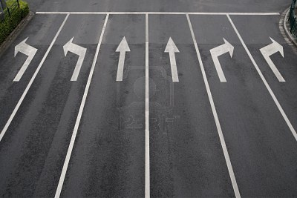
Basic Sign and Marking Improvements
CRF = 30% Total Crashes

Slide 73
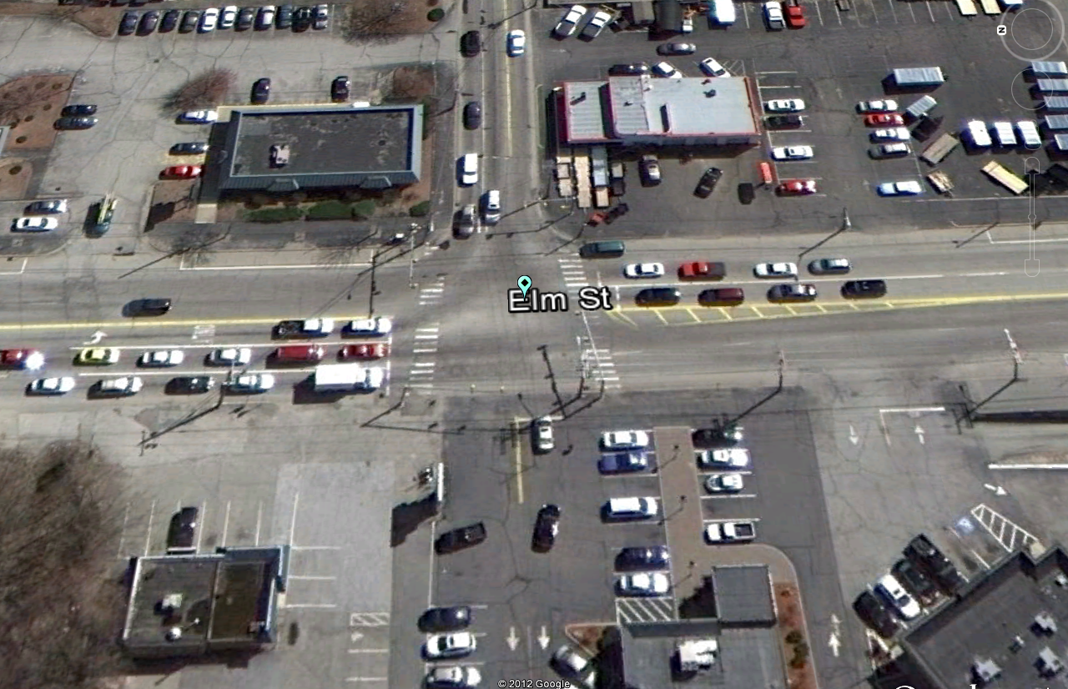
Basic Sign and Marking Improvements
Manchester, NH
193 Intersections @ $5k = $0.96M yields 277 KABs

Slide 74
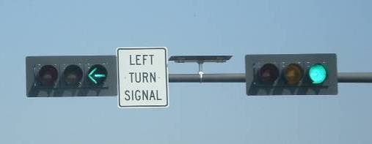
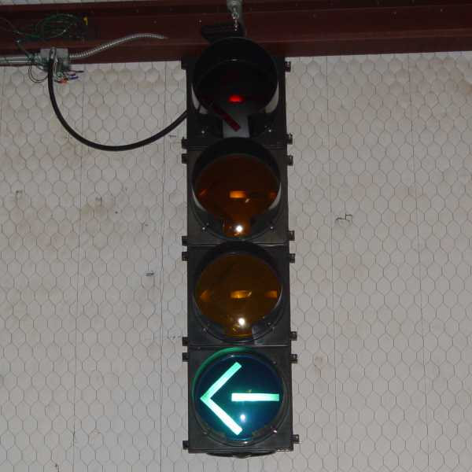
Change of Permitted and Protected Left-Turn Phase to Protected-Only
CRF = 41-48% Left Turn Crashes

Slide 75
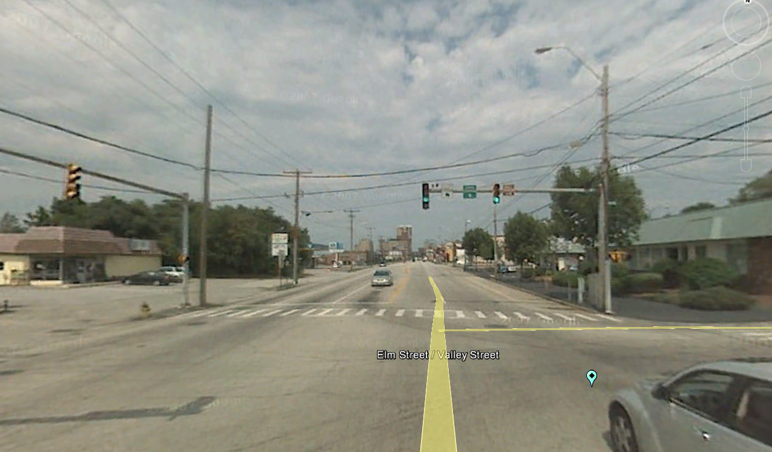
Left Turn Phasing to Protected only
Manchester, NH
525 Intersections @ $2.5k = $1.31M yields 452 KABs

Slide 76
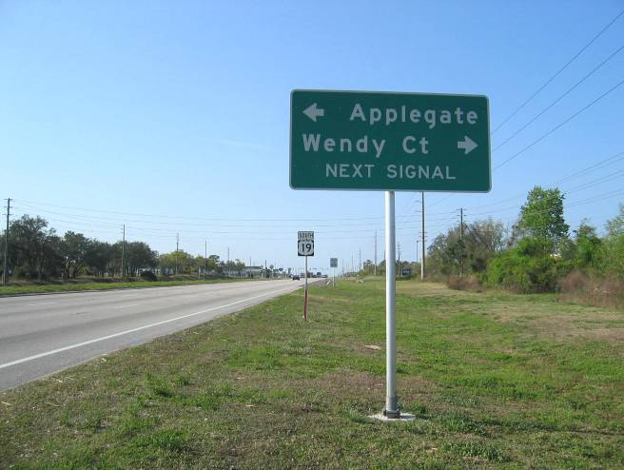
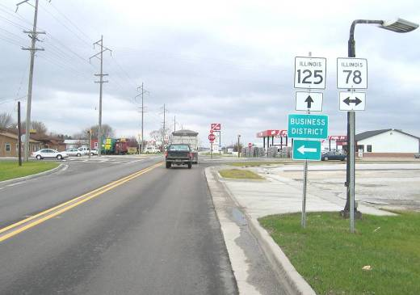
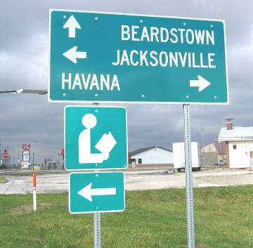
Advanced Cross Street Name Signs
CRF = 1% Total Crashes

Slide 77
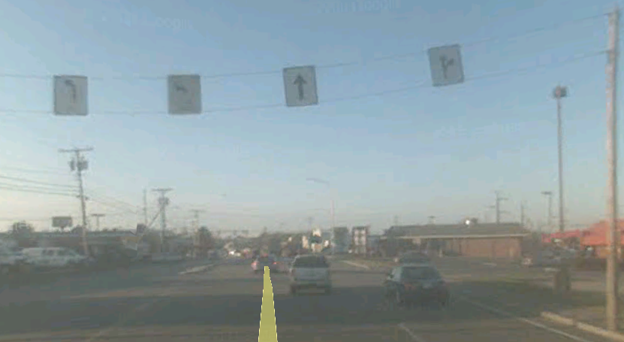
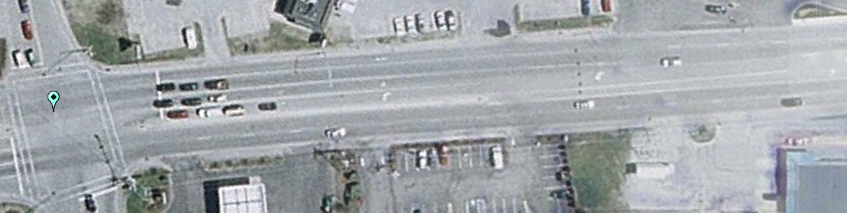
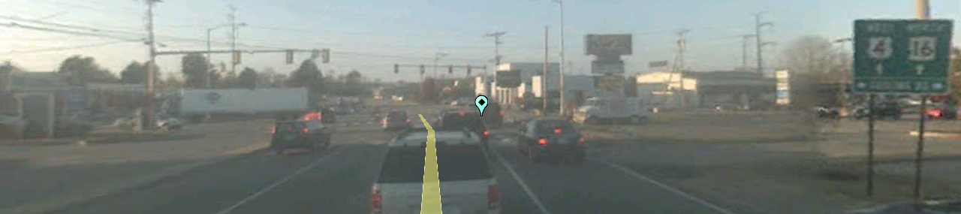
Install Advanced Cross Street Name Signs
Portsmouth, NH
180 Intersections @ $750 = $0.14M yields 9 KABs

Slide 78
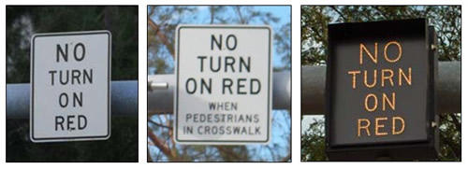

No Turn on Red Signs
CRF = 30% right angle crashes
CRF = 20% rear-end crashes

Slide 79

Install No Turn on Red Signs
Manchester, NH
107 Intersections @ $750 = $0.35M yields 8 KABs

Slide 80


Advance “Signal Ahead” Warning Sign
CRF = 22%

Slide 81


Install advanced signal ahead warning signs
Milford, NH
115 Intersections @ $750 = $0.08M yields 121 KABs

Slide 82

Install Advance Detection Control System
CRF = 40% Severe Crashes

Slide 83

Install Advanced Detection Control Systems
Hooksett, NH
151 Intersections @ $25k = $3.77M yields 238 KABs

Slide 84

Example of Pedestrian Countdown Signal
CRF = 25% Pedestrian Crashes

Slide 85

Install pedestrian countdown signals
Manchester, NH
787 Intersections @ $7.5k = $5.90M yields 8 KABs

Slide 86


Example of enhanced crosswalks
CRF = 15% Pedestrian Crashes

Slide 87

Install enhanced crosswalks
Manchester, NH
787 Intersections @ $2k = $1.57M yields 5 KABs

Slide 88


Example of flashing Yellow Left Turn Arrow
CRF = 25%

Slide 89

Install flashing Yellow Left Turn Arrow
Nashua, NH
508 Intersections @ $2k = $1.02M yields 266 KABs

Slide 90


Example of Enforcement-assisted Lights
CRF = 15%

Slide 91

Install Enforcement-assisted Lights
Manchester, NH
66 Intersections @ $1k = $0.07M yields 15 KABs

Slide 92
Stop controlled intersections
Intersection Safety Implementation Plans

Slide 93

Basic Set of Countermeasures: Stop Controlled
Low-Cost Countermeasures:
Through Approach
  Doubled up (left and right), oversize advance intersection warning signs with street name sign plaques
Stop Approach
  Doubled up (left and right), oversize advance “Stop Ahead” intersection warning signs
  Doubled up (left and right), oversize STOP signs
  Properly placed stop bar
  Double arrow warning sign at stem of T-intersections
  Splitter island
  Removal of any foliage or parking that limits sight distance
Crash reduction factor = 40%
Average cost per site = $5K-$8K
129 Intersections @ $5k = $0.65M yields 165 KABs

Slide 94

Advance Intersection Warning Signs
*NCHRP 500, Objective 17.1 E1 – Improve Visibility of Intersections by providing enhanced signing
Notes:
Application of warning signs for intersections reduces incidence of crashes. Traffic signs were found to reduce fatalities by 39% and nonfatal injuries by 15%.
Missouri HAL manual identifies advance warning signs for intersections with CRF of 30% for urban and 40% for rural intersections
Pak-Poy and Kneebone (1988) quoted a U.S. study which suggested collision reductions of around 20 to 30 percent for other warning signs, such as side-road signs.
New York DOT reports Evaluation Data for Low Cost Accident Countermeasures for all intersection signs for 60 sites with a 33% reduction in right angle crashes, 36% reduction in rear-end/ side swipe, and 32% reduction in head-on crashes.
NCHRP 500 Volume 5: Page V-68 “Advance Warning Signs, such as the standard intersection warning sign, can also alert drivers to the presence of an intersection.”

Slide 95



Advance Intersection Warning Signs

Slide 96

Advance Intersection Warning Signs
“Double-Up” or “Gate-posting”
Notes:
Left Hand side sign of same size added to right hand side sign installation for additional emphasis as a supplementary sign, example is from IL 394 south of I-80
Winston-Salem NC reports a 31% decrease in crashes when double up on warning signs and right of way controls

Slide 97


Advance Intersection Warning Signs with speed advisory plates
Londonderry, NH
490 Intersections @ $750 = $0.04M yields 34 KABs

Slide 98

Stop Ahead Pavement Marking

Slide 99


"Stop Ahead" markings and warning signs
Peterborough, NH
Need Stop Ahead Marking
431 Intersections @ $1.5k = $0.65M yields 85 KABs

Slide 100

Properly Placed Stop Bars
Notes:
NCHRP 440, page 77-79, Sight Obstructions, from Table 48

Slide 101

Enhanced Advance Stop Ahead Warning Signing for Right-of Way Controls
Doubled-Up Stop Aheads
Notes:
Staggered placement of doubled up stop Aheads; Left Hand side sign of same size added to right hand side sign installation for additional emphasis as a supplementary sign
Photo is north approach of county hwy 11 at IL route 125 west of Virginia, IL

Slide 102

Double-Up Stop Signs
Stop signs – Left and Right Hand Side of Two-Lane Road
Notes:
Doubled Up Stop signs with the left hand sign larger than the right hand side stop sign to increase conspicuity
Photo is IL 47 at IL 136 in Champaign, Illinois
CRF of 11%

Slide 103

Double arrow warning

Slide 104


Flushed or Raised Median

Slide 105

Intersection Median Control

Slide 106

Intersection Median Control
Hampton, NH

Slide 107



Sight Distance Improvements – Vegetation etc.
Move Stop Bar Forward

Slide 108


Improve Sight Distance
And/or Parking Interference with Sight Distance
Improve Intersection Sight Distance…

Slide 109

Sight Distance Improvements – Vegetation etc.
Derry, NH
490 Intersections @ $5k = $2.45M yields 323 KABs

Slide 110

Sight Distance Improvements – Parked Vehicles

Slide 111

Sight Distance Improvements – Parked Vehicles
Manchester, NH

Slide 112

Enhanced sign and marking improvements
Somersworth, NH
129 Intersections @ $5k = $0.65M yields 165 KABs

Slide 113



"Stop Ahead" markings, warning signs and transverse rumble strips

Slide 114
Transverse rumble strips
Peterborough, NH
One set even with Stop Ahead
10 Intersections @ $2k = $0.02M yields 16 KABs

Slide 115
Extension of the Through Edge Line
Using Short Skip Pattern

Slide 116

Extension of through edge line
Exter, NH
41 Intersections @ $750 = $0.03M yields 1 KAB

Slide 117

Overhead Flashing Intersection Beacon

Slide 118

Overhead Flashing Intersection Beacon
Manchester, NH
24Intersections @ $10k = $0.02M yields 15 KABs

Slide 119

Reflective Stripes on Sign Posts

Slide 120

Reflective Stripes on Sign Posts
Manchester, NH
133 Intersections @ $500 = $0.07M yields 4 KABs

Slide 121
ALL intersections
Intersection Safety Implementation Plans

Slide 122


  Access management of high volume driveways within 50-100 feet
CRF = 7%

Slide 123

  Access management of high volume driveways within 50-100 feet
Manchester, NH
561 Intersections @ $7.5k = $4.21M yields 72 KABs

Slide 124

  Delineate or remove fixed objects at intersections
CRF = 5%
975 Intersections @ $5k = $4.88M yields 89 KABs

Slide 125

Intersection Lighting
CRF = 50% of night crashes
12 Intersections @ $5k = $0.06M yields 17 KABs

Slide 126

Skid-Resistant / High Friction Pavement
201 Intersections @ $40k = $8.04M yields 352 KABs

Slide 127

Lane Narrowing with Pavement Markings and Rumble Strips
21 Intersections @ $3k = $0.06M yields 13 KABs

Slide 128

Module ii: the strawman putting it all together
Intersection Safety Implementation Plans

Slide 129
Choosing Thresholds for Cost Effectiveness
Improvements deployed on a systemic basis have to be cost effective
The overall B/C ratio for low-cost intersection countermeasures with widespread deployment and a moderate crash history usually exceeds 10.

Slide 130
Choosing Thresholds for Cost Effectiveness
Install advanced signal ahead warning sign
Formula
T = (Annual Cost × B/C) / (CRF × Average Crash Cost)
Where T = Threshold
Annual Cost = $62 ($750 averaged over 12 years)
B/C = 10.0
CRF = 0.22
Average Crash Cost = $271,000 (estimated from the distribution of fatalities, and serious injuries).
Result
T= (62 × 10.0) / (0.22 × 271,000) = 1 severe crash

Slide 131
Developing a Hierarchy of Countermeasures
All Intersections
Signalized Intersections
Unsignalized Intersections

Slide 132
The Strawman
Countermeasure | Widespread | Limited | None |  |  |  |  |  |  |  |  |  |  |  |  |  |  |  |  |  |  |  |  |  |  | EstimatedKAB per 100 Crashes | Estimated Severe CRF | Estimated KABs Prevented | KAB Cost Savings over 5 years | Approx. Benefit Cost Ratio
 |  |  |  | Crash Reduction Factor |  | Selected (Typical) Crash Threshold |  | Total Number of Intersections |  |  |  |  |  |  |  |  | Approximate Number of Intersections with Threshold Applied | Deployment Level | Total Targeted Crashes | Estimated Number of Improvements | Construction Unit Cost | Life Cycle Costs |  | Interest Rate | Total
 |  |  |  |  |  |  |  | Urban |  |  |  |  | Rural |  |  | UNK
 |  |  |  | Estimate | Crash Type | Urban | Rural | 3 Leg Signal | 4 Leg Signal | 5 Leg Signal | 4 Leg Stop | 5 Leg Stop | 3 Leg Signal | 4 Leg Signal | 5 Leg Signal | Signal
Systemic
All intersections
Intersection Lighting |  | X |  | 50; 25 | Night (new inst.); night (upgrade) | 1.25 (10) night crashes in 5 years and a night /total crash ratio above the statewide average for urban unlit intersections | 1 (5) night crashes in 5 years and a night/total crash ratio above the statewide average for rural unlit intersections | 199 | 280 | 17 | 480 | 10 | 24 | 31 | 1 | 294 | 52 | 24% | 154 | 12 | $ 5,000 | 20 |  | 2% | $ 62,400 | 22 | 50 | 17 | $ 4,585,320 | 240
Skid resistant /high friction surface treatment |  | X |  | 50 | Wet pavement | 4 (8) wet pavement crashes in 5 years, a wet /total crash ratio above the statewide average wet/total crashes for intersections | 1.25 (8) wet pavement crashes in 5 years, a wet /total crash ratio above the statewide average wet/total crashes for intersections | 199 | 280 | 17 | 480 | 10 | 24 | 31 | 1 | 294 | 410 | 49% | 3833 | 201 | $ 40,000 | 7 |  | 2% | $ 8,036,000 | 18 | 50 | 352 | $ 95,476,010 | 15
Lane narrowing with pavement markings and rumble strip |  | X |  | 31 | All | 1,25 (10) speed-related crashes in 5 years | 1 (5) speed-related crashes in 5 years | 199 | 280 | 17 | 480 | 10 | 24 | 31 | 1 | 294 | 91 | 23% | 193 | 21 | $ 3,000 | 3 |  | 2% | $ 62,790 | 22 | 31 | 13 | $ 3,593,948 | 33
Access Control – Driveways, | X |  |  | 7 |  | None | None | 199 | 280 | 17 | 480 | 10 | 24 | 31 | 1 | 294 | 1336 | 42% | 5421 | 561 | $ 7,500 | 20 |  | 2% | $ 4,208,400 | 19 | 7 | 72 | $ 19,520,130 | 15
Fixed Objects at Intersection | X |  |  | 5 |  | None | None | 199 | 280 | 17 | 480 | 10 | 24 | 31 | 1 | 294 | 1336 | 73% | 9422 | 975 | $ 5,000 | 20 |  | 2% | $ 4,876,400 | 19 | 5 | 89 | $ 24,234,175 | 16
Parking/Sidewalks/ADA – Urban Areas |  | X |  | 5 |  | None | None | 199 | 280 | 17 | 480 | 10 | 24 | 31 | 1 | 294 | 1336 | 71% | 9164 | 949 | $ 10,000 | 20 |  | 2% | $ 9,485,600 | 19 | 5 | 87 | $ 23,570,225 | 8
Signalized intersections
Basic signal and sign improvement | X |  |  | 30 | All | 20 crashes in 5 years | 10 crashes in 5 years | 199 | 280 | 17 |  |  | 24 | 31 | 1 | 294 | 205 | 94% | 5081 | 193 | $ 5,000 | 12 |  | 2% | $ 963,500 | 18 | 30 | 277 | $ 75,199,248 | 165
Change permitted and protected / permitted left turn phasing to protected only | X |  |  | 41-48 | Left turn | 20 (5) left turn mvmt crashes | 10 (5) left turn mvmt crashes | 199 | 280 | 17 |  |  | 24 | 31 | 1 | 294 | 846 | 62% | 6044 | 525 | $ 2,500 | 20 |  | 2% | $ 1,311,300 | 18 | 41 | 452 | $ 122,409,470 | 305
Install advanced cross street name sign | X |  |  | 1 | All | 20 crashes in 5 years | 10 crashes in 5 years | 199 | 280 | 17 |  |  | 24 | 31 | 1 | 294 | 205 | 88% | 4756 | 180 | $ 750 | 12 |  | 2% | $ 135,300 | 18 | 1 | 9 | $ 2,346,841 | 37
Install No Turn on Red Signs |  | X |  | 43 |  | None | None | 199 | 280 | 17 |  |  | 24 | 31 | 1 | 294 | 846 | 55% | 107 | 465 | $ 750 | 12 |  | 2% | $ 348,975 | 18 | 43 | 8 | $ 2,277,345 | 14
Install advanced signal ahead warning sign |  | X |  | 22 | All | 20 crashes in 5 years | 10 crashes in 5 years | 199 | 280 | 17 |  |  | 24 | 31 | 1 | 294 | 205 | 56% | 3027 | 115 | $ 750 | 12 |  | 2% | $ 86,100 | 18 | 22 | 121 | $ 32,853,005 | 807
Install additional signal head per approach | X |  |  | 28 | All | 20 crashes in 5 years | 10 crashes in 5 years | 199 | 280 | 17 |  |  | 24 | 31 | 1 | 294 | 205 | 68% | 3675 | 139 | $ 10,000 | 20 |  | 2% | $ 1,394,000 | 18 | 28 | 187 | $ 50,772,826 | 119
Install advanced detection control system |  | X |  | 40 | Injury | 2.5 (5) angle crashes in 5 years | 1.25 (5) angle crashes in 5 years | 199 | 280 | 17 |  |  | 24 | 31 | 1 | 294 | 314 | 48% | 2587 | 151 | $ 25,000 | 20 |  | 2% | $ 3,768,000 | 23 | 40 | 238 | $ 64,623,744 | 56
Re-Time traffic signals for better coordination and for proper red and amber clear intervals | X |  |  | 32 | All | 20 crashes in 5 years | 10 crashes in 5 years | 199 | 280 | 17 |  |  | 24 | 31 | 1 | 294 | 205 | 99% | 5351 | 203 | $ 5,000 | 3 |  | 2% | $ 1,014,750 | 18 | 32 | 313 | $ 84,723,706 | 48
Install pedestrian countdown signals with appropriate pedestrian crossing clearance interval | X |  |  | 25 | Pedestrian | 1.25 (2) pedestrian crashes in 5 years | 1.25 (2) pedestrian crashes in 5 years | 199 | 280 | 17 |  |  | 24 | 31 | 1 | 294 | 846 | 93% | 181 | 787 | $ 7,500 | 20 |  | 2% | $ 5,900,850 | 18 | 25 | 8 | $ 2,238,827 | 1.2
Install enhanced crosswalks and advanced pedestrian warning signs | X |  |  | 15 | Pedestrian | 1.25 (2) pedestrian crashes in 5 years | 1.25 (2) pedestrian crashes in 5 years | 199 | 280 | 17 |  |  | 24 | 31 | 1 | 294 | 846 | 93% | 181 | 787 | $ 2,000 | 3 |  | 2% | $ 1,573,560 | 18 | 15 | 5 | $ 1,343,296 | 0.5
Flashing Yellow Left Turn Arrow | X |  |  | 25 |  | None | None | 199 | 280 | 17 |  |  | 24 | 31 | 1 | 294 | 846 | 60% | 5849 | 508 | $ 2,000 | 20 |  | 2% | $ 1,015,200 | 18 | 25 | 266 | $ 72,220,233 | 233
Enforcement-assisted lights |  | X |  | 15 | Angle | 2.5 (8) angle crashes in 5 years | 1.25 (4) angle crashes in 5 years | 199 | 280 | 17 |  |  | 24 | 31 | 1 | 294 | 100 | 66% | 544 | 66 | $ 1,000 | 20 |  | 2% | $ 66,000 | 18 | 15 | 15 | $ 3,979,277 | 197
Stop controlled intersections
Enhanced basic sign (double-up/oversize/retroreflective/Beacon) and pavement marking improvements (stop bars, yield lines, longitudinal markings), as well as optional lane control signs and markings or advance street name signs. | X |  |  | 40 | all | 9 (10) crashes in 5 years | 2 (4-5) crashes in 5 years |  |  |  | 480 | 10 |  |  |  |  | 133 | 97% | 1956 | 129 | $ 5,000 | 3 |  | 2% | $ 645,050 | 21 | 40 | 165 | $ 44,687,900 | 40
Install intersection median control; Install raised divider (6 ft or wider) on stop approach |  | X |  | 15 |  | 18 (20) crashes in 5 years | 4 (10) crashes in 5 years |  |  |  | 480 | 10 |  |  |  |  | 30 | 50% | 393 | 15 | $ 50,000 | 20 |  | 2% | $ 750,000 | 21 | 15 | 12 | $ 3,353,625 | 15
Advanced intersection warning signs with speed advisory plates |  | X |  | 5 |  | None | None |  |  |  | 480 | 10 |  |  |  |  | 490 | 100% | 3159 | 490 | $ 750 | 12 |  | 2% | $ 367,500 | 21 | 5 | 34 | $ 9,119,150 | 52
"Stop Ahead" pavement marking legend; Advanced stop sign warning signs |  | X |  | 15 | All | 1.25 (5) running stop sign crashes in 5 years | 1 (3) running stop sign crashes in 5 years |  |  |  | 480 | 10 |  |  |  |  | 490 | 88% | 2702 | 431 | $ 1,500 | 3 |  | 2% | $ 646,800 | 21 | 15 | 85 | $ 23,148,596 | 21
Overhead flashing intersection beacons; Flashing beacons on advance intersection warning signs and stop signs |  | X |  | 10; 13 | All; angle | 18 (15-20) crashes in 5 years | 4 (8-10) crashes in 5 years |  |  |  | 480 | 10 |  |  |  |  | 30 | 81% | 636 | 24 | $ 10,000 | 12 |  | 2% | $ 243,000 | 23 | 10 | 15 | $ 3,933,992 | 34
Transverse rumble strips |  | X |  | 28 | All | 1.25 (5) running stop sign crashes in 5 years | 1 (3) running stop sign crashes in 5 years |  |  |  | 480 | 10 |  |  |  |  | 30 | 34% | 267 | 10 | $ 2,000 | 5 |  | 2% | $ 20,400 | 21 | 28 | 16 | $ 4,255,274 | 197
Sight distance improvements for posted speed limits | X |  |  | 48 |  | None | None |  |  |  | 480 | 10 |  |  |  |  | 490 | 100% | 3159 | 490 | $ 5,000 | 5 |  | 2% | $ 2,450,000 | 21 | 48 | 323 | $ 87,543,840 | 34
Extension of through edge line along major road using short skip pattern |  | X |  | 1 | All | 9 (10) crashes in 5 years | 2 (5) crashes in 5 years |  |  |  | 480 | 10 |  |  |  |  | 133 | 31% | 625 | 41 | $ 750 | 3 |  | 2% | $ 30,923 | 21 | 1 | 1 | $ 357,020 | 7
Reflective panels on sign posts |  | X |  | 1 | All | 9 (10) crashes in 5 years | 2 (5) crashes in 5 years |  |  |  | 480 | 10 |  |  |  |  | 133 | 100% | 2016 | 133 | $ 500 | 12 |  | 2% | $ 66,500 | 21 | 1 | 4 | $ 1,151,750 | 37

Slide 133
Key Systemic Countermeasures
Stop-Controlled Intersections
  Basic set of sign and marking improvements
  Improve sight distance for speed limits
Signalized Intersections
  Basic set of signal and sign improvement
  Protected-only left turn phases
  Install one signal head per lane
  Retime Traffic Signals including change intervals
Both Stop-Controlled and Signalized Intersections
  Access management of high volume driveways within 50-100 feet
  Delineate or remove fixed objects at intersections

Slide 134
Key Systemic Countermeasures
It is estimated that these countermeasures will cost $16.8M and prevent 1,879 fatalities and serious injuries over a five year period.
Using a severity relationship, implementing these systemic measure would save:
  28 lives
  740 incapacitating injuries
  1110 non-incapacitating injuries
The benefit to cost ratio would be approximately 30:1
Key countermeasures are demonstrated to be some of the most cost effective countermeasures to implement and are identified by New Hampshire DOT for widespread use

Slide 135
Discussion

Slide 136
Implementing the plan
Intersection Safety Implementation Plans

Slide 137
Keys to Success using the Systemic Approach
All stakeholders are involved and support the safety initiative
Obligate adequate funding over a defined period of time
Agree on the set of intersections that need to be considered for low cost countermeasures
  Establish a threshold
  Any intersection above threshold needs to be considered
Establish a base set of signal, sign and marking improvements that can be implemented at these intersections
  Use the base recommended set and determine if any additions or changes

Slide 138

Keys to Success using the Systemic Approach
Make a decision if a higher level of enhancements should be added to basic sign and marking improvements for higher crash stop controlled intersections.

Slide 139
Keys to Success using the Systemic Approach
Determine how improvements are to be made (regional/local multi-intersection contract or local state or local government forces)
Determine data needs for implementation
Develop check list for field review
  Make determination if sign and marking improvements are valid or if alternate improvements should be made
  Check for and identify serious sight distance limitations and brush cutting/tree trimming/other obstruction
  Removal
  Secure inventory of existing signs and marking and needed upgrades –establish spreadsheet to do this
  Identify any other improvements that should be considered

Slide 140
Keys to Success using the Systemic Approach
Identify and train technicians to review intersections and make determinations of the appropriate improvements
Review crash data for each intersection identified make a decision to retain for field review or reject due to wide dispersion of crashes among numerous but close intersections

Slide 141

Keys to Success using the Systemic Approach
Conduct field reviews
Summarize and tabulate field review results
Perform necessary quality reviews of field reviews
Prepare contract documents and let projects

Slide 142
Example of Statewide Systemic Construction Schedule

Slide 143
Systemic Approach for New Hampshire
Decide which Low Cost Countermeasures
  Stop-Controlled Intersections
    Basic set of sign and marking improvements
    Improve sight distance for speed limits
  Signalized Intersections
    Basic set of signal and sign improvement
    Protected-only left turn phases
    Install one signal head per lane
    Retime Traffic Signals including change intervals
  Both Stop-Controlled and Signalized Intersections
    Access management of high volume driveways within 50-100 feet
    Delineate or remove fixed objects at intersections
Decide if a higher level of enhancements should be added to basic improvements.

Slide 144
Module 3: strategic thinking
Intersection Safety Implementation Plans

Slide 145
Overall Direction
Identify top barriers (institutional and technical) that may prevent full implementation of each key countermeasure and discuss potential remedies
Identify resource requirements
Identify key milestones or decisions to successfully implement the countermeasure

Slide 146
Potential Barriers and Remedies
Funding
Improvements at local intersections
New or rarely used countermeasures in the State
Additional barriers?
  List…
Actions to overcome barrier:

Slide 147
Intersection Maintenance Responsibility

Slide 148
Locally Maintained Intersections (70%)

Slide 149
Key Actions to Plan’s Success

Slide 150
Module 4: first steps to deployment
Intersection Safety Implementation Plans

Slide 151
Deploying Key Countermeasures: The Road Ahead
The General Roadmap for Countermeasure Deployment
  Deployment framework
  Countermeasure
    Who’s responsible?
    Key decision(s)
    Who makes the decision?
    Steps to complete
    Estimated timeframe

Slide 152
First Steps: Basic Sign /Marking Improvements
Finalize a package to apply at the intersections (who, when)
Develop criteria for improvements based upon existing conditions at the site
Using photo logs and / conduct field reviews to verify improvements are appropriate; (who, when)
List the specific improvements for each intersection (what, who will perform, when)

Slide 153
First Steps: Basic Sign /Marking Improvements
Determine how the improvements are to be made
  If maintenance,
    What information is needed to install the improvements?
    Prepare requirements to install (who, when)
  If by contract,
    What set of intersections will be included in the contract?
    Prepare a contract package to implement improvements (who, when)
Set performance measures for implementation;
Monitor progress (who, when)
Set performance measures for effectiveness;
  Evaluate the actual crash reduction effectiveness and compare to that estimated in the plan (who, when)

Slide 154
Performance Measures
Implementation progress measurement :
  Output
Goal-oriented measurement:
  Outcome

Slide 155
Types of Performance Measures - Output
Application - Intersections to Apply Countermeasure
  Targeted # Intersections
  Actual # Intersections

Slide 156
Types of Performance Measures – Outcome
Crash Reduction - Type of Crashes to be Reduced
  Estimated Annual Reduction Severe Crashes
  Actual Annual Reduction in Severe Crashes

Slide 157
Module 5: next steps
Intersection Safety Implementation Plans

Slide 158
Finalize Implementation Plan
What organizations need to review the plan?
What are the key steps to finalize and gain acceptance of the plan?

Slide 159
Next Steps
Develop draft plan
Identify offices that must approve plan
Finalize plan
Obtain approvals
Implement the plan
Is anything missing?

Slide 160
Questions
Intersection Safety Implementation Plans
Mr. Tim Taylor, P.E.
Safety Engineer | FHWA
Timothy.Taylor@dot.gov
404-562-3560
Mr. Mike Sawyer, P.E.
Safety Engineer | VHB
msawyer@vhb.com
804-343-7100

