Slide 1
Diagonal Curb Ramp Evaluation
Notes:
Slide:
Key Message: This session discusses one component of curb ramp design and evaluation.
Background and Information: Reference for curb ramps comes from Americans Disabilities Act Accessibility Guide
& Public Right of Way Guide.
Interactivity:
Notes:

Slide 2
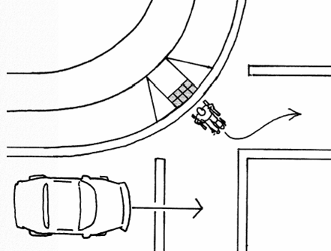
Learning Outcome
Evaluate diagonal curb ramp for ADAAG compliance
Notes:
Slide: The learning outcome for this session will be to teach the student to evaluate a diagonal curb ramp to meet the requirements outlined in the Americans with Disabilities Act Accessibility Guide and the Public Right of Way Guide.
Key Message: Our focus for this session will be on diagonal ramps.
Background and Information: Title II of ADA Requirements: State and Local Agencies must ensure that individuals with disabilities are not excluded from programs, services, and activities (pedestrian facilities are an example of a program)
Any facility altered or constructed after January 26,1992 must comply with ADA Accessibility Guidelines (ADAAG)
Interactivity: Experience, resent “designing for pedestrians workshop”.
Notes:

Slide 3
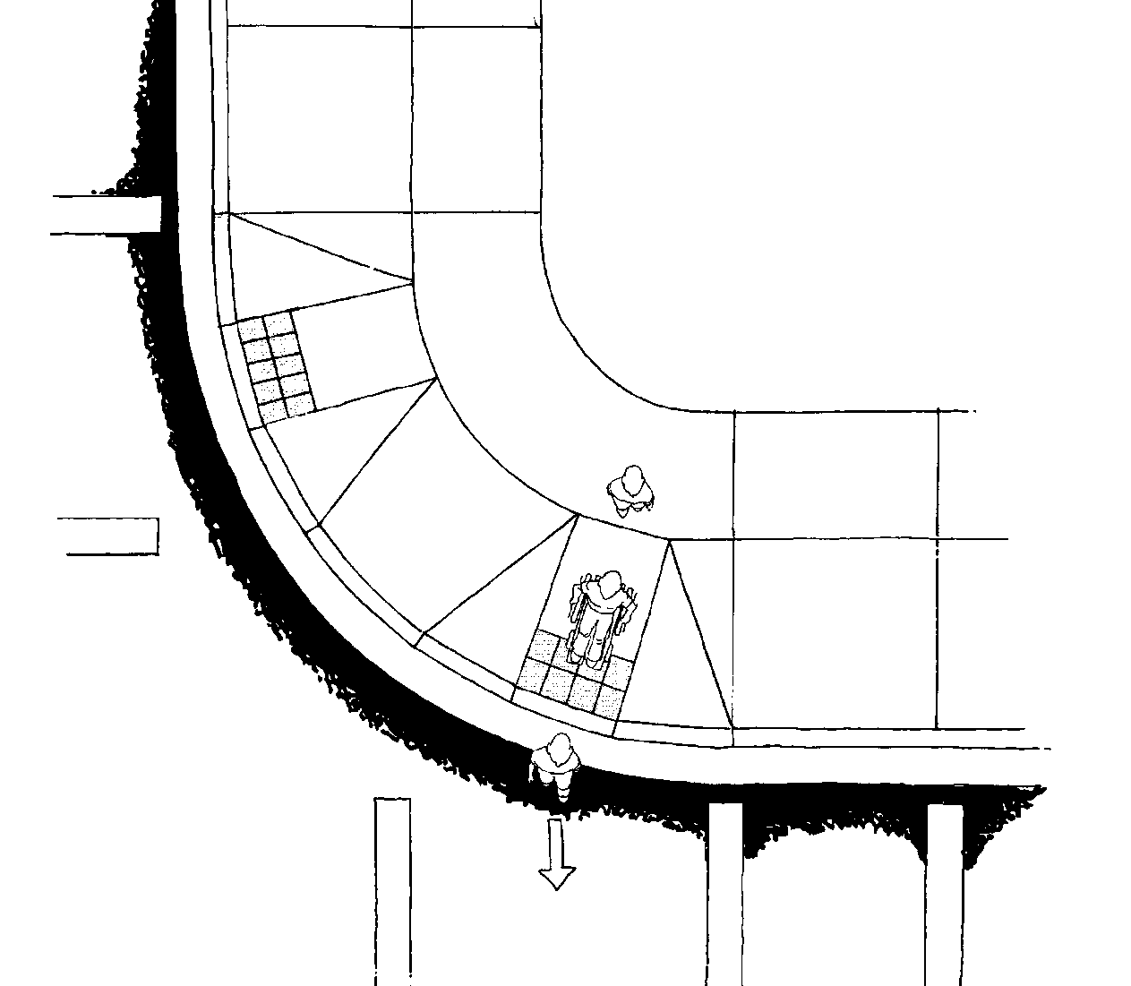
Perpendicular Curb Ramp
Parallel
Parallel
Perpendicular
Notes:
Slide: Perpendicular Curb Ramp
Key Message: Explain what the picture is showing , sidewalk, ramp. Include the concept of vehicle travel lane in the same direction.
Background and Information:
Interactivity:
Notes:

Slide 4
Curb Ramp Components
48”
APPROACH
UPPER
LANDING
APPROACH
FLARE
RAMP
FLARE
GUTTER
TRANSITION AREA
LOWER
LANDING
Notes:
Slide: General Curb Ramp Components
Key Message: There are various types of ramps. Generally the components of each are:
Background and Information:
Interactivity: Can someone describe the significance of the components.
Notes:

Slide 5
Curb Ramp Components
2%
- 8.3%
2%
+ 5%
Notes:
Slide: Curb Ramp Components
Key Message:
The People restricted to a wheel chair may have trouble navigating on excessive cross slopes and grades.
The core strength may be limited and the ability to stabilize challenged.
In the case of a perpendicular ramp the user proceeds down the ramp and across the road.
At the top of the ramp the user needs to have room to turn the wheel chair to meet the approach of the ramp.
When the grade of the ramp exceeds the ratio of 1/12 (8.33%) the wheel chair may tip over backwards.
At the bottom of the ramp the user transitions from a downgrade to and upgrade. The transition needs to be smooth with no lips.
To keep the wheel chair from becoming bound, or grounding against the slope, a slope of less than 5% need to be maintained.
Background and Information:
Interactivity: Show smart level
Notes:

Slide 6
Diagonal Ramp
Diagonal
Diagonal
Notes:
Slide:
Key Message:
The path of the user on a diagonal ramp requires them to complete the movement into the street, then turn to either crosswalk.
The design of the landing area at the bottom of ramp needs to account for the both vehicle paths. Generally the radius of the sidewalk area needs to be at least 15 feet.
Background and Information:
Interactivity: What other challenges might the user have? Sight distance, Visibility, quadriplegic
Notes:

Slide 7
Diagonal Curb Ramp
2%
8.3%
2%
Notes:
Slide:
Key Message:
Since the user needs to travel in the road some distance the cross slope at the bottom of the becomes the travel path and should not exceed 2%.
Background and Information:
Interactivity:
Notes:

Slide 8
Diagonal Ramp - Metrics
Travel way is 48” wide
No cross slope greater than 2%
Ramp grade not greater than 8.33%
No lip in transition area
Landing area clear of parallel travel lane
Road crown no greater than 5%
Notes:
Slide:
Key Message:
These are the measurements we need to collect to evaluate a curve ramp.
I will pass out the evaluation forms.
Background and Information:
Interactivity:
At this point we will proceed to the ground level and meet at the corner of Washington and Union to evaluate a curb cut. Additionally there is a wheel chair at the security station we to collect. Please work in two groups.
One group should collect the chair and take turns negotiating the curb ramp at this location.
The other should take the smart level and tape to perform the evaluation. Once you are finished you can switch.
Notes:

Slide 9
Learning Outcome
Evaluate diagonal curb ramp for ADAAG compliance
Notes:
Slide: Review and Summarize learning Outcomes
Key Message: Our focus for this session has been on the evaluation of Diagonal Curb Ramps
Background and Information: Title II of ADA Requirements: State and Local Agencies must ensure that individuals with disabilities are not excluded from programs, services, and activities (pedestrian facilities are an example of a program)
Any facility altered or constructed after January 26,1992 must comply with ADA Accessibility Guidelines (ADAAG)
Interactivity: We have reviewed the guidance from ADAAG, and the PROWG
Notes:

Slide 10
Presented by
G. Stuart Thompson, P.E.

