Slide 1
Update on NH GRANIT Clearinghouse
Fay Rubin
Earth Systems Research Center
University of New Hampshire
granit.unh.edu
December 4, 2015
Grappone Center, Concord, NH
December 4, 2015

Slide 2
Presentation Outline
Overview of GRANIT
Key GRANIT Data Sets
Accessing GRANIT Data
Other GRANIT Resources for the Surveying Community
Data Updates
Q&A/Discussion
NHLSA Annual Meeting
December 4, 2015
Notes:
DELETE GRAY!

Slide 3
Overview of GRANIT
Central GIS Data Clearinghouse at UNH Earth Systems Research Center
Collaboration of Multiple Data Providers and Data Users
State/Federal Agencies
Regional Planning Commissions
Municipalities
Private Sector
Non-profit Sector
Academic Community
GRANIT Services
Create, Archive, and Distribute Data
Develop Data Standards
Conduct Spatial Analysis
Develop and Host Online Resources – Map Services, Map Viewers
Providing Training and Technical Support
Coordinate with Statewide Partners
NHLSA Annual Meeting
December 4, 2015
Notes:
History – GRANIT started in mid 1980’s
Create data, archive data from other sources, distribute data
Develop standards –metadata standards, land use mapping standards, etc.
HB377 Status?

Slide 4
Overview of GRANIT: Current GRANIT Projects
Core GRANIT Clearinghouse Activities (OEP, NHDOT, NHDES, Fish & Game, DRED)
GRANIT Data Hosting/GRANIT Web Site
GRANITViewII, NH Wetlands Mapper, NH Wildlife Sitings Site
Data Development (Conservation Lands)
Orthoimagery Project Management (NHDOT)
Cooperating Technical Partner (FEMA)
Floodplain Map Updates – Rockingham/Strafford
Nonregulatory Products – Rockingham/Strafford
“Discovery Projects” – Coastal Watershed, Connecticut River Watershed
Impervious Surface Mapping (EPA, PREP)
Broadband Availability in Coos County (NBRC)
C-RiSe – Climate Risk in the Seacoast (NOAA)
NH Coastal Viewer Development (NOAA, NHDES)
“Dirt to Trees to Wildlife” Tool (Town of Randolph, USDA?)
NHLSA Annual Meeting
December 4, 2015
Notes:
We do this work with a variety of funding mechanisms and partnerships.
CRiSE – assess impacts of climate change on infrastructure, natural resources, and other assets in 10 coastal NH communities; includes culvert assessment for priority culverts within those communities
Will return to many of these later, but just want to provide a perspective on the range of projects we work on.

Slide 5
Key GRANIT Data Sets
Aerial Photography
Topographic Data
Digital Elevation Models (DEMs) - LiDAR
DEMs- USGS
Other Imagery
USGS Quads (including historic quads)
Landsat Data
Feature Data Layers
Base Layers - Town Bounds, Road Centerlines, Surface Water
Geodetic Control
Parcels
Floodplains
Wetlands
Soils
Land Use
Conservation Lands
NHLSA Annual Meeting
December 4, 2015
Notes:
But also others that may be of interest – CAI, generalized land cover, sea level rise, coastal resource habitat layers, surficial geology, etc.

Slide 6
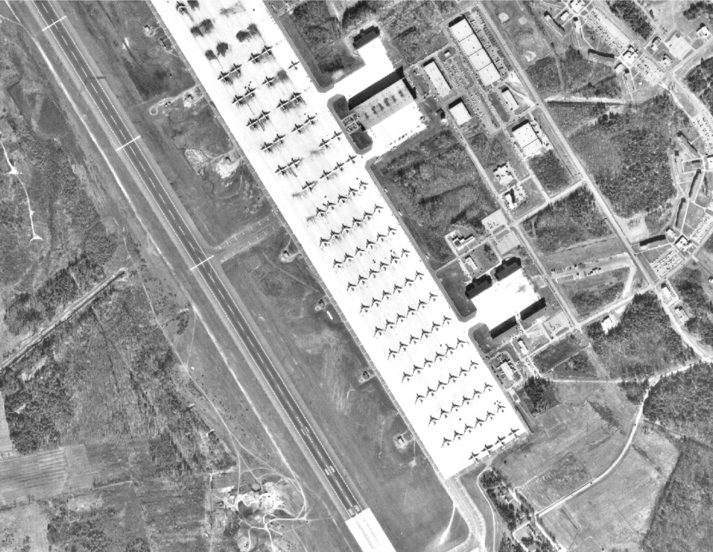
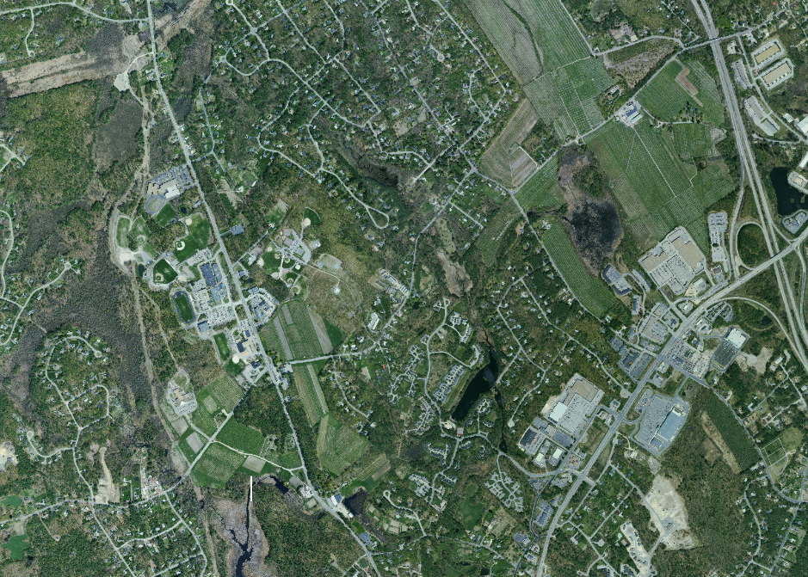
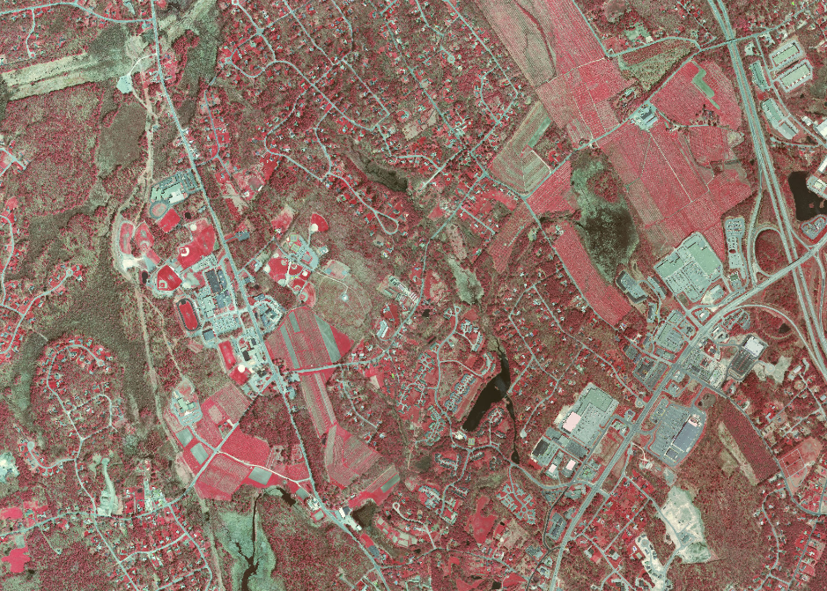
Key GRANIT Data Sets: Aerial Photography
1 ft. imagery – RGB and CIR:
2010 Statewide
2005 SE NH and Lakes Region
NAIP 1 or 2 meter statewide imagery:
2003, 2004, 2006, 2008, 2009, 2011, 2012, 2014
Selected Historic Photography
NHLSA Annual Meeting
December 4, 2015
Notes:
Generally, available in geotiff format. Some data also available in compressed, Mr. SID format. For 2010 imagery, have posted town-based .zip files of the compressed imagery to our ftp site.
1 ft. imagery – funded by NHDOT/USGS partnership, with contributions from other state agencies in 2005. Leaf-off/spring or fall collection.
NAIP – generally flown in late summer during agricultural season. Leaf-on.
Also have:
2014 1 ft. imagery for immediate coastal area
2010 6 in. imagery for SE NH
2008 1 ft. imagery for northern NH/Canadian border
DOQs from 1995/1998
Historic photos from 1962, 1974 – Rockingham and Strafford Counties

Slide 7
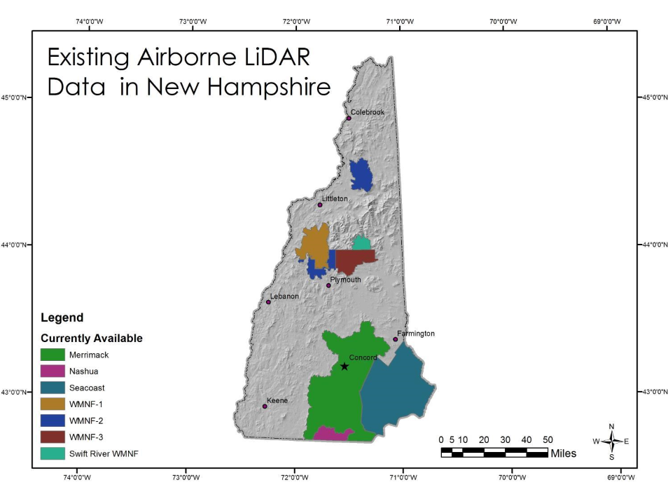
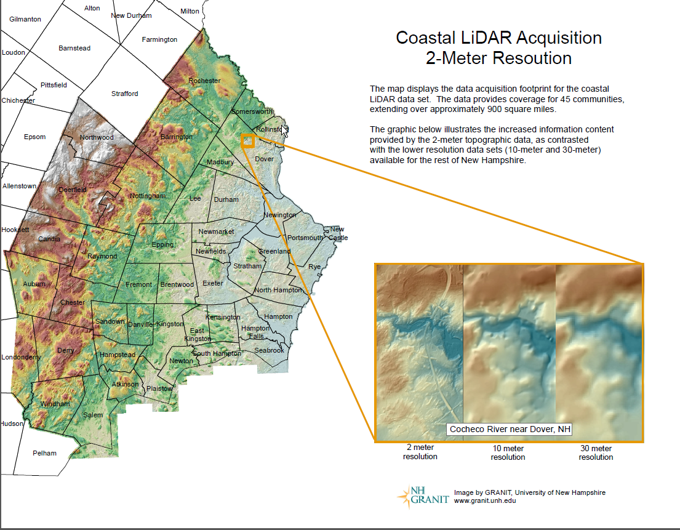
Key GRANIT Data Sets: Topographic Data
NHLSA Annual Meeting
December 4, 2015
Notes:
We have Digital Elevation Models from USGS – generally 10m and 30m. But probably of more interest to you are DEM’s derived from LiDAR data. This shows comparison.
For some regions, have contours, e.g. 2 ft. contours for Merrimack, for Coastal Watershed

Slide 8
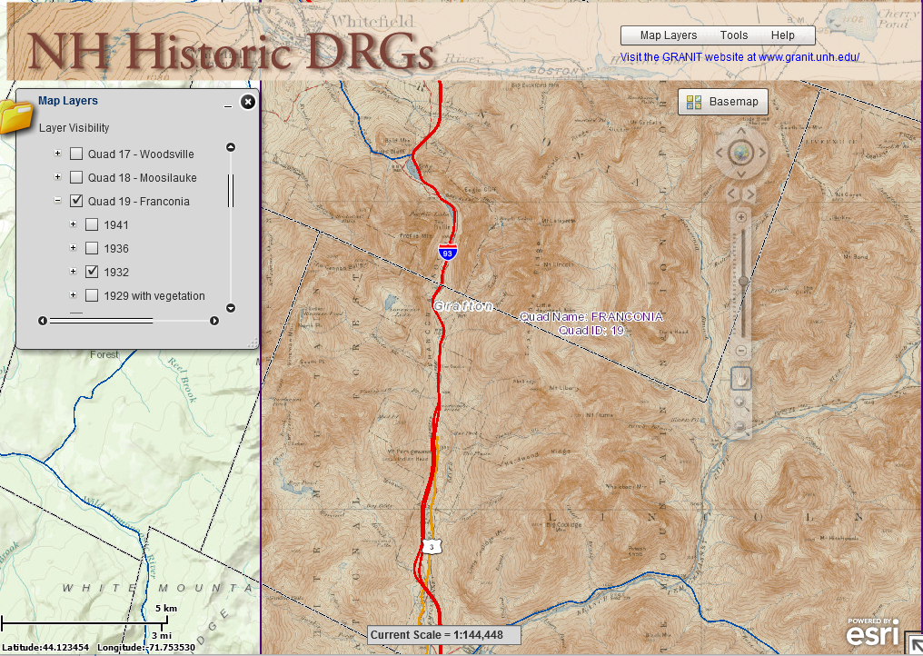
Key GRANIT Data Sets: Other Imagery
USGS Topographic Quads (current and historic)
Landsat TM Imagery
NHLSA Annual Meeting
December 4, 2015

Slide 9
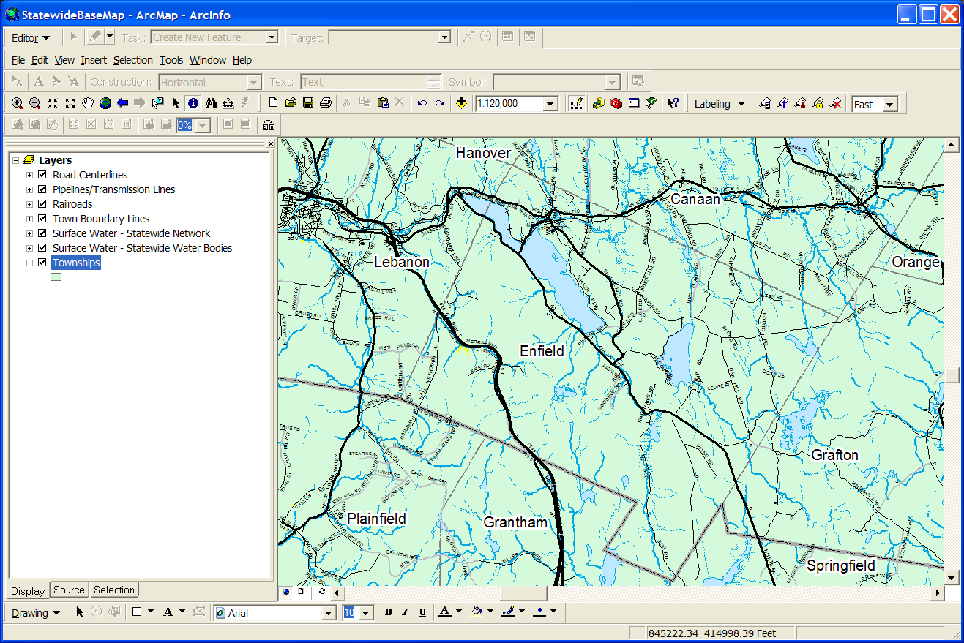
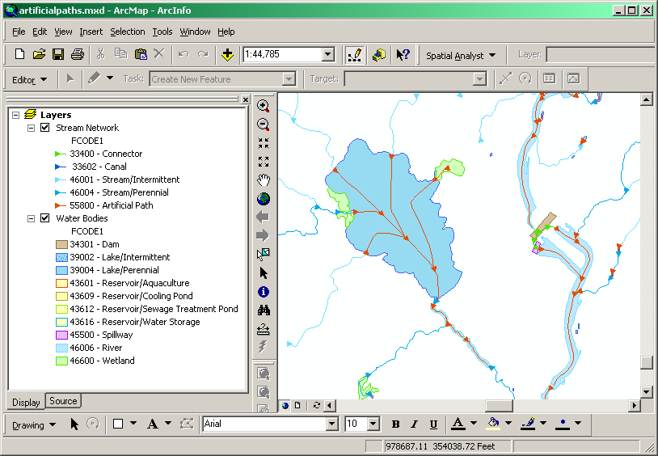
Key GRANIT Data Sets: Base Layers
Political boundaries (town/county)
Surface water
Road centerlines
Railroads
Pipelines
NHLSA Annual Meeting
December 4, 2015
Notes:
Towns – from USGS quad maps. Known inaccuracies. Subcommittee of the NH GIS Advisory Committee is looking at ways to improve it, but there is not funding available.
Surface water – really a collection of data sets that together define water bodies, streams, rivers. Includes networking information, that allows you to identify upstream/downstream segments. Initial source – USGS quad maps. But NHDES is state custodian, and actively updating the geometry as well as the attributes. Updated approximately annually.
Road centerlines, from DOT – has fairly comprehensive attributing, including road names, road classification, physical characteristics (# of lanes, pavement width), traffic counts, etc. Updated quarterly.

Slide 10
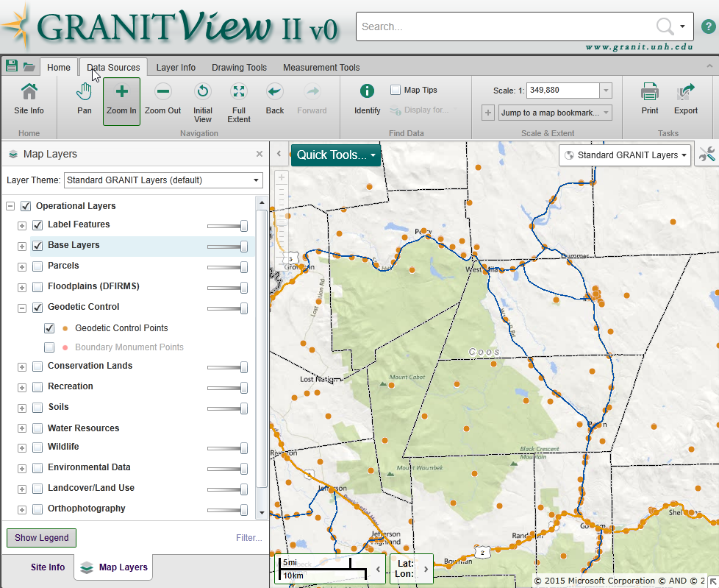
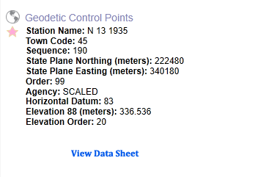
Key GRANIT Data Sets: Geodetic Control
Data from NHDOT
Updated annually
NHLSA Annual Meeting
December 4, 2015
Notes:
Will return to the full data sheet later in the presentation.

Slide 11
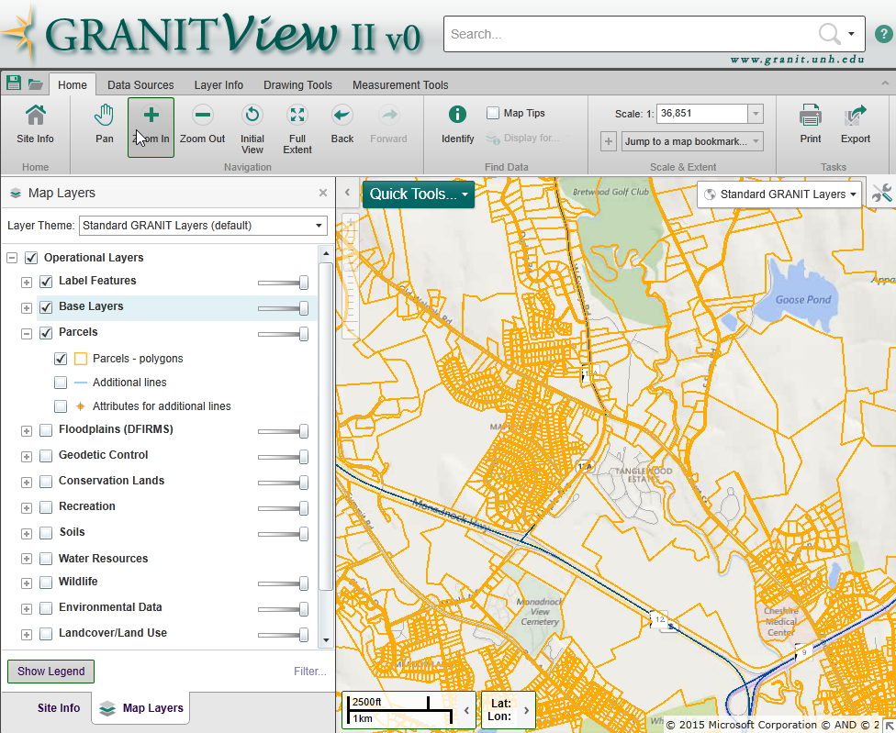
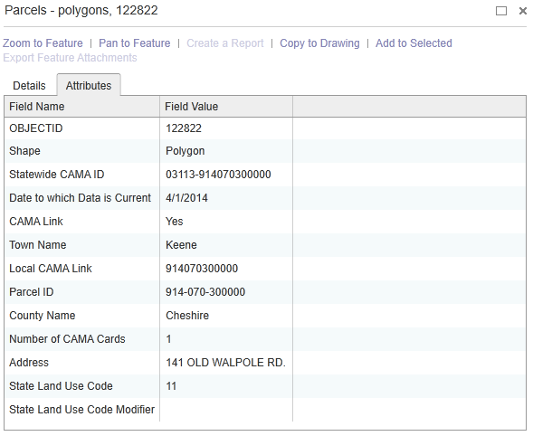
Key GRANIT Data Sets: Parcels
Data from NH DRA
Updated annually
Unofficial GRANIT layer
NHLSA Annual Meeting
December 4, 2015
Notes:
Not official GRANIT data layer – no metadata. So we have it and make it available via the ftp site, but it can’t be incorporated in our web search tools that I’ll explain in a moment.

Slide 12
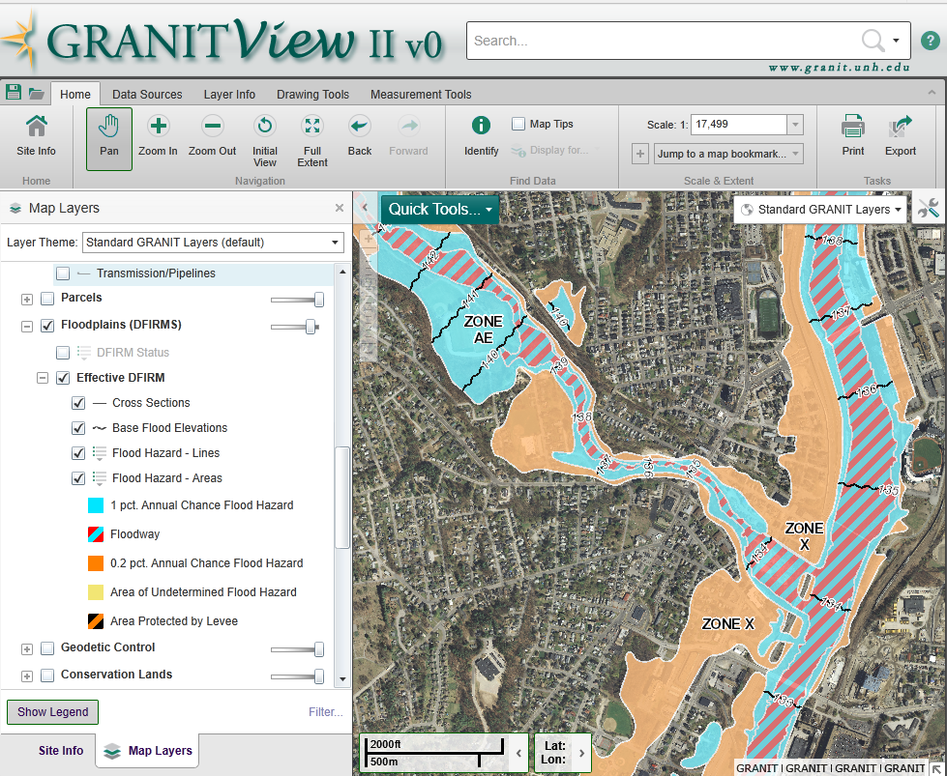
Key GRANIT Data Sets: Floodplains
Effective DFIRM data for all but Belknap County
Includes floodplains, floodways, cross-sections, BFE’s, etc.
NHLSA Annual Meeting
December 4, 2015

Slide 13
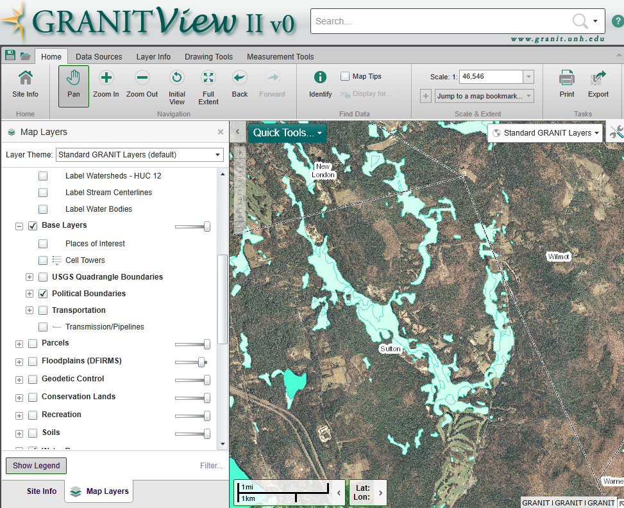
Key GRANIT Data Sets: Wetlands
Available statewide
Most of state – from interpretation of 1970’s photography; 2014/2015 updates in seacoast
NHLSA Annual Meeting
December 4, 2015

Slide 14
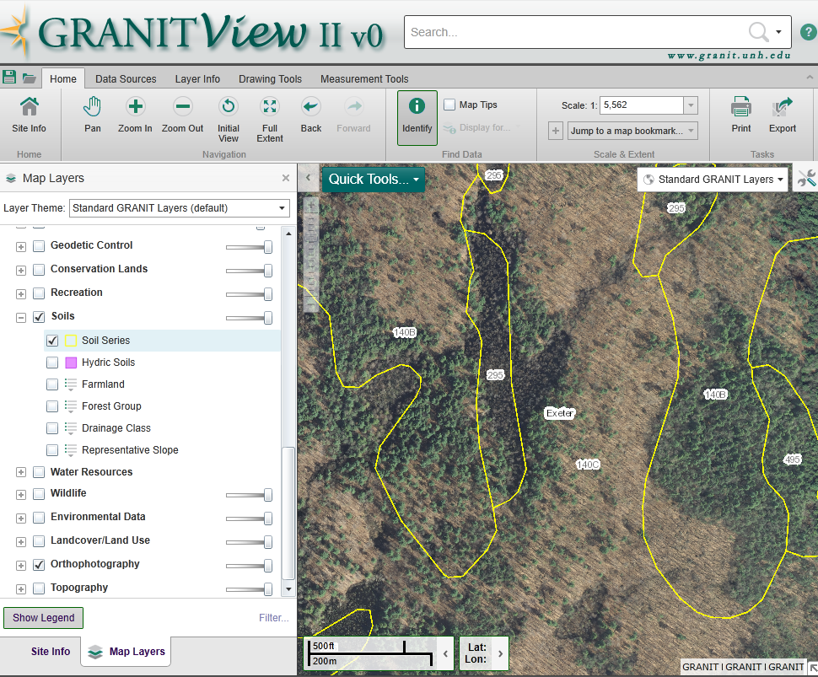
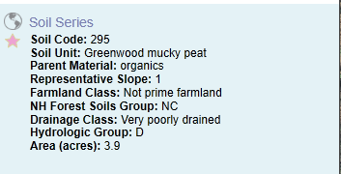
Key GRANIT Data Sets: Soils
Available statewide
“Linkable” to large set of attributes
NHLSA Annual Meeting
December 4, 2015

Slide 15
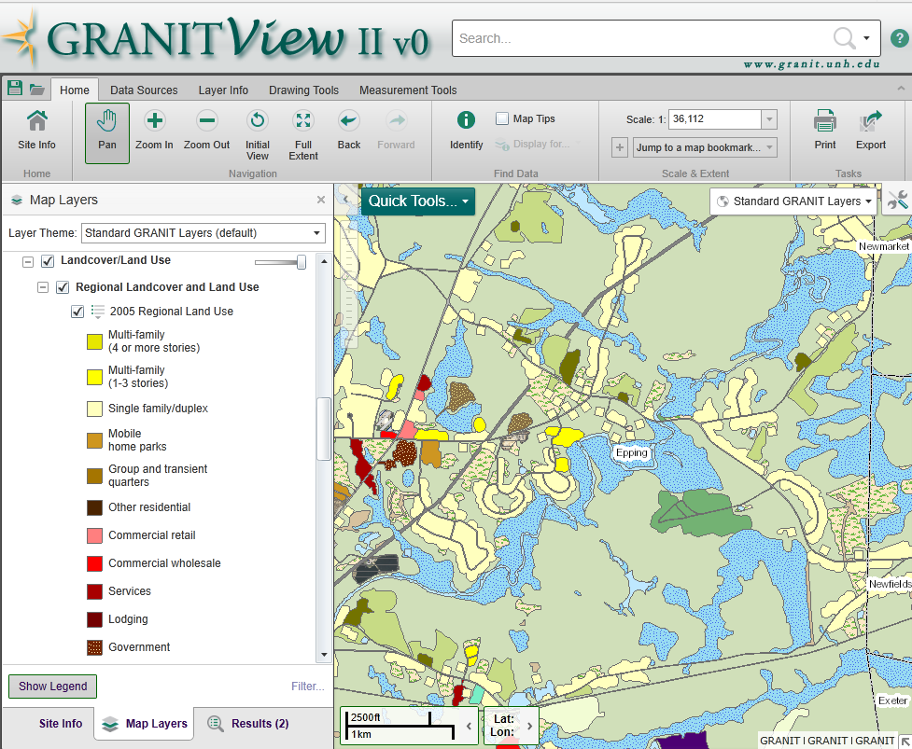
Key GRANIT Data Sets: 2010 Land Use
Available for Rockingham, Strafford, and parts of Carroll Counties
NHLSA Annual Meeting
December 4, 2015

Slide 16
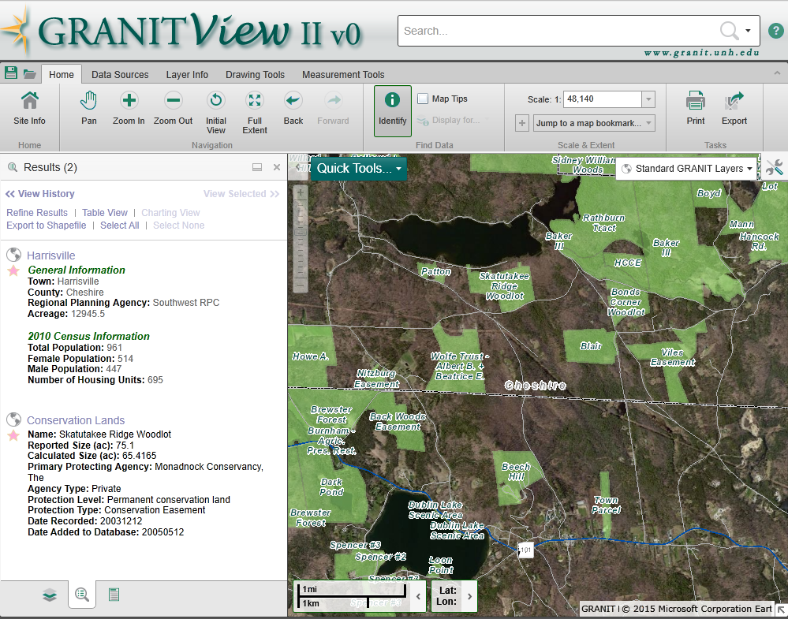
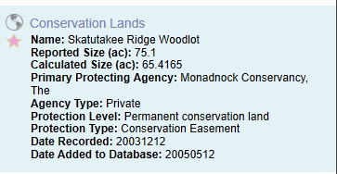
Key GRANIT Data Sets: Conservation Lands
Includes ~10,200 tracts of land; 1,850,000 acres statewide
Updated semi-annually
NHLSA Annual Meeting
December 4, 2015

Slide 17
Accessing GRANIT Data
GRANIT Web Site
LiDAR Data Distribution Site
Web Services
Online Viewers
GRANITViewII
NH Coastal Viewer
Historic USGS Quad Viewer
NHLSA Annual Meeting
December 4, 2015
Notes:
GRANIT Web Site – Data Layer Listing, Data Search Tool
Download .zip files, go to ftp site
Also, can request external media
Web services – map services, image services, geocoding service.

Slide 18
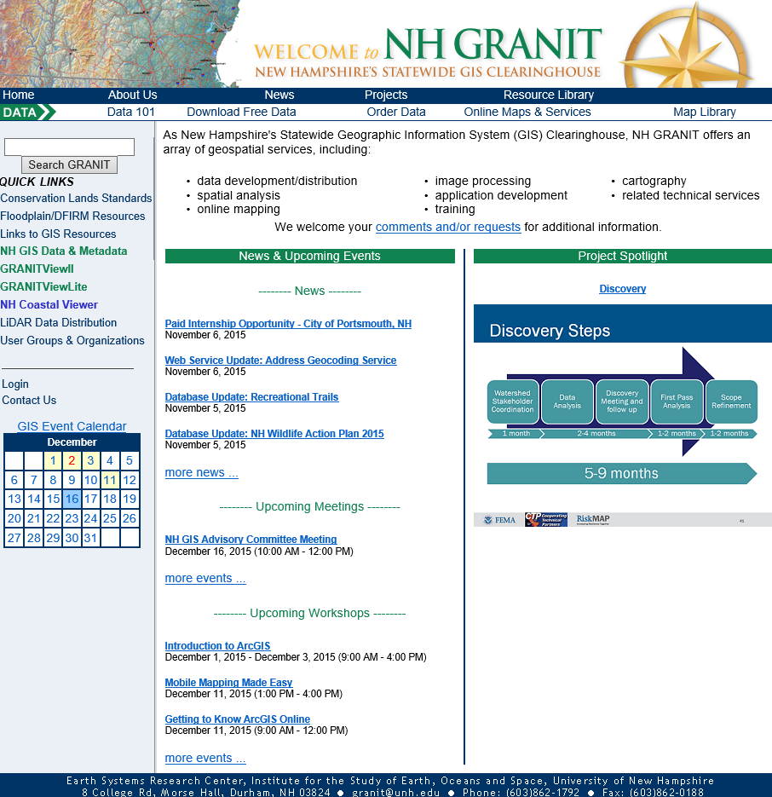
Accessing GRANIT Data: GRANIT Web Site – granit.unh.edu
NHLSA Annual Meeting
December 4, 2015
Notes:
Hopefully you’ll find multiple resources of use to you here. For now, will focus on accessing data …

Slide 19
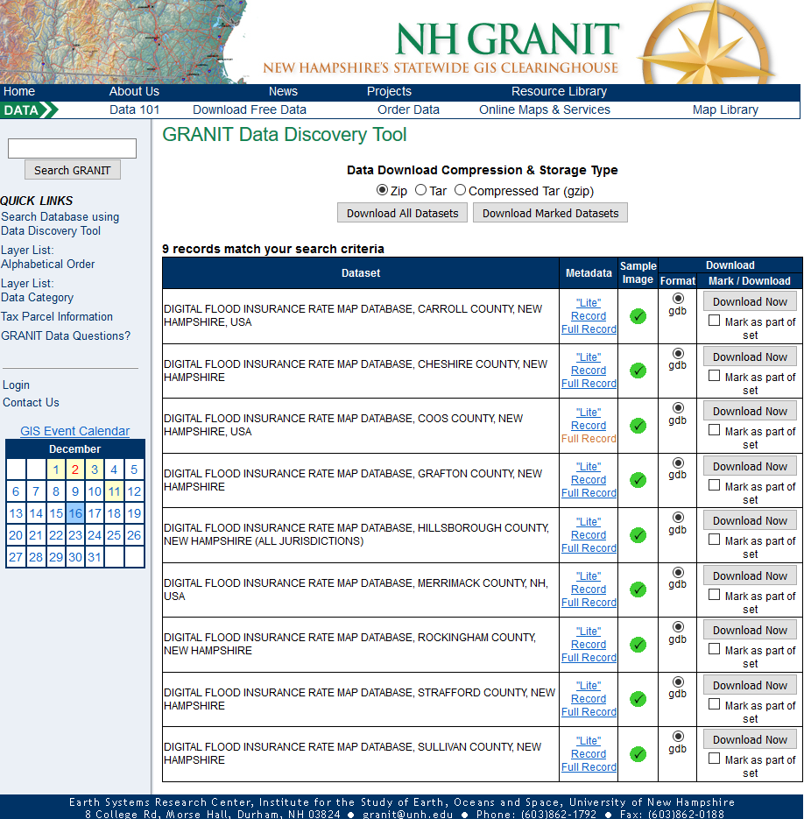
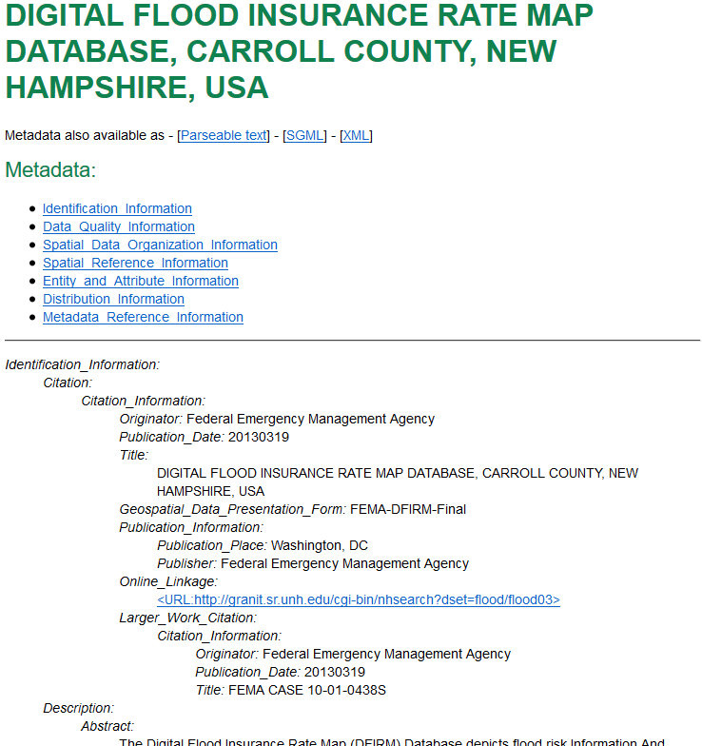
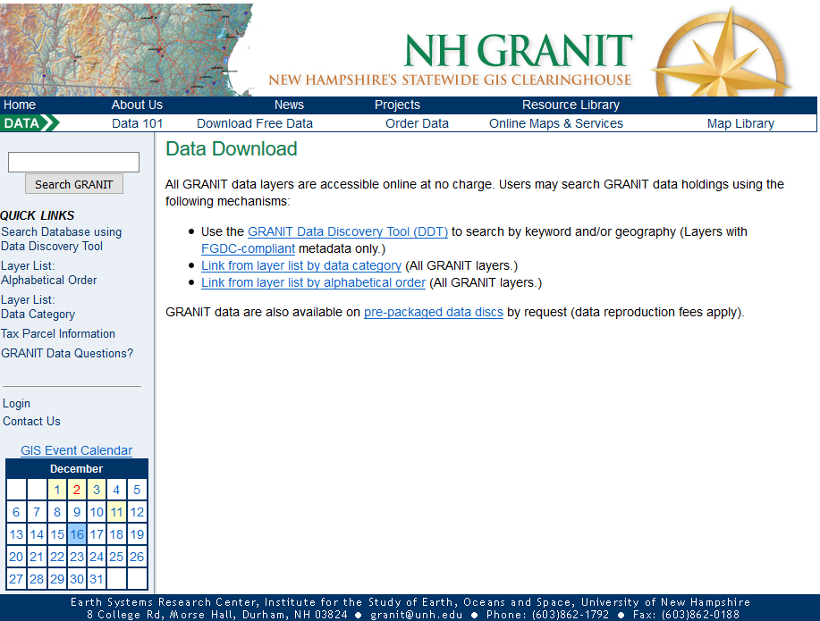
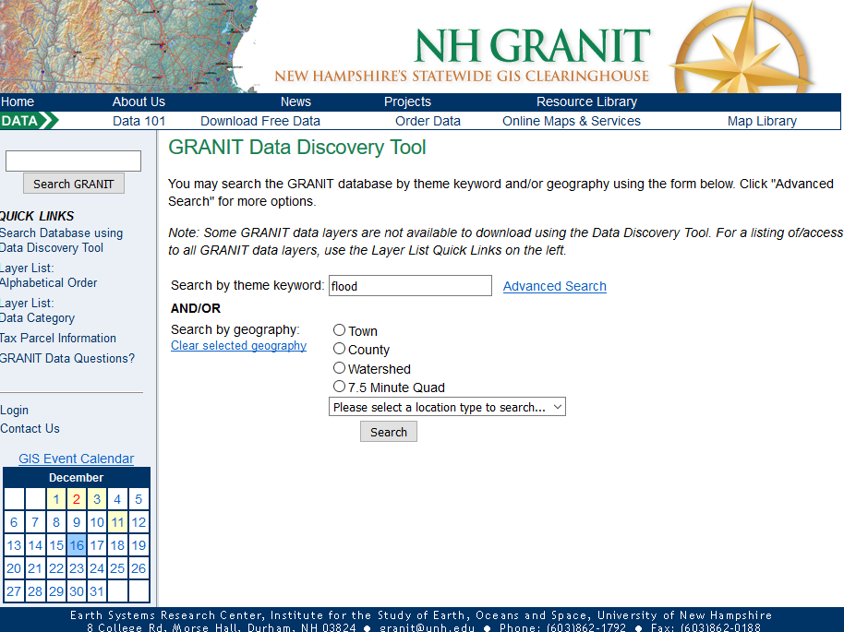
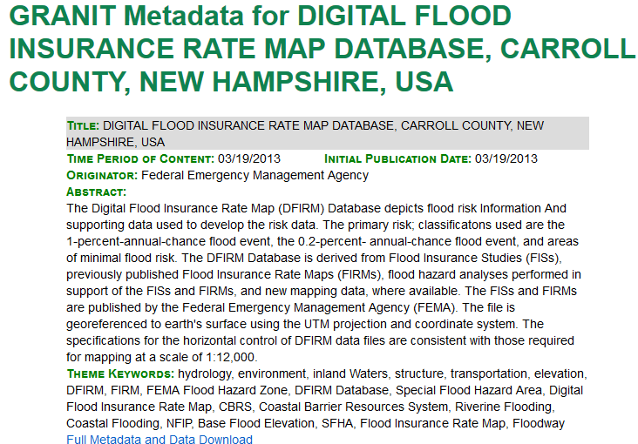
Accessing GRANIT Data: GRANIT Web Site
For local access:
Search by keyword or data listing
Download from website or ftp site
Request external media
NHLSA Annual Meeting
December 4, 2015
Notes:
Using the Data Discovery Tool and entering a keyword
Using the alphabetical or data category listing
Most feature data sets – available as shapefiles. Many also as geodatabases, although of limited use to this audience.
Images – geotiffs, sids. Often provide these on external media due to size of data sets, particularly if using geotiffs.
Note that

Slide 20
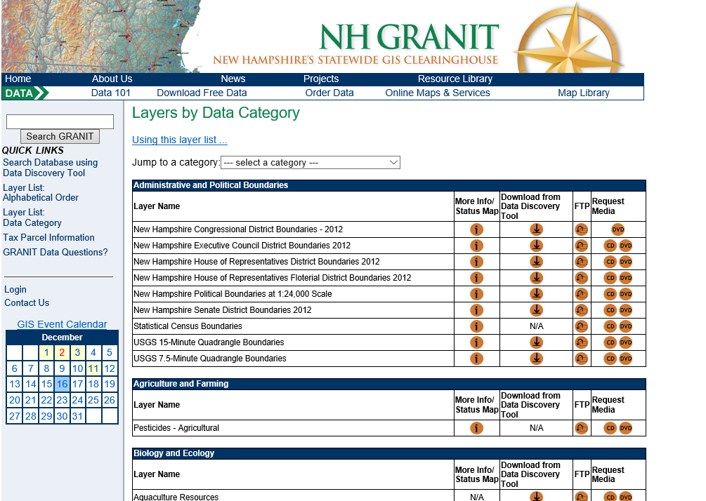
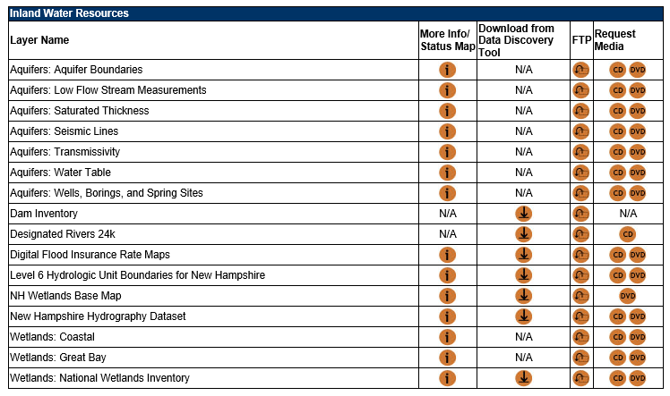
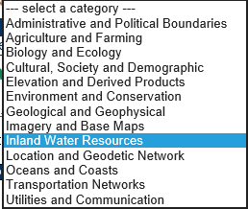
Accessing GRANIT Data: GRANIT Web Site
NHLSA Annual Meeting
December 4, 2015

Slide 21
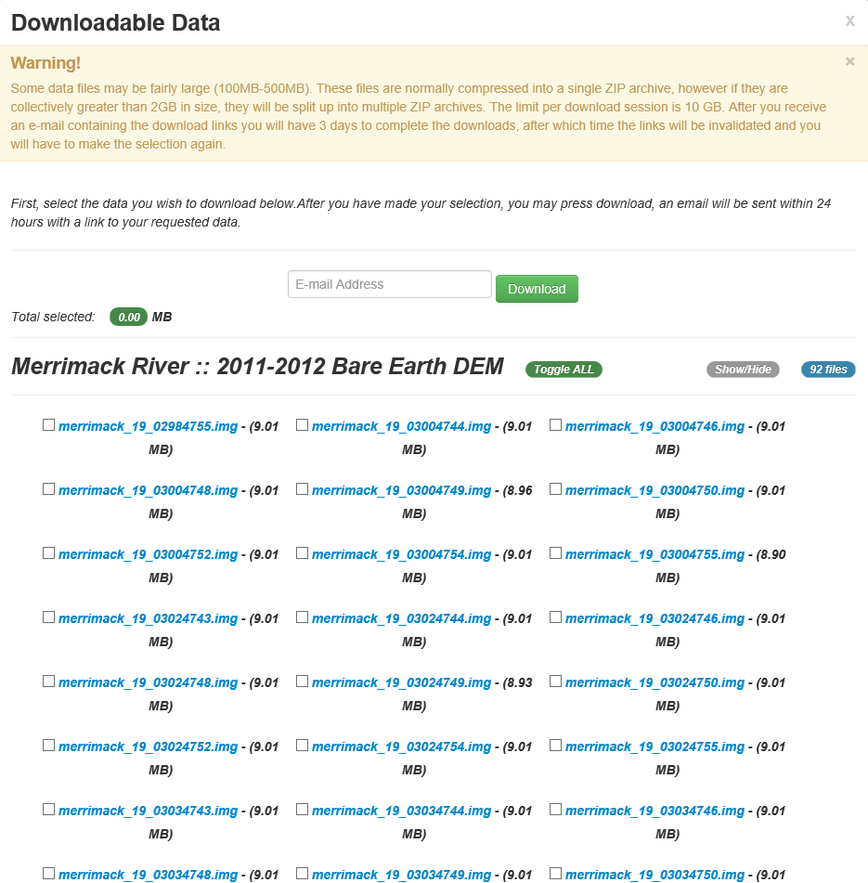
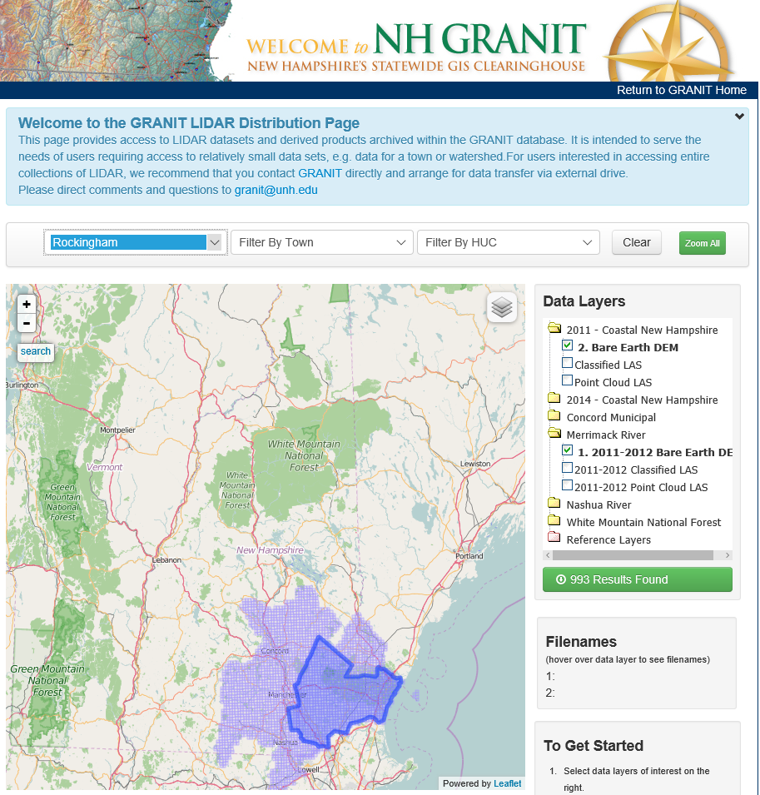
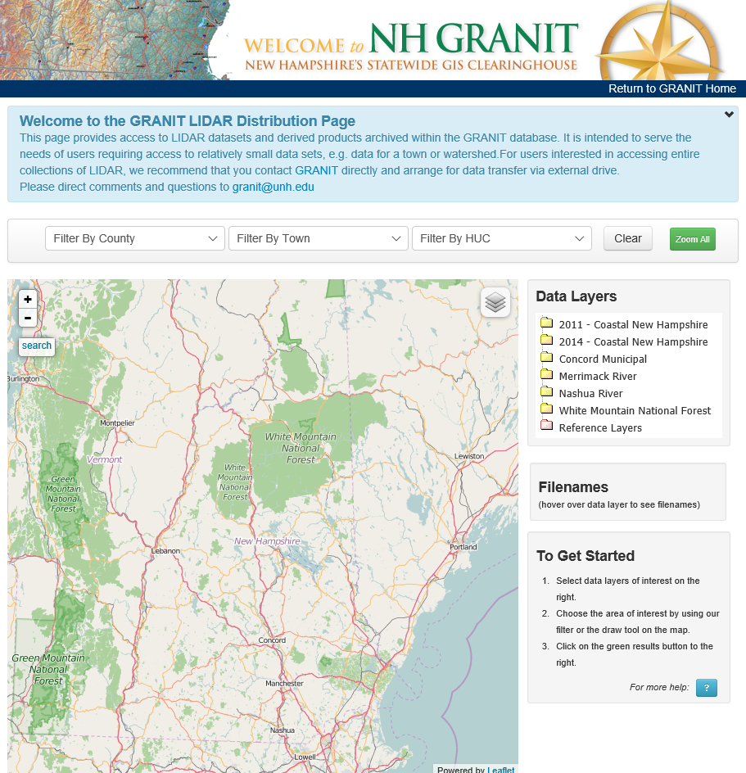
Accessing GRANIT Data: LiDAR Data Distribution Site – lidar.unh.edu
NHLSA Annual Meeting
December 4, 2015
Notes:
Here I’m showing available data sets from the 2011 Coastal Collection as well as the 2011-2012 Merrimack River Watershed data set. (purple). I’ve also applied a filter for Rockingham County, which is reporting 993 data sets found. I can click on that green link, and go to a results page to download the actual data sets.

Slide 22
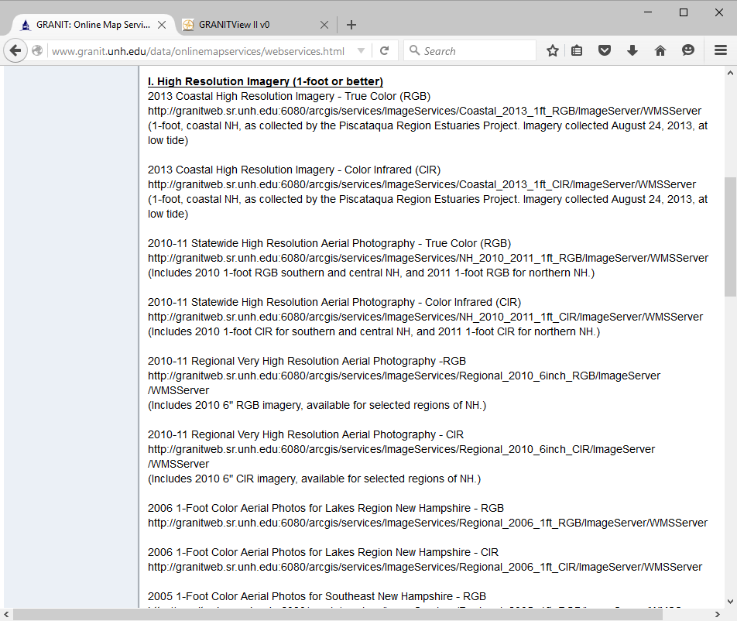
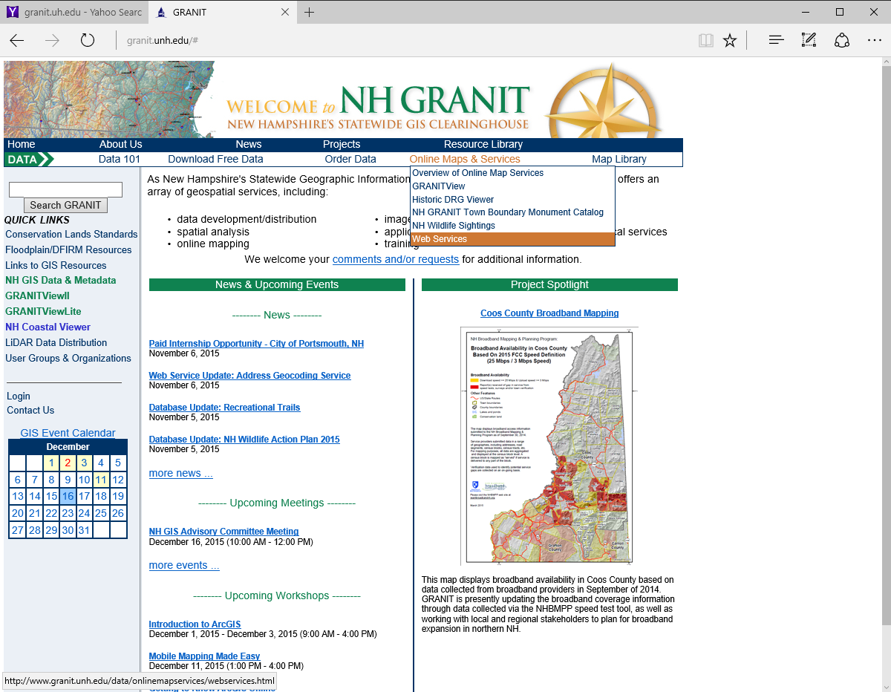
Accessing GRANIT Data: Web Services
NHLSA Annual Meeting
December 4, 2015
Notes:
Click on overview to get a summary of the types of services we offer. Most popular – Web Mapping Services, Viewers. Here is partial listing of the image WMS’ we offer.

Slide 23
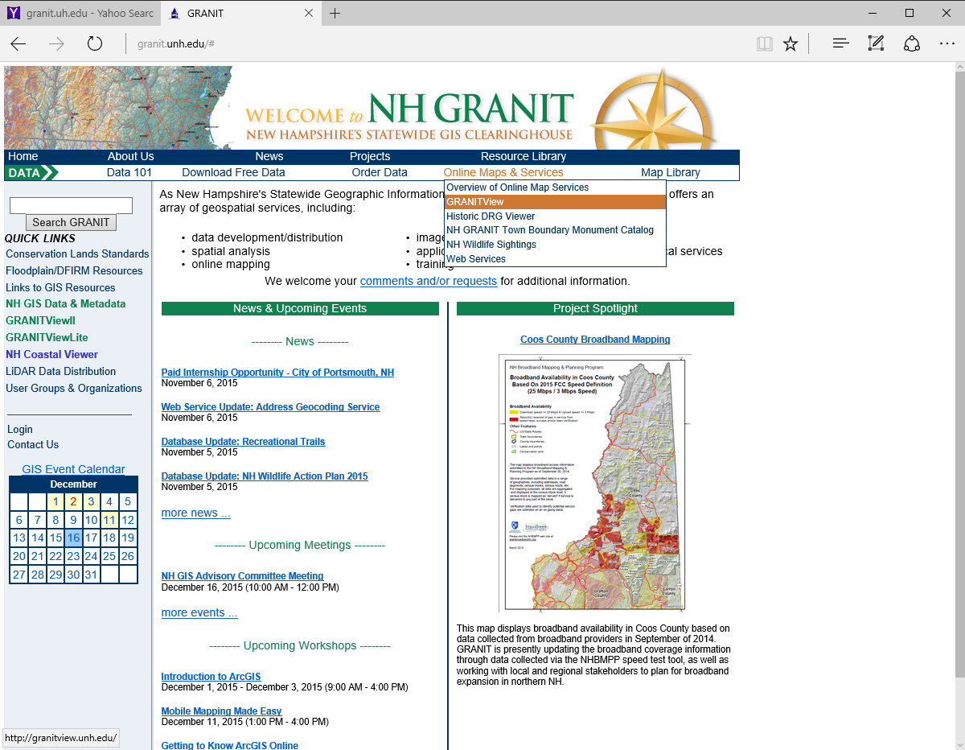
Accessing GRANIT Data: Online Viewers
NHLSA Annual Meeting
December 4, 2015
Notes:
Have seen this already in many of the data slides I showed. Note that this requires that Microsoft Silverlite be installed on your machine.
Also have
GRANITViewLite – intended for use on mobile devices
Coastal Viewer
Historic Quads Viewer.

Slide 24
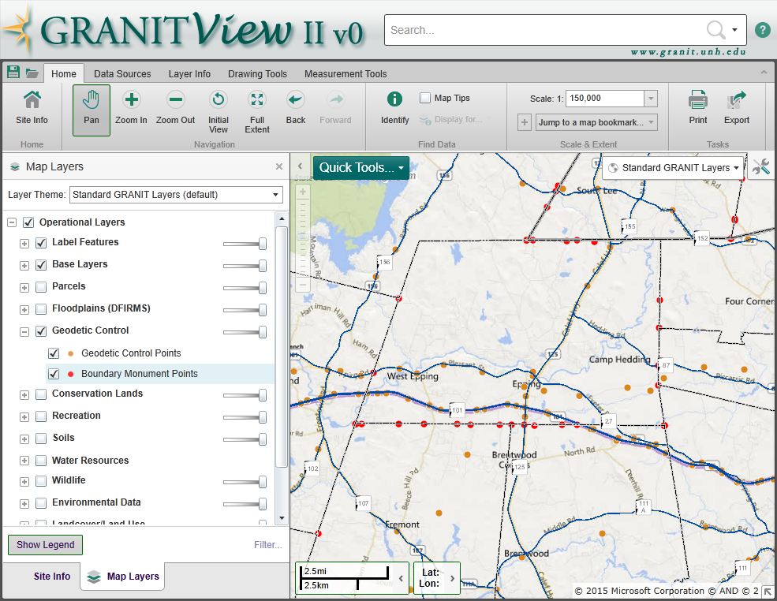
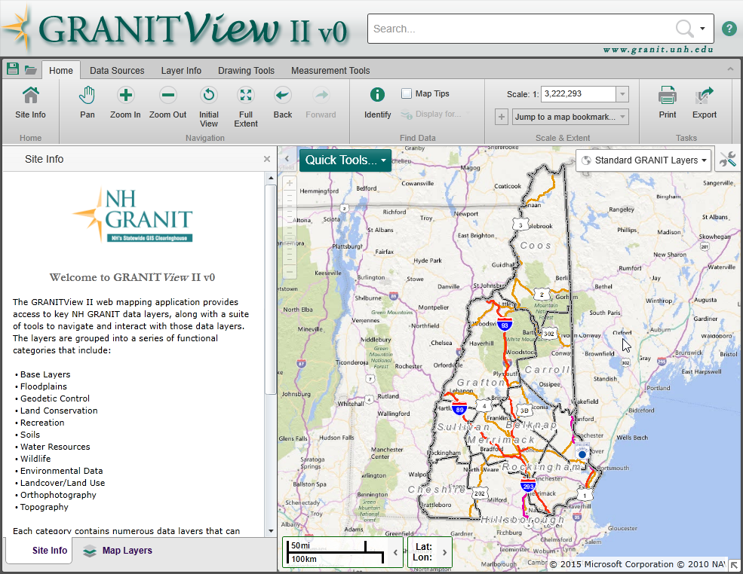
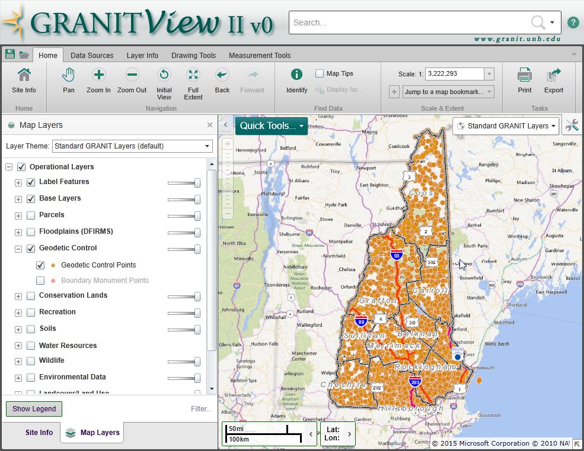
Accessing GRANIT Data: Online Viewers - GRANITViewII
NHLSA Annual Meeting
December 4, 2015
Notes:
General data organization
Basic navigation tools
Expandable folders
Click all levels to turn layer on.
Notice that boundary monument points are grayed out – scale dependency.
Use zoom/pan tools to zoom into area of interest. Now boundary monument points display.
Right click to access additional tools – change symbolization, viewer metadata

Slide 25
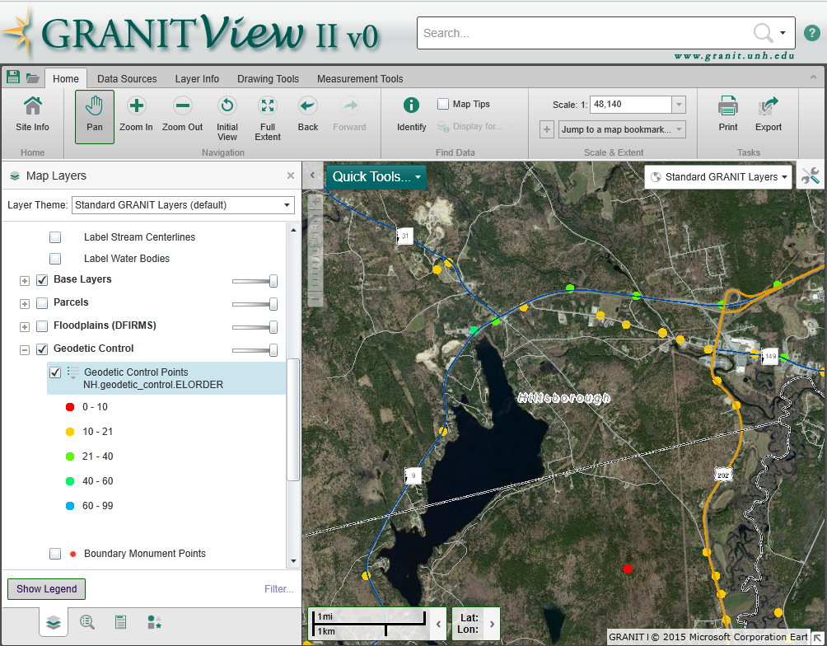
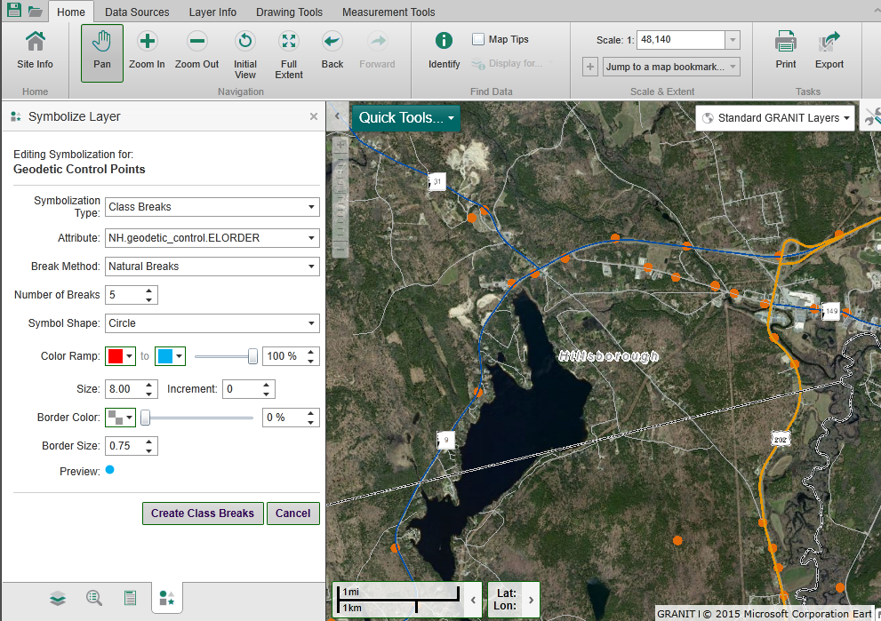
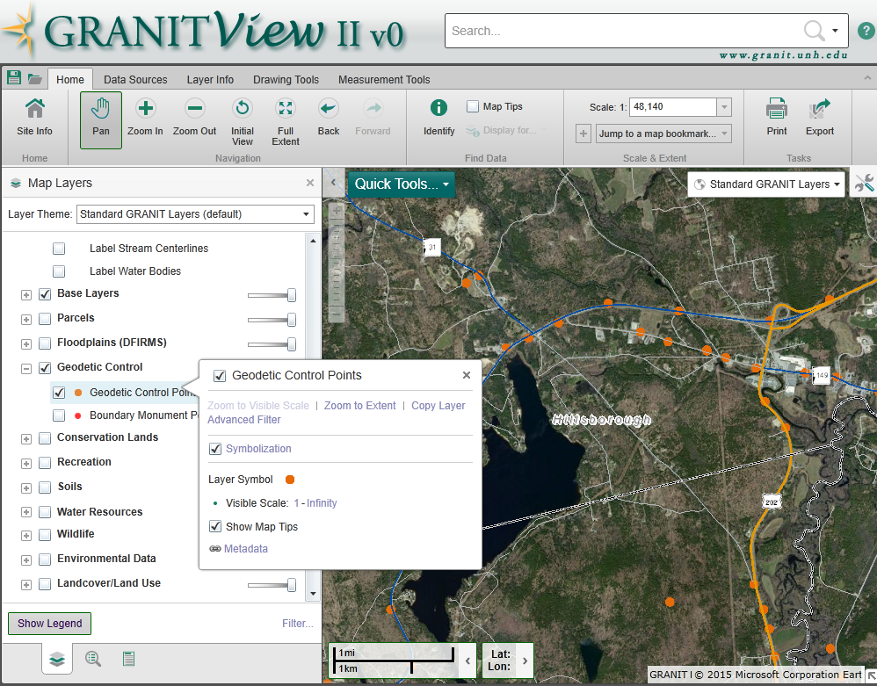
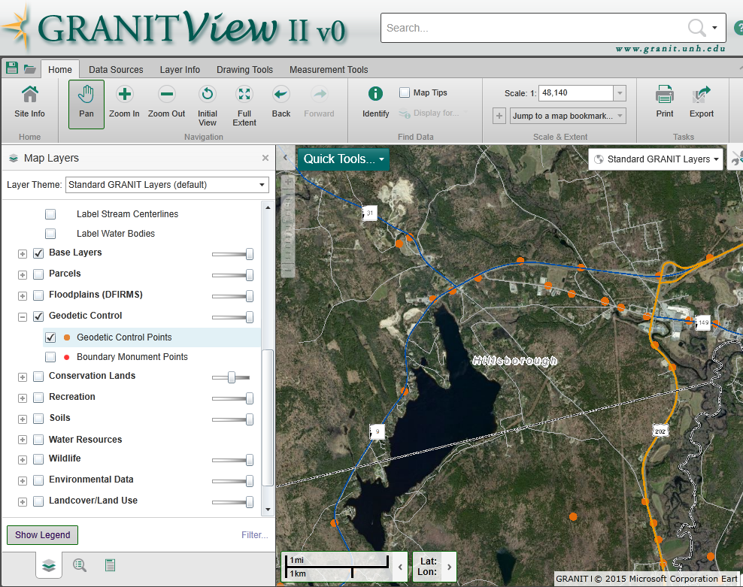
Accessing GRANIT Data: Online Viewers - GRANITViewII
NHLSA Annual Meeting
December 4, 2015
Notes:
Right click to access additional tools – change symbolization, viewer metadata

Slide 26
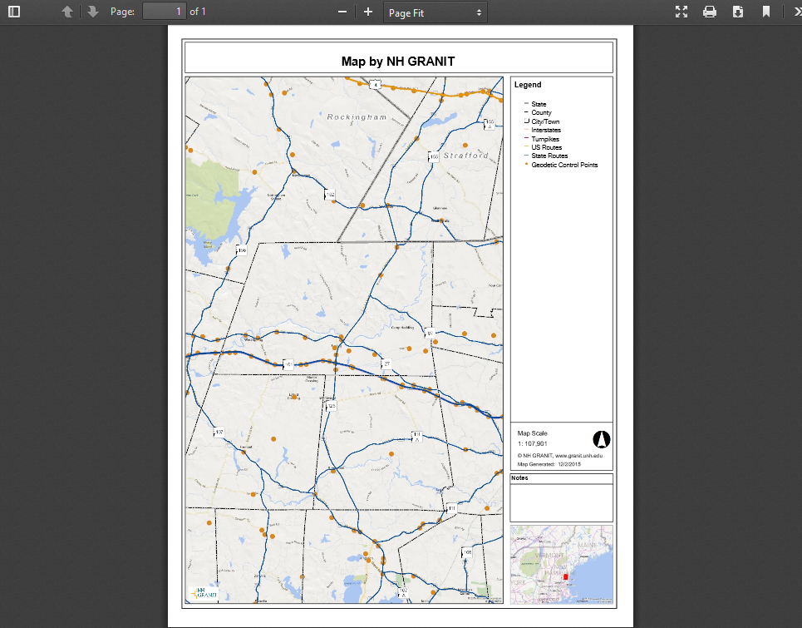
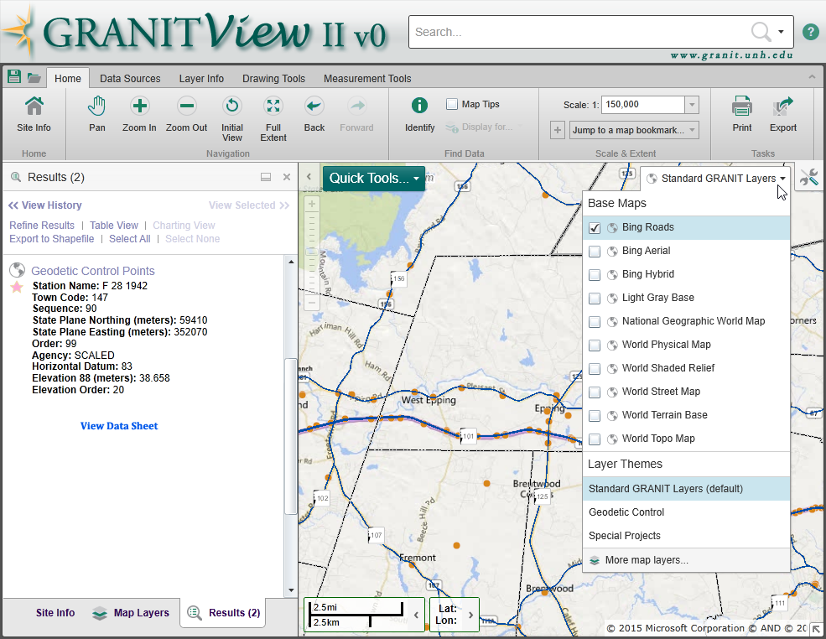
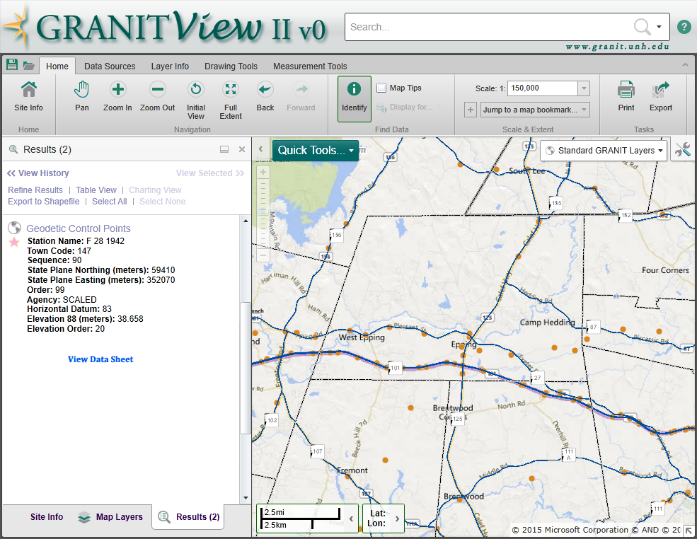
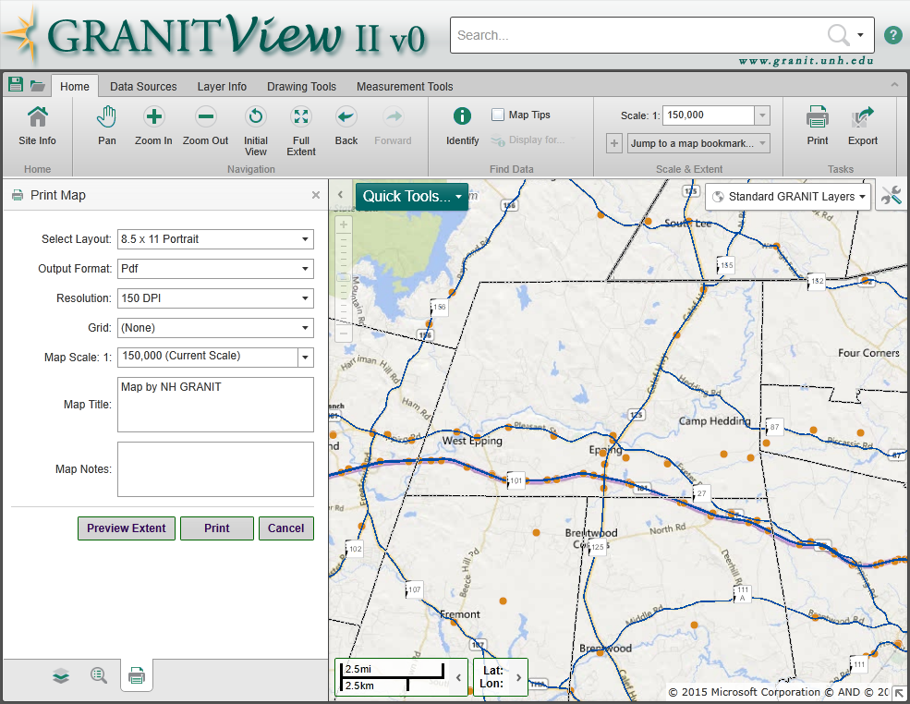
Accessing GRANIT Data: Online Viewers - GRANITViewII
NHLSA Annual Meeting
December 4, 2015
Notes:
Lots of other tools - identify, print, measure

Slide 27
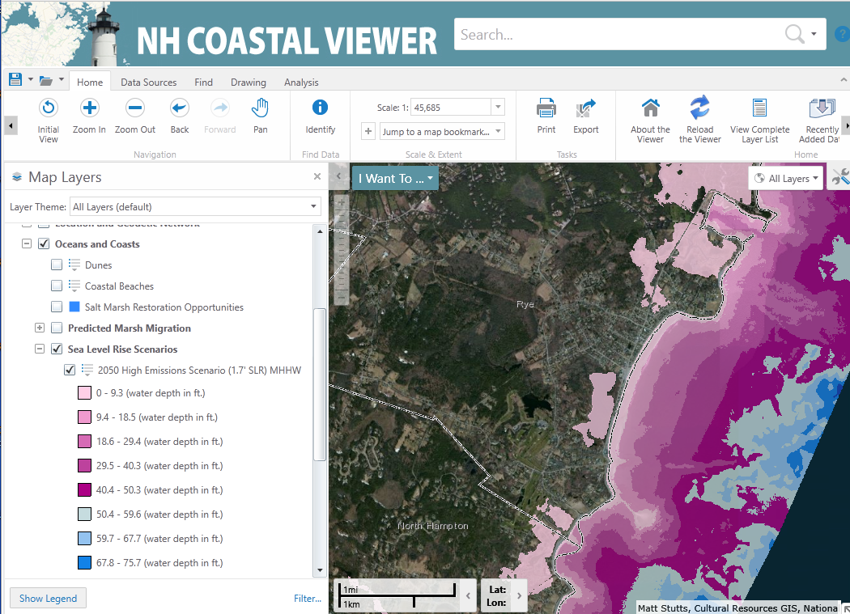
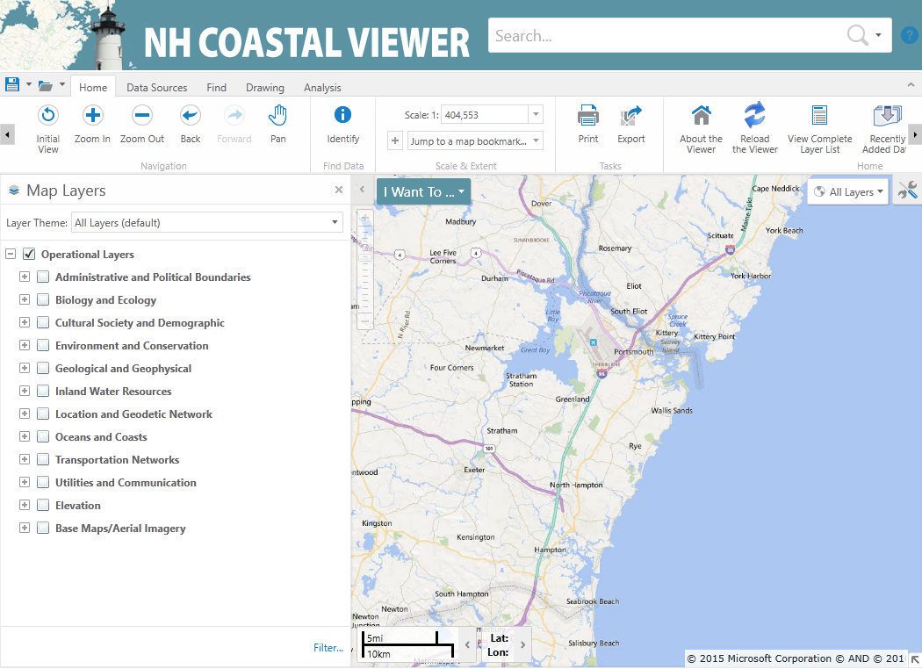
Accessing GRANIT Data: Online Viewers – Coastal Viewer
NHLSA Annual Meeting
December 4, 2015

Slide 28
Other GRANIT Resources
Geodetic Control Data Sheets
Town Boundary Monument Catalog
NH Wetlands Mapper
NH Wildlife Sitings Site
NHLSA Annual Meeting
December 4, 2015

Slide 29
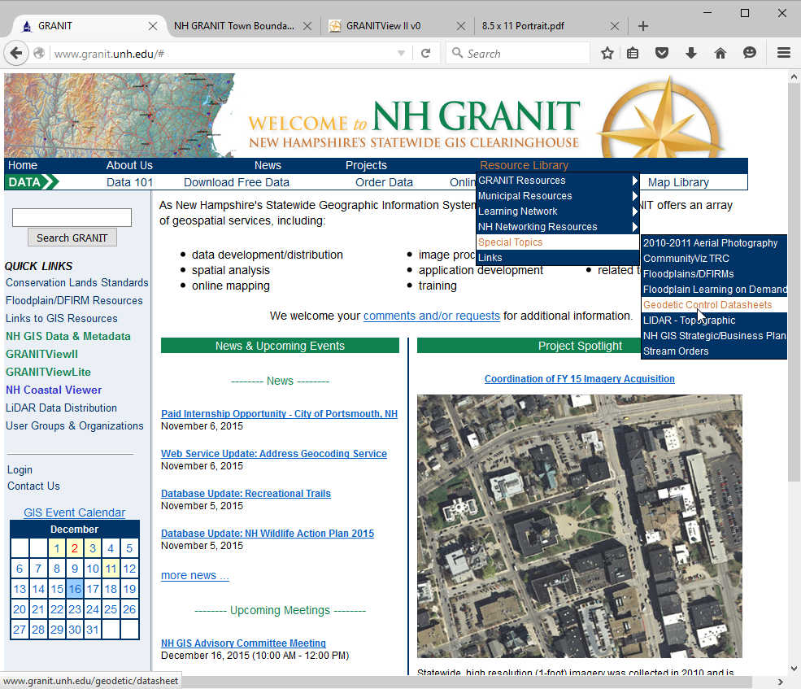
Other GRANIT Resources: Geodetic Control Data Sheets
NHLSA Annual Meeting
December 4, 2015

Slide 30
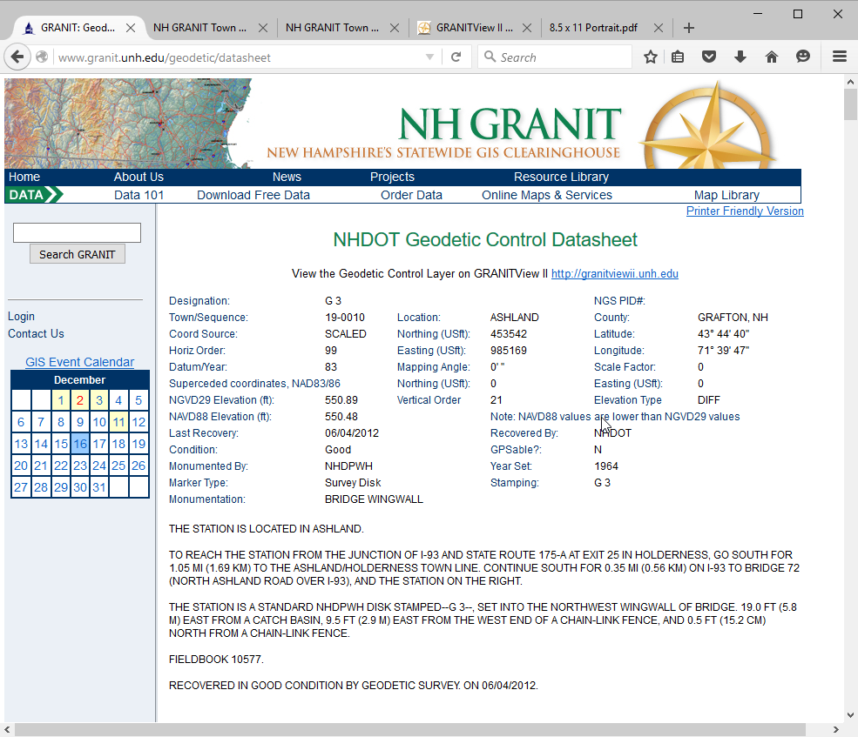
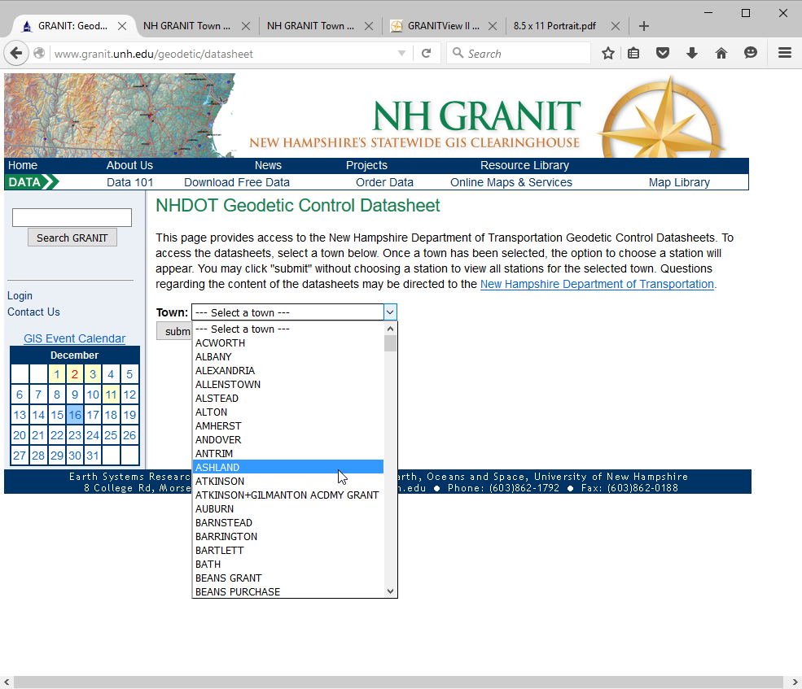
Other GRANIT Resources: Geodetic Control Data Sheets
NHLSA Annual Meeting
December 4, 2015
Notes:
Select a town, then can view the sheets station by station. Also note link back to the GRANITView viewer.

Slide 31
Other GRANIT Resources: Town Boundary Monument Catalog
NHLSA Annual Meeting
December 4, 2015
Notes:
Select a town, then can view the sheets station by station. Also note link back to the GRANITView viewer.

Slide 32
Other GRANIT Resources: NH Wetlands Mapper
NHLSA Annual Meeting
December 4, 2015

Slide 33
Other GRANIT Resources: NH Wildlife Sitings Site
NHLSA Annual Meeting
December 4, 2015

Slide 34
Data Updates
2015 Statewide Orthoimagery
4-band imagery
Spring, 2015 acquisition, winter 2015/2016 delivery
2015 LiDAR
~5,000 sq. miles
Fall 2015 acquisition, spring 2016 delivery
NRCS Statewide Soils Update
Floodplains – Rockingham County
NHLSA Annual Meeting
December 4, 2015
Notes:
Lidar – USGS Base Spec 1.2, deliverables include raw & classified .las files, hydro flattened DEMs, intensity images 1m DEM; 10cm vertical RMSE

Slide 35
Questions/Discussions
Other Data Sets of Interest?
Other Map Services?
Tools?
Contact Info:
Fay Rubin
Earth Systems Research Center
University of New Hampshire
fay.rubin@unh.edu
granit.unh.edu
granitviewii.unh.edu
NHLSA Annual Meeting
December 4, 2015

