Slide 1
Discovery Meeting
Piscataqua-Salmon Falls Watershed (partial)
December 3, 2015 – Lee, NH (AM)
December 3, 2015 – Rochester, NH (PM)
Notes:
Fay

Slide 2
Introductions
Risk MAP Project Team
Community partners and officials
State of New Hampshire partners and officials
Other federal agency partner representatives
Associations
Others
Notes:
Fay

Slide 3

Agenda
Why We’re Here
Risk MAP Program Overview
Discovery Overview & Discussion
Flood Risk Assessment Products Overview
Communities in Study Area
Mitigation Planning and Communication
Questions to Consider
Next Steps
Notes:
Fay

Slide 4
Why We’re Here
Start a dialogue about your flood risk
Understand your needs and priorities
Communicate available resources
Offer partnerships and answer questions
Give you a complete, current picture of your flood hazards and risks to help you better:
  Plan for the risk
  Take action to protect your communities
  Communicate the risk to your citizens
Notes:
Fay

Slide 5

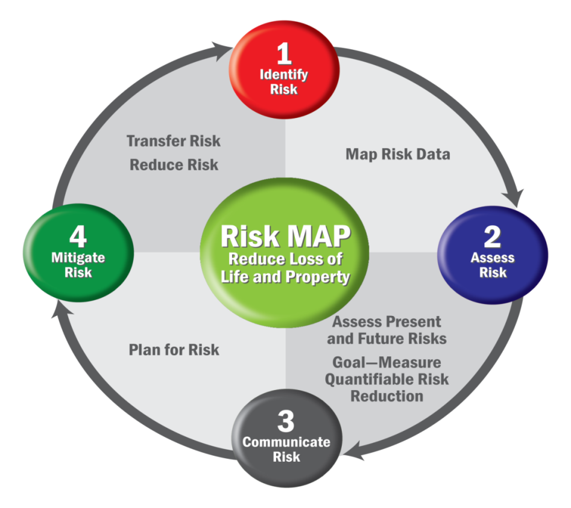
Risk MAP Program Overview
Risk MAP
  Mapping – Flood hazard and risk identification
  Assessment – HAZUS and other risk assessment tools
  Planning – Hazard mitigation planning and HMA grants
Risk MAP Vision
  Deliver quality data
  Increase public awareness of flood risk
  Encourage local/regional actions that reduce risk
Notes:
John

Slide 6

Discovery Overview
Discovery is the process of data mining, collection, and analysis with the goal of conducting a comprehensive watershed study and initiating communication and mitigation planning discussions with the communities in the watershed.
Occurs prior to…
  Flood studies
  Flood risk assessments
  Mitigation planning technical assistance projects
Notes:
John
Discovery is the process of data mining, collection, and analysis for the determination of flood study update, flood risk assessment, and/or mitigation planning technical assistance projects and scopes of work.
Discovery also involves collecting information that allows for a holistic understanding of a community’s risk and flood mitigation actions that the community may implement.
Discovery is the collection of data and information for not only a flood study update, flood risk assessment, and/or mitigation planning technical assistance project, but also for developing a communication strategy that leads to increased flood risk awareness in the community and actionable flood hazard mitigation planning.
When does Discovery occur?
It is required… but also flexible, and can be tailored to the specific project needs.
The purpose is not only to define the project scope and get buy-in from the local officials, but to increase visibility of flood risk for all stakeholders. This provides a great opportunity to educate organizations and officials about options for mitigation and to stimulate local discussion.

Slide 7
Risk MAP Project Timeline
Discovery Meeting
Flood Study Review
Resilience Meeting
Final CCO Meeting
Project Kickoff*
3-5 Year Process
*Kickoff and subsequent steps will only occur if a Risk MAP project is conducted.
Notes:
John (Because of the nature of our project, it seems more appropriate to use this generalized timeline rather than something more specific. But I’ve included a specific timeline as well in case you prefer that.)

Slide 8
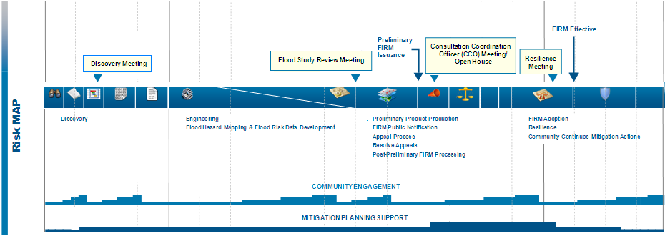
Piscataqua-Salmon Falls
Watershed Timeline
Use this or previous slide
Activities
Project Timeline
Products
Projected Preliminary
Projected
Effective
Projected
Flood Study Review
Work Map Meeting
Discovery Meeting
December 2015
Projected CCO Meeting
Projected LFD
Notes:
John
50 month schedule
Date prelims
Date LFD
Flood Study Review Meeting ( a couple months before preliminary): After the engineering analysis is completed to present initial mapping results and draft risk assessment products. Presented in work map format
CCO Meeting
Resilience Meeting: Between LFD and effective Date Focus on hazard mitigation plan implementation and available resources. Flood Risk products are again discussed.

Slide 9
Involvement from Communities
Four meetings during the study when involvement from communities is needed:
  Discovery meeting
  Work Map meeting
  Community Coordination & Outreach (CCO) meeting
  Open House/Resiliency meeting
Notes:
John

Slide 10
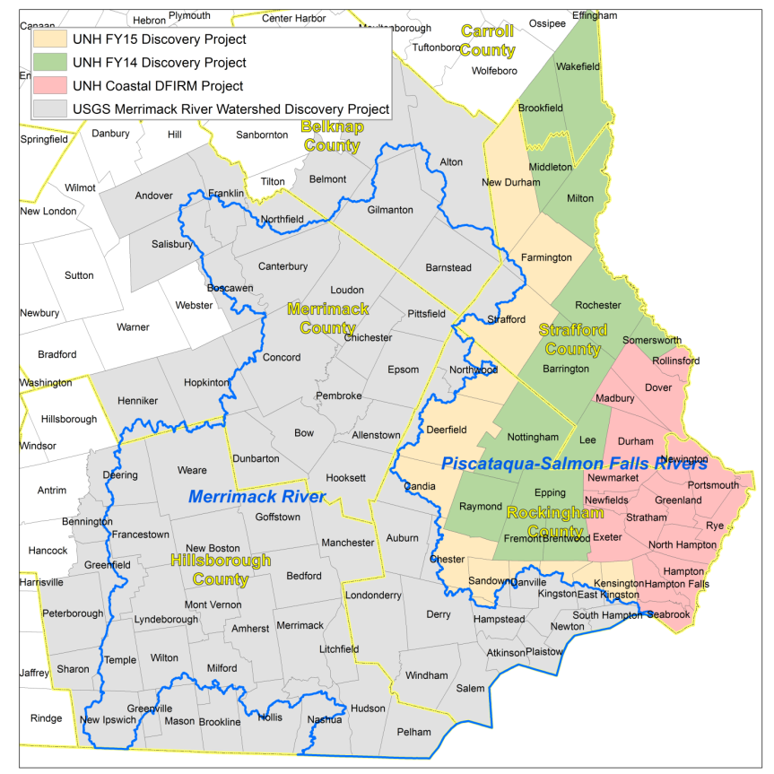
Watershed Communities
Entire Piscataqua-Salmon Falls Watershed contains or touches 48 communities in 5 counties
Project study area (in green) contains or touches:
  3 counties in NH
    2 communities in Carroll County, 5 communities in Rockingham County, 4 communities in Strafford County
  590 total stream miles
  Approximately 96,698 residents (2010 Census)
Notes:
Fay
Entire Watershed - 48 communities. However, 17 of these communities are being remapped as part of a coastal map update project (recently completed – Strafford; underway – Rockingham) as shown in pink.
Focus of this effort is on the 13 communities that are adjacent to that footprint. The remaining towns are either part of a current Merrimack River Watershed Discovery project (gray), or are part of a project we will be initiating this spring to complete the watershed (orange).
590 total stream miles, 243 Zone A stream miles

Slide 11
Major Rivers/Streams
  Salmon Falls River
  Branch River
  Cocheco River
  Isinglass River
  North River
  Lamprey River
  Exeter River
  Other smaller rivers and tributaries
Notes:
Fay

Slide 12
Need for Updates
Known discrepancies in current FISs
Additional problems
  Out-of-date hydrology
    Re-calculation of 10-, 50-, 100-, and 500-year peakflow annual exceedance probabilities (AEPs) needed, due to additional 35+ years of streamflow data and recent large events
  Clusters of Letters of Map Change (LOMCs) indicating inaccuracies in the effective floodplains
  First Order Approximation (FOA) indicates that many effective A Zones may be inaccurately mapped and/or may be based on outdated engineering
Notes:
Fay

Slide 13
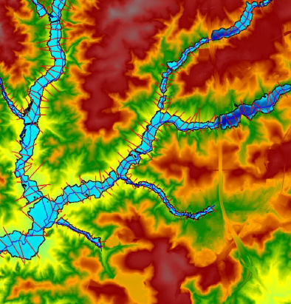
First Order Approximation (FOA)
What is it?
  Automated process using best available data to model and map estimates of flood hazard boundaries for multiple recurrence intervals.
What’s it used for?
  Helps in illustrating potential changes in flood elevation and mapping that may result from a proposed project scope.
  Assessing/validating the effective mapped inventory of Zone A flood boundaries
  Can be leveraged for eventual production of regulatory products.
  Provides additional value to other program areas (non-regulatory products, outreach and risk communication, best available data in unmapped areas, LOMA processing for Zone A’s, etc.).
Notes:
Erik

Slide 14
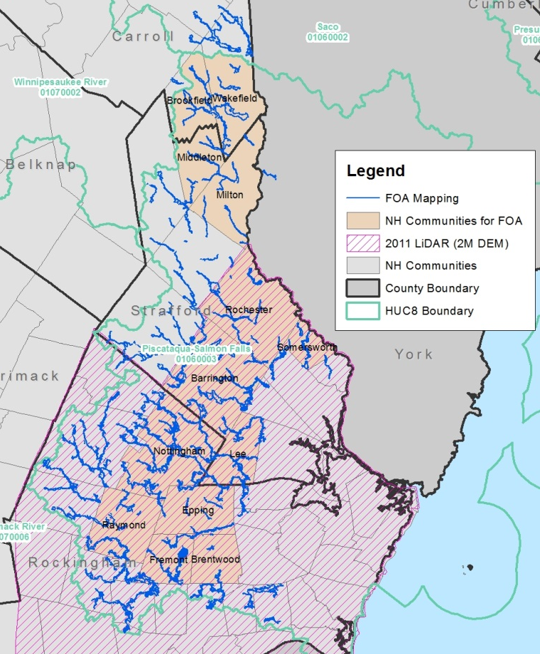
Piscataqua-Salmon Falls Watershed FOA
Source Topography:
  2-meter resolution Digital Elevation Model (DEM) from 2011 LiDAR
  10-meter USGS National Elevation Dataset (NED) used for Carroll and Strafford County communities (Brookfield, Wakefield, Middleton, Milton)
Hydrology:
  USGS Regression equation (2009 New Hampshire SIR 2008-5206)
  Gage analysis where stream gages with sufficient records exist (Oyster River)
Hydraulics:
  Automated cross section layout, manual inspection/modification
Mapped boundaries for 1% annual-chance-storm event
Calculated discharges for the 10%-, 4%, 2%-, 1%-, 0.2%-, 1% plus, and 1% minus annual chance storm events
Notes:
Erik

Slide 15
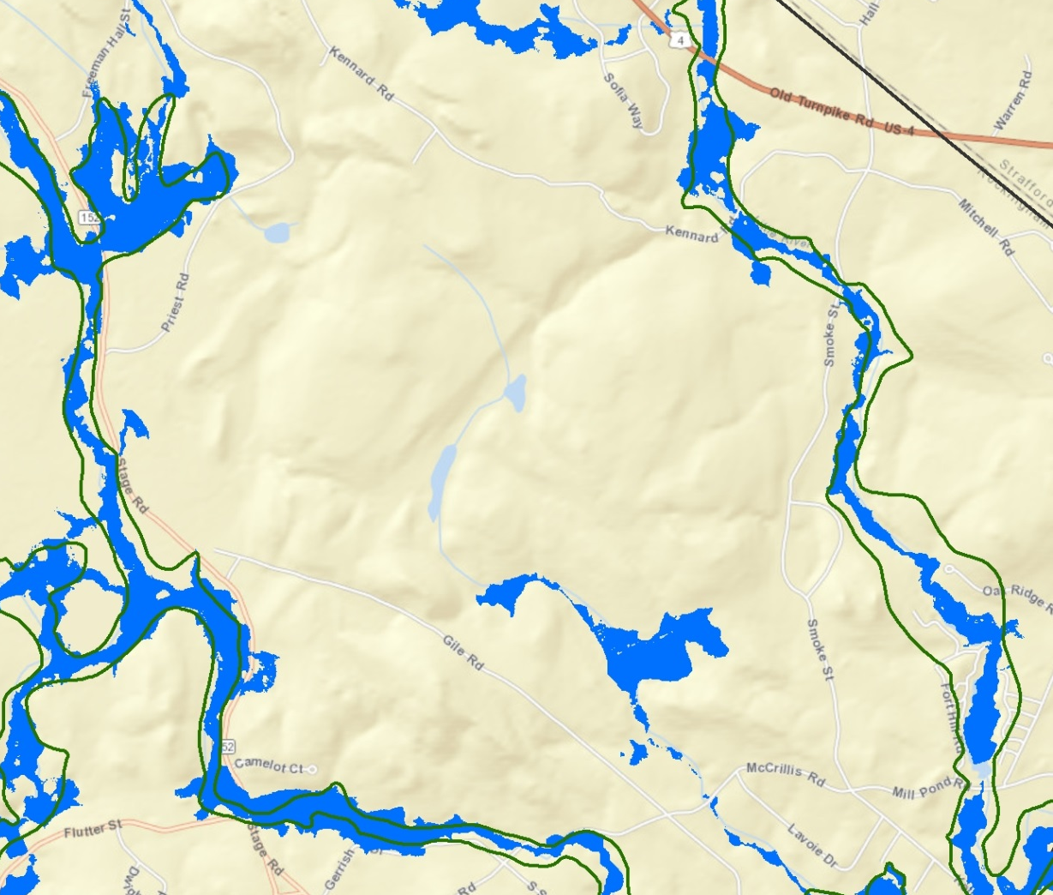
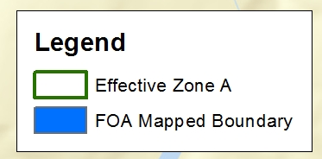
FOA Results
104 modeled streams in study area
Comparison of effective Zone A boundaries to FOA % annual-chance-storm event boundaries
  Inputs: +/-1% flood profiles from FOA, effective boundaries, source topography, horizontal and vertical tolerances
  Only 47% pass comparison test (>85% needed to validate effective Zone A boundaries)
Conclusion: effective Zone A boundaries in study area are not adequately representing flood risk
CNMS database updated: effective Zone A studies classified as “Unverified – To Be Studied”
Notes:
Erik

Slide 16
Priority Stream Reaches
  One goal of Discovery: Coordinate with all watershed stakeholders to select highest-priority reaches for redelineation and/or detailed study
  Priority list then used to set scope of revision
    Communities having DFIRM panels revised
    Communities not having DFIRM panels revised
  Watershed areas done by other recent studies
Notes:
Fay
Have already had input from one community about a priority stream – Salmon Falls.

Slide 17
Project Discovery Report/Map
Select priority reaches based on analysis of :
  Coordinated Needs Management Strategy (CNMS)
  Letter of Map Changes (LOMCs)
  Hydrology comparisons
  HWM comparisons
  First Order Approximation (FOA)
  State National Flood Insurance Program (NFIP) Coordinator’s annual report
  NFIP claims
FOA Report
  Will be available soon
STAKEHOLDER INPUT NEEDED! Please tell us your mapping needs.
  Community questionnaire – please fill out - if you have not already done so
  Breakout session today
Notes:
Fay
Ultimately, the information from the all of these sources, will be presented in the Project Discovery Report. But again, one of the critical pieces of data we need is information we collect from you – both today after this presentation and via the questionnaire we sent out.

Slide 18
Best Available Data
LiDAR (Light Detection And Ranging) elevation data – available for most of study area
U.S. Geological Survey (USGS) regional regression equations for estimating peakflows for selected annual exceedance probabilities - 2008
Existing Digital Flood Insurance Rate Maps (DFIRMs)
  Carroll County - effective March, 2013
  Rockingham County - effective May, 2005
  Strafford County - effective September, 3015
Notes:
Fay:
In addition to the FOA results, we will use the best available data sources in this effort:
Lidar – currently available fall 2011
USGS HEC-RAS models
Existing DFIRMs

Slide 19
Data Request
Names, titles, roles, addresses, emails, and numbers of community officials involved in NFIP program, floodplain management, etc.
Desired study reaches
Existing data studies
Available funding or data to contribute to a potential study
Areas of Mitigation Interest
Existing, proposed, or altered dams and levees
Past mitigation successes, future mitigation goals
Environmentally sensitive areas
Community-level flood hazard, risk, or general GIS data
Outreach or training methods, goals, and needs
See questionnaire, and/or provide information whenever possible
Notes:
Fay

Slide 20
Level of Study
Coastal Zones AE and VE not relevant for this study
Riverine Zone AE (Detail Study)
Riverine Zone AE (Limited Detail Study)
Riverine Zone A (Approximate Study)
Redelineation (Zone AE or Zone A)
Notes:
Fay

Slide 21
Level of Study
ZONE AE: Detailed Study
Most detailed and most expensive study
Structures and cross-sections are field surveyed
Streamgage data or regression equations used for hydrology and HEC-RAS modeling used for hydraulics
Floodway Data Table and Flood Profiles included in Flood Insurance Study (FIS)
Mapped:
BFEs – Appeal Eligible
1% annual exceedance probability(100-yr flood) floodplain
Cross Sections
Floodway
0.2% annual exceedance probability (500-yr flood) floodplain
Notes:
Fay
Make a note that this will result in new BFEs, therefore will be appeal eligible (i.e. community can provide better technical or scientific info to refute the BFE.)

Slide 22
Level of Study
ZONE AE: Limited Detail Study
Hydrologic and hydraulic modeling analysis based on new terrain data
Streamgage data or regression equations for hydrology and HEC-RAS modeling used for hydraulics
Basic field survey
Cross-section values derived from new Light Detection And Ranging (lidar) terrain data
Mapped: approximate delineation and Base Flood Elevations (BFE) for the 1% annual exceedance probability (100-yr flood) event (appeal-eligible)
Notes:
Fay
Make a note that this will result in new BFEs, therefore will be appeal eligible (i.e. community can provide better technical or scientific info to refute the BFE.)
Differences – cross sections are derived from terrain data (vs. field surveys), no floodway, no 500-year

Slide 23
Level of Study
ZONE A: Approximate Study
Hydrologic and hydraulic modeling analysis based on new terrain data
Streamgage data or regression equations used for hydrology and HEC-RAS modeling used for hydraulics
No field survey
Cross-section values derived from new lidar terrain data
Mapped: approximate delineation for the 1% annual exceedance probability (100-yr flood) event (appeal-eligible)
No BFEs
Notes:
Fay
Make a note that this will NOT result in new BFEs, therefore will not be appeal eligible

Slide 24
Level of Study
ZONE A: First Order Approximation
Hydrologic and hydraulic modeling analysis based on new terrain data
Streamgage data or regression equations used for hydrology and HEC-RAS modeling used for hydraulics
No field survey
Cross-section values derived from new lidar terrain data
Mapped: approximate delineation for the 1% annual chance event, no BFEs
Also available: delineations and analysis grids for 0.2%, 2%, 4%, 10%, and 1% +/- annual chance events
Notes:
Fay
Make a note that this will NOT result in new BFEs, therefore will be appeal eligible

Slide 25
Level of Study
Redelineation
No new engineering analysis
Acceptable when effective Base Flood Elevations (BFEs) are considered accurate
Effective model data are transferred to new LiDAR terrain data to create new floodplain delineations for FIRMs
Flood Insurance Study (FIS) data: Same as effective study
Notes:
Fay
Make a note that this will NOT result in new Base Flood Elevations (BFEs), therefore will not be appeal eligible

Slide 26
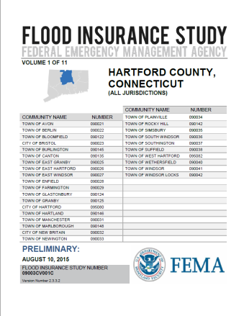
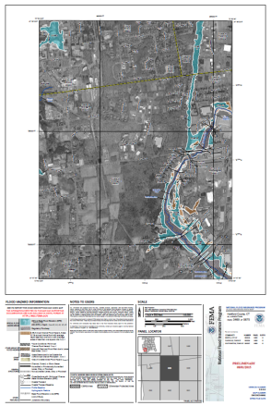
Digital Flood Insurance Rate Maps / Flood Insurance Study
FIS Reports and DFIRM Maps will continue to fulfill
regulatory requirements and support the NFIP
Notes:
Fay
Long-term objectives include
FIS reports will continue to be provided
Database-driven
On-demand updating and delivery
Ability to pull all FIS information related to an area of interest (e.g., political boundary, watershed)
Short-term objectives
Better align DFIRM/FIS tables
Streamlined and searchable text
Improved user guidance
Multi-color on DFIRMs
Accommodate new Risk Assessment tables and text
Provide foundation for future updates to FIS as it moves towards a geo-database driven FIS
Database-driven = FIS elements stored in database by flooding source
Get rid of unnecessary boiler plate text
Update narrative elements to table format (store in DFIRM database)
Align existing tables in FIS report in DFIRM Database
Add new tables for Levees and Coastal (5 to 10)into FIS report (store in DFIRM database and update Appendix L)
Require all new PDF text to be searchable
Deconstruct FIS to database (Need to confirm that communities will still get FIS Report)
Distribution through existing mechanisms (MSC)

Slide 27
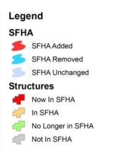
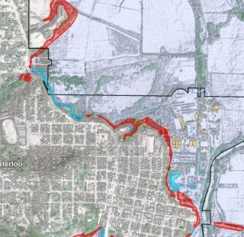
Flood Risk Products
Changes Since Last Map
  Shows areas of change
  Improved outreach
HAZUS Risk Assessment & National Flood Risk Layer
  Enables communities to understand risk by reference to existing structure loss
Notes:
Fay
Changes Since Last Map Product Objective: To enable improved outreach, increase transparency and trust, and to reduce potential delays.
Basic Products – Special Flood Hazard Areas (SFHA) Changes Highlighted, Identifies Impacted Structures, Study Type
Digital data provided to quickly highlight where the SFHA has changed
If building footprint data is available, structures experiencing a change can be symbolized accordingly; otherwise, use National Datasets to estimate impacted structures
Information on potential structures/population affected is included in the Watershed Flood Risk Report, available at the community level
Study processes are uniquely identified (e.g. detailed versus re-delineation)
Multi-Frequency Depth Grid Product Objective: To allow homeowners to comprehend true risk and make better decisions, and enable Benefit Cost Analysis
Profiles Delivered: 10%, 2%, 1%, 1%+ (confidence interval), 0.5%, and 0.2% Annual Chance
Depth grids will help stakeholders better understand their risk. Highlights the fact that there are areas within the SFHA that experience more than 3 feet of flooding even in the 10% annual chance event.

Slide 28
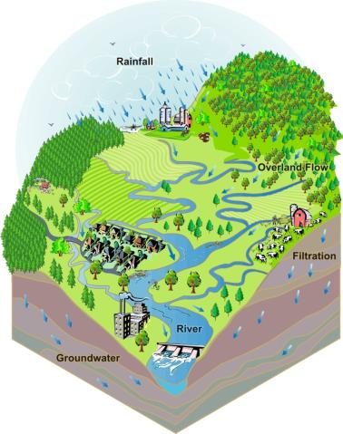

Quinebaug Watershed
Flood Risk Report
Watershed
Flood Risk Report
Changes Since Last Map
HAZUS Risk Assessment
Notes:
Fay
Map Mod focused on production of digital FIRMs at the county level for 92 percent of Nation’s population
Risk MAP flood map updates focus on the engineering data supporting the maps; FEMA is working towards identifying, planning, and producing Risk MAP flood map updates at the watershed level; this does not mean all map panels within a county may need to be updated, but that watershed boundaries were considered in reviewing map update needs and planning mapping projects
Watershed approach also enables broader sharing of flood risk data with communities, other Federal, State, local agencies.
Users receive a flood risk report spanning entire watershed and communities within.
Example shown conveys what the paper report could look like.

Slide 29
Piscataqua-Salmon Falls
Watershed Timeline
Activities
Project Timeline
Products
Projected Preliminary
Projected
Effective
Projected
Flood Study Review
Work Map Meeting
Discovery Meeting
December 2015
Projected CCO Meeting
Projected LFD
Notes:
Fay
Potentially, 50 month schedule
Date prelims
Date LFD
Flood Study Review Meeting ( a couple months before preliminary): After the engineering analysis is completed to present initial mapping results and draft risk assessment products. Presented in work map format
CCO Meeting
Resilience Meeting: Between LFD and effective Date Focus on hazard mitigation plan implementation and available resources. Flood Risk products are again discussed.

Slide 30
Discover the Watershed Communities
Understand local interest, issues, capabilities of communities
  Status of Mitigation Plans
  Communication desire, skills, resources
  Interest in and resources for mitigation
  Experience with flood disasters and recovery
  Floodplain administration
  Mitigation support needs and interests
Notes:
Dick

Slide 31
Hazard Mitigation Plan Status
Please see handout
Notes:
Dick

Slide 32
Discover FEMA Programs
  Flood Mitigation Assistance – annual funding to reduce risk to NFIP-insured structures
  Hazard Mitigation Grant Program – declared disaster funding for long-term hazard mitigation measures
  Pre-Disaster Mitigation Program – annual funding for hazard mitigation planning and implementation
  Community Rating System – proactive communities receive insurance discounts for residents
  National Dam Safety Program – dam safety standards
  Building Science
Notes:
Dick

Slide 33

Communication
Communication, data sharing, and feedback
Role of each community in keeping their communities informed of
  Their flood risk
  Steps they can take to protect themselves and their property
  Study progress
Communication tools available to help communities communicate about risk and projects
Notes:
Dick
Discuss the importance of regular communication, data sharing, and feedback between FEMA and the communities
Discuss coordination with and related resources available from other Federal Agencies, State agencies, and associations
Highlight the role of each community in keeping their communities informed of their flood risk, steps they can take to protect themselves and their property, and study progress
Describe the communication tools available to help communities communicate about risk
Enhances local capabilities to communicate effectively with constituents about risk
Provides customizable communications plans, key messages, and materials to communities

Slide 34
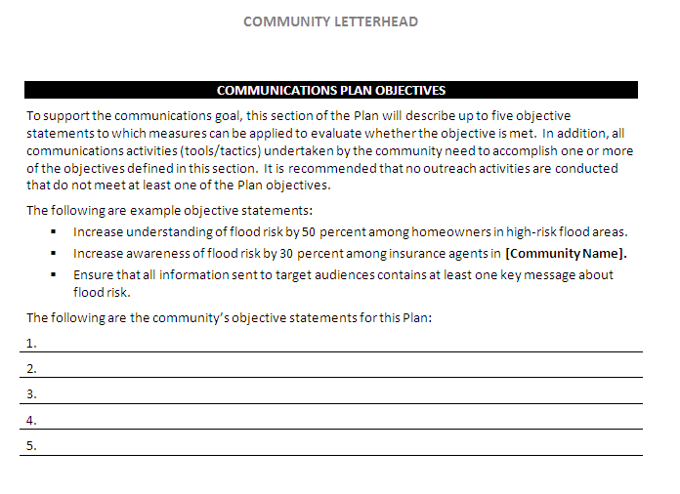
Community Outreach Plan Template
Notes:
Dick
Community Outreach Plan Template

Slide 35
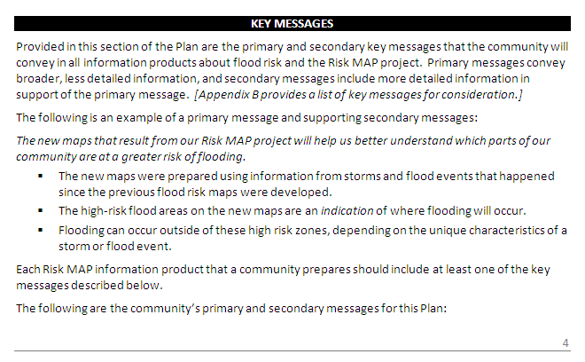
Community Outreach Plan Template
Notes:
Dick
Pre-preliminary templates
Post-preliminary templates
Changes since last map

Slide 36
Points of Contact
Piscataqua-Salmon Falls Watershed
NH State Contacts
  Jennifer Gilbert, NFIP Coordinator, NH Office of Energy and Planning
  jennifer.Gilbert@nh.gov
  Elizabeth Peck, State Hazard Mitigation Program Officer, NH Homeland Security & Emergency Management
  elizabeth.peck@dos.nh.gov,
University of New Hampshire Contacts
  Fay Rubin, Project Director, UNH
  fay.rubin@unh.edu
  Chris Phaneuf, GIS Specialist, UNH
  chris.phaneuf@unh.edu
FEMA Contacts
  John Grace, Project Manager and Coastal Engineer, FEMA Region I
  john.grace@fema.dhs.gov
  Marilyn Hilliard, Risk Analysis Branch Chief, Mitigation Division, FEMA Region I
  marilyn.hilliard@fema.dhs.gov
  Richard Verville, Hazard Mitigation Branch Chief, Mitigation Division, FEMA Region I
  richard.verville@fema.dhs.gov
  Karl Anderson, Floodplain Management & Insurance Branch, FEMA Region I
  karl.anderson@fema.dhs.gov
FEMA Regional Service Center
  Alex Sirotek, RSC Lead, Compass PTS
  sirotekar@cdmsmith.com
Notes:
Fay

Slide 37
General Points of Contact
For general FEMA mapping and Letter of Map Change (LOMC) questions contact FEMA’s Map Information Exchange (FMIX): 1-877-FEMA MAP (1-877-336-2627) or email a Map Specialist: FEMAMapSpecialist@riskmapcds.com
Map Service Center (MSC): where you can view effective maps online for free http://www.msc.fema.gov/
To learn more about the National Flood Insurance Program (NFIP): http://www.floodsmart.gov/floodsmart/ or call 1-888-379-9531

Slide 38
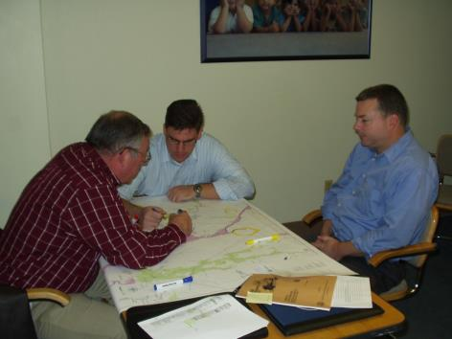
Optional Breakout Session
Community -specific questions on:
Study Areas
Data Availability on a Community and Watershed Basis
QUESTIONS??
Notes:
Fay

Slide 39
Data Request
Names, titles, roles, addresses, emails, and numbers of community officials involved in NFIP program, floodplain management, etc.
Desired study reaches
Existing data studies
Available funding or data to contribute to a potential study
Areas of Mitigation Interest
Existing, proposed, or altered dams and levees
Past mitigation successes, future mitigation goals
Environmentally sensitive areas
Community-level flood hazard, risk, or general GIS data
Outreach or training methods, goals, and needs
See questionnaire, and/or provide information whenever possible
Notes:
Fay
Reminder of what we’re looking for …

