Slide 1
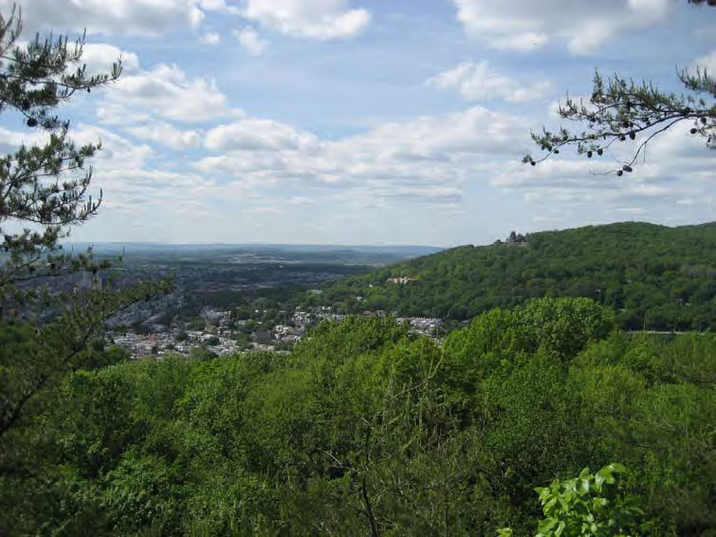

Water Resources
Connecticut 2010 Update
Highlands Regional Study
Scientific team
Elizabeth Ahearn, David Bjerklie,
John Mullaney, Virginia de Lima

Slide 2
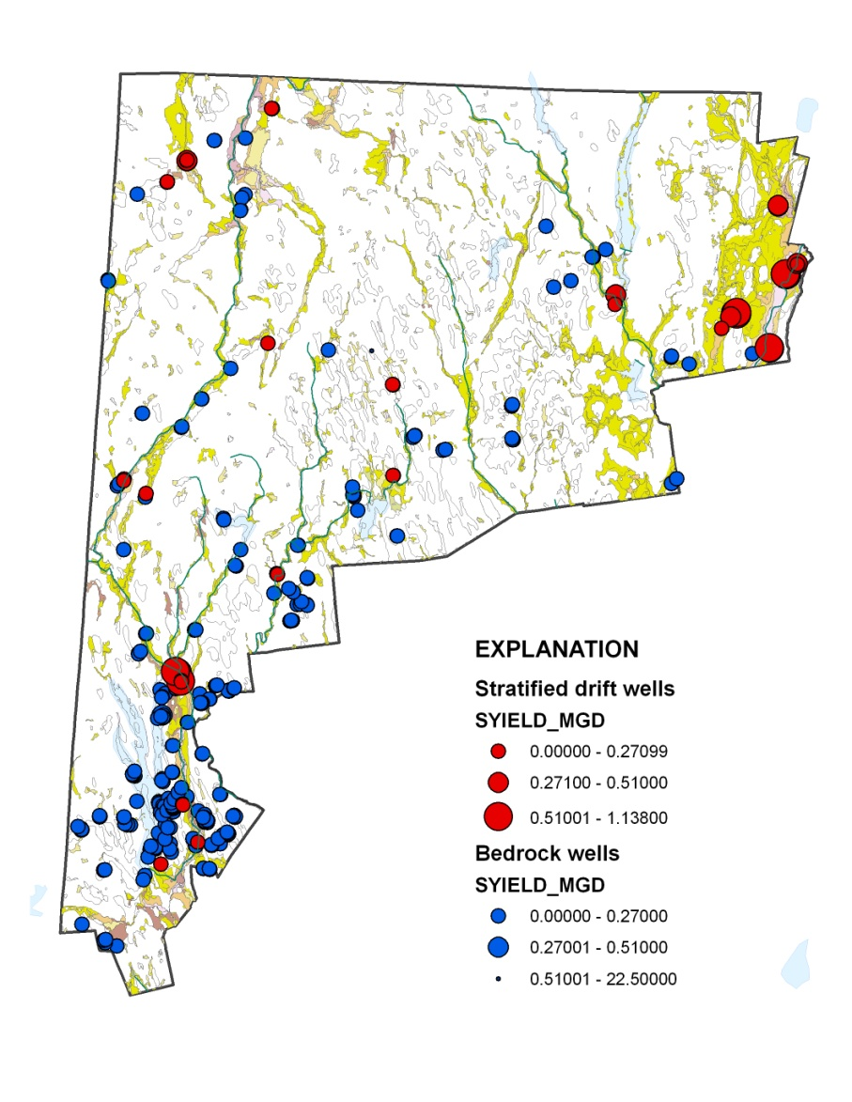
Major Aquifers
Safe Yields of Community Wells
Glacial aquifers (46 wells)
15.3 million gallons per day
Bedrock aquifers (150 wells)
3.9 million gallons per day

Slide 3
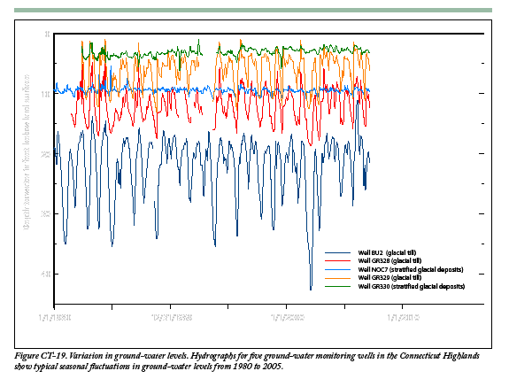
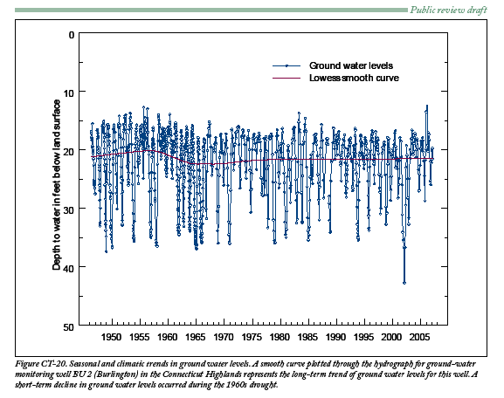
Typical ground water levels over time in glacial till and glacial stratified aquifers
Seasonal and climatic changes

Slide 4
Ground water – Key Findings
Average of Yields
Glacial (sand/gravel) 0.318 Mgal/d
Bedrock 0.026 Mgal/d
Ground water Withdrawals for Domestic Uses
  12.3 Mgal/d (self supplied)
  4.2 Mgal/d (public suppliers)
    196 Community Wells – Public Water Supply System
    19.2 Mgal/d – Total Safe Yield
    Withdrawals during summer
    75 percent of safe yield, and
    90-100 percent of safe yield (smaller systems)

Slide 5
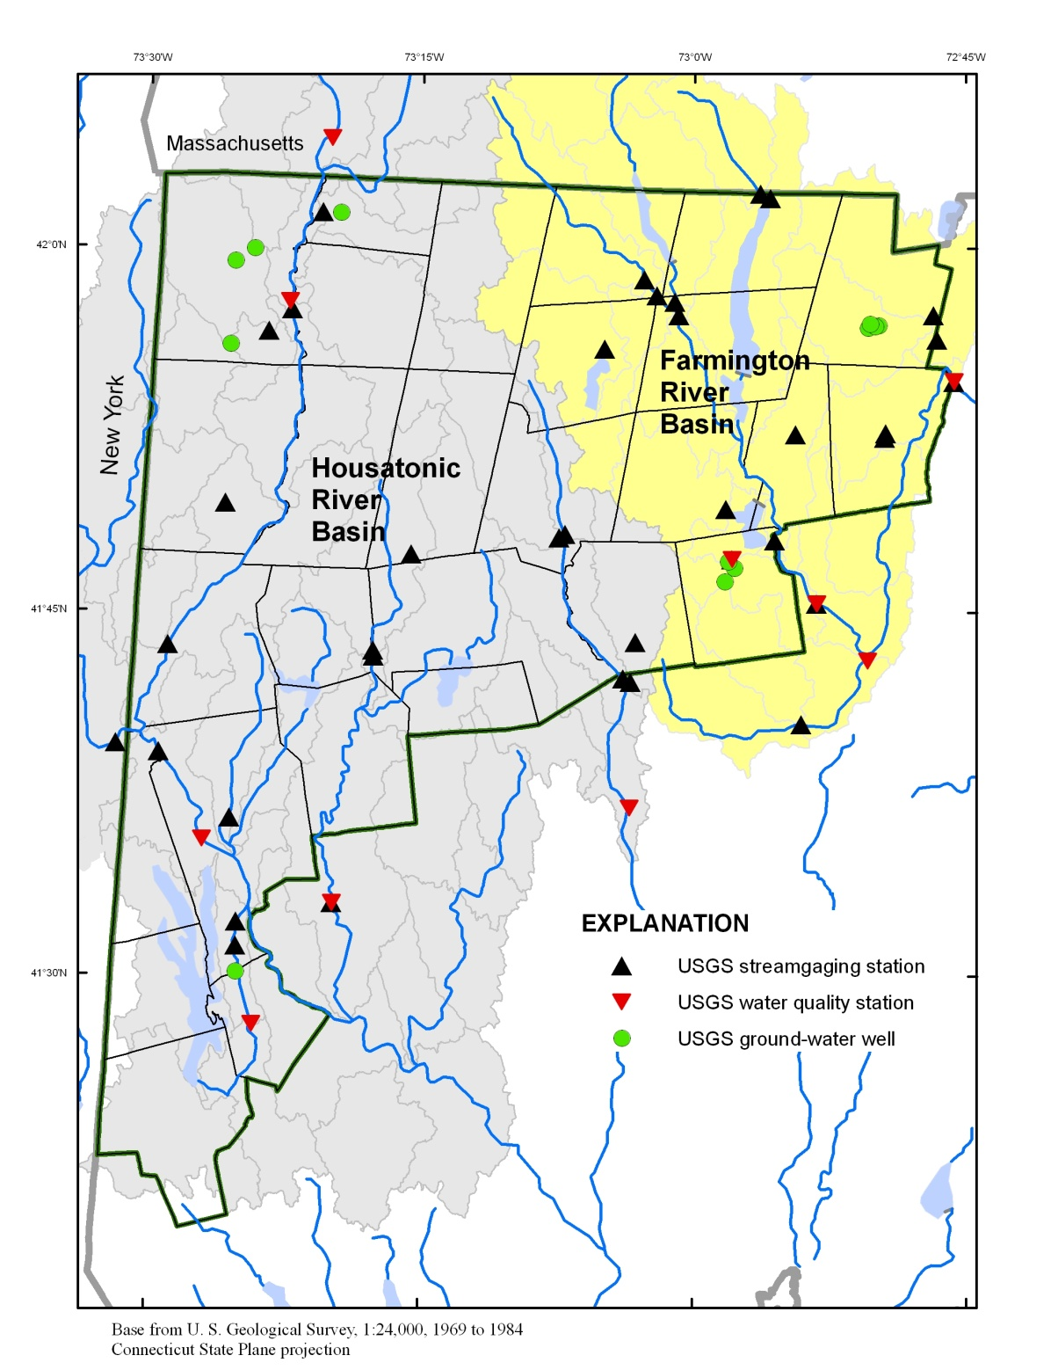
SURFACE WATER
Mean annual streamflow
1.78 ft³/s/mi²
1.15 gal/d/mi²
(0.90-2.37 ft³/s/mi² )
Mean annual baseflow
1.25 ft³/s/mi²
0.81 gal/d/mi2
(0.60-1.71 ft3/s/mi2)

Slide 6
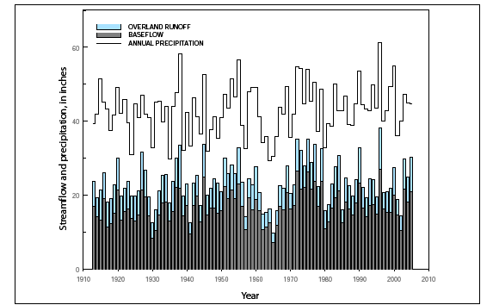
Annual variation of streamflow, baseflow, and precipitation
Housatonic River Falls Village
During 1960 drought, streamflow was 30-60 percent less than long term average
During wet years, streamflow was 50-65 percent greater than long term average

Slide 7
Annual Water Production, 2005
32.3 billion gallons
88.6 Mgal/d (average)
28.2 of 32.3 billion gallons exported out of Highlands

Slide 8
Surface water – Key Findings
Public-supply reservoirs are a major water supply source for communities in and adjacent to the Highlands.
Reservoirs combined safe yield of 124 Mgal/d.
In 2005, withdrawals averaged about 89 Mgal/d.
87 percent of SW withdrawals exported.

Slide 9
Water Use (2005) —Key findings
125 Mgal/d — Total Use
109 Mgal/d ― Public Suppliers
25 Mgal/d — Domestic Use
52 percent (154,000) community water systems.
48 percent (145,000 ) private wells (self-supplied)
374 Mgal/d — Registered and Permitted Diversions
(the maximum daily withdrawals authorized by the State)
Safe Yield of Existing Systems – 143 Mgal/d

Slide 10
Water Quality—Key findings
Ground water provides high quality water to streams
Upland streams are suitable for multiple uses.
Natural contaminants in the ground water (radon, iron, manganese)
Pesticides detected in ground water at 20 percent or more of stream sites
Some of larger rivers are impaired.
Concentrations of dissolved trace metals are elevated
Nutrient criteria commonly exceeded
High concentrations of PCBs
Urban and agriculture contributed to excess concentrations of
nitrate nitrogen, VOCs, pesticides
Water quality is improving downstream from wastewater –treatment facilities since 1970’s.

Slide 11
HOUSATONIC RIVER AT STEVENSON

Slide 12
Housatonic River at Stevenson

Slide 13
Water Quality Trends—Key Findings
Total Phosphorus
Farmington Tariffville —downward (1975-03) upward (1993-03)
Farmington Unionville —no trend (1993-03)
Housatonic Stevenson —downward (1975-03, no trend 1993-03)
  Total Nitrogen
  Farmington Tariffville —no trend (*downward flow-adj 1975-03)
  Farmington Unionville —no trend (1993-03)
  Housatonic Stevenson —downward (1975-03) no trend 1993-03)

Slide 14
YIELDS OF TOTAL NITROGEN
PERCENTAGE OF LAND DEVELOPED

Slide 15
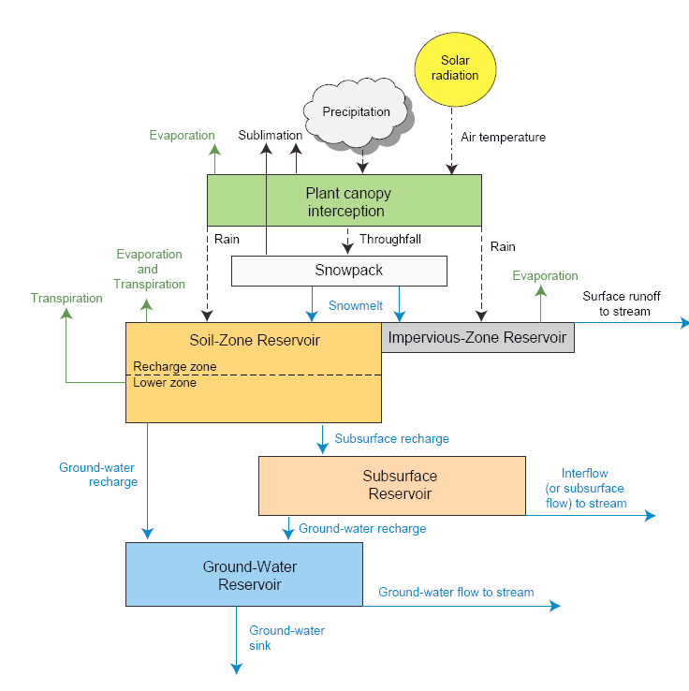
Precipitation Runoff Modeling System (PRMS)
Model Inputs
Precipitation
Temperature
Land cover
Vegetation
Soil
Elevation
Drainage density

Slide 16
Regional Water Budget
Precipitation 5,296 Mgal/d
Streamflow 2,569 Mgal/d
Baseflow 1,727 Mgal/d
Runoff 842 Mgal/d
ET 2,642 Mgal/d
Transfers 77.3 Mgal/d Consumptive use 7.5 Mgal/d

Slide 17
Increase in Impervious Area
4.4 percent average increase impervious surface
[range 0.2 to 8.9 percent]
0.8 percent average increase in effective impervious surface [range 0.1 to 1.7 percent]
Population Increases
270,000 to 370,000 additional people
New groundwater withdrawals 22 to 34 Mgal/d

Slide 18
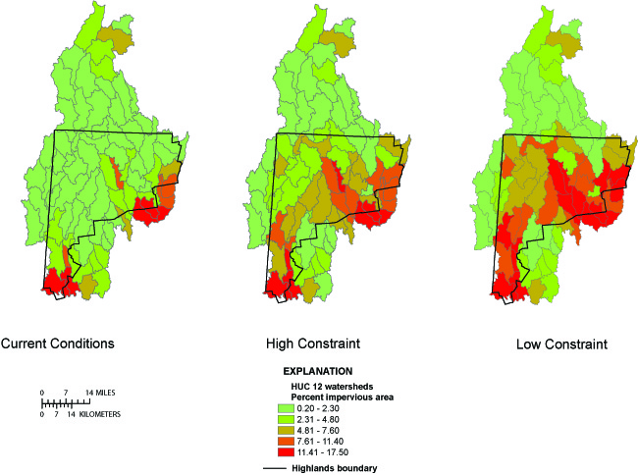
Water use—Key findings

Slide 19
Impacts of Increase in Impervious Area
on Water Resources
Decrease in baseflow 8 to 31 Mgal/d
Increase in runoff 21 to 76 Mgal/d
Increase in streamflow 12 to 45 Mgal/d

Slide 20
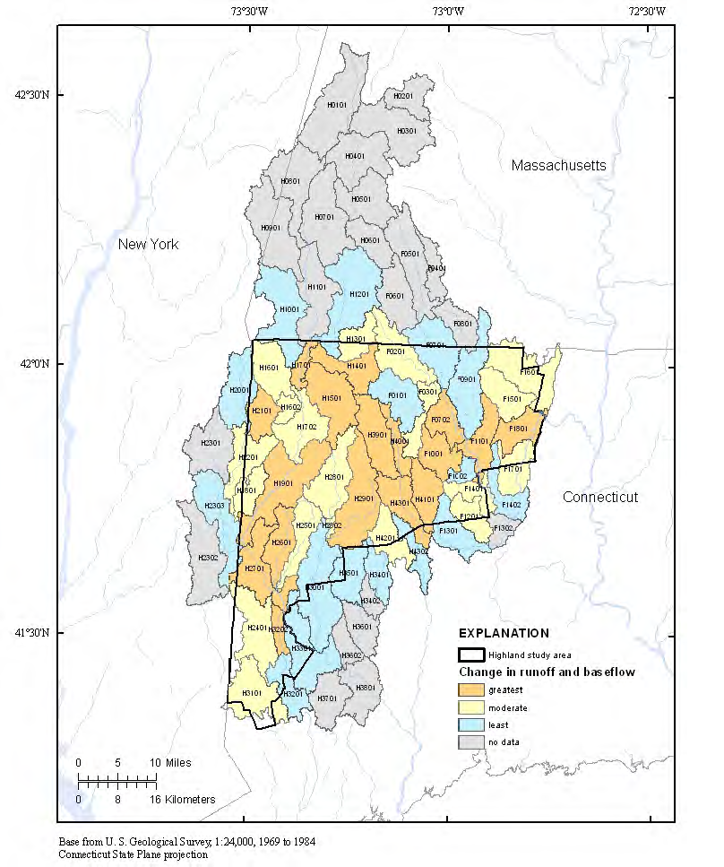
Areas of moderate and greatest change
aaaaaaaa
Farmington River (F1101)
Nepaug River
Housatonic River (H1901 and H2701)
Blackberry River
West Aspectuck River
Leadmine Brook
West Branch Naugatuck
Naugatuck River (H4301)

Slide 21
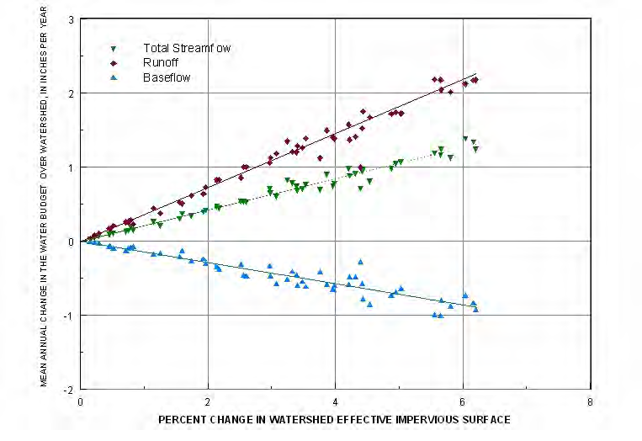
Changes in the water budget are directly proportional to changes in the impervious surface area
Notes:
Sharon, CT ------Mudge Pond Brook, which has a 5 percent increase in effective impervious surface under the low-constraint scenario.
A potential change of 1.0 Mgal/d in Q represents a large portion of the available water during seasonal dry periods and could compromise water availability and quality, and ecosystem health.
Under the low-constraint scenario, 8 of 74 12-digit-HUC subwatersheds have increases in effective impervious surface greater than 5 percent.
The water budget model indicates a potential 1.7 inch per year (1.6 Mgal/d) increase in runoff, a 1.1 inch per year (1.0 Mgal/d) increase in streamflow, and a 0.6 inch per year (0.6 Mgal/d) decrease in mean annual base flow for Mudge Pond Brook.

Slide 22
Water Budget– Key Findings
Increases in ground water withdrawals and impervious area will put additional stresses on the resources by reducing water availability and degrading the water quality of the streams.
Consider evaluating changes to monthly or seasonal water budgets when making water resources management decisions.

Slide 23
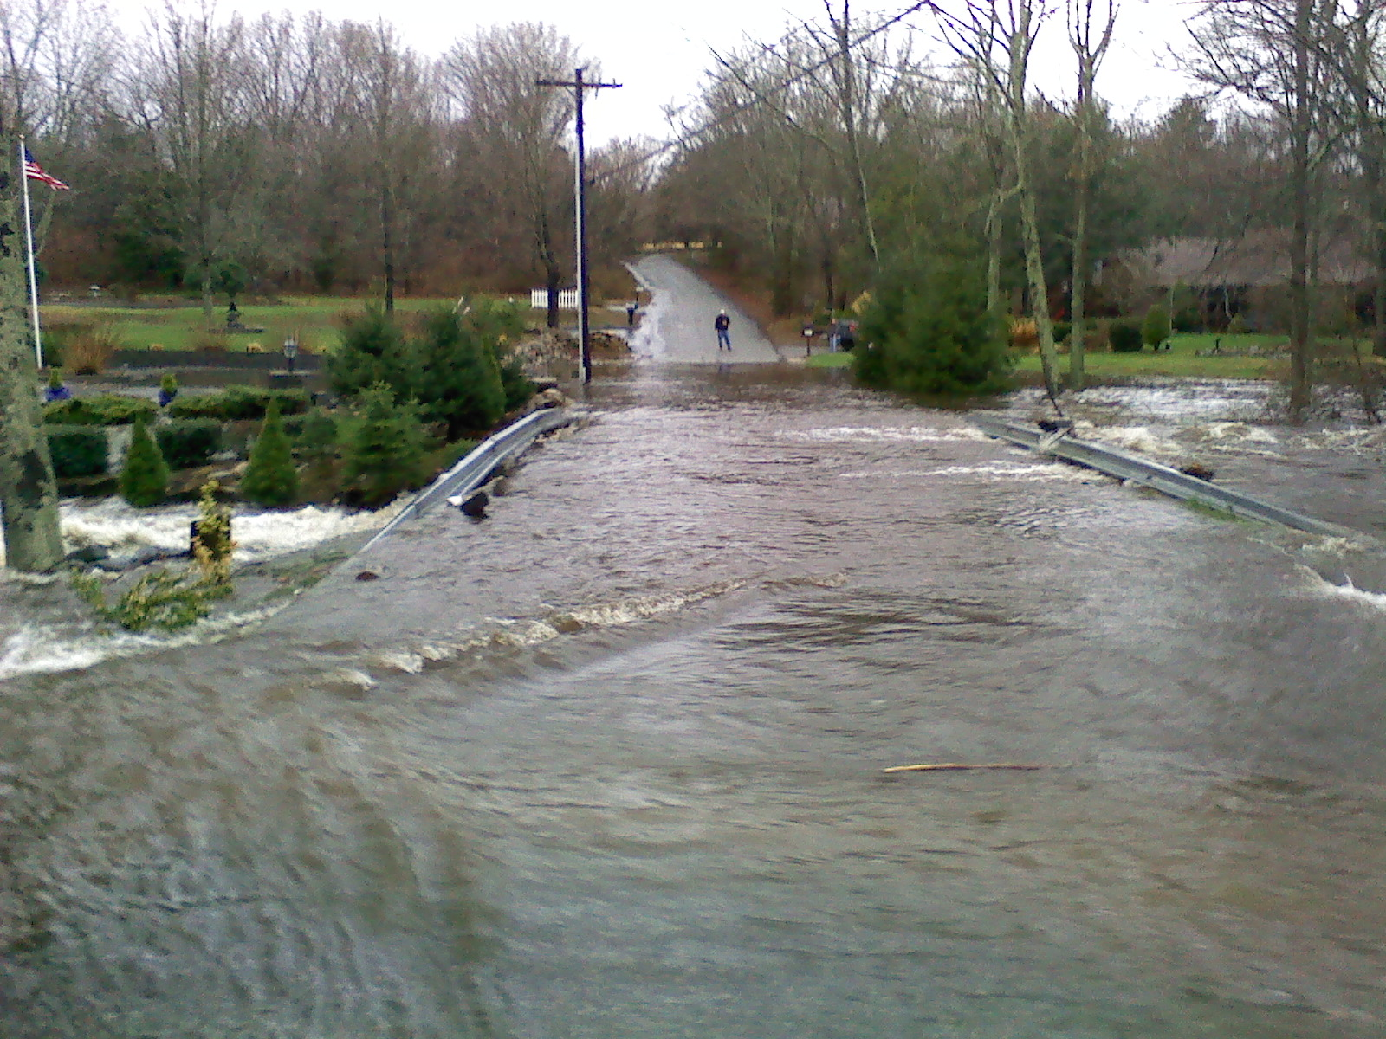
THE END.
April 1, 2010

Slide 24
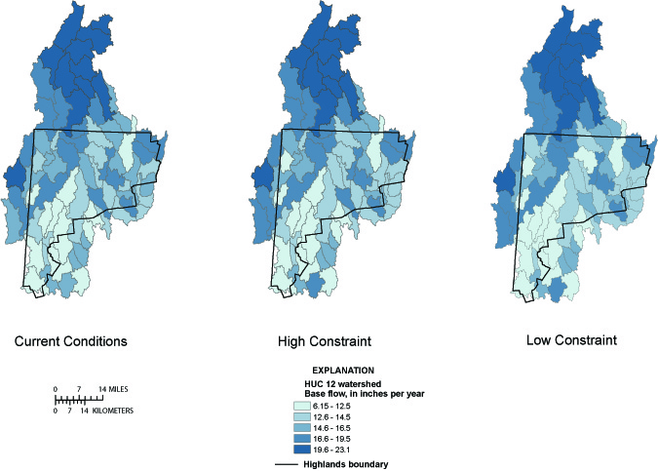
Water use—Key findings

Slide 25
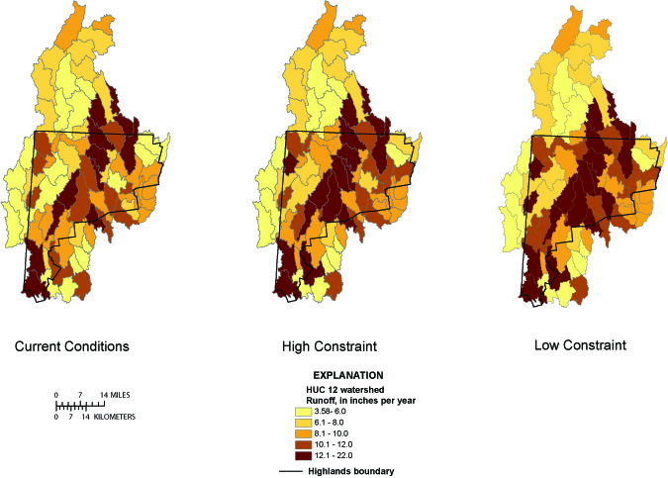
Water use—Key findings

Slide 26
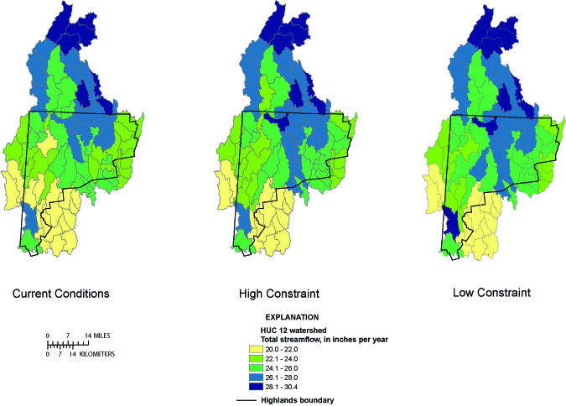
Water use—Key findings

