Slide 1
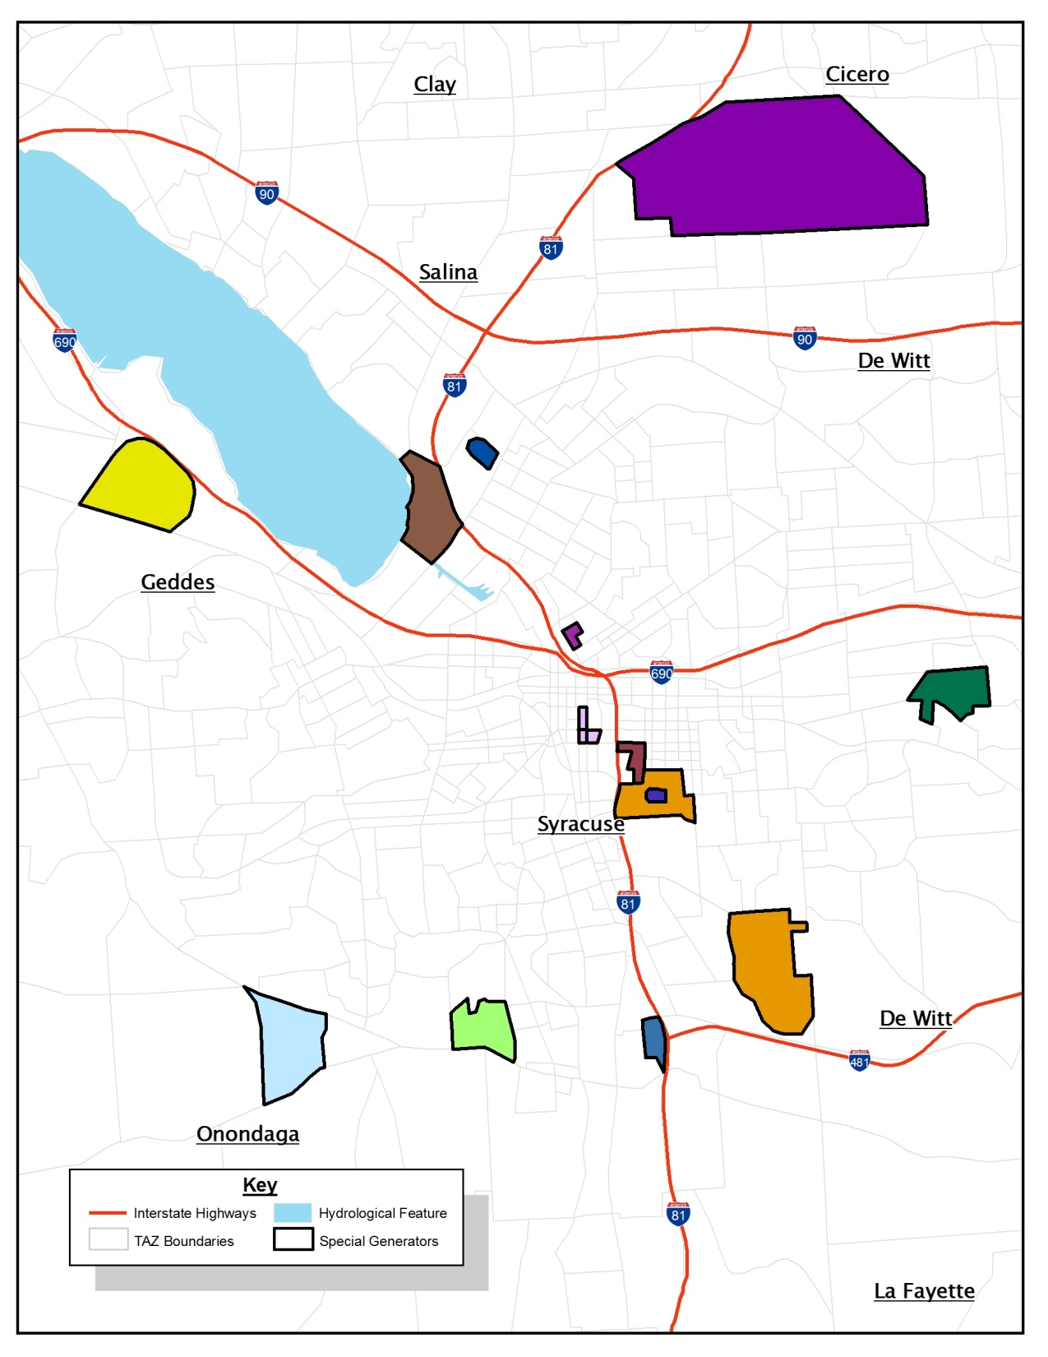
Hancock International Airport
The New York State Fairgrounds
NBT Bank Stadium
Destiny USA
St. Joseph’s Hospital
Le Moyne College
OnCenter
Upstate Medical
University Hospital
Carrier Dome
Syracuse University
Main Campus
Onondaga Community College
Syracuse University
South Campus
Community General Hospital/
Van Duyn Home and Hospital
Loretto

