Slide 1
Using FEMA’s Flood Risk Products to Increase Flood Resiliency
City of Dover
October 25, 2016

Slide 2
Welcome and Introductions
Agenda Items
Overview of the FEMA Flood Risk Products
Flood Risk Analysis Results for Your Community
Using the Flood Risk Data for Your Community’s Planning Initiatives

Slide 3
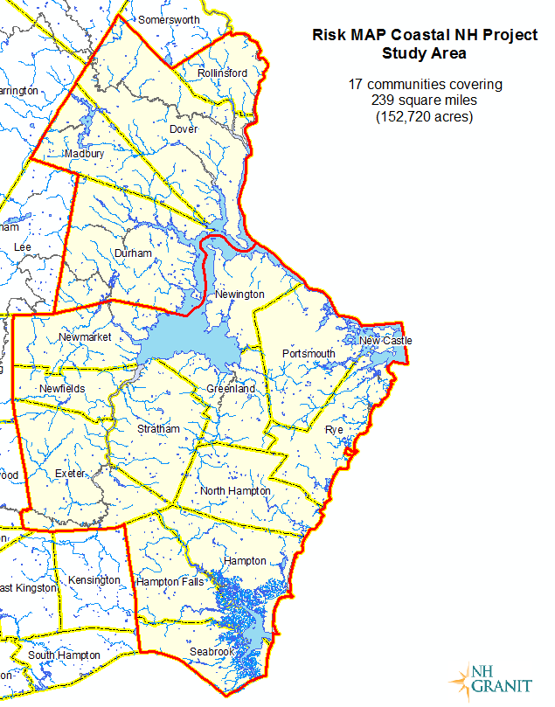
Coastal Project Summary
Four communities in Strafford County were part of the FEMA Risk MAP Coastal Project.
Flood Insurance Rate Maps (new format) and Flood Insurance Study went effective on 9/30/15.
Flood Risk Products were also produced.
1st time these products were released in NH
Strafford County
portion
Rockingham County
portion
Notes:
Changed graphic as it appeared washed out

Slide 4
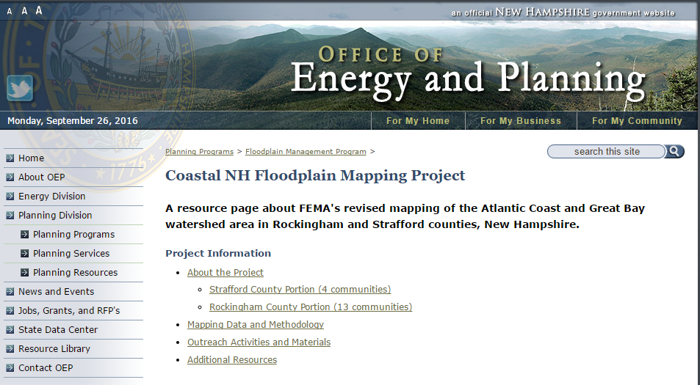
www.nh.gov/oep/planning/programs/fmp/ coastal-mapping-project/
Notes:
Replaced top graphic to fix typo

Slide 5
Flood Risk Products for Your Community
Fay Rubin, Chris Phaneuf, NH GRANIT
Notes:
Merged slides from Rubin/Phaneuf pieces

Slide 6
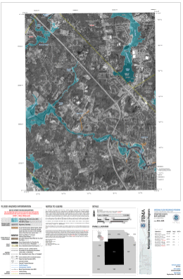
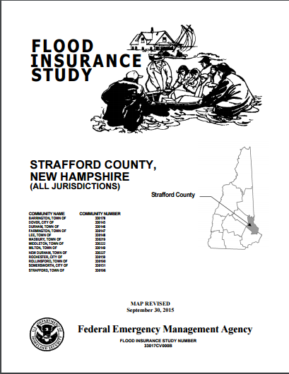
NFIP Regulatory Products
Required under the National Flood Insurance Program (NFIP)
Notes:
Purpose of the meeting – review the nonregulatory products that are available. But to provide context, we also produced the standard regulatory products required to support the NFIP – Flood Insurance Report and map panels. These are available from the MSC. We also have them available on the GRANIT web site.

Slide 7
Flood Risk Products
Products are not required by the NFIP (Non-Regulatory)
Products are intended to help communities better understand and communicate flood risk
All products are based on GIS analysis
Notes:
Note about GIS analysis – most of the data sets that you will see are available as GIS data layers in the Flood Risk database. But there is one notable exception that we will review during the presentation.

Slide 8
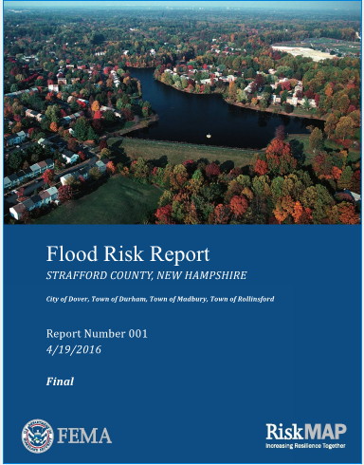
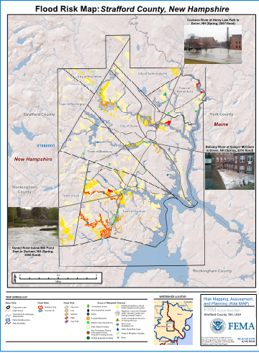
Flood Risk Products
Flood Risk Report
Flood Risk Map
Flood Risk
Database
Notes:
Standard Flood Risk Products. Contents are governed by FEMA guidelines. Available from the MSC. Flood Risk database requires GIS software to really utilize, but the other products are in a format that anyone can utilize/read.

Slide 9
Flood Risk Database
Changes Since Last FIRM
Flood Depth and Analysis Grids
Estimated Flood Loss Information (Not part of database for this project)
Areas of Mitigation Interest
Notes:
Here are the 4 standard layers in the Flood Risk Database. For some studies, there may be additional layers. For some studies, there may be additional layers. As noted, the estimated flood loss information, which is essentially potential economic damages associated with a flooding event, is not part of this particular flood risk database.

Slide 10
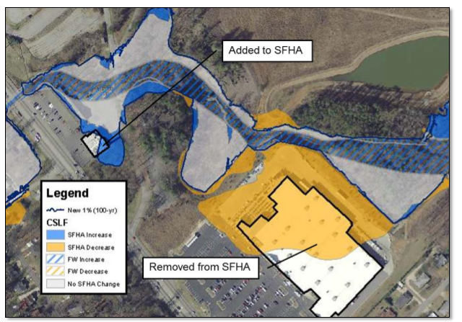
Changes Since Last FIRM
Indicates changes in horizontal extent of the floodplain
Attributes in dataset may include engineering factors that contributed to the map changes
Notes:
Represents changes in mapped horizontal extent of floodplains, and/or changes in flood zone designation. So users can see where floodplains have expanded or contracted as a result of new mapping. They can also see where a flood zone designation has changed. The dataset may include the engineering factors that contributed to the change, typically new hydrologic model, new hydraulic structure (e.g. bridge), etc. In the case of Strafford County, the factor that most often contributed to changes in mapping is new topographic data from LIDAR.

Slide 11
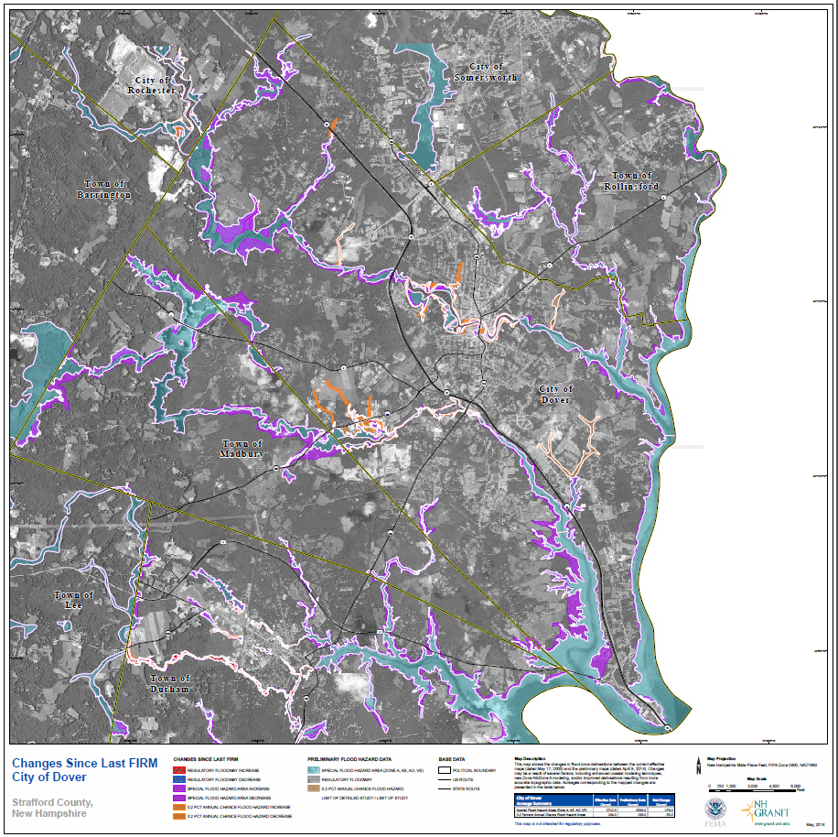
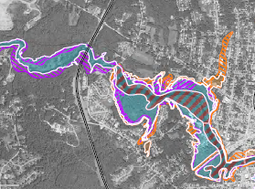
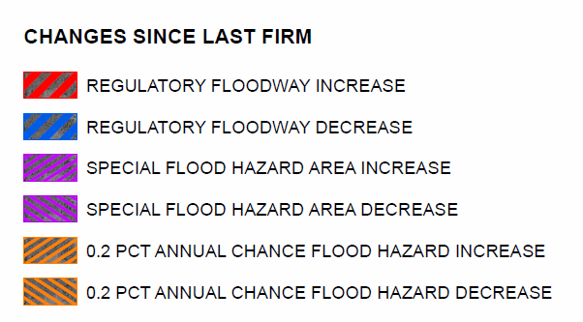
Changes Since Last FIRM
Notes:
1st Flood Risk Product to be released in May 2014. Available on OEP’s web site.
- Dataset was created my merging (unioning) the previously effective 2005 floodplain data with the new floodplain data (that became effective in 2015).
- Looks at increases and decreases in the floodplain mapping as well as any changes in zone designation.
- Seen here is the Changes Since Last FIRM map for Dover.
- Additionally, the data are available as a GIS feature class in the Flood Risk database and community summaries are also available in the Flood Risk Report.
- Zooming in around Cocheco River - can see areas of floodplain increase, small fringe areas of floodplain decrease, and areas of floodway increase/decrease.

Slide 12
Changes Since Last FIRM
Notes:
- Here, you can see the Changes Since Last FIRM summary for Dover.
- Shows the town area, the number of acres for Special Flood Hazard Areas (A, AE, AO) previously mapped, currently mapped, areas where the floodplains have increased, where they’ve decreased, and finally the net change in the number of acres mapped. Note that there has actually been a reduction in acres mapped as 100-year floodplain zones in the city of Dover, as well as the 4-town area studied.

Slide 13
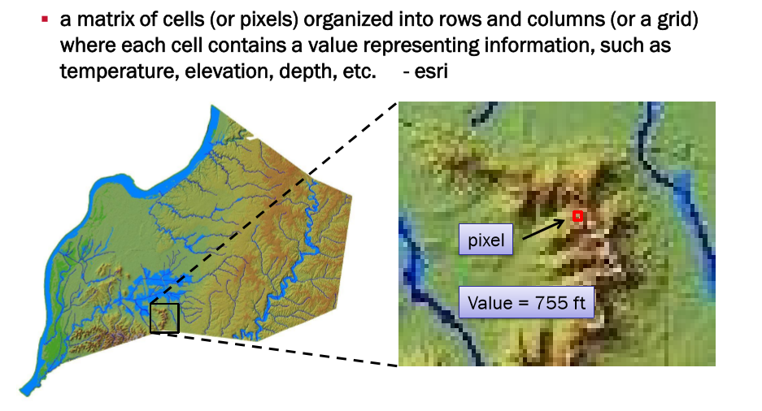
Flood Depth Grids
What is a “Grid”?
Notes:
Second standard products – flood depth grids. Before discussing that particular product, I want to review what we mean by a grid. It’s a data format consisting of a series of pixels or grid cells in rows and columns, with each cell having a unique value. Typically used to represent data that are continuous in nature – for example topographic data, precipitation data, etc. In this case we’re looking at a topographic grid, where each cell carries a value that represents the elevation at that location.

Slide 14
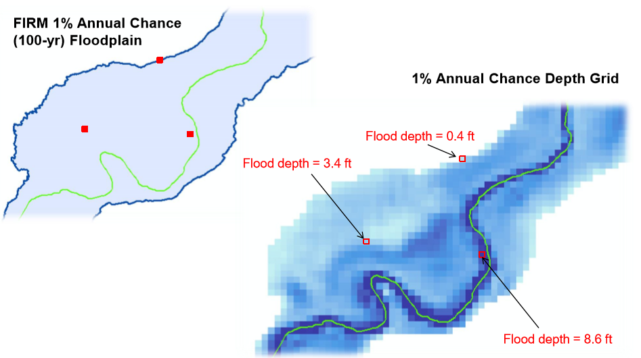
Flood Depth Grids
Notes:
UNH
Helps communicate that the level of hazard, and therefore the level of risk, varies within the mapped floodplain areas. Typically database includes a range of flood frequencies (depth grids for the 10% (10-year) 4% (25-year) , 2% (50-year) 1% (100-year), and 0.2% (500-year) annual chance events). Other analysis grids may also be in the database, including water surface elevation, percent annual chance of flooding and percent chance of flooding over 30-year period (e.g. over lifetime of a mortgage).

Slide 15
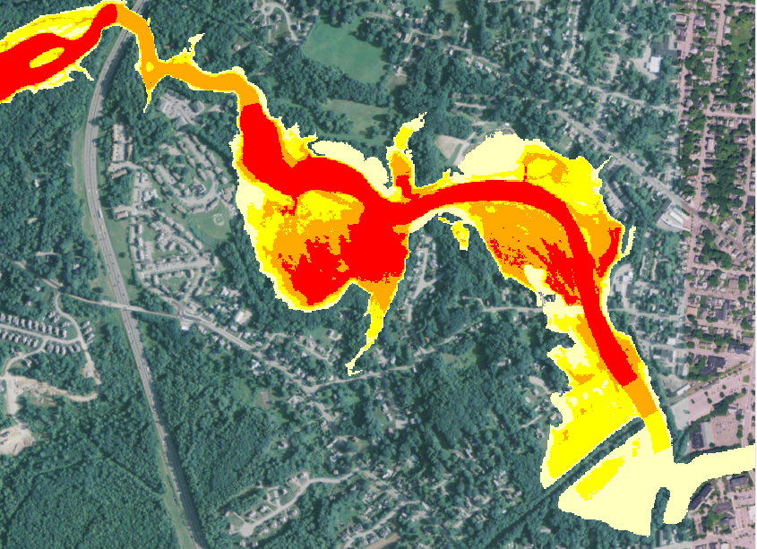
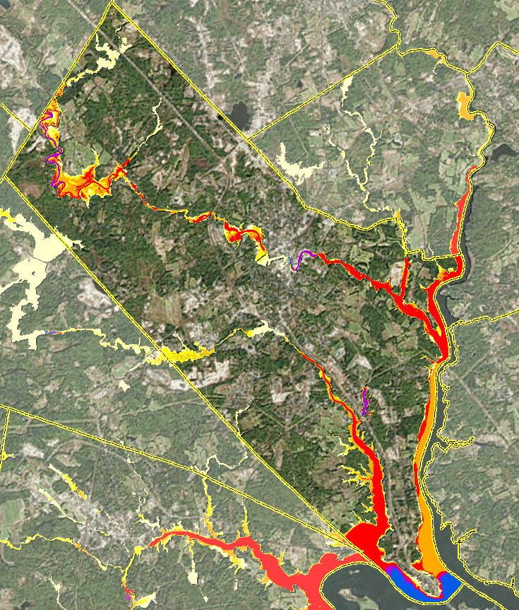
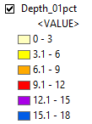
Flood Depth Grid: 1 Pct Chance Event
Notes:
Area zoomed in – Cocheco River, Dover
Again, as previously mentioned, the depth grids are a useful product in that they show not only the extent of flooding, but also the anticipated depth of flooding.
The image shown here is displaying ranges of depth values, but the data itself can also be accessed in the Flood Risk Database as raster datasets and you can actually identify individual pixel values to determine the specific depth at any given location.

Slide 16
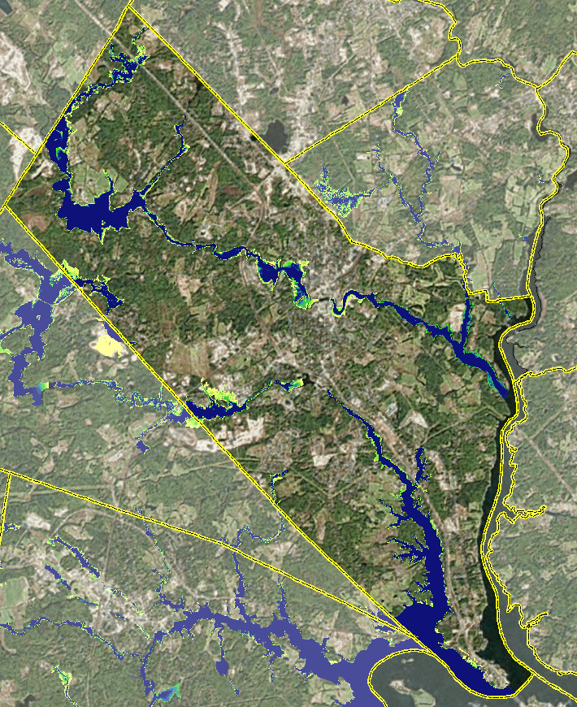
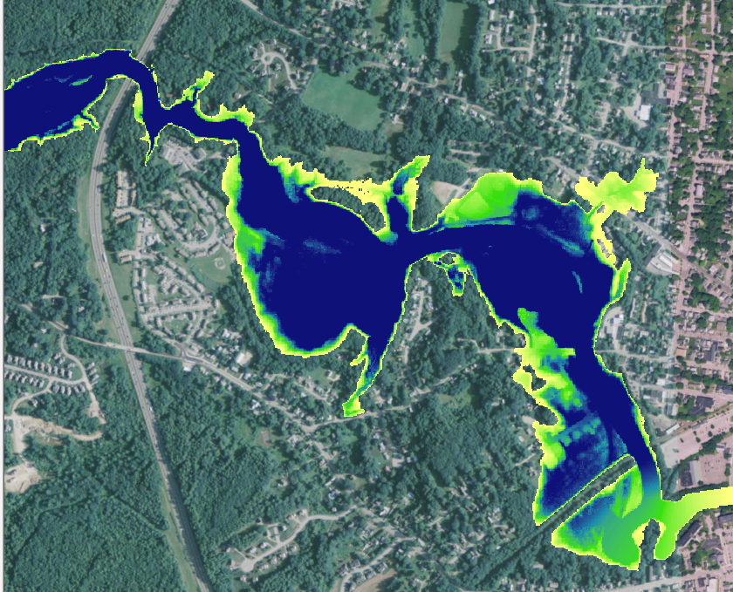
Flood Depth Grid: Pct 30-Year Chance

Slide 17
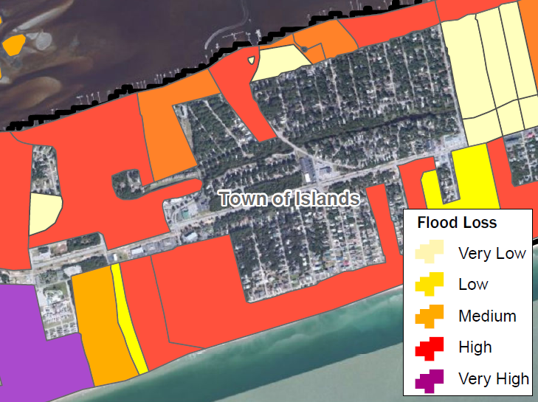
HAZUS-Multi-Hazard Flood Risk Assessment
Annualized flood losses are displayed on the Census Block Data
Aimed at depicting general flood loss areas
Notes:
Modeling software developed by FEMA to allow users to estimate economic losses associated with various flooding events. The software can actually model losses from earthquakes, hurricanes, and floods. It is capable of modeling physical, economic, and social impacts of these disasters, although we typically focus on the economic aspect.

Slide 18
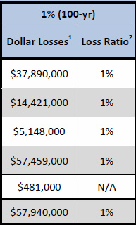
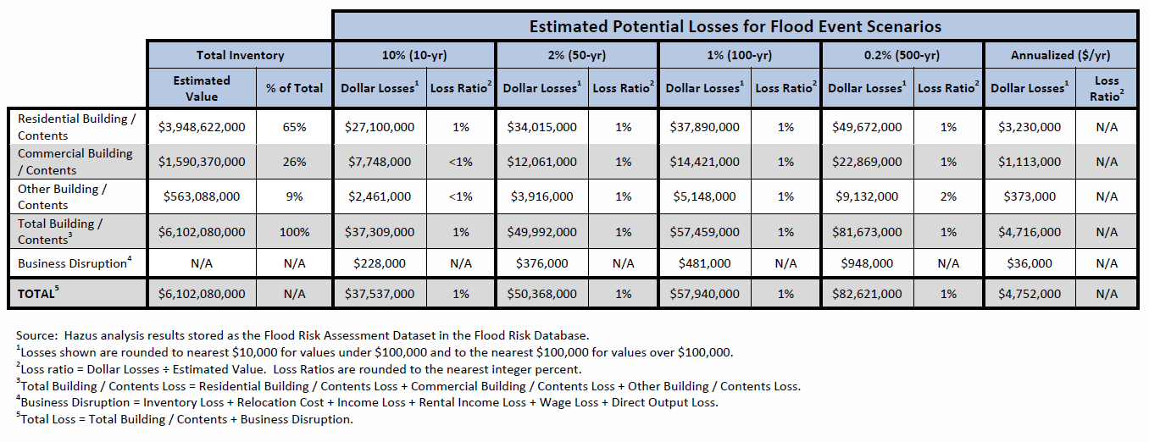
Estimated Potential Losses for Flood Event Scenarios Table
Notes:
Focusing on potential losses associated with 100-yr flood.
This slide shows the results of the HAZUS analysis
This project utilized what’s known as a Level 1 analysis, the most basic. It uses the census data and its generic building stock information when calculating the dollar loss amounts for the various flood event scenarios.
For example, the results shown here are reporting that during a 100 year flood event, anticipated losses for residential building and contents would be approximately $37.9 million. Further, it shows the loss ratio (which is the percentage that dollar amount is of the estimated value for all of Dover’s residential building and contents). In this case - ~1%.
It should be noted that a more accurate analysis could be conducted if local building footprint data were used.
- This data is only available in the form of tabular reporting in the Flood Risk Report. Not available in the Flood Risk Database.

Slide 19
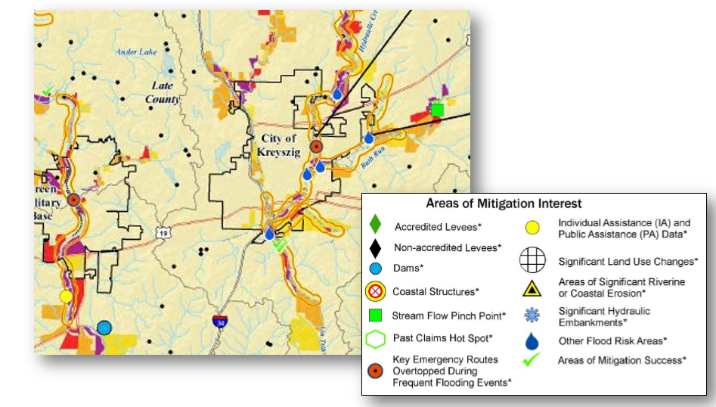
Areas of Mitigation Interest
At Risk Essential Facilities
Dams
Streamflow Constrictions
Past Claims Hot Spot
Individual and Public Assistance Data
Areas of Mitigation Success
Notes:
Another data set that is included in the flood risk database, the flood risk report, and the flood risk map. Identifies specific locations within a community that are of particular significance – includes areas of concern as well as areas of mitigation success.
Helps communities understand impact of multiple physical factors on the floodplain elevation and extent. Identifies conditions that may contribute to the severity of the flood hazard.

Slide 20
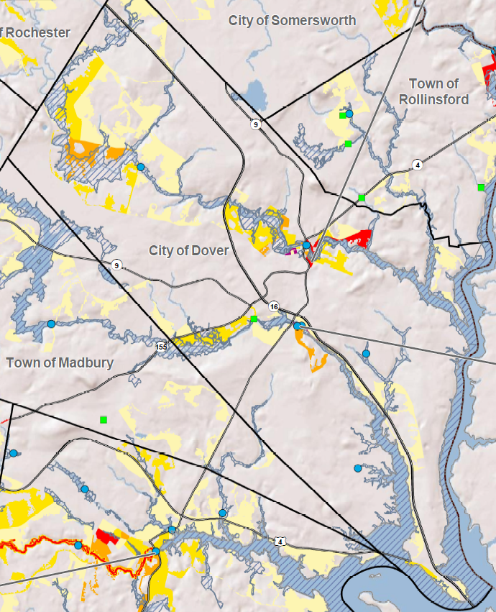
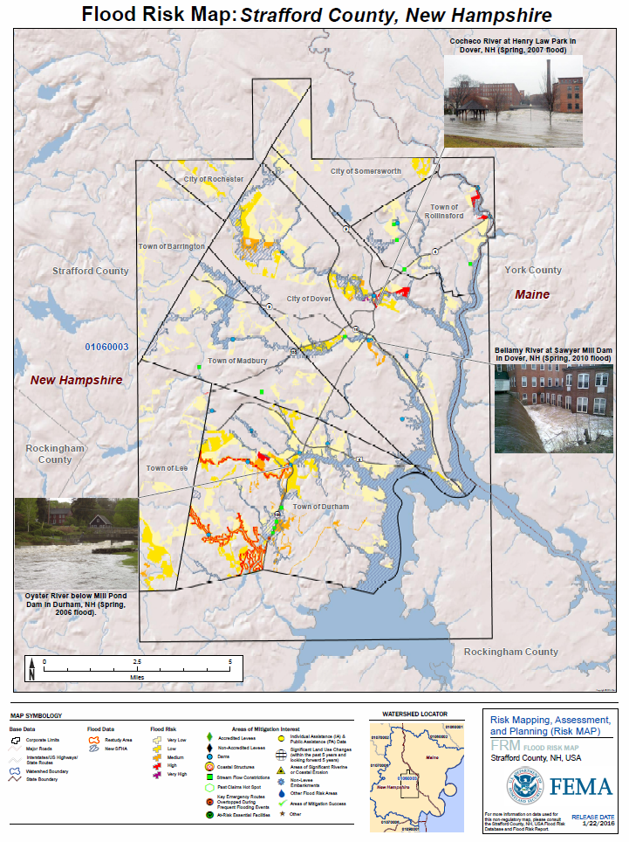
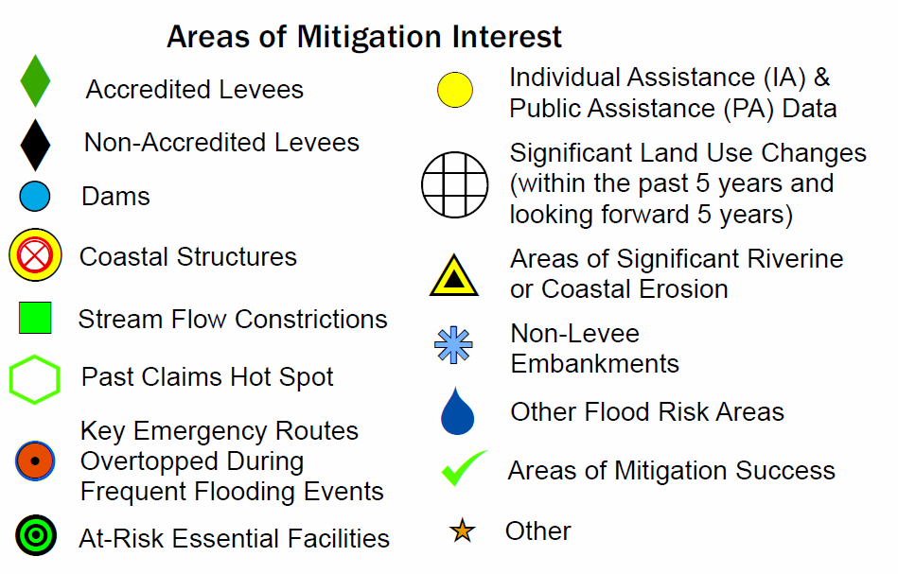
Areas of Mitigation Interest
Notes:
Areas of Mitigation Interest:
Features like levees, dams, streamflow constrictions (typically undersized culverts), essential facilities that are in (or very nearly in) a floodplain.
This dataset was developed first by assembling what we could from known available GIS data resources:
(ex: dam locations extracted from DES statewide dataset, undersized culverts from USGS stream crossings study/data set)
The data were then presented in the form of a map to each community requesting from community officials their review and further input for additional areas of concern and areas where there’s been mitigation success. That input was then incorporated back into the dataset and the results can be accessed in all 3 Flood Risk Products.

Slide 21
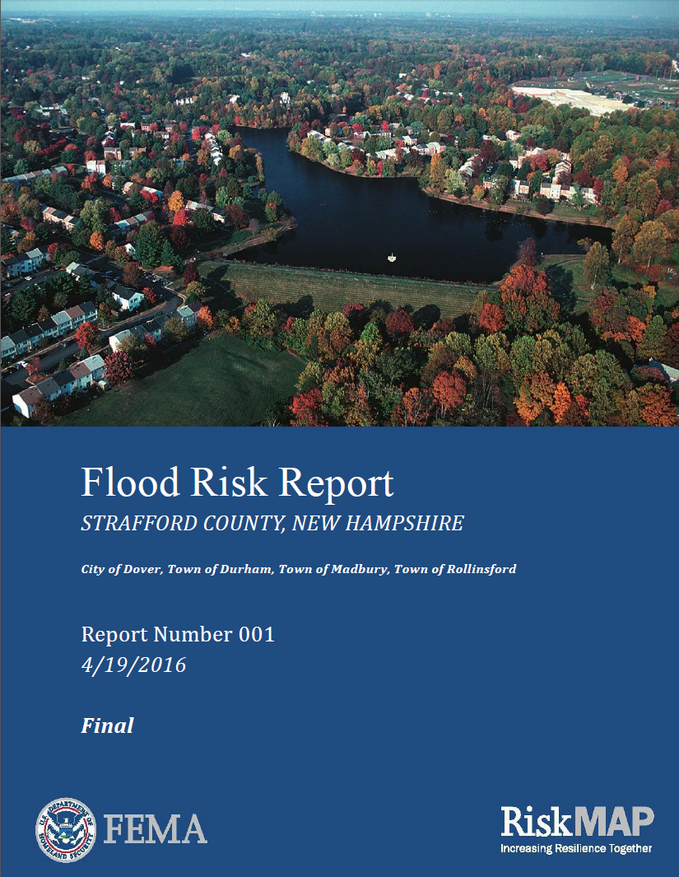
Flood Risk Report & Map
Notes:
- Finally, the Strafford County Flood Risk Report, Map and Database are all available for download from FEMA’s Map Service Center. There is a handout containing instructions on how to access these products.
- Questions? Or hand over to Kyle.

Slide 22
Using the Flood Risk Data for Your Community’s Planning Initiatives
Kyle Pimental, Strafford Regional Planning Commission

Slide 23
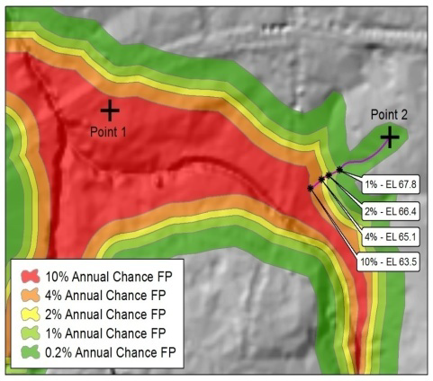
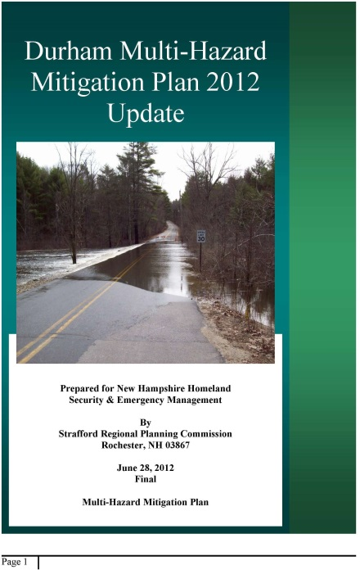
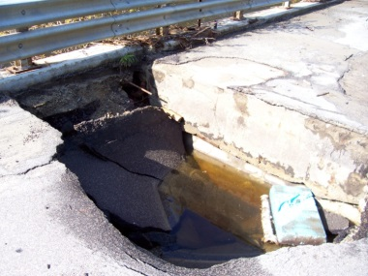
Uses of Flood Risk Data
Identifying vulnerable areas that may need additional focus
Develop mitigation strategies and techniques
Flood Depth Grids
Estimated Loss Information
Areas of Mitigation Interest
Incorporating into local planning mechanisms

Slide 24
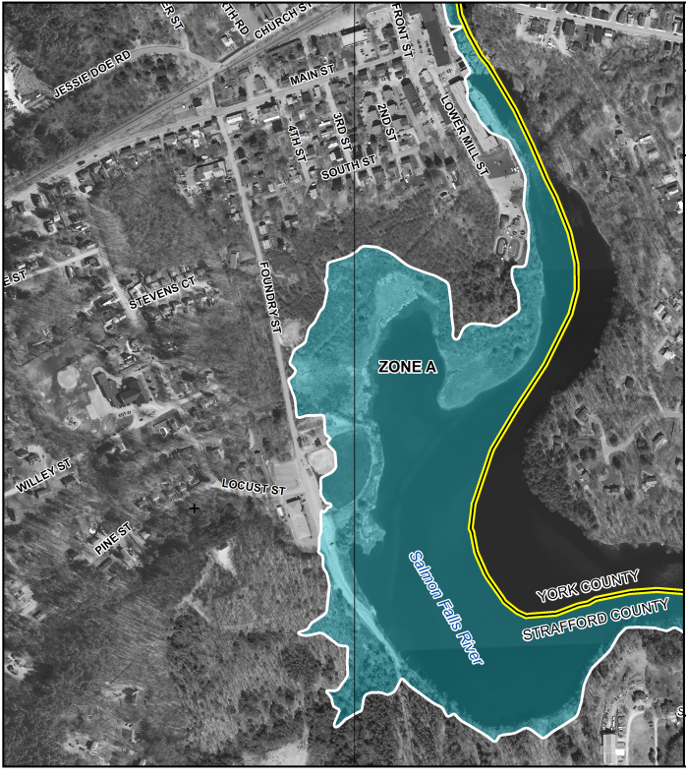
Flood Depth Grids
FEMA - FIRM
Flood Depth Grid
Vs.
“What” & “Where”
“How bad”

Slide 25
Flood Depth Grids
Additional analysis and scenario planning
Determining risk with different flood depths under various flooding frequencies
Enhanced visualization & communication
Showing where floodplains are particularly deep or hazardous
Determining where losses may be the greatest after an event
Inform vulnerability analysis and floodplain management
Use as preliminary benefit-cost analysis screening
Higher regulatory standards can be developed in higher hazard flood prone areas

Slide 26
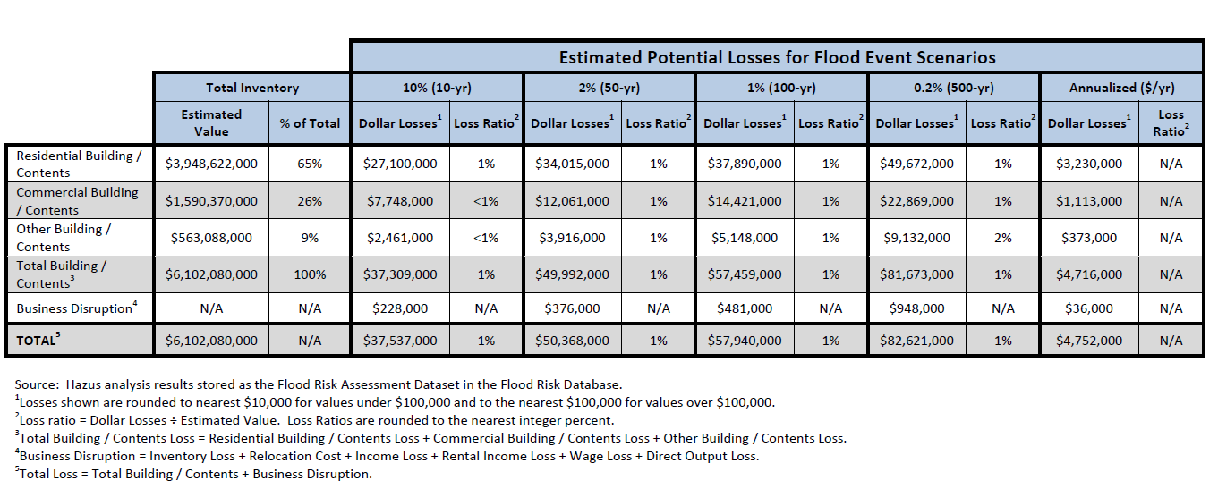
Estimated Loss Information
HAZUS is a loss estimation methodology (FEMA)
Newly modeled areas and depths

Slide 27
Estimated Loss Information
Additional information and data layers should be used to further analyze potential losses:
Use the average annual losses by Census block to identify and prioritize areas for mitigation activities.
Provide more local information such as building footprint and assessing data

Slide 28
Areas of Mitigation Interest
Important element of defining a more comprehensive picture of flood risk:
Dams
Levees and major embankments
Coastal structures
Stream flow constrictions
Essential facilities
Insurance claims
Significant land use change
Emergency routes impacted
Drainage or stormwater-based flood areas
Mitigation success
Riverine or coastal erosion

Slide 29
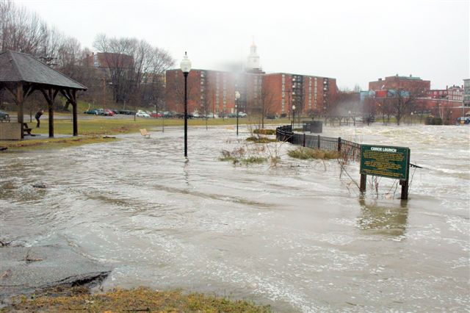
Areas of Mitigation Interest
In Dover:
Dams – 6
Stream flow constrictions – 1
High rate of crossing failure
NFIP insurance – 128 policies
$31,656,900
Repetitive loss properties near Mill Street and Knox Marsh Road

Slide 30
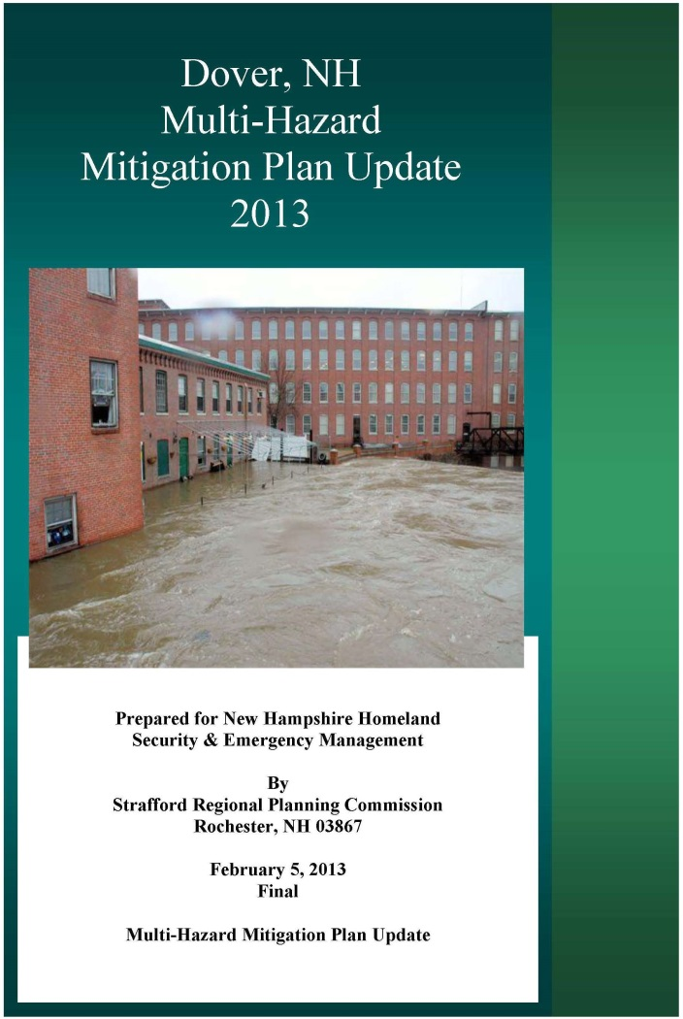
Incorporating into Planning Mechanisms
Updates to local plans:
Hazard Mitigation Plan (2/1/2018)
Emergency Operations Plan
Master Plan
Modification of development standards
Capital Improvements Plan
Mitigation projects
Communicate flood risk

Slide 31
Thank you

