Slide 1
Summary of GRANIT Clearinghouse Modernization Proposal
December 19, 2019
NH GIS Steering Committee
Fay Rubin
GRANIT Project Director
University of New Hampshire

Slide 4
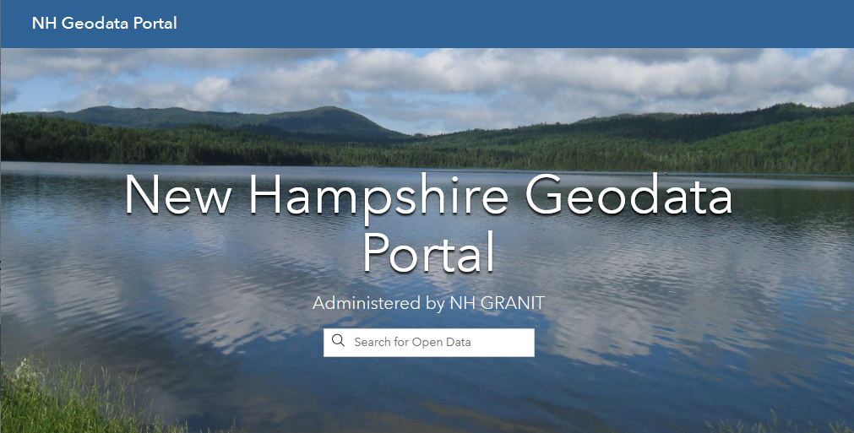
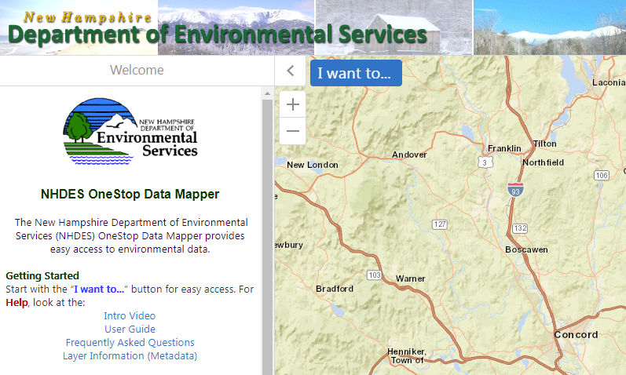
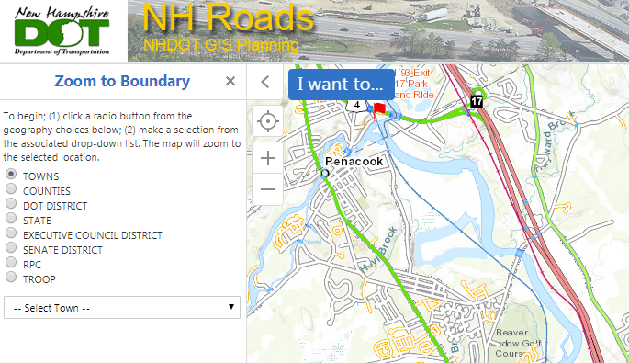
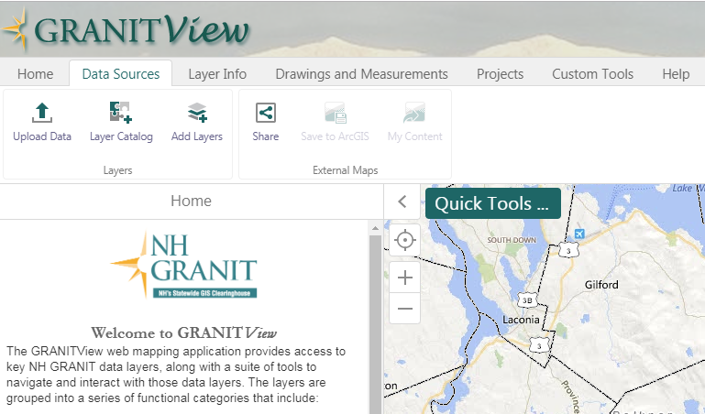
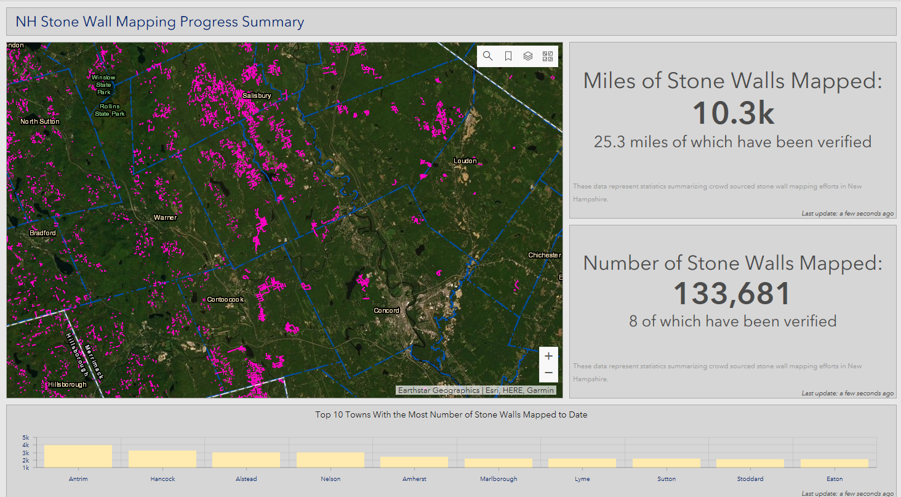
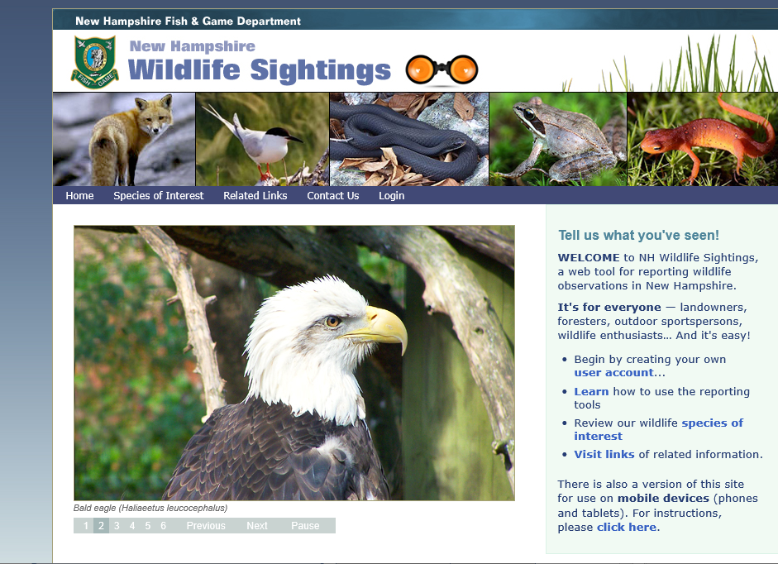
NH GRANIT Open Data
NH DES Gallery
NH DOT Gallery
ArcGIS Hub
Main GRANIT Clearinghouse Site
NH GRANIT Data Viewers
Project Dashboards
Future Collaborators
Future Initiatives/
Dashboards
GRANIT Public Clearinghouse
Site Modernization
NH Fish & Game Gallery

Slide 5
ArcGIS Hub Implementation
Related Websites
Main GRANIT Clearinghouse Site
Announcements
Events Calendar
Data Standards
Document Library
Other Content
GRANIT Open Data Site
Partner Agency
Galleries
GIS Initiatives
Project Dashboards

Slide 6
GRANIT Public Clearinghouse Site Modernization
Authorized Publishers:
State Agencies
Regional Planning Commissions
Municipalities
...
ArcGIS Hub
Main GRANIT Clearinghouse Site
Published Services
(Local Servers, AGO)
GRANIT Open Data Site
Data
Listings
Maps/App
Gallery
GRANIT Servers
Published Services
Custom
Tools
Authorized Contributors:
State Agencies
Regional Planning Commissions
Municipalities
...
Data Sets

Slide 7
Key Elements of Proposal
Establish multi-agency data sharing framework
Develop guidelines for participation in Open Data portal
Create mechanism for streamlined submission of data sets
Migrate GRANIT website to NH Geodata Portal
Add new elements to NH Geodata portal – current agency initiatives, agency apps
Populate OpenData database with current holdings – estimated 160 layers
Review/update metadata
Create/publish/share map service
Develop and maintain customized tools to facilitate access to selected datasets
Image subsetting tool (to extend spatial subsetting options)
Other tools as required

Slide 8
Key Elements of Proposal (cont.)
Conduct outreach and coordination with state agencies
Update/promote metadata standards
Work with partners to prioritize, document, and expose/share existing data sets
Identify new agencies/organizations with data holdings of broad interest; explore data sets and identify those suitable for sharing
Work with partners to promote “initiatives” that are underway, including establishing new site(s) with user-contributed data
Integrate NH Geodata Portal with Regional GIS resources
Inventory existing maps, apps, and other regional authoritative ArcGIS Online content
Organize content using standardized tags and other NH Geodata portal best practices
Highlight the use of NH Geoportal resources by supporting the development of new ArcGIS online resources by regional stakeholders
Coordinate with NH GIS Advisory Committee
Participate in quarterly meetings – present progress; solicit recommendations

Slide 9
Integration with Regional Resources:
NH Regional GIS Node
Illustrate & Reinforce the value of a modern portal to promote the sharing, distribution, and responsible use of resources that exist from the State’s investment in GIS
Extend the breadth of content beyond state agency-originated resources

Slide 10
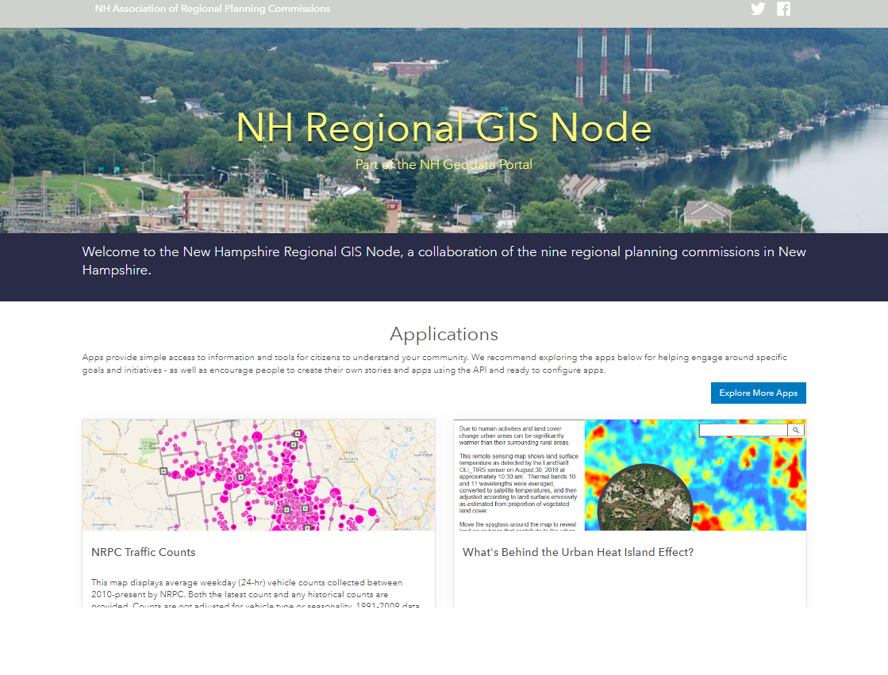

Slide 11
Integration with Regional Resources:
NH Regional GIS Node
Inventory existing maps, apps, and other authoritative regional ArcGIS Online content using ESRI Hub
Organize content using standardized tags and other NH Geodata Portal best practices
Highlight the use of NH Geodata Portal resources by supporting the development of new ArcGIS online resources by regional stakeholders

Slide 12
Data Access/Sharing Modernization
Current GRANIT Site:
Vector data download is available in limited formats
Download is limited to entire dataset
Data cannot be previewed
Limited published web services are listed
Some legacy layers are difficult to import into modern data formats
Distribution primarily from GRANIT holdings and selected submissions from larger state agencies (NHDOT, NHDES)
Partner collaboration is more cumbersome
Contributing partner must deliver data for publication on GRANIT servers
Contributing partner must notify GRANIT of service urls, url changes, etc.

Slide 13
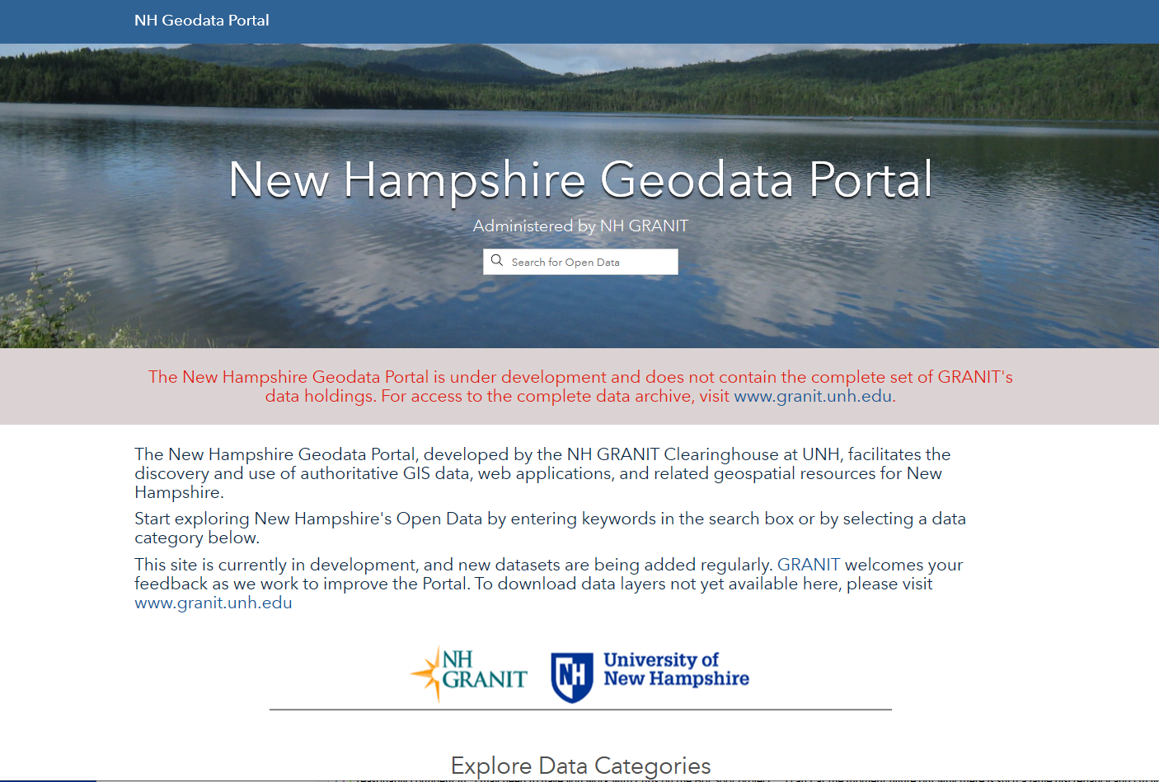
Prototype of Portal

Slide 14
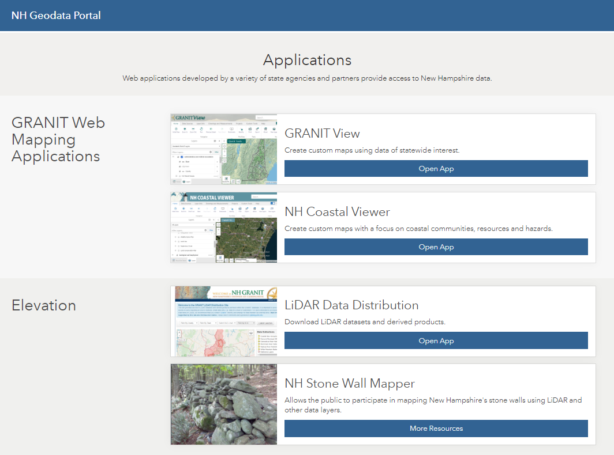
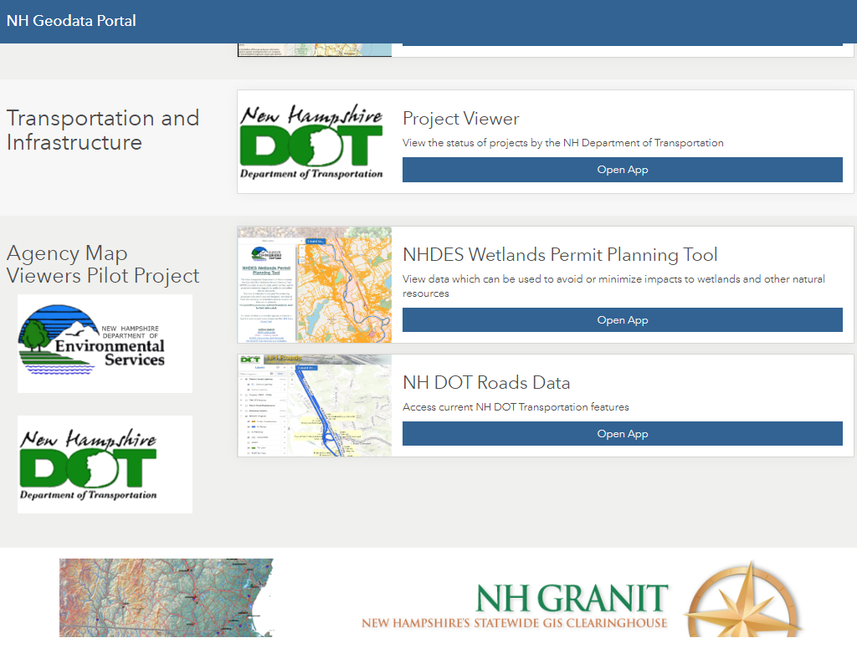
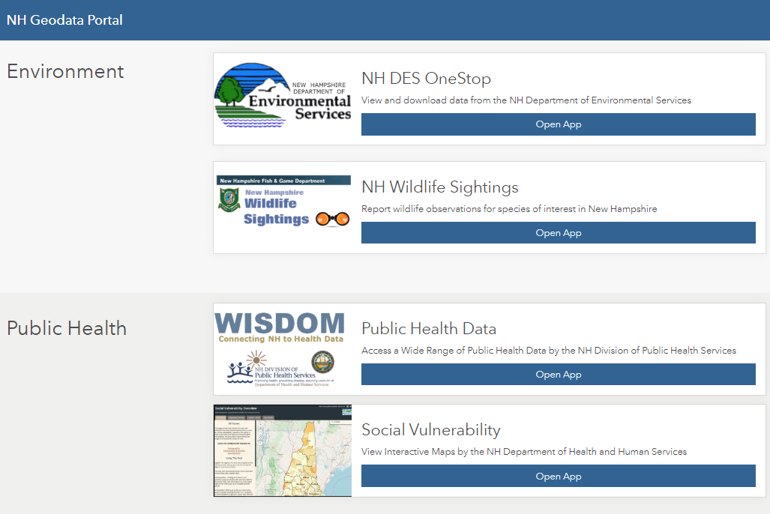
Map Galleries

Slide 15
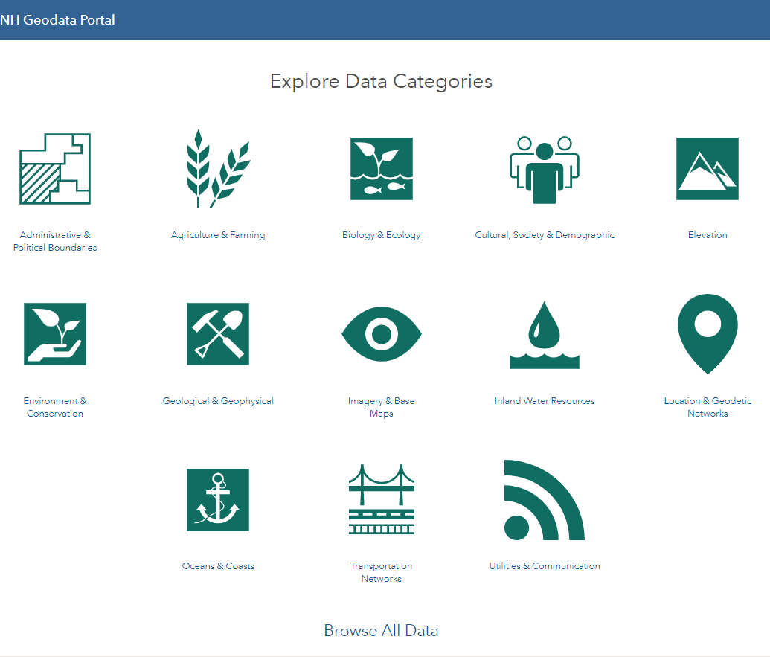
Open Data

Slide 16
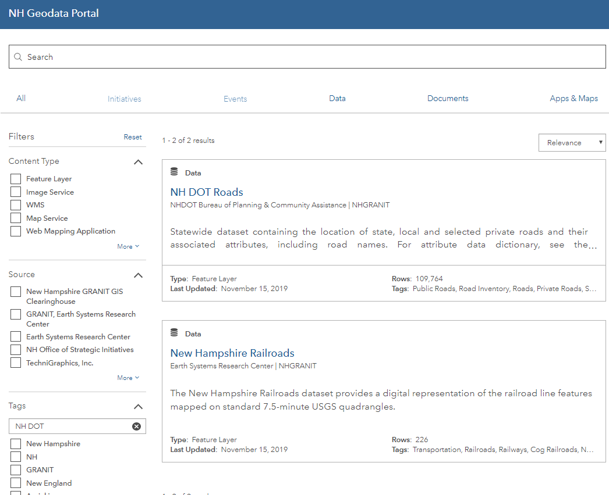
Open Data

Slide 17
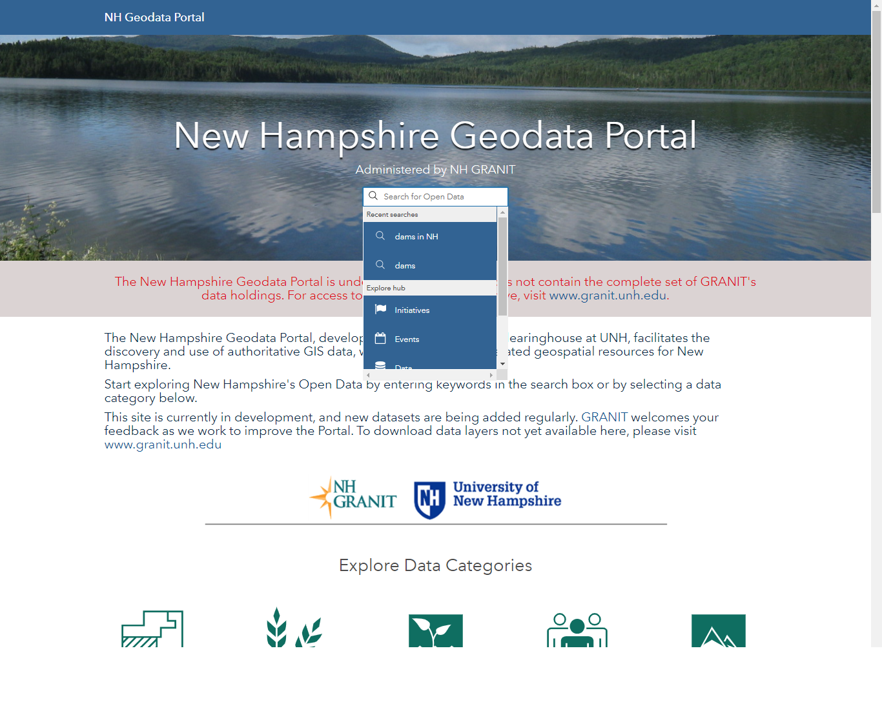
Keyword Search

Slide 18
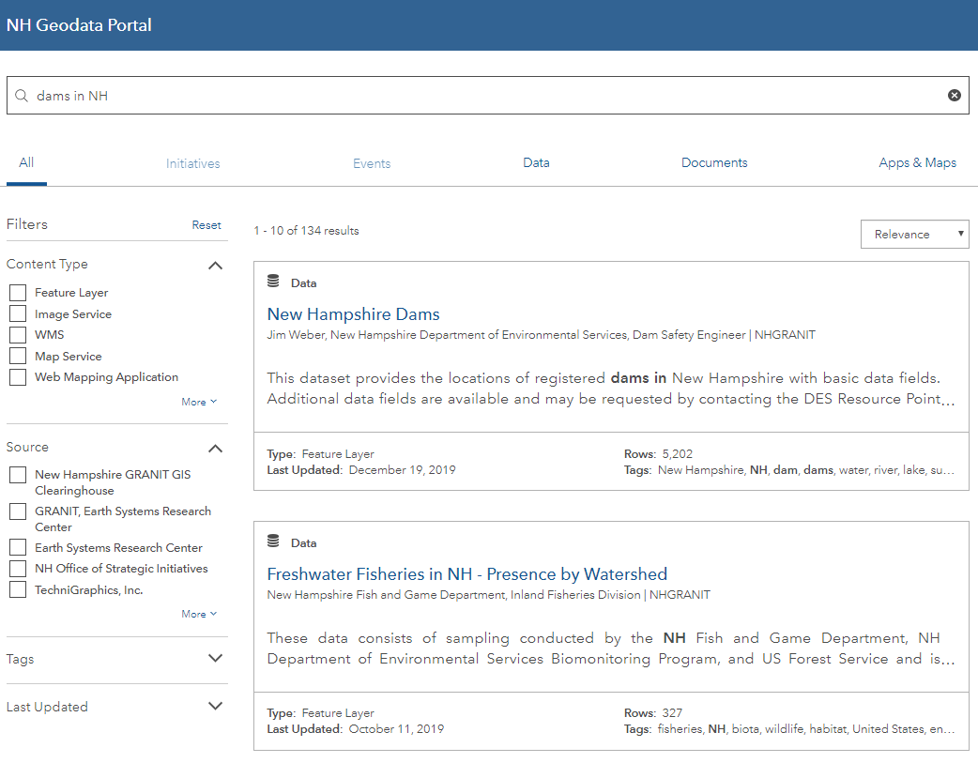
Keyword Search Results

Slide 19
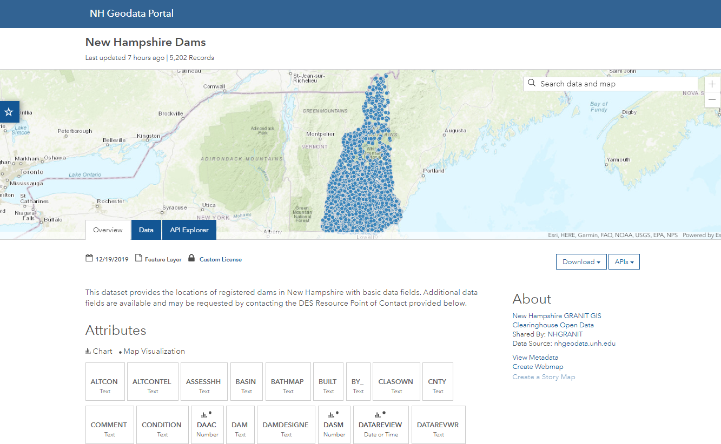

Slide 20
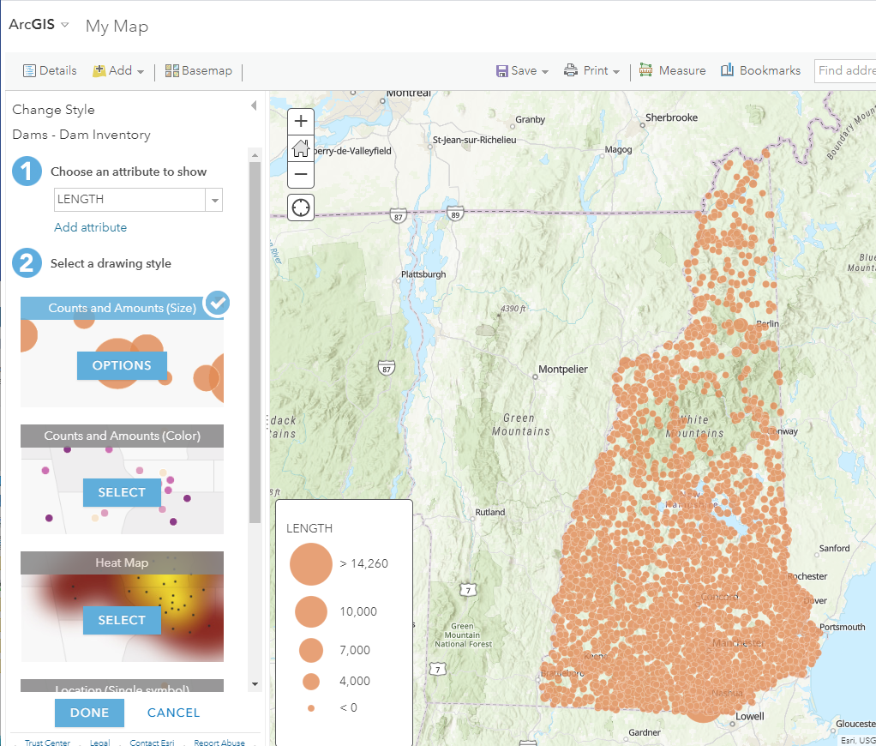

Slide 21
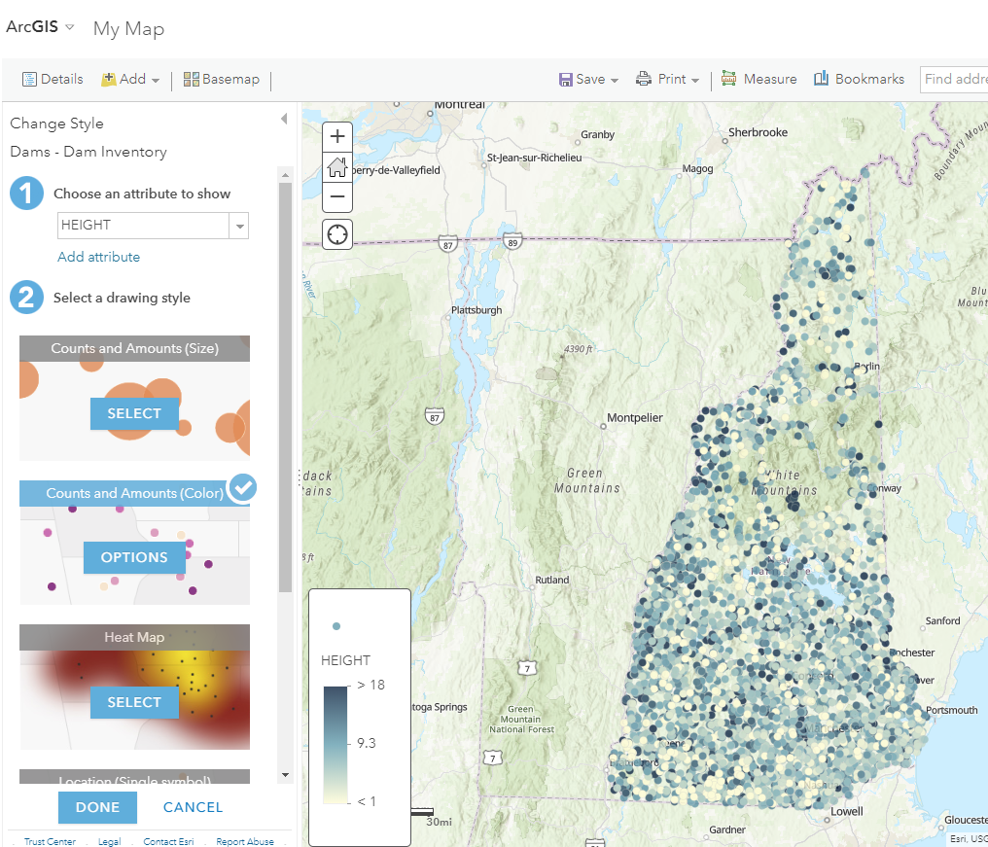

Slide 22
Primary Benefits to Stakeholders
Easily discoverable data, applications, dashboards, maps, and resources
Expanded and convenient tools to access data and resources – from any device, from anywhere, at any time
Expanded data holdings from authorized partners - state agencies, regional planning commissions, municipalities and others
Improved documentation of data sets
Enhanced, curated notifications to users of data, project, and resource updates

Slide 23
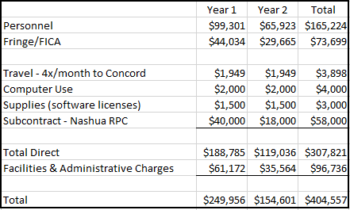
Proposed Budget

Slide 24
Questions/Discussion

Slide 25
GRANIT Transition Plan
David Justice,
Acting GRANIT Director
Mary Martin,
Project Manager
Chris Phaneuf,
GIS Analyst
Christina Herrick,
Developer/GIS Analyst
Sara Murcko,
Environmental Engineering Student

