Slide 1

NH GRANIT GIS Clearinghouse
Digital Equity Applications
Presented at the
NH Summit on Economic Inclusion and Digital Equity
Fay Rubin, Project Director
Earth Systems Research Center
University of New Hampshire
October 28, 2019
BTOP – State Broadband Initiative
5-Year Project 2010 -2015
Mapping
Planning
Technical Assistance
Capacity Building
Notes:
My focus is going to be on the geospatial data and tools available to examine digital equity issues in NH. I do so as a representative of the NH GRANIT System, which is the state’s public GIS clearinghouse. We are located at UNH, and are active in a broad range of activities – many of which result in data that can help inform discussions around digital equity issues.

Slide 2
Digital Inclusion refers to the activities necessary to ensure that all individuals and communities, including the most disadvantaged, have access to and use of Information and Communication Technologies (ICTs). This includes 5 elements:
affordable, robust broadband internet service;
internet-enabled devices that meet the needs of the user;
access to digital literacy training;
quality technical support; and
applications and online content designed to enable and encourage self-sufficiency, participation and collaboration.
Reference: www.digitalinclusion.org/definitions/
BTOP – State Broadband Initiative
5-Year Project 2010 -2015
Mapping
Planning
Technical Assistance
Capacity Building
Digital Inclusion Digital Equity
Notes:
Our charge: Mapping economic inclusion asset providers and disseminating information about them to LMI individuals, families and communities.
But first, I want to present at least one national organization’s definition of digital inclusion. And why digital inclusion?
It is a required condition to achieve digital equity. In particular, I will start by looking at access to broadband.

Slide 3


BTOP – State Broadband Initiative
5-Year Project 2010 -2015, funded by NTIA
Mapping
Planning
Technical Assistance
Capacity Building
BTOP – State Broadband Initiative
5-Year Project 2010 -2015
Mapping
Planning
Technical Assistance
Capacity Building
Notes:
I want to begin by introducing a project that we became involved in almost 10 years ago – and that’s the NH Broadband Mapping and Planning Program. The program was funded for 5 years by the NTIA, and involved a broad range of activities – including working at the regional and community levels on planning and capacity building issues. But I am going to focus on the broadband mapping component where we described where broadband is/is not available to residents of NH. Because that foundational data is necessary in order to know where there are gaps in availability, and therefore is an important piece of the digital equity discussion.

Slide 4


Broadband in Coos County (NBRC1), 2015-2016
Broadband in Northern NH (NBRC2)
http://iwantbroadbandnh.org/completed-projects
Notes:
The NTIA project was then followed by 2 smaller efforts funded by the Northern Border Regional Commission, where we worked primarily with communities and organizations in the northern part of the state. However, on the mapping side, we continued to map broadband availability statewide.

Slide 5
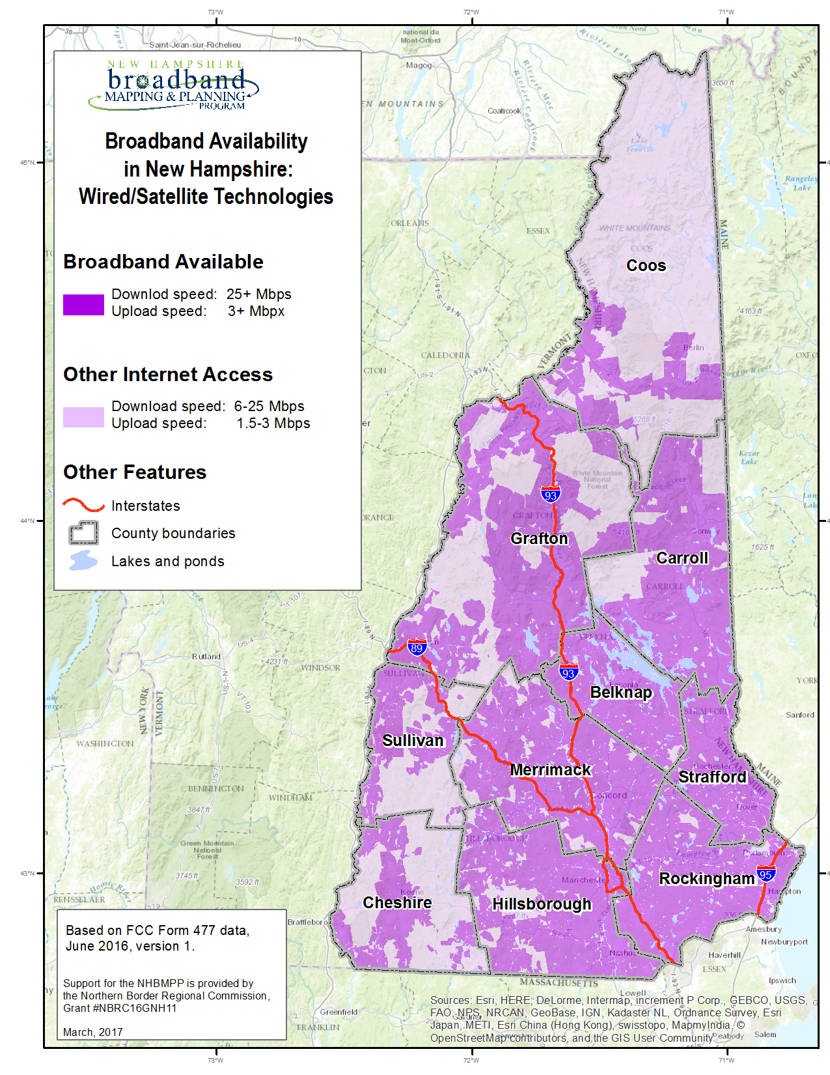
Mapping Broadband
Availability
BTOP – State Broadband Initiative
5-Year Project 2010 -2015
Mapping
Planning
Technical Assistance
Capacity Building
Notes:
This is one of the last statewide products we generated two years ago – showing where broadband is available. One thing to note at the outset – we adopted the FCC definition of broadband that required download speed of 25 or more Mbps and upload speed of 3 or more Mbps. So areas that are served are displayed in the bright fuschia color. You can see that while essentially all of the state had internet service at that time, large portions of the state did not have service that met the broadband speed thresholds.

Slide 6
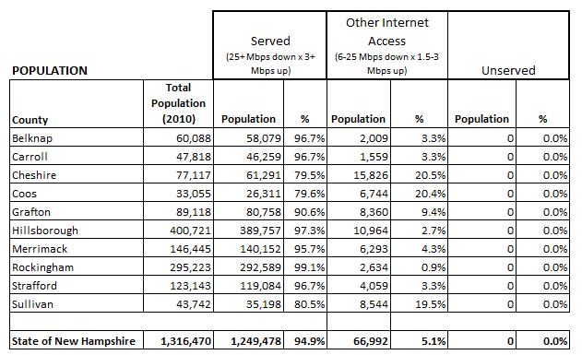
Broadband Availability – Consumer Service
BTOP – State Broadband Initiative
5-Year Project 2010 -2015
Mapping
Planning
Technical Assistance
Capacity Building
Notes:
Looking at the numbers behind the map - as a state the data suggested that almost 95% of the population was served. However, when you look at the county level numbers the picture is very different. Note that over 20% of the residents of Cheshire and Coos Counties do not have access to broadband.

Slide 7
Form 477 Data Now
Collected from providers in June/December of each year
Describes residential, fixed broadband coverage
Available for public access:
  https://broadbandmap.fcc.gov
BTOP – State Broadband Initiative
5-Year Project 2010 -2015
Mapping
Planning
Technical Assistance
Capacity Building
Notes:
The source of the map and tabular data – the Form 477 data submitted by providers to the NTIA twice/year. Provides data for every state/US territory on fixed broadband coverage.

Slide 8
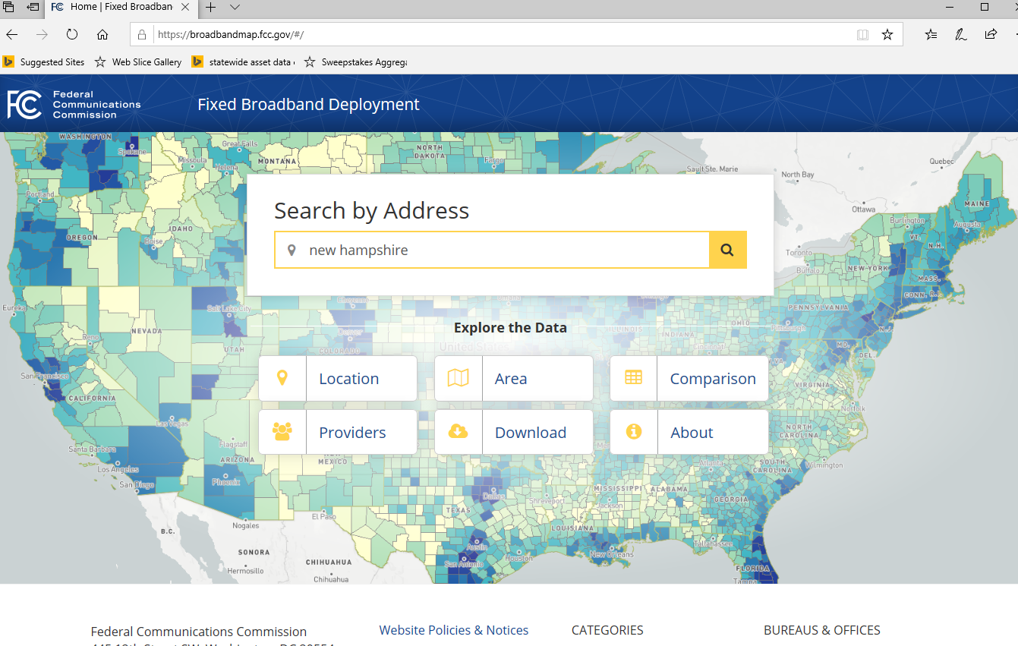
BTOP – State Broadband Initiative
5-Year Project 2010 -2015
Mapping
Planning
Technical Assistance
Capacity Building
Notes:
The source of the map and tabular data – the Form 477 data submitted by providers to the NTIA twice/year. Provides data for every state/US territory on fixed broadband coverage.

Slide 9
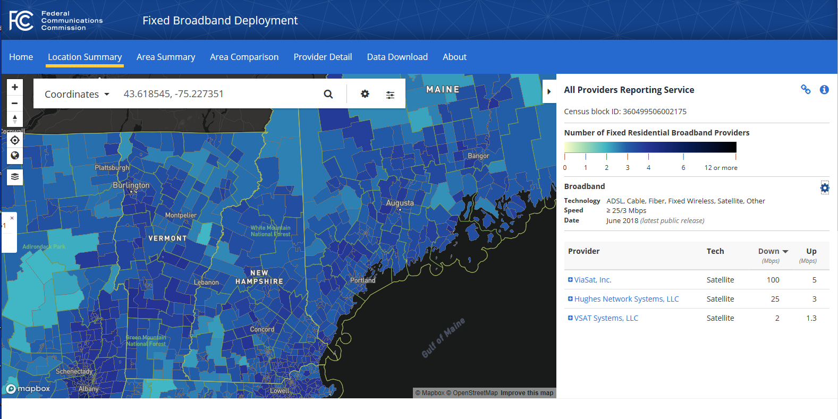
BTOP – State Broadband Initiative
5-Year Project 2010 -2015
Mapping
Planning
Technical Assistance
Capacity Building
Notes:
Here we look at just NH, and this seems to suggest that all of the state is served by at least 2 broadband providers. We know that’s not the case, however, as we are contacted by residents who simply do not have service.

Slide 10
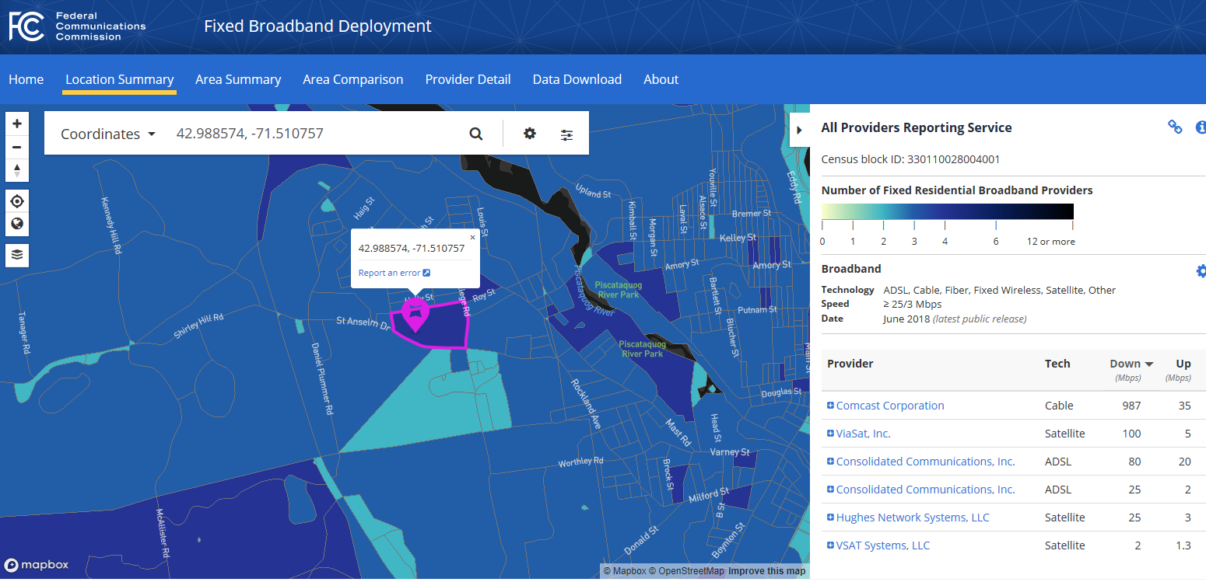
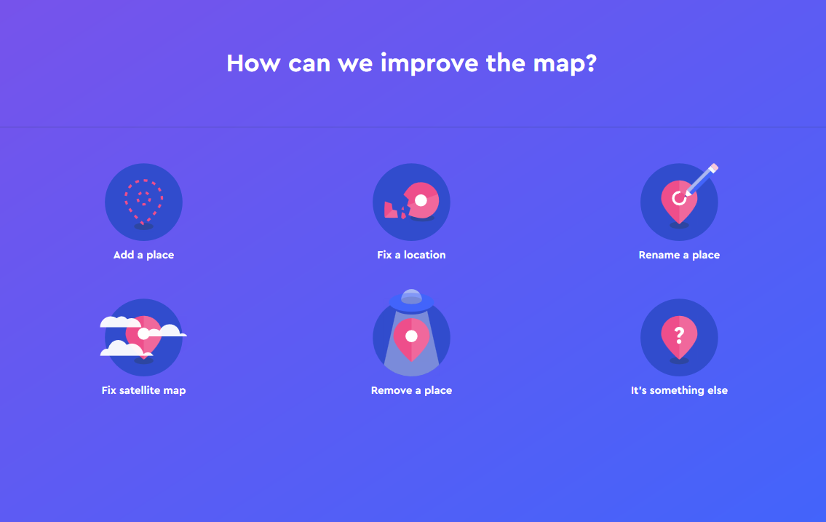
BTOP – State Broadband Initiative
5-Year Project 2010 -2015
Mapping
Planning
Technical Assistance
Capacity Building
Notes:
The site itself has some great capabilities. For example, I can zoom in to a location, click on any census block, and discover who providers service and the type and speed of service they provided. Here I click on our current location and the site is reporting that there are 3 fixed residential providers delivering service and 3 satellite providers. Note also that I can report an error by clicking on the fuschia icon.

Slide 11
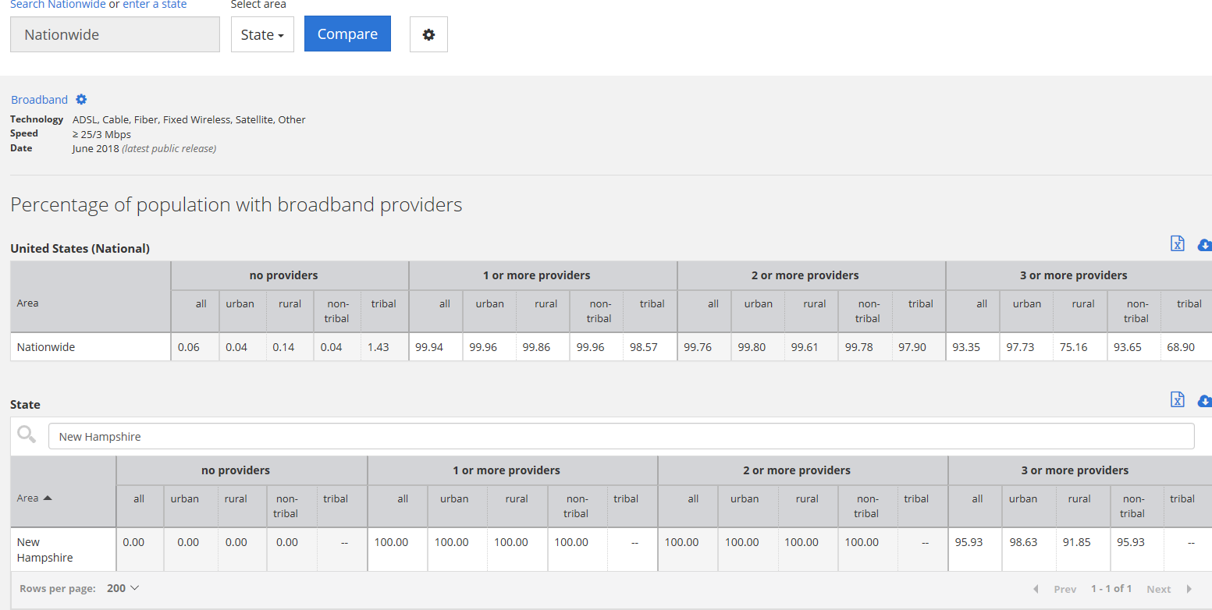
BTOP – State Broadband Initiative
5-Year Project 2010 -2015
Mapping
Planning
Technical Assistance
Capacity Building
Notes:
Can also do comparisons. Here, have compared the state of NH to national numbers – looking at % of population with access to multiple broadband providers. You can see that NH fairs slightly above average, with 92% of the rural population being served by 3 or more providers compared to 75% nationally. However, we know there are some serious limitations with the data – related to accuracy, resolution, and currency.

Slide 12
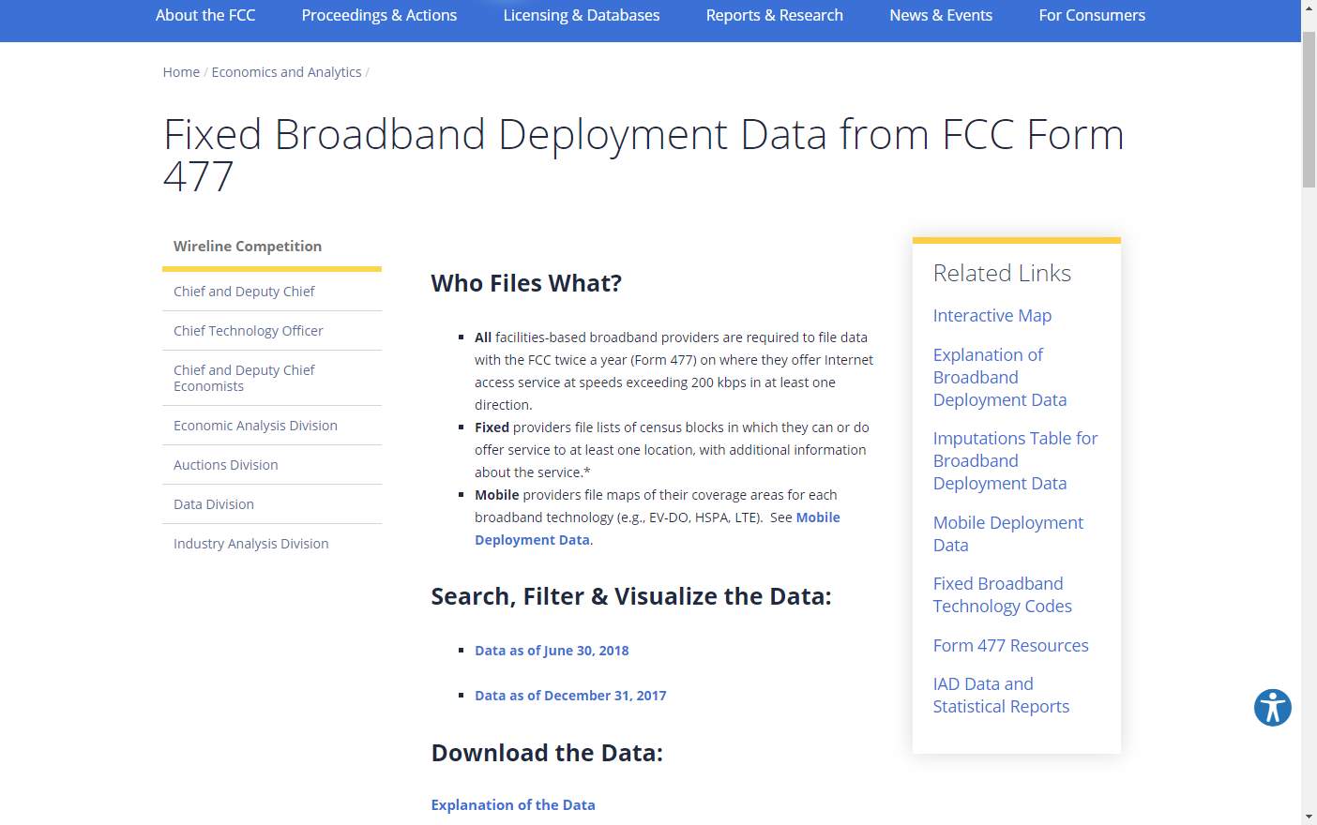
Form 477 Data Now - Currency
BTOP – State Broadband Initiative
5-Year Project 2010 -2015
Mapping
Planning
Technical Assistance
Capacity Building
Source:
https://www.fcc.gov/general/broadband-deployment-data-fcc-form-477
Accessed 10/24/2019

Slide 13
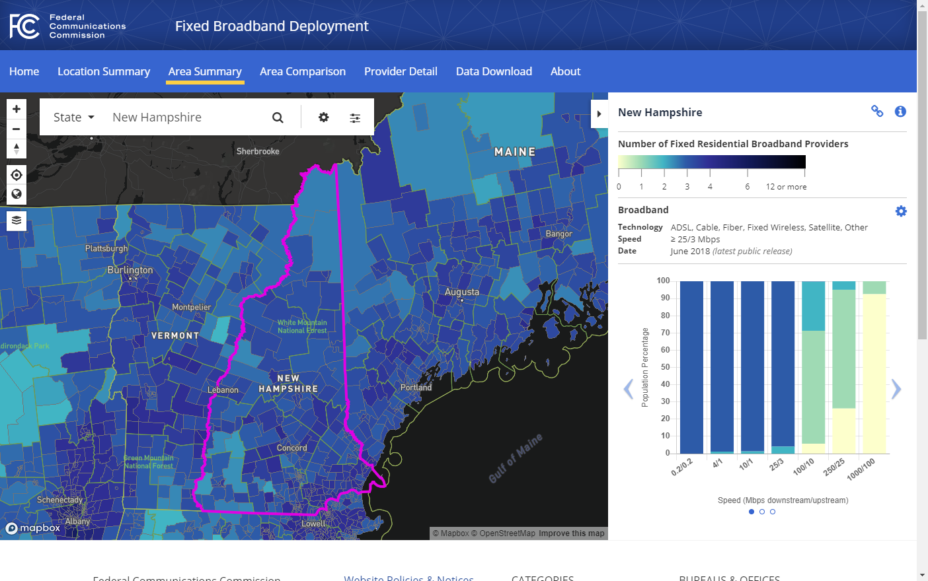
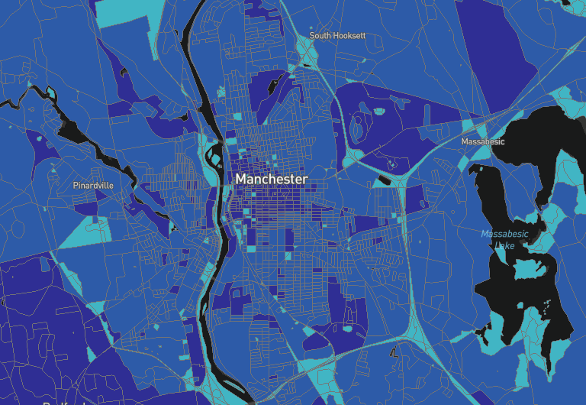
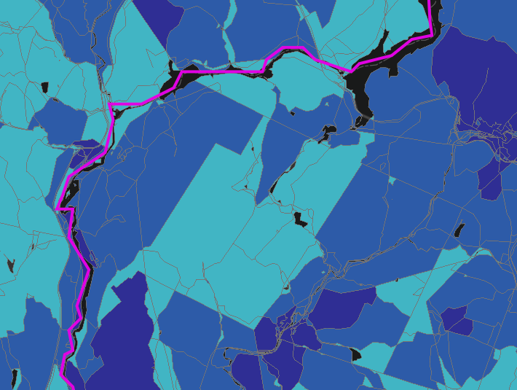
Form 477 Data Now – Resolution
BTOP – State Broadband Initiative
5-Year Project 2010 -2015
Mapping
Planning
Technical Assistance
Capacity Building
Monroe
Lyman
Notes:
Census block resolution – means that if any single address in a census block is served, the entire block is considered to be served.
This may be adequate in urban areas, but not in more rural areas

Slide 14
Form 477 Data Future –
Modernizing the FCC Form 477 Data Program
Same collection frequency - June/December of each year
Same objectives - describes residential, fixed broadband coverage
Potential improvement in resolution – directs providers to submit actual service area polygons vs. lists of census blocks
Currency – streamlined efforts to review data, including easier mechanisms for public comment. May reduce frequency to annual submission
BTOP – State Broadband Initiative
5-Year Project 2010 -2015
Mapping
Planning
Technical Assistance
Capacity Building
Notes:
New rules

Slide 15
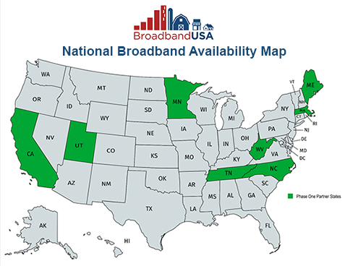
National Broadband Availability Map
2018 Congressional appropriation to update the National Broadband Availability Map (NBAM)
Incorporates data from Form 477 and available 3rd party datasets
6 pilot states:
BTOP – State Broadband Initiative
5-Year Project 2010 -2015
Mapping
Planning
Technical Assistance
Capacity Building
Notes:
NTIA- also initiating a project that goes beyond the 477 datasets: the National Broadband AvailabilityMap
3rd party datasets – state government, local/tribal governments, owners/operators of broadband networks, educational institutions, nonprofits and cooperatives
Described as a full GIS (and not just a map), with capabilities to compare data across multiple sources (and therefore identify discrepancies in areas served/unserved), produce reports and analyses, etc.
Because it includes publicly available and non-public data, it will only be accessible by state and federal partners. So useful for state decision-making, but not clear to me how, in NH for example where the regional planning agencies work closely with communities on this topic among many others, how this data can be used. Perhaps the guidelines will change as the pilot progresses.

Slide 16
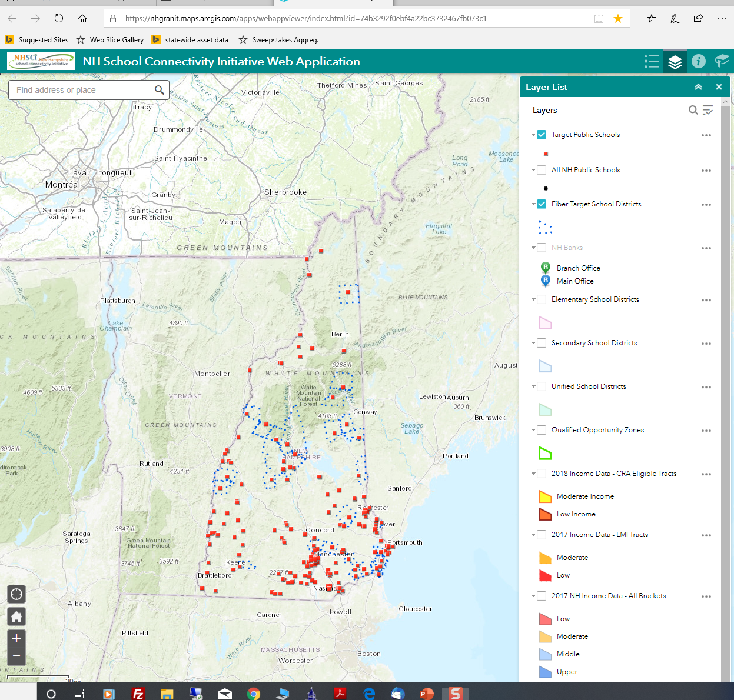
Mapping Economic Inclusion Asset Providers –
New Hampshire School Connectivity Initiative Web Map
Notes:
Moving on to mapping economic inclusion asset providers, I would like to present one web mapping application we worked on last year to help inform discussions in the state related to the NH School Connectivity Initiative - efforts to expand K-12 broadband access and improve digital equity in New Hampshire. Purpose of the application: Consolidate available data and inform stakeholder discussions by providing an easy to use mapping tool.
In this application, we built the tool in the ArcGIS Online environment. But there are definitely other options, as we will see from Kevin’s remarks.
Opening page – shows location of target schools and fiber target school districts
Last updated: November 2018. 744 views

Slide 17
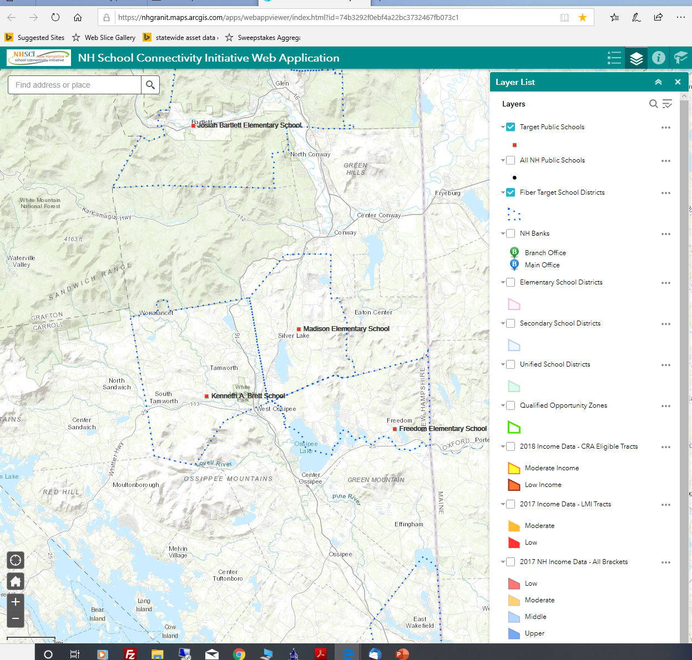
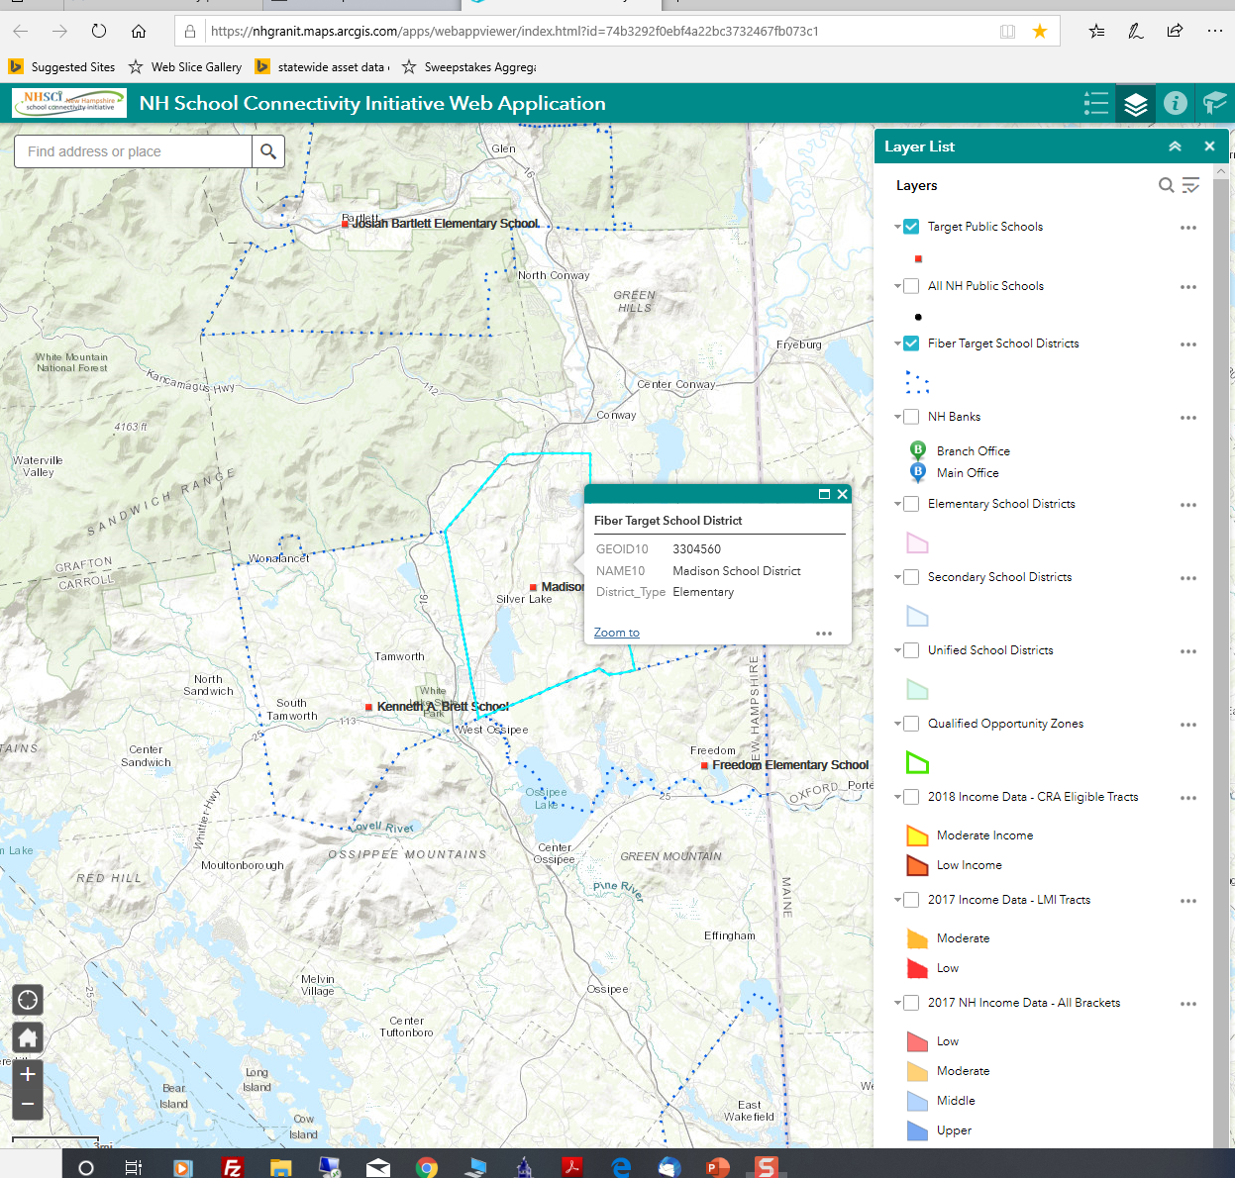
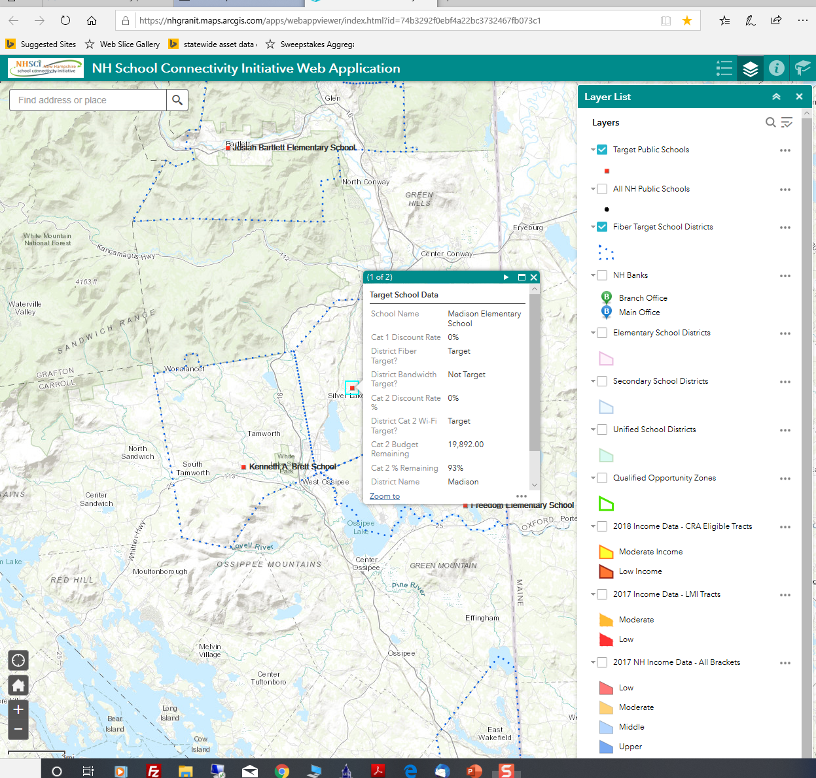
Notes:
I can zoom into a location and click on any school to retrieve information about it ...
Or I can retrieve information about the district itself, in this case looking at fiber target school districts.

Slide 18
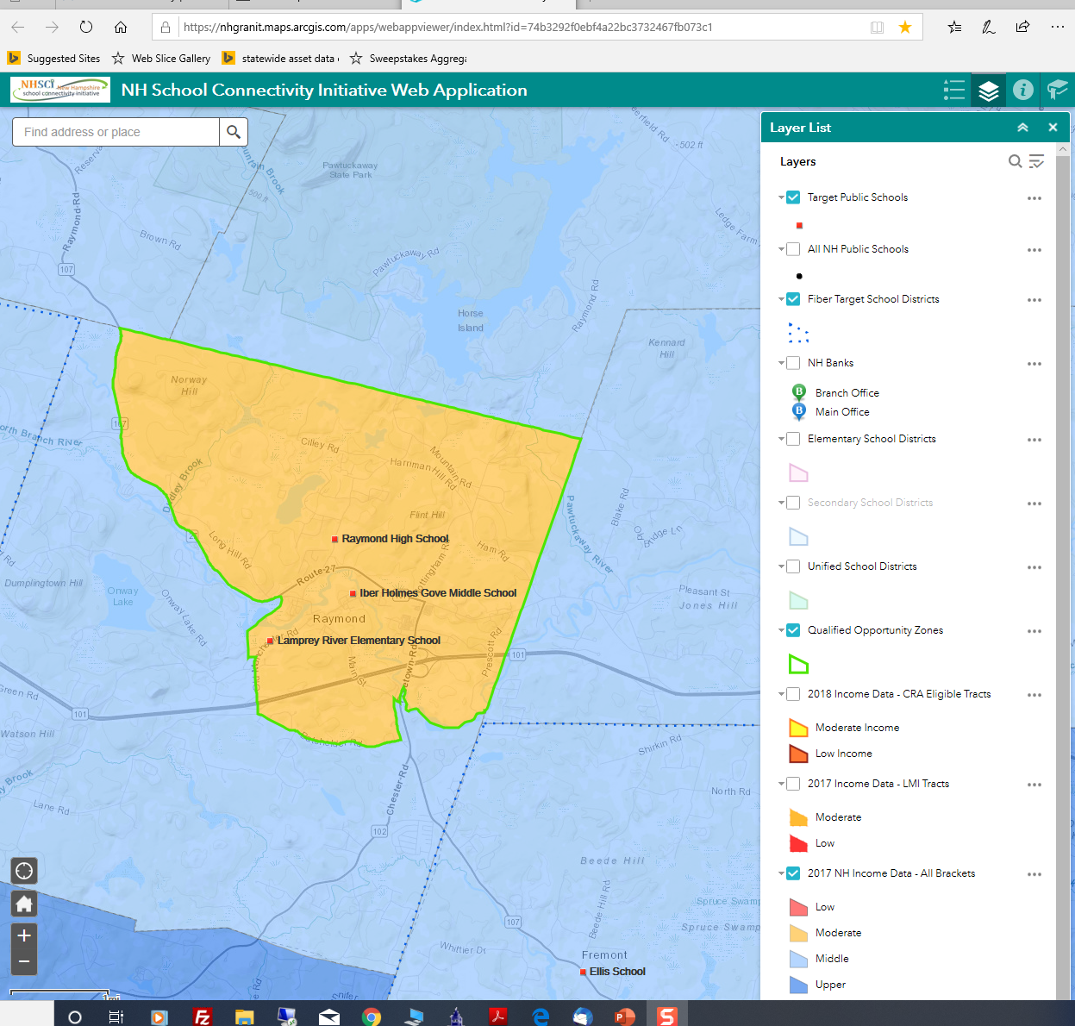
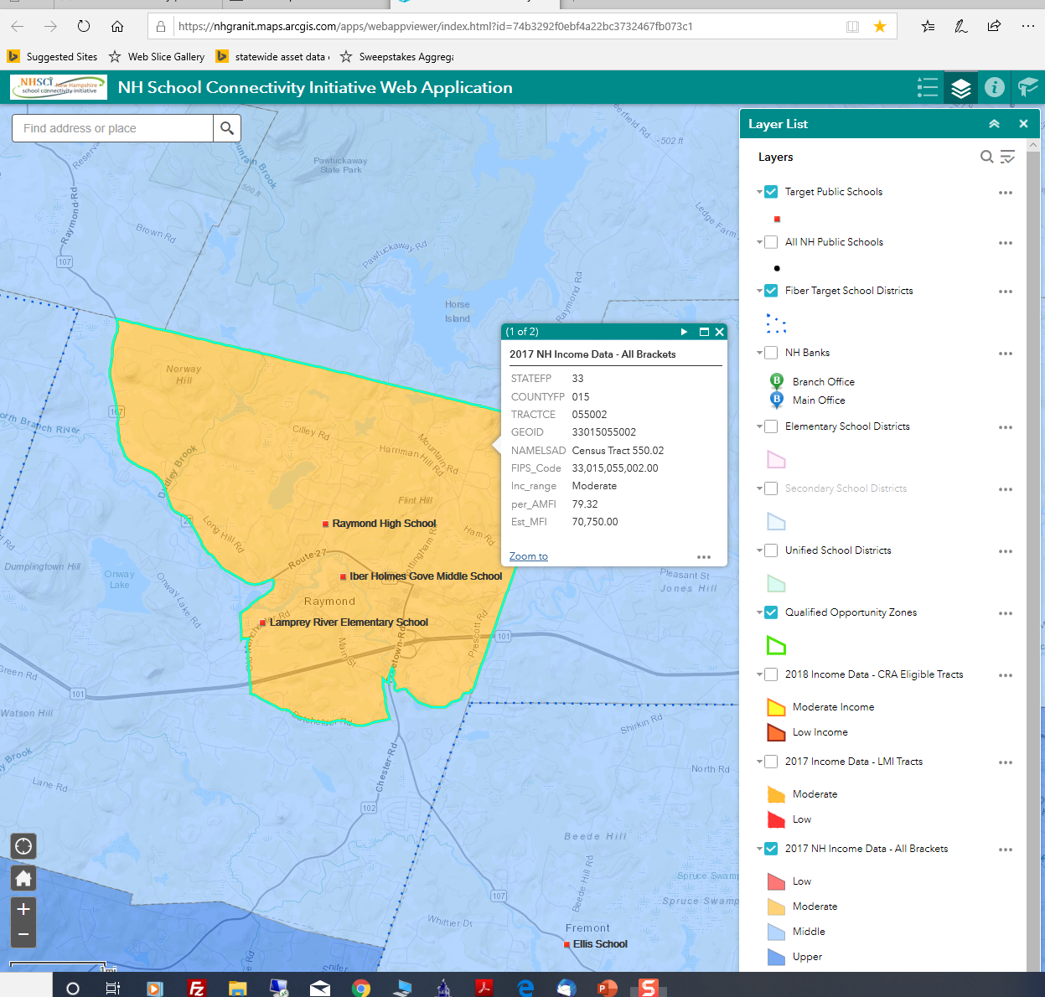

Notes:
I can also display additional data sets that may help inform a discussion around digital equity. Here we see a school district in Raymond where the income of the host census tract is considered moderate. Note it represents a designated qualified opportunity zone.
Here I’ve clicked to retrieve the actual numbers behind the income data ...
And now I’ve displayed the banks that have either a main office or a branch office within or in close proximity to the district.

Slide 19
New Hampshire School Connectivity Initiative Web Map
Data Layer | Source
NH Public Schools | NH Department of Education
School Districts: Fiber Target School Districts Elementary School Districts Secondary School Districts Unified Schools Districts | US Census Bureau; E-Rate data provided by EducationSuperHighway
New Hampshire Bank Locations | FDIC tabular listing geocoded using ArcGIS World Geocode Services
Qualified Opportunity Zones | NH Department of Business and Economic Affairs
Income Data: Income Data, All Brackets LMI Tracts CRA Eligible Tracts | Downloaded from www.policymap. Income brackets are based on Census tract Median Family Income (MFI) as a percent of Metro Area MFI, as of 2017.
Census Tracts | Census Bureau, www.data.gov
Notes:
So the tool has a lot of versatility. I wanted to just take a moment to emphasize that the tool is bringing together data from multiple sources into one online map viewer. One of the questions I think it would be interesting to get your feedback on is what other datasets would be valuable to consider including.
Income brackets are based on Census tract Median Family Income (MFI) as a percent of Metro Area MFI, as of 2017.
“In May 3, 2018, New Hampshire Gov. Chris Sununu nominated 27 census tracts to be designated as Opportunity Zones, a federal program encouraging economic development and investment in low income areas around the country.
Investors can defer capital gains on earnings that have been reinvested in the zones through Opportunity Funds. Opportunity Funds are private sector investment vehicles that invest at least 90 percent of their capital in Opportunity Zones. Long-term investments maintained for over 10 years do not have to pay additional capital gains taxes on earnings from Opportunity Zone investments.”
So there are a dozen or data sets presented in the web map. They can be displayed individually or in combination. And each can be queried to determine the characteristics of the feature that is mapped.

Slide 20
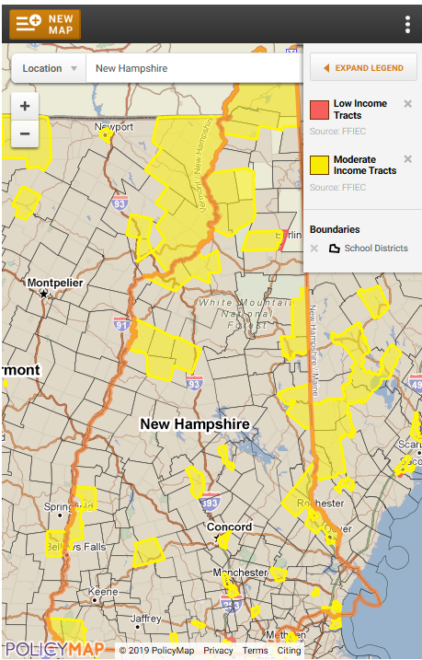
National Center for Digital Equity Online Mapping Resource
Notes:
I mentioned just a moment ago that there are other options besides ArcGIS Online. Here is a map hosted on the NCDE (National Center for Digital Equity) website that uses PolicyMap as a tool to present/visualize data.
You’ll see some overlap in the data sets presented, however ...

Slide 21
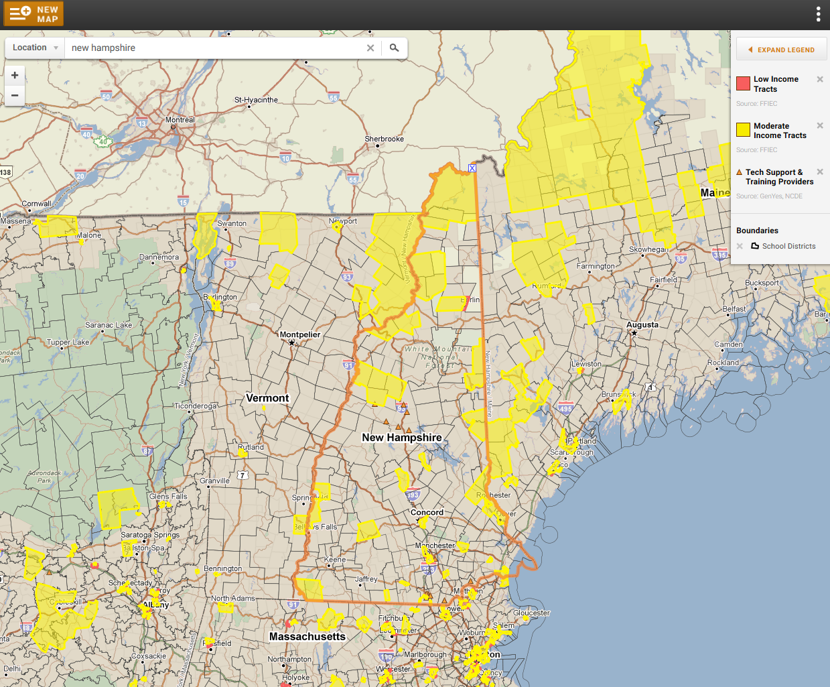
National Center for Digital Equity Online Mapping Resource
Notes:
The data is not just for New Hampshire and there are some different options – here, for example, I’ve added providers of technical support as we saw in an earlier slide that having broadband service is not enough ... People need to be able to use it.
So I hope we can have a discussion about the data you think would be useful to include in these kinds of web maps, and effective ways to present it.

Slide 22

Thank You
BTOP – State Broadband Initiative
5-Year Project 2010 -2015
Mapping
Planning
Technical Assistance
Capacity Building
Fay Rubin
Project Director
603-862-4240
fay.rubin@unh.edu

Slide 23
BTOP – State Broadband Initiative
1. What data sets are most important as we explore questions about digital equity?
2. What is the most effective way to present the data?

Slide 24

Broadband Technology Comparison
Dial-up
  56,000 bits per second (bps)
DSL – within 18,000 feet
  1.5+ Million bps download (Mbps)
  1 Million bps upload (Mbps)
VDSL – within 4,000 feet
  40+ Mbps download
  16 Mbps upload
Cable
  10-150+ Mbps download
  5-20 Mbps upload
4G LTE Cellular and Wi-Fi
  10 – 20 Mbps download
  3+ Mbps upload
5G Wireless and Microcells (2020)
  One to 10Gbps connections to end points in the field
  One millisecond end-to-end round trip delay
  10 to 100x number of connected devices
  (Perception of) 100 percent coverage and 99.999 availability
  90 percent reduction in network energy usage
  Up to ten-year battery life for low power, machine-type devices
Fiber – Best Scalability
  Dense Wave Division Multiplexing (DWDM)
  88 x 100 gigabit lightwaves on a single fiber
Broadband trend
  Expand fiber closer to neighborhood
  Use existing copper/wireless for last mile

Slide 25




New Hampshire School Connectivity Initiative
The goals of the NHSCI are:
  Facilitate fiber connectivity to all of our K-12 school buildings
  Increase statewide utilization of E-Rate funds
  Facilitate enhanced Wi-Fi deployment in schools
  Educate and Assist with level broadband pricing options
Notes:
What vendors have existing fiber?
Will it be reasonably priced?
Who may be last on the list?
Create a local or statewide purchasing consortium?

Slide 26
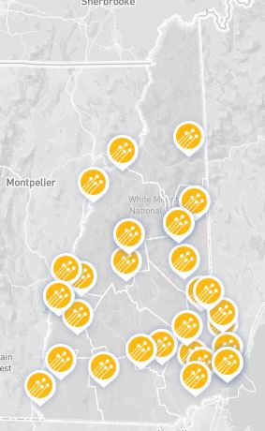


Fiber Upgrades
10 school districts have filed for fiber upgrades
6 school districts/consortiums applied for E-rate state match money through the NH Infrastructure Fund
  Goffstown
  Mascoma
  Manchester Consortium
  Landaff
  Hampstead
  Unity
  Contoocook Valley
  Dover
  Farmington
  Grantham
  Landaff
  Lempster
  Newfound Area
  Shaker
  Timberlane
  Unity
7 school districts did not file this year
  Candia
  Cornish
  Greenland
  Hooksett
  Freemont
  Sanborn
  Derry (already on fiber)

Slide 27
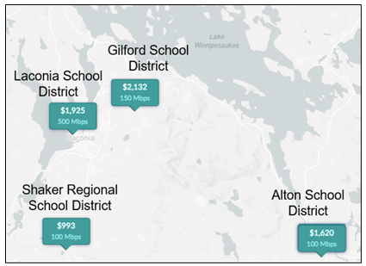
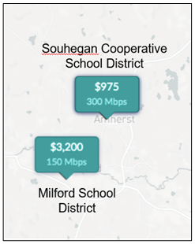

Districts in the same region pay very different costs
3X BW at lower cost
Same BW @ 1.5 x Cost
Double the BW at 1/3 the Cost

