Slide 1

NH GRANIT GIS Clearinghouse
Digital Equity Applications
Presented at the
NH Summit on Economic Inclusion and Digital Equity
Fay Rubin, Project Director
Earth Systems Research Center
University of New Hampshire
October 28, 2019
BTOP – State Broadband Initiative
5-Year Project 2010 -2015
Mapping
Planning
Technical Assistance
Capacity Building

Slide 2
Digital Inclusion refers to the activities necessary to ensure that all individuals and communities, including the most disadvantaged, have access to and use of Information and Communication Technologies (ICTs). This includes 5 elements:
affordable, robust broadband internet service;
internet-enabled devices that meet the needs of the user;
access to digital literacy training;
quality technical support; and
applications and online content designed to enable and encourage self-sufficiency, participation and collaboration.
Reference: www.digitalinclusion.org/definitions/
BTOP – State Broadband Initiative
5-Year Project 2010 -2015
Mapping
Planning
Technical Assistance
Capacity Building
Digital Inclusion Digital Equity

Slide 3


BTOP – State Broadband Initiative
5-Year Project 2010 -2015, funded by NTIA
Mapping
Planning
Technical Assistance
Capacity Building
BTOP – State Broadband Initiative
5-Year Project 2010 -2015
Mapping
Planning
Technical Assistance
Capacity Building

Slide 4


Broadband in Coos County (NBRC1), 2015-2016
Broadband in Northern NH (NBRC2)
http://iwantbroadbandnh.org/completed-projects

Slide 5
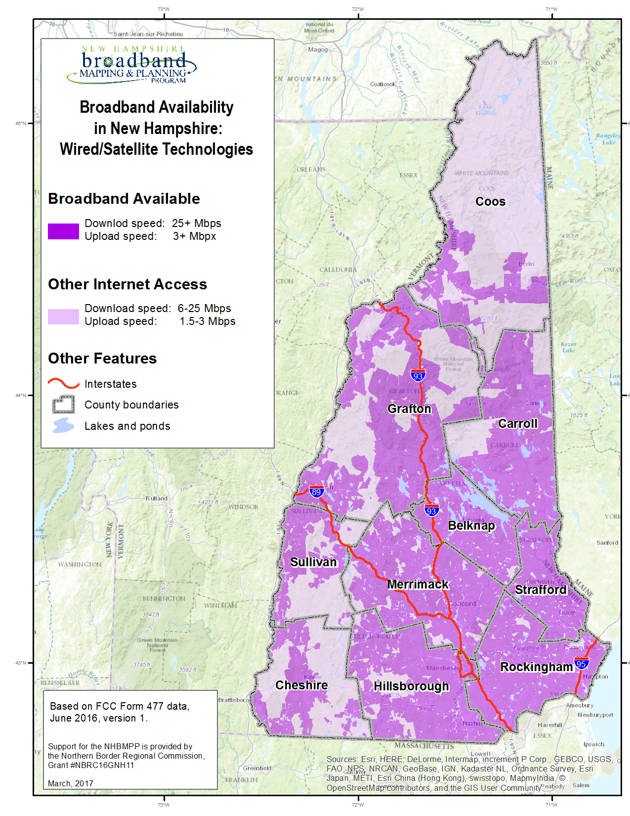
Mapping Broadband
Availability
BTOP – State Broadband Initiative
5-Year Project 2010 -2015
Mapping
Planning
Technical Assistance
Capacity Building

Slide 6
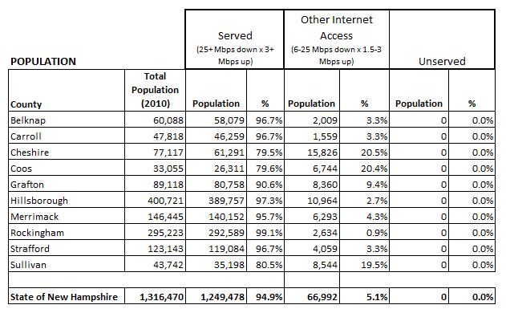
Broadband Availability – Consumer Service
BTOP – State Broadband Initiative
5-Year Project 2010 -2015
Mapping
Planning
Technical Assistance
Capacity Building

Slide 7
Form 477 Data Now
Collected from providers in June/December of each year
Describes residential, fixed broadband coverage
Available for public access:
  https://broadbandmap.fcc.gov
BTOP – State Broadband Initiative
5-Year Project 2010 -2015
Mapping
Planning
Technical Assistance
Capacity Building

Slide 8
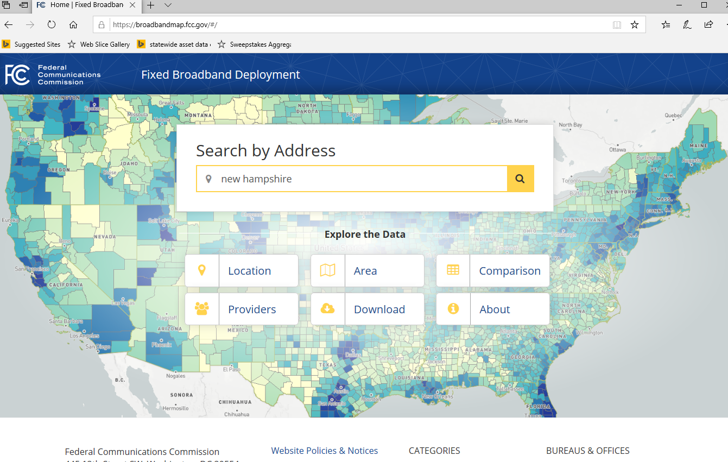
BTOP – State Broadband Initiative
5-Year Project 2010 -2015
Mapping
Planning
Technical Assistance
Capacity Building

Slide 9
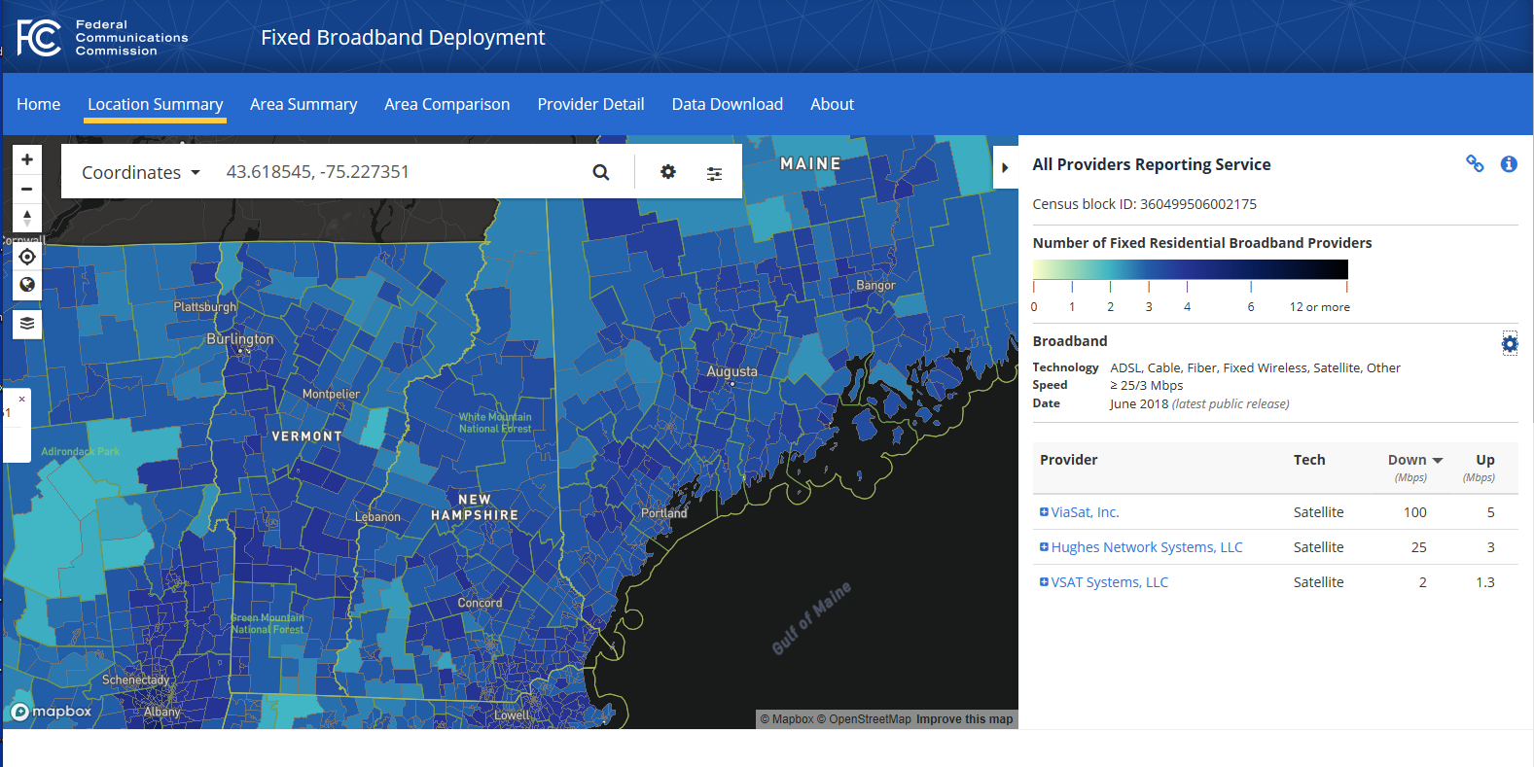
BTOP – State Broadband Initiative
5-Year Project 2010 -2015
Mapping
Planning
Technical Assistance
Capacity Building

Slide 10
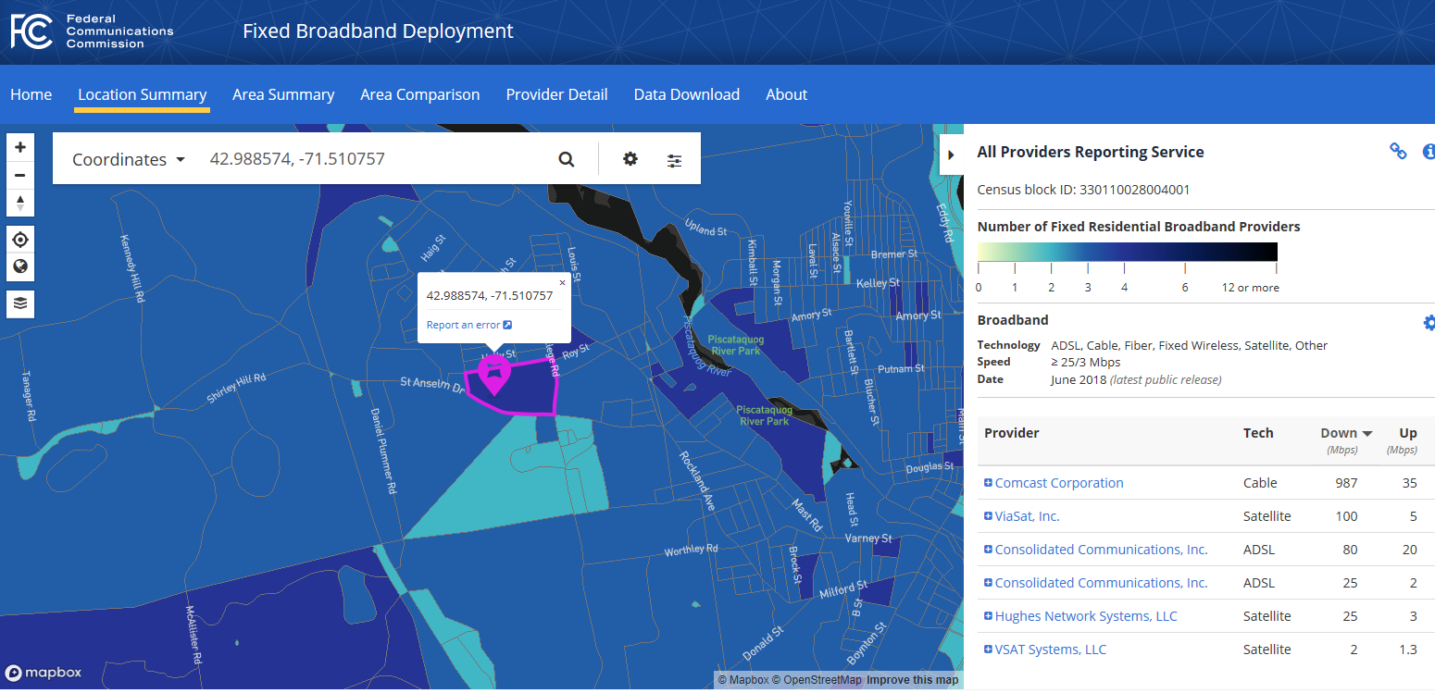
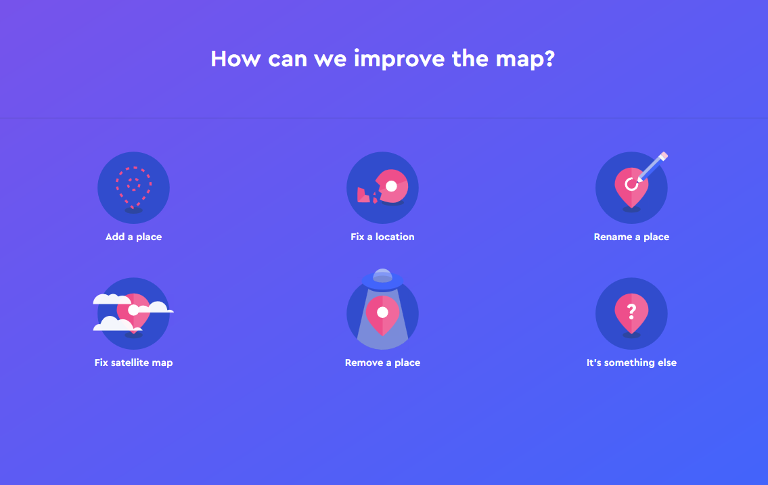
BTOP – State Broadband Initiative
5-Year Project 2010 -2015
Mapping
Planning
Technical Assistance
Capacity Building

Slide 11
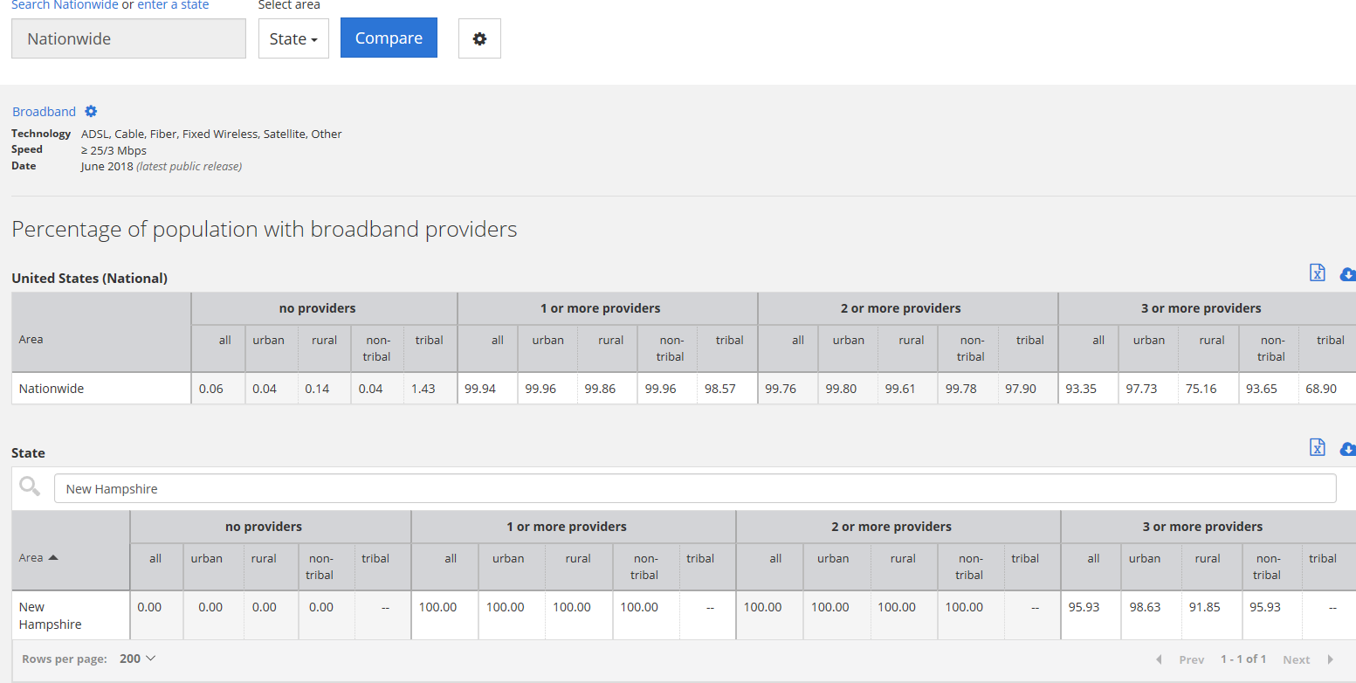
BTOP – State Broadband Initiative
5-Year Project 2010 -2015
Mapping
Planning
Technical Assistance
Capacity Building

Slide 12
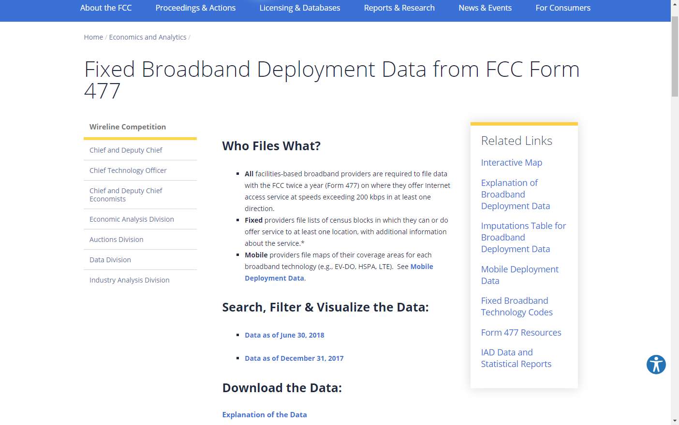
Form 477 Data Now - Currency
BTOP – State Broadband Initiative
5-Year Project 2010 -2015
Mapping
Planning
Technical Assistance
Capacity Building
Source:
https://www.fcc.gov/general/broadband-deployment-data-fcc-form-477
Accessed 10/24/2019

Slide 13
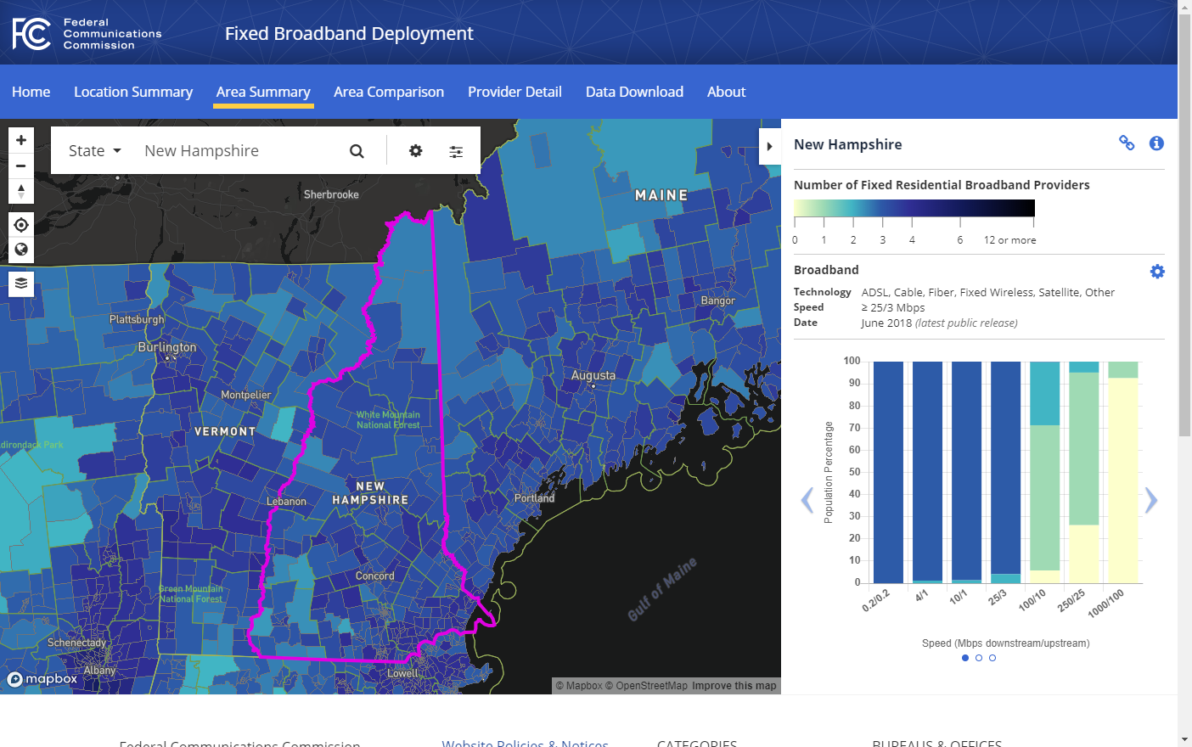
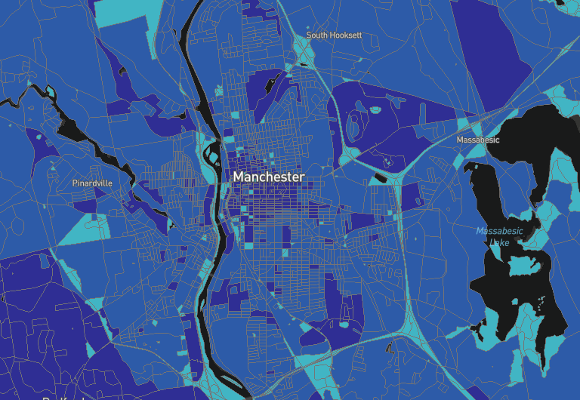
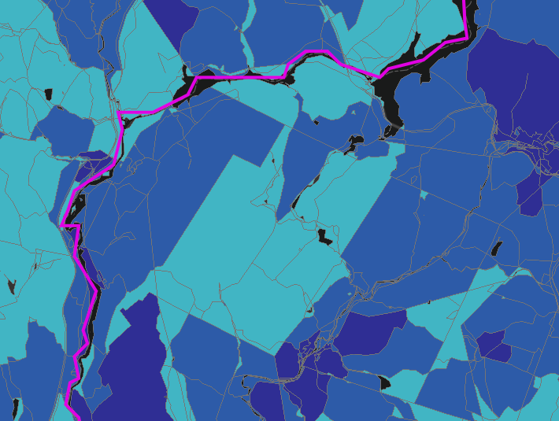
Form 477 Data Now – Resolution
BTOP – State Broadband Initiative
5-Year Project 2010 -2015
Mapping
Planning
Technical Assistance
Capacity Building
Monroe
Lyman

Slide 14
Form 477 Data Future –
Modernizing the FCC Form 477 Data Program
Same collection frequency - June/December of each year
Same objectives - describes residential, fixed broadband coverage
Potential improvement in resolution – directs providers to submit actual service area polygons vs. lists of census blocks
Currency – streamlined efforts to review data, including easier mechanisms for public comment. May reduce frequency to annual submission
BTOP – State Broadband Initiative
5-Year Project 2010 -2015
Mapping
Planning
Technical Assistance
Capacity Building

Slide 15
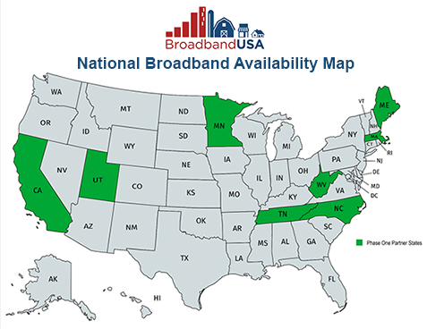
National Broadband Availability Map
2018 Congressional appropriation to update the National Broadband Availability Map (NBAM)
Incorporates data from Form 477 and available 3rd party datasets
6 pilot states:
BTOP – State Broadband Initiative
5-Year Project 2010 -2015
Mapping
Planning
Technical Assistance
Capacity Building

Slide 16
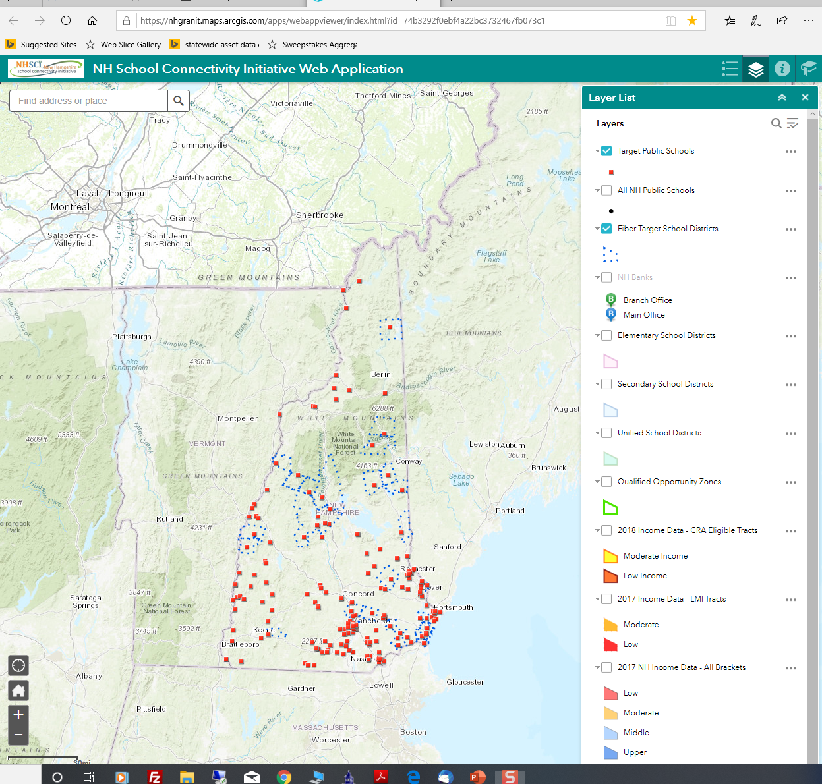
Mapping Economic Inclusion Asset Providers –
New Hampshire School Connectivity Initiative Web Map

Slide 17
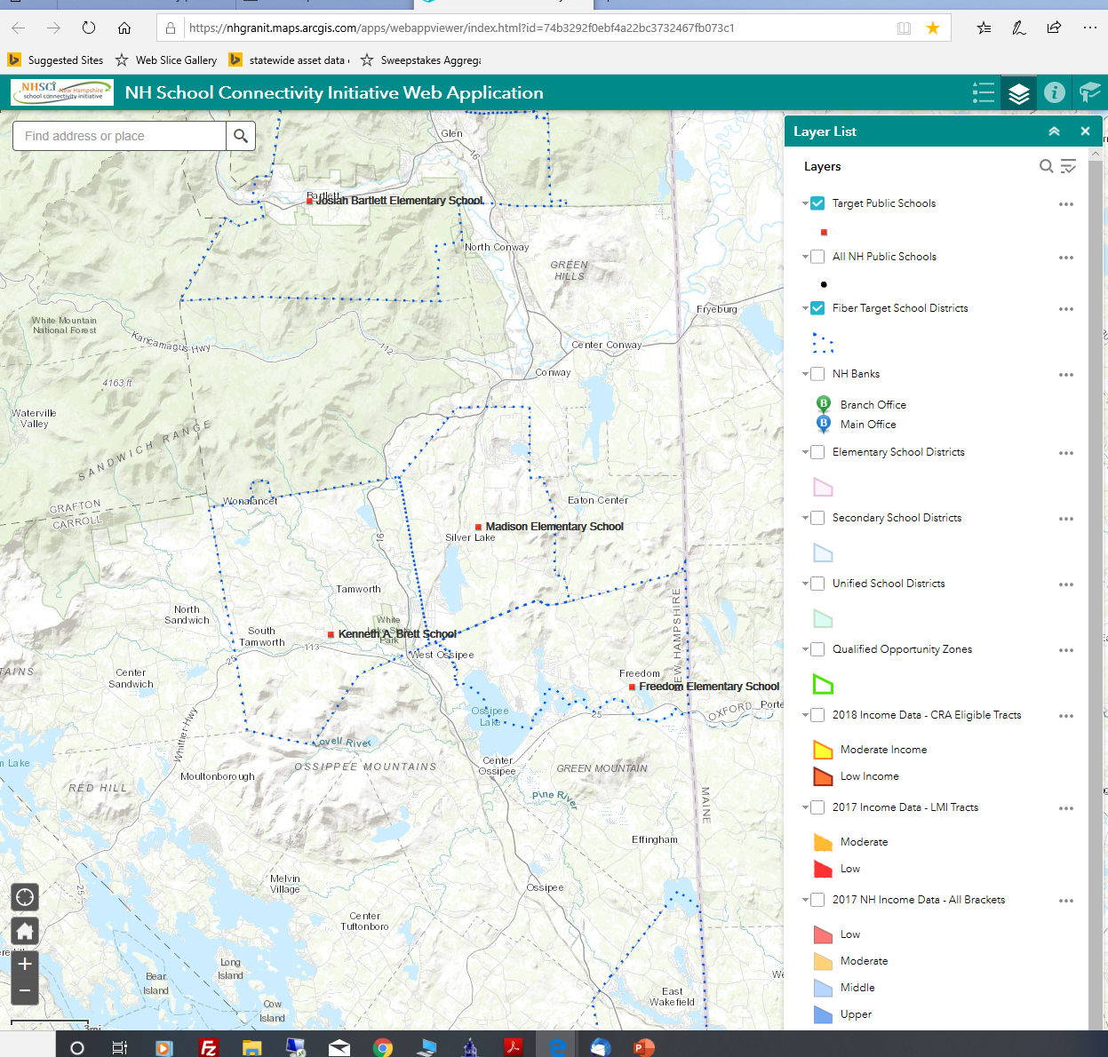
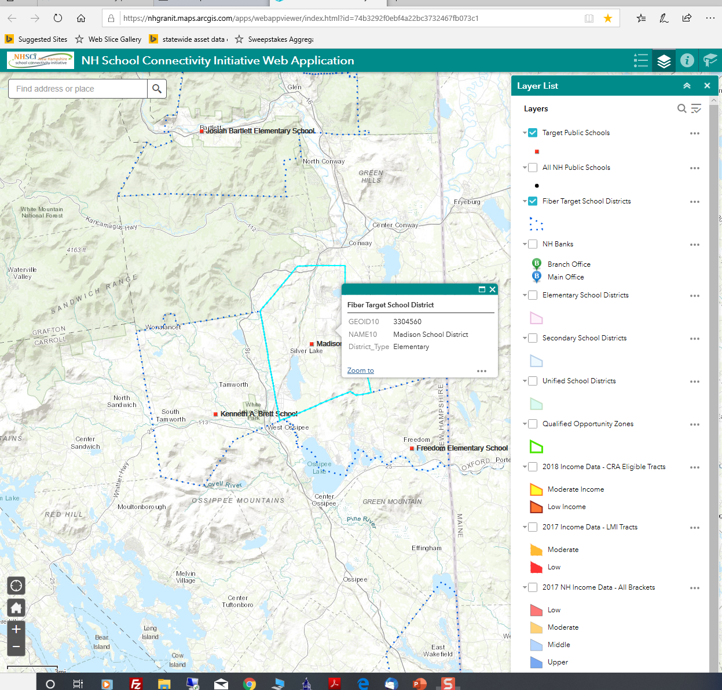
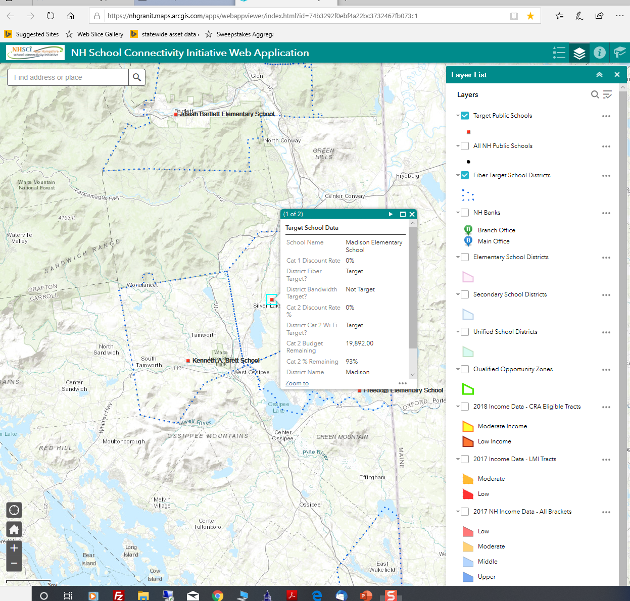

Slide 18
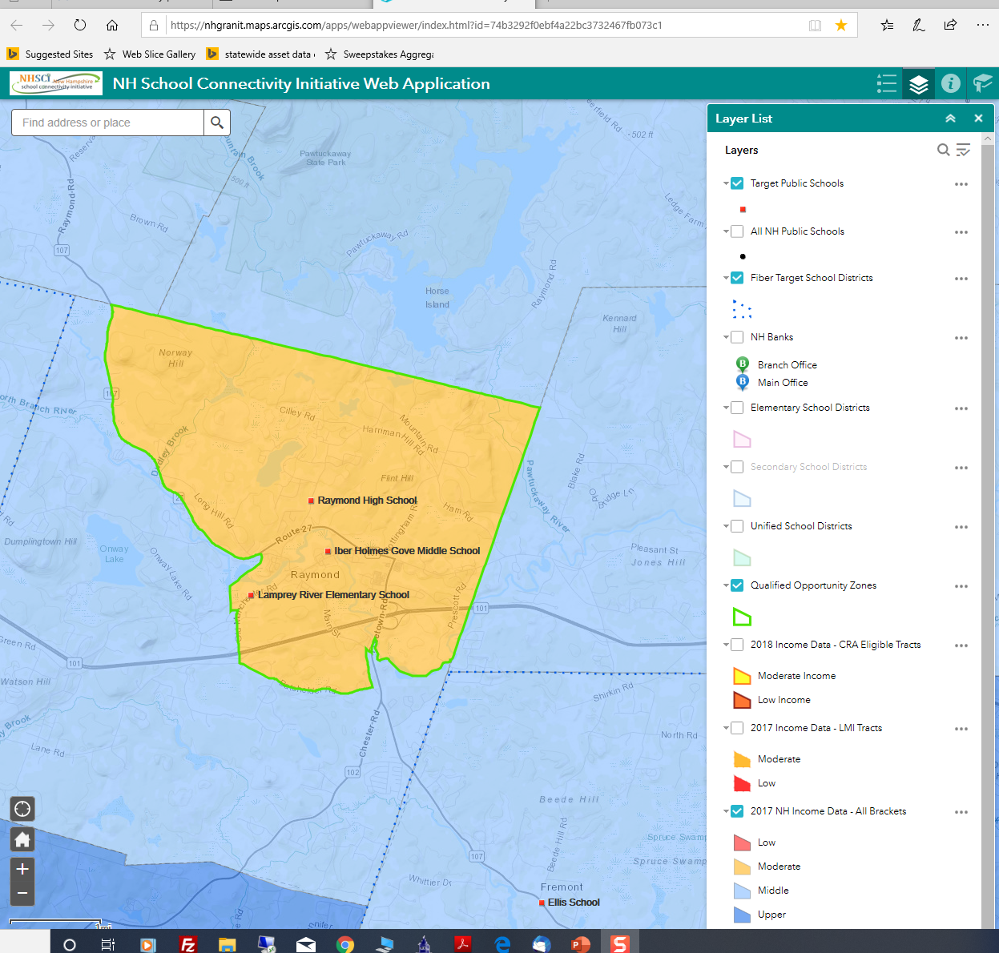
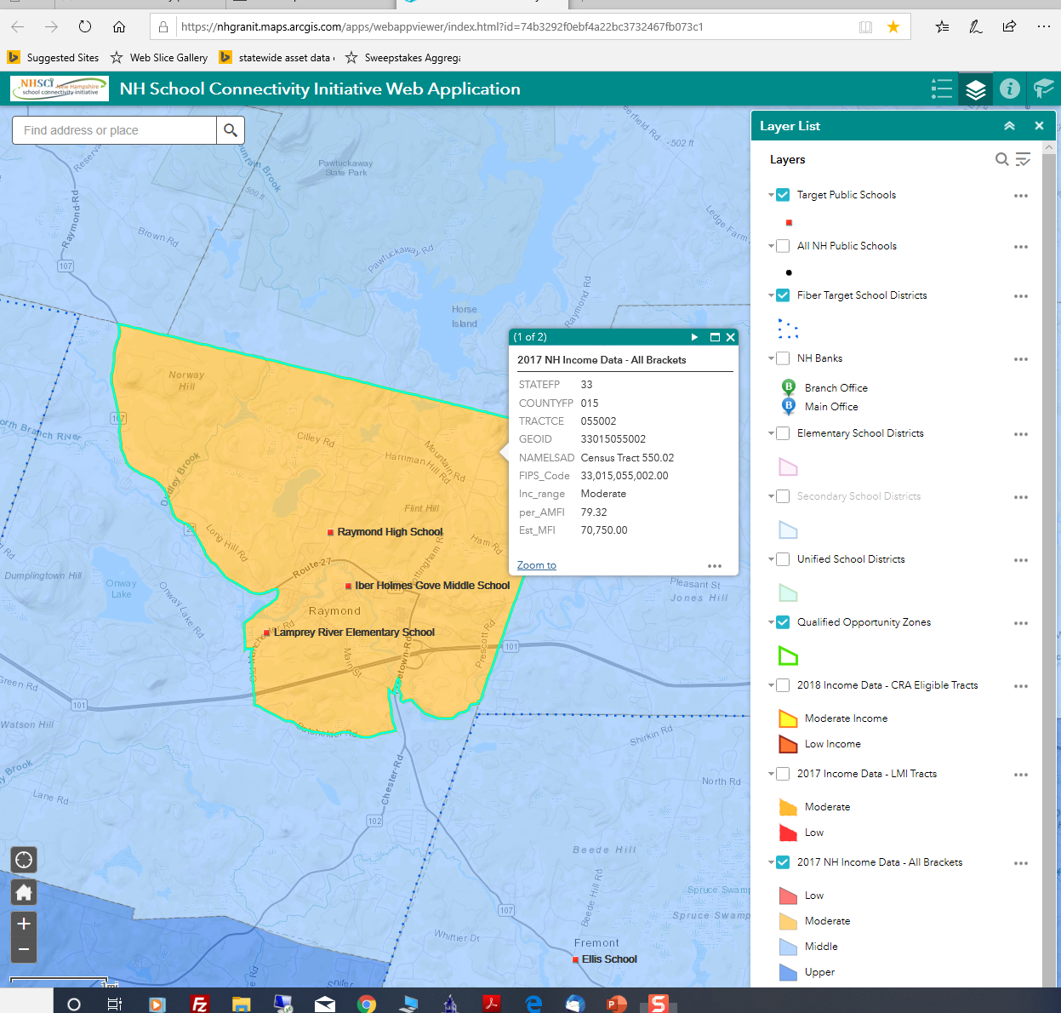


Slide 19
New Hampshire School Connectivity Initiative Web Map
Data Layer | Source
NH Public Schools | NH Department of Education
School Districts: Fiber Target School Districts Elementary School Districts Secondary School Districts Unified Schools Districts | US Census Bureau; E-Rate data provided by EducationSuperHighway
New Hampshire Bank Locations | FDIC tabular listing geocoded using ArcGIS World Geocode Services
Qualified Opportunity Zones | NH Department of Business and Economic Affairs
Income Data: Income Data, All Brackets LMI Tracts CRA Eligible Tracts | Downloaded from www.policymap. Income brackets are based on Census tract Median Family Income (MFI) as a percent of Metro Area MFI, as of 2017.
Census Tracts | Census Bureau, www.data.gov

Slide 20
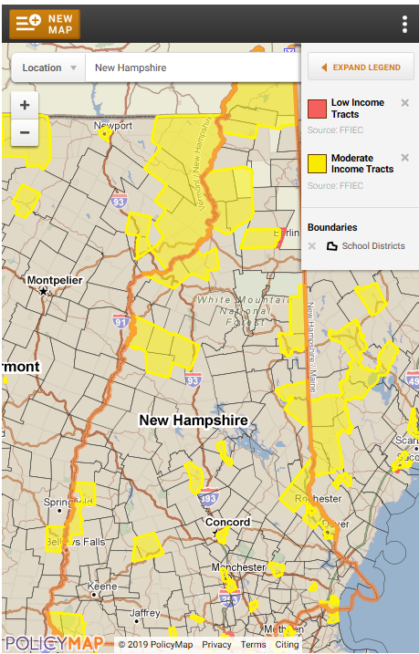
National Center for Digital Equity Online Mapping Resource

Slide 21
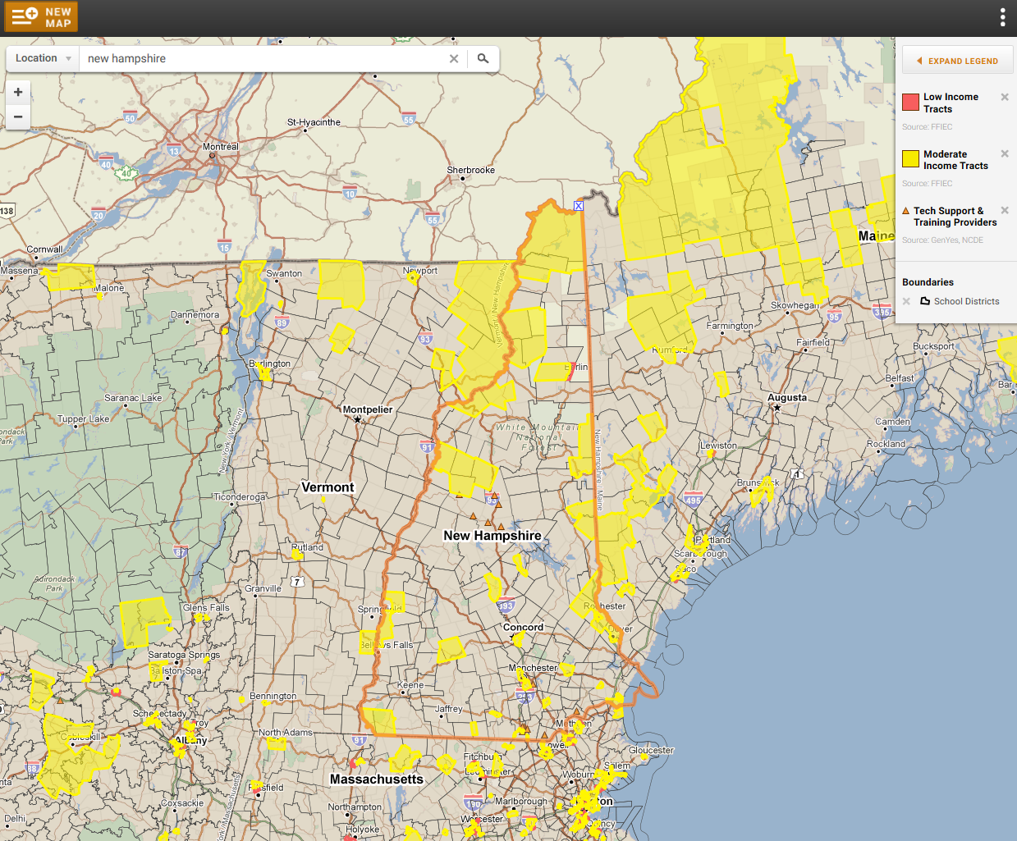
National Center for Digital Equity Online Mapping Resource

Slide 22

Thank You
BTOP – State Broadband Initiative
5-Year Project 2010 -2015
Mapping
Planning
Technical Assistance
Capacity Building
Fay Rubin
Project Director
603-862-4240
fay.rubin@unh.edu

Slide 23
BTOP – State Broadband Initiative
1. What data sets are most important as we explore questions about digital equity?
2. What is the most effective way to present the data?

Slide 24

Broadband Technology Comparison
Dial-up
  56,000 bits per second (bps)
DSL – within 18,000 feet
  1.5+ Million bps download (Mbps)
  1 Million bps upload (Mbps)
VDSL – within 4,000 feet
  40+ Mbps download
  16 Mbps upload
Cable
  10-150+ Mbps download
  5-20 Mbps upload
4G LTE Cellular and Wi-Fi
  10 – 20 Mbps download
  3+ Mbps upload
5G Wireless and Microcells (2020)
  One to 10Gbps connections to end points in the field
  One millisecond end-to-end round trip delay
  10 to 100x number of connected devices
  (Perception of) 100 percent coverage and 99.999 availability
  90 percent reduction in network energy usage
  Up to ten-year battery life for low power, machine-type devices
Fiber – Best Scalability
  Dense Wave Division Multiplexing (DWDM)
  88 x 100 gigabit lightwaves on a single fiber
Broadband trend
  Expand fiber closer to neighborhood
  Use existing copper/wireless for last mile

Slide 25




New Hampshire School Connectivity Initiative
The goals of the NHSCI are:
  Facilitate fiber connectivity to all of our K-12 school buildings
  Increase statewide utilization of E-Rate funds
  Facilitate enhanced Wi-Fi deployment in schools
  Educate and Assist with level broadband pricing options
Notes:
What vendors have existing fiber?
Will it be reasonably priced?
Who may be last on the list?
Create a local or statewide purchasing consortium?

Slide 26
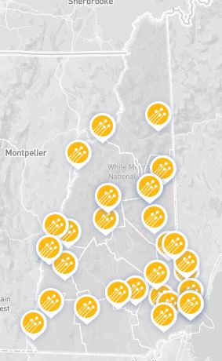


Fiber Upgrades
10 school districts have filed for fiber upgrades
6 school districts/consortiums applied for E-rate state match money through the NH Infrastructure Fund
  Goffstown
  Mascoma
  Manchester Consortium
  Landaff
  Hampstead
  Unity
  Contoocook Valley
  Dover
  Farmington
  Grantham
  Landaff
  Lempster
  Newfound Area
  Shaker
  Timberlane
  Unity
7 school districts did not file this year
  Candia
  Cornish
  Greenland
  Hooksett
  Freemont
  Sanborn
  Derry (already on fiber)

Slide 27
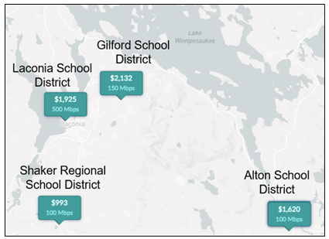
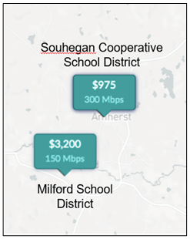

Districts in the same region pay very different costs
3X BW at lower cost
Same BW @ 1.5 x Cost
Double the BW at 1/3 the Cost

