Slide 1

COMMUNITY DEVELOPMENT FINANCE AUTHORITY
Data Initiative
NH Summit on Economic Inclusion and Digital Equity
OCTOBER28, 2019
Kevin Peterson, director of economic Development
Notes:
Thank you for the opportunity to provide a very broad overview of CDFA’s current data efforts.
As part of our responsibility to gather and use data to inform deployment of resources, and in line with our Strategic Plan, CDFA is looking to expand our capacity to gather, track, utilize and present data.
We have been working with the NH Fiscal Policy Institute over the past several months
.

Slide 2
Notes:
Last year, presentation by NHFPI to our board that highlighted data at the municipal level.
I’ll show you some of the maps generated by the Fiscal Policy Institute that provide visualizations of some of the data they explored for this report. The report is online at www.nhfpi.org.

Slide 3
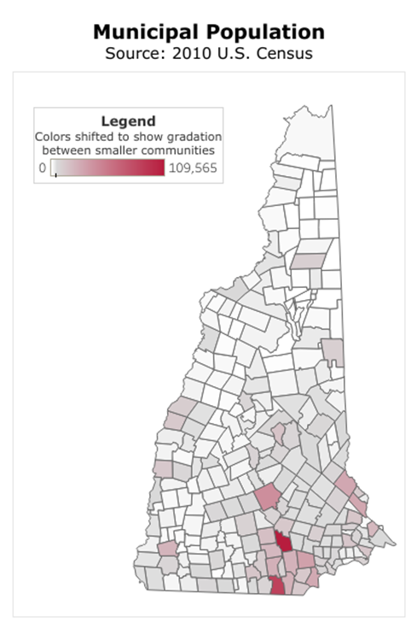
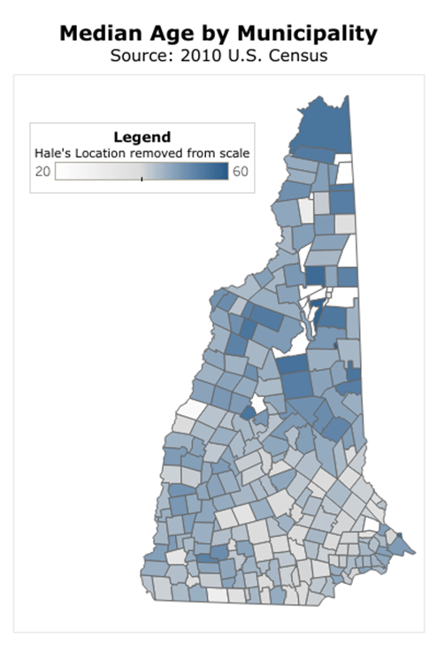
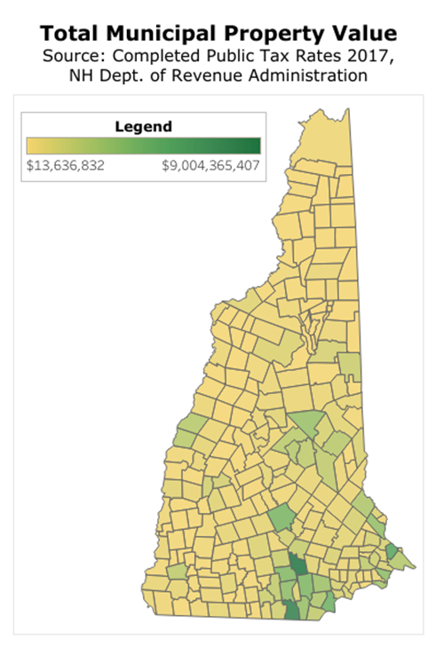
New Hampshire Population Distribution,
Median Ages, and Property Valuations

Slide 4
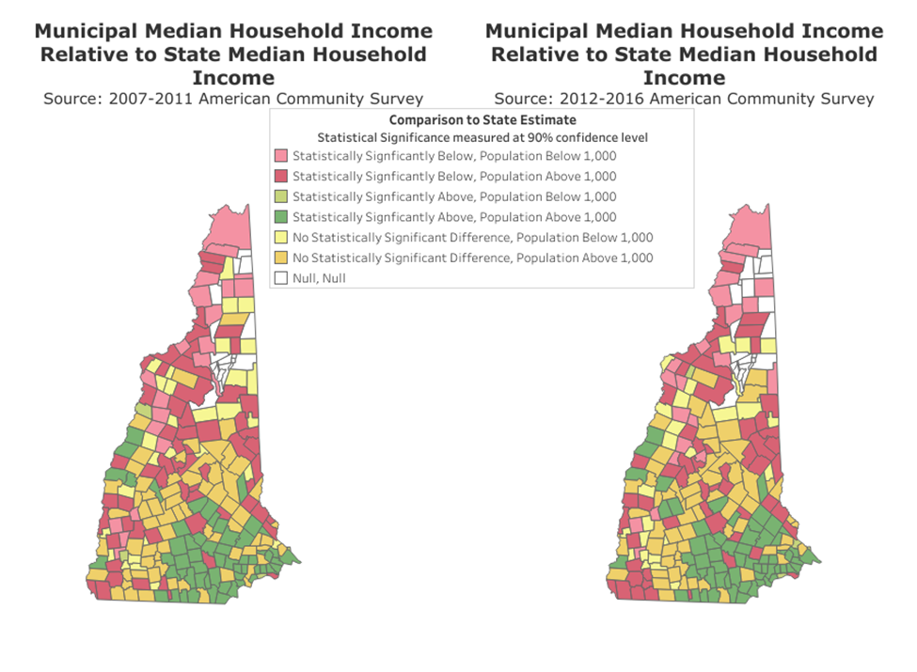
Resident Income at the Municipal Level

Slide 5
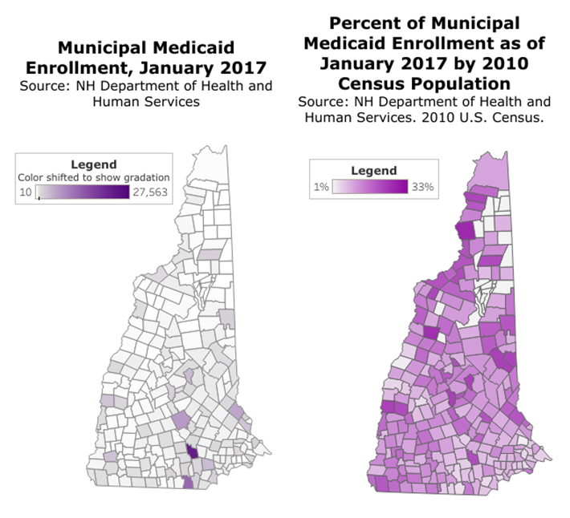
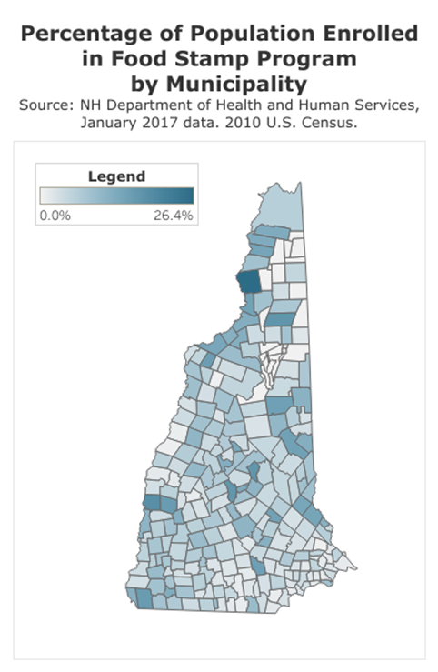
Anti-Poverty Program Enrollment by Municipality

Slide 6
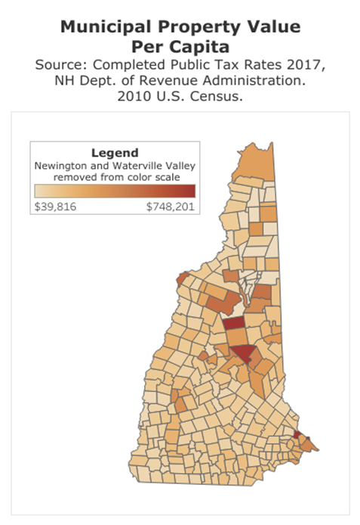
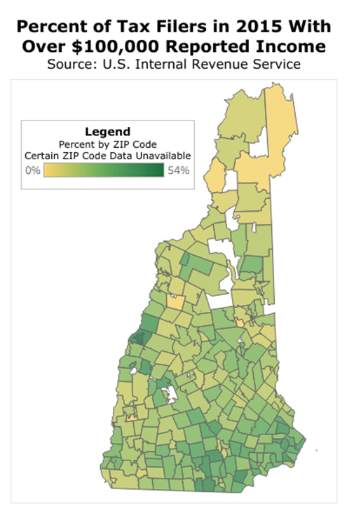
Municipal Disparities in Fiscal Capacity
Municipal Disparities in Fiscal Capacity
Notes:
The NHFPI presentation gave us a strong sense of new capacity for gathering and analyzing data on the municipal level.
CDFA challenge – using data when State Administrative Rules for CDBG program limited our ability to modify the program
In the recent legislative session, we sought and received exemption for these rules.
In anticipation of that change, we embarked on an effort with NHFPI to update our data sources and analysis capability.

Slide 7
Exploring and Vetting Available Core Data Sets
FOCUS: Municipal-level data
Study identified over 100 data sets
NHFPI recommended key data sets (weighted and tiered)
  Municipal and county data
  Applied consistently
  Regularly updated (annual if possible)
  Readily accessible
Notes:
We worked with NHFPI to engage a Fellow from the Carsey School of Public Policy at UNH to do two things
Examine possible data sets that we could use to replace the data we had been using from the 2010 Census
Explore different ways to display those data and make our data work more accessible and transparent to our stakeholders.
Based on NHFPI’s earlier report on municipalities, and the CDBG orientation to individual municipalities, we focused on municipal-level data.
informs analyses by providing insight beyond county level
helps inform local government decisions
many data lack certainty, are based on surveys or modeling
SO, we needed to be careful, and to use County data where it was more reliable

Slide 8
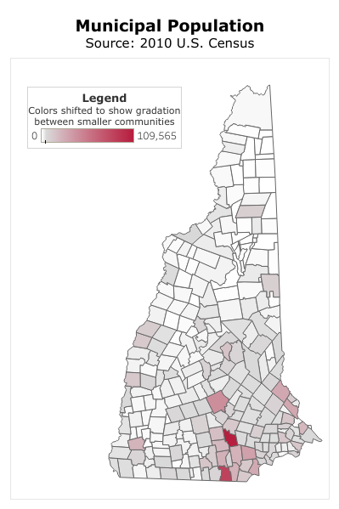
Three Broad Categories
Basic Human Needs
Poverty
Housing
Access to Health Care
Population Composition
Access to Opportunity
Income
Municipal Fiscal Capacity
Economic Growth
Opportunity for Children
Community Sustainability and Vibrancy
Population Growth
Community Infrastructure
Notes:
Data were divided into three basic categories to be consistent with CDFA’s strategic plan to meet basic human needs, increase access to opportunity, and build stronger community sustainability and vibrancy.
The data sets were most focused on the first two categories. We still have some work to do to flesh out the third category.

Slide 9
CDFA Core Data Index
Part of CDBG Scoring
Updated annually
Part of broader data initiative
  Community need
  Opportunity and vibrancy
  Places to focus additional capacity
  Local input
Notes:
We now have NHFPI’s recommended data sets, which we are using to craft anew “Core Data Index” on community well being. This data index will replace the old, 2010 Census data that we have been using for the past decade.
Updated annually
Going forward, we hope to expand our data work to look at other factors
AND, we want to make our work accessible and transparent—displayed on our Web site, downloadable and usable in other platforms, such as ArcGIS used by regional planning commissions.
And a way for communities to add their own data to the mix if appropriate.
Finally, we are working closely with other agencies and organizations in the state that collect, analyze and display data. Hoping to be able to collaborate with them going forward.
I’ll turn now to the visualization element of our data work.

Slide 10
Data Visualization Tools Overview
PolicyMap
An online mapping and data application. PolicyMap is fully web-based and comes pre-loaded with over numerous data layers, single-point datasets, and other indicators relating to several areas of policy, including demographics, housing, income, quality of life, and education.
Tableau
A data analytics and visualization tool. Tableau has both web-based and desktop-based applications. Both can be used to generate maps, charts, graphs, and other visuals (vizzes) to better display and understand data.
ArcGIS
A platform for the creation, visualization, and analysis of spatial and geographic data. Data can be displayed through interactive maps and through visualizations, including story maps, graphs, and charts.
Notes:
Our Data fellow looked at three different data visualization platforms. Each one offers a pretty powerful way to show information in a graphic way. There are benefits and drawbacks to each, and we will be exploring each more deeply in the coming months. We likely will use one of these tools on our new web site in 2020.

Slide 11
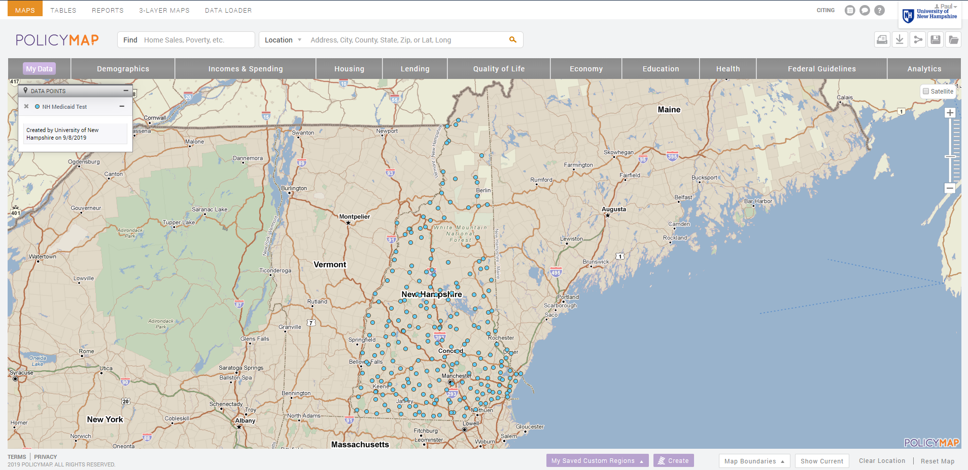
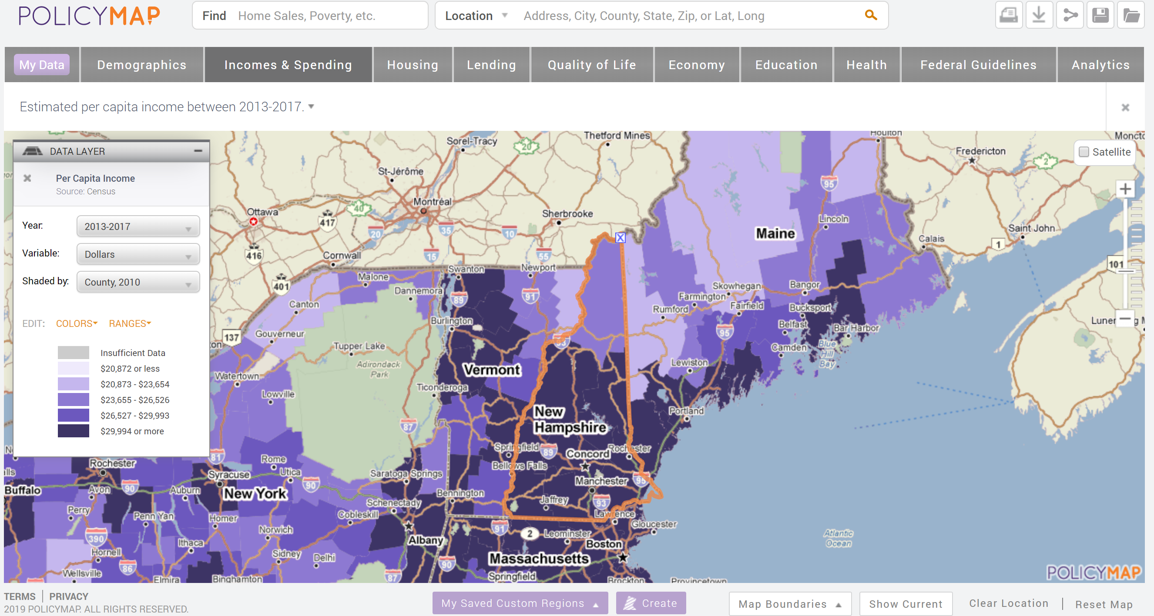
Notes:
This is PolicyMap’s public userface.
Paid members can upload their own point datasets here and view 1-3 layer maps.
Data can be downloaded in to excel file format and exported as tables and reports.
There is a print function
Data layers can be sent to PolicyMap to be uploaded into the tool.
Over 15,000 data sets uploaded in PolicyMap
Demographics, Incomes & Spending, Housing, Lending, Quality of Life, Economy, Education, Health, Ect.

Slide 12
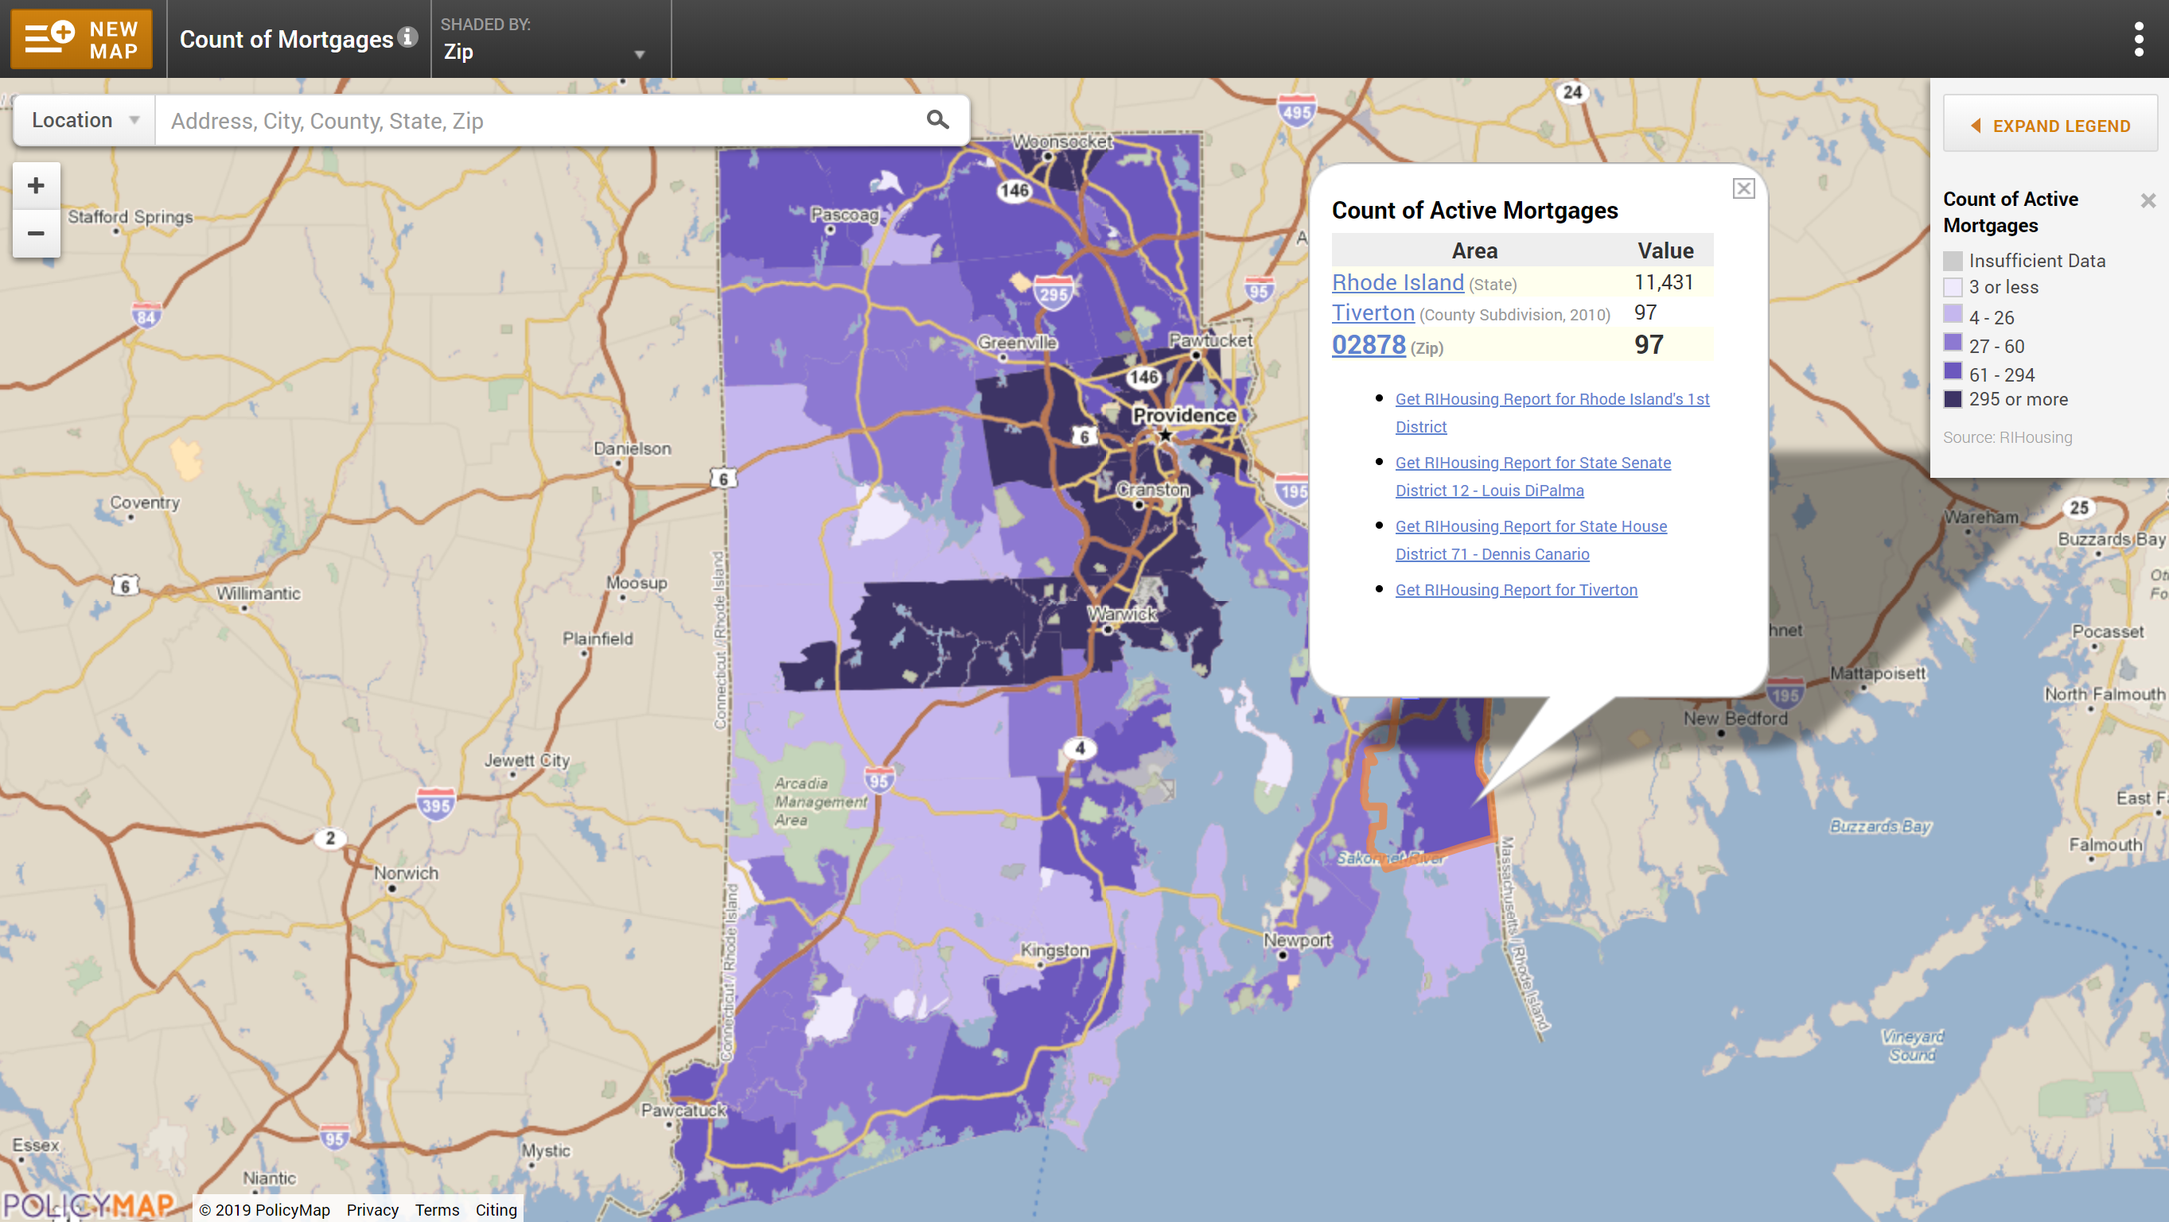
Widget Example – Rhode Island Housing
Notes:
The widget will show only data selected by client.
Widgets are created by the PolicyMap team for clients
30 data layers and 8 data point sets can be included in one widget
It is embedded in a client website and can be accessed by anyone.
RIHousing also allows users to generate reports outside of the map function which costs additional funds

Slide 13
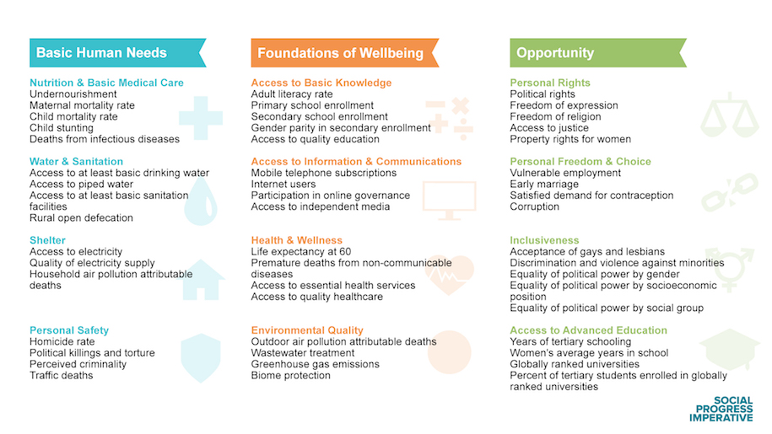
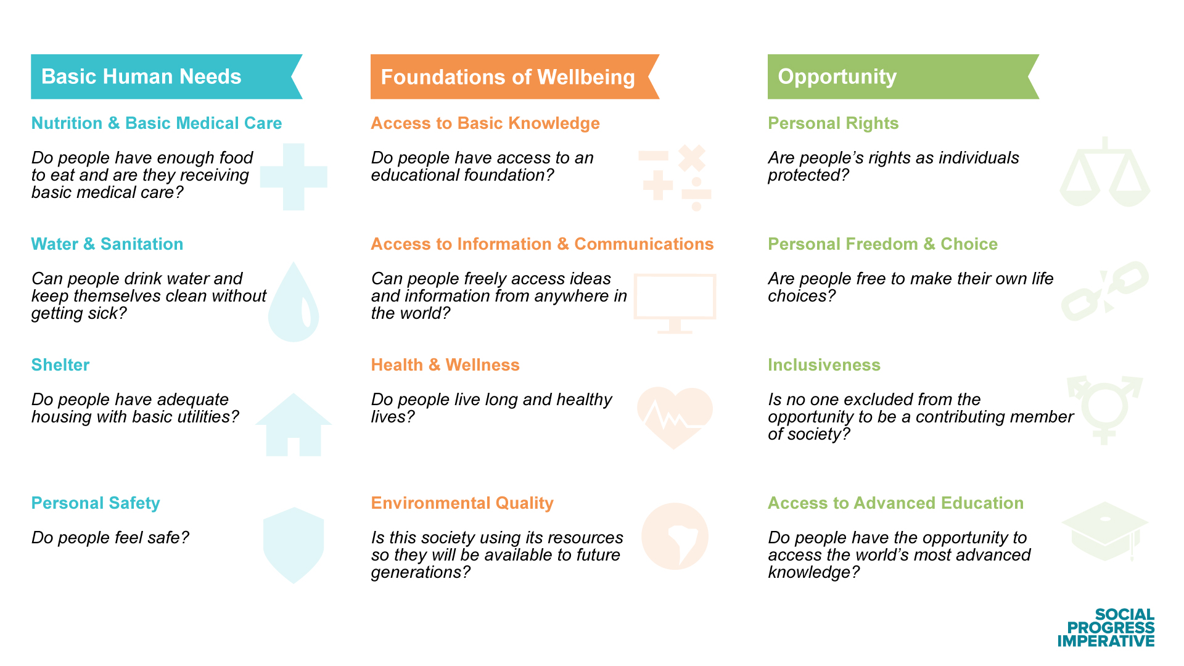
VALUES
Just finished some additional review of the MEDC CDBG-ED application.
INTEGRITY
COLLABORATION
ADAPTABILITY
RESPECT
FOCUS
PROSPERITY
Notes:
As a precursor to the Carsey Fellow project with NHFPI this past summer, we found a number of other data indices. Here is one example
The Social Progress Index is a global data-aggregation platform that uses three major categories and dozens of data sets to create a kind of alternative to the traditional Gross Domestic Product index.
You can see that there are a number of subsets under Basic Human Needs, Foundations of Well-being and Opportunity.
This index has been applied to more than 100 countries.
Some of these sub-categories are quite relevant to New Hampshire communities and measures that CDFA currently uses; others not so much

Slide 14
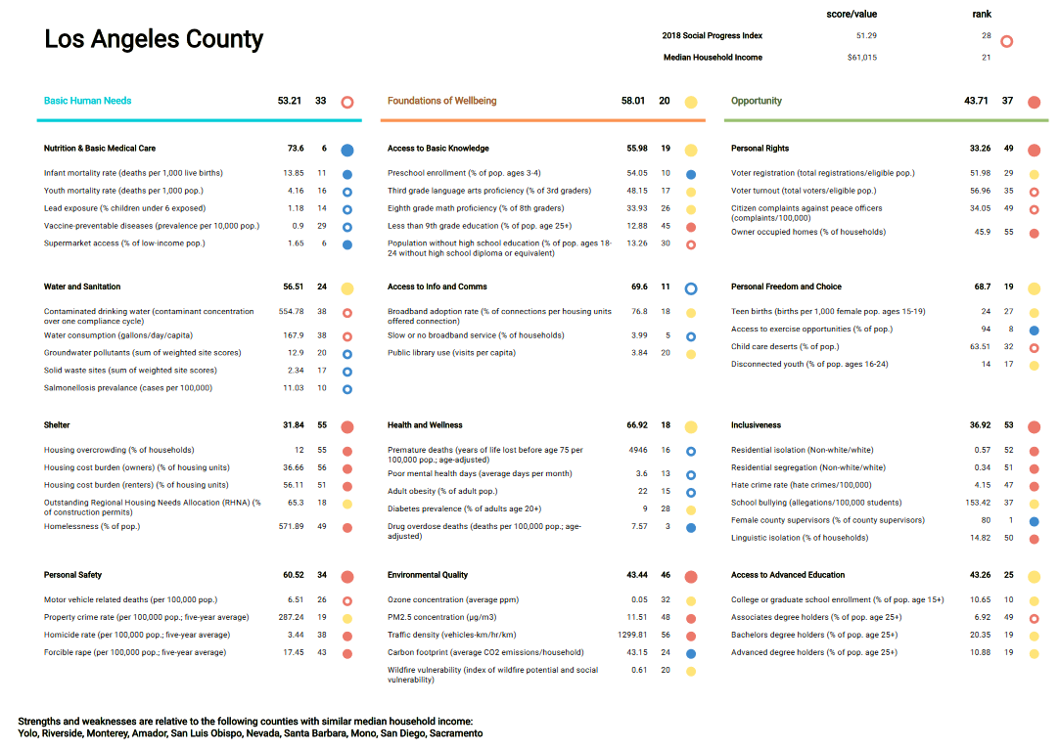
Just finished some additional review of the MEDC CDBG-ED application.
INTEGRITY
COLLABORATION
ADAPTABILITY
RESPECT
FOCUS
PROSPERITY
Notes:
In the US, the index is being deployed in California to evaluate social progress at the county level. This is an example of the index for LA County. The blue dots are high ratings, the orange dots are low ratings, and yellow dots are average – all in comparison to other California counties with similar median household incomes.

Slide 15
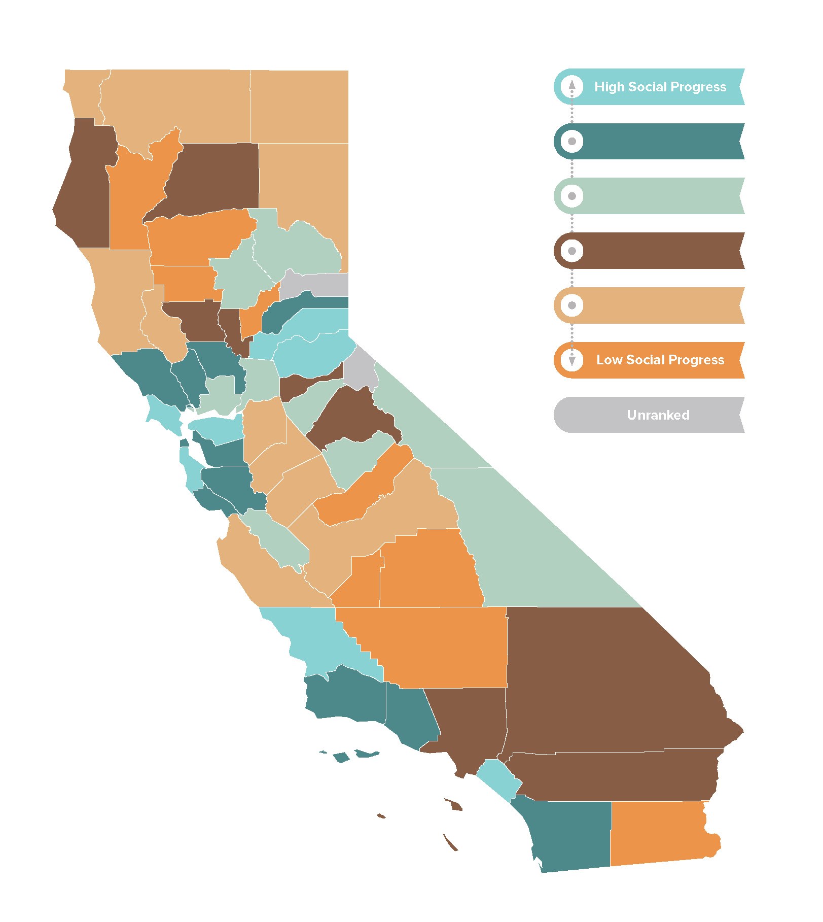
Notes:
The Social Policy Index for California shows the relative progress for each county – this is a Tableau-version visual application of the county-level index (details for LA County in your handout).
I have not seen this index deployed at the municipal level.
Tableau also was used by NH Fiscal Policy Institute to produce the maps and charts in their municipalities report
Another great visualization tool is Policy Map, which enables visual representation of literally hundreds of different data sets, at various geographic scales—depending on the data set, you may be able to see data by state, county, municipality or census tract.
Here is an example.
https://www.policymap.com/maps Income/Spending, Housing Cost Burdens, Renter Cost Burdens
Policy Map lets you aggregate up to 30 different data sets, several of which can be ‘custom’ data sets that you upload.

Slide 16
QUESTIONS
Community Development Finance Authority
www.nhcdfa.org
kp@nhcdfa.org
Notes:
This is just the beginning of CDFA’s effort to gather, use and display data in a transparent and accessible way. Stay tuned as we continue the journey in 2020 and beyond.

