Slide 1
Discovery Meeting
NH Piscataqua/Salmon Falls Basin
Coastal Project
September 22, 2011
Notes:
Fay – Slides 1-7

Slide 2
Why are we here?
Risk Mapping, Assessment, and Planning (Risk MAP FY2010 - FY2014)
  Ensure 80% of nation's flood hazards are current
  Provide updated data for 100% of populated coastal areas
  Mitigation Planning - Status update
  4-Meeting Format
Best Available Data
Coastal Input Conditions
Community data available?
Notes:
Fay
Map Mod focused on production of digital FIRMs at the county level for 92 percent of Nation’s population

Slide 3

Discovery
Discovery for NH Coastal Project is the process of data mining, collection, and analysis with the goal of conducting a comprehensive coastal study and initiating communication and mitigation planning discussions with the affected communities.
Occurs prior to…
  Flood studies
  Flood risk assessments
  Mitigation planning technical assistance projects
Notes:
Fay
Discovery also involves collecting information that allows for a holistic understanding of a community’s risk and flood mitigation actions that the community may implement.
Discovery is the collection of data and information for not only a flood study update, flood risk assessment, and/or mitigation planning technical assistance project, but also for developing a communication strategy that leads to increased flood risk awareness in the community and actionable flood hazard mitigation planning.
When does Discovery occur?
It is required… but also flexible, and can be tailored to the specific project needs.
The purpose is not only to define the project scope and get buy-in from the local officials, but to increase visibility of flood risk for all stakeholders. This provides a great opportunity to educate organizations and officials about options for mitigation and to stimulate local discussion.

Slide 4
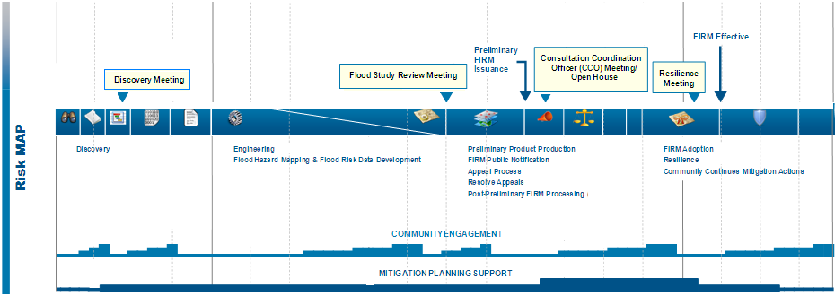
NH Coastal Project Timeline
Activities
Project Timeline
Products
Projected Preliminary
May 2013
Projected
Effective
June 2014
Projected
Flood Study Review
April 2013
Discovery
September 2011
Projected CCO
June 2013
Projected LFD
Dec 2013
Notes:
Fay
Coastal Schedule
Prelims –May, 2013
LFD – December 2013
Flood Study Review Meeting ( a couple months before preliminary): After the engineering analysis is completed to present initial mapping results and draft risk assessment products. Presented in work map format
CCO Meeting
Resilience Meeting: Between LFD and effective Date Focus on hazard mitigation plan implementation and available resources. Flood Risk products are again discussed.

Slide 5
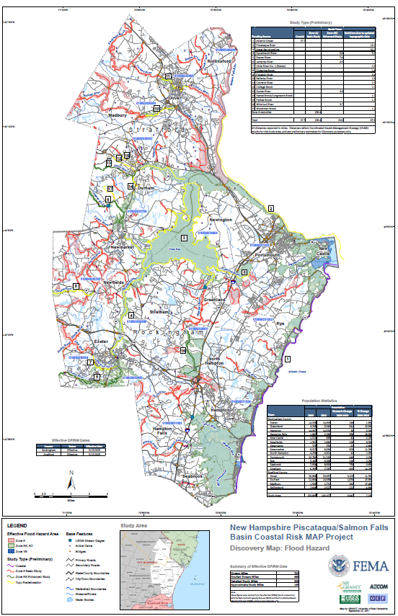
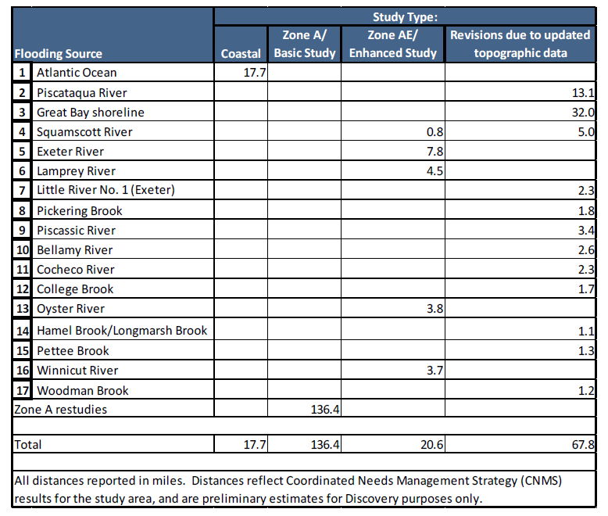
NH Coastal Project –
Preliminary Discovery Map
Notes:
Fay
Coastal Schedule
Prelims –May, 2013
LFD – December 2013
Flood Study Review Meeting ( a couple months before preliminary): After the engineering analysis is completed to present initial mapping results and draft risk assessment products. Presented in work map format
CCO Meeting
Resilience Meeting: Between LFD and effective Date Focus on hazard mitigation plan implementation and available resources. Flood Risk products are again discussed.

Slide 6
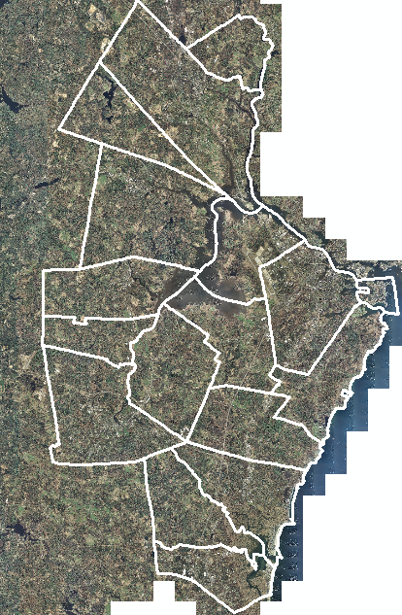
Best Available Data
2010 1-ft. Orthophotography
Coastal LiDAR – acquisition underway – data available in late Fall 2011
Field Data Collection
Notes:
Fay
Best available data:
Lidar –acquisition underway and data will be available Fall of 2011
Orthos – latest from NH GRANIT
Data collected as part of field visits

Slide 7
Topographic Data
Notes:
Fay
LiDAR will be available for entire study area:
– Nominal Point Spacing < 2 meters
- 3-meter DEM
NSSDA vertical accuracy at 95% confidence level = 30 cm, based on RMSE of 15 cm in open terrain category
2-foot contour capable

Slide 8
Study Methods
Methods for Updated Mapping
  Riverine studies:
    Revisions due to updated topographic data
    Riverine Zone A Basic Study
    Riverine Zone AE Enhanced Study
  Coastal Study
Notes:
Brent – slides 8-21

Slide 9
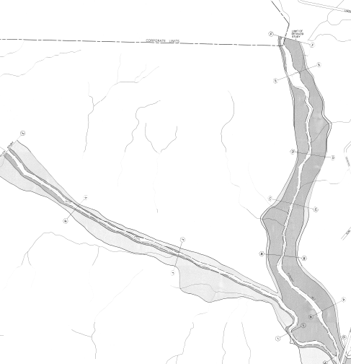
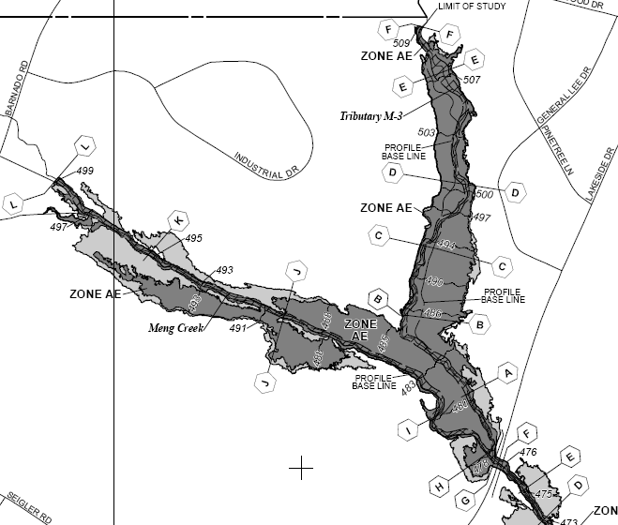
Revisions Due to Updated Topography (Redelineation)

Slide 10
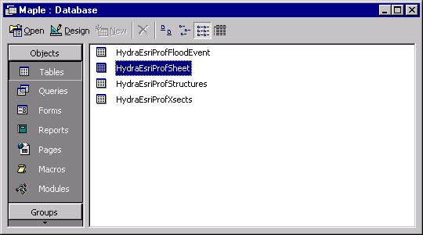
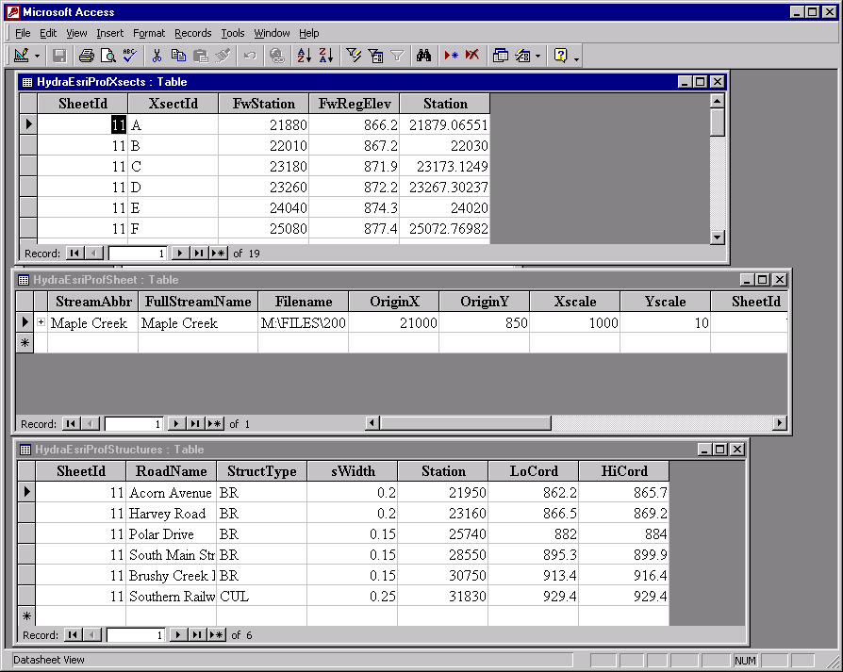
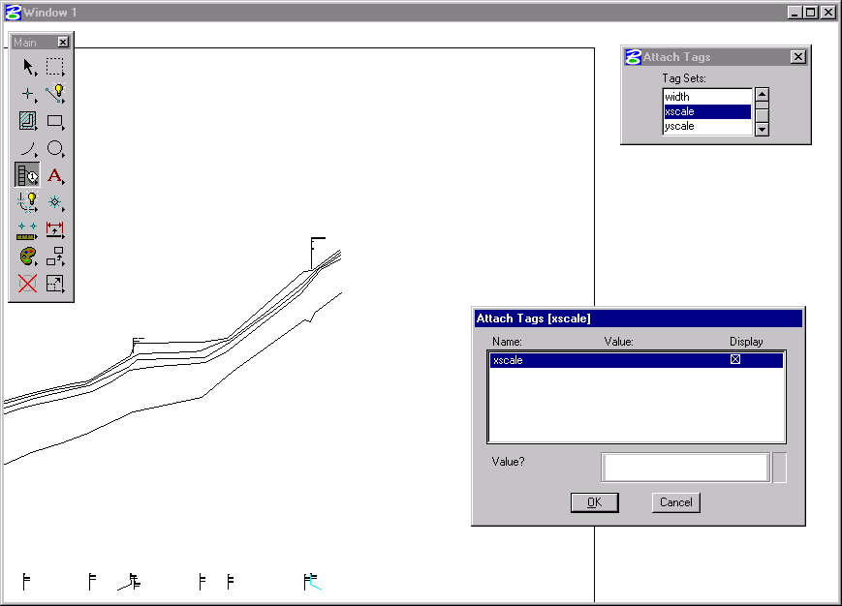
Revisions Due to Updated Topography (Redelineation)
Used to Update Effective Mapping with new Terrain Data
Foundation is the FEMA Profile

Slide 11
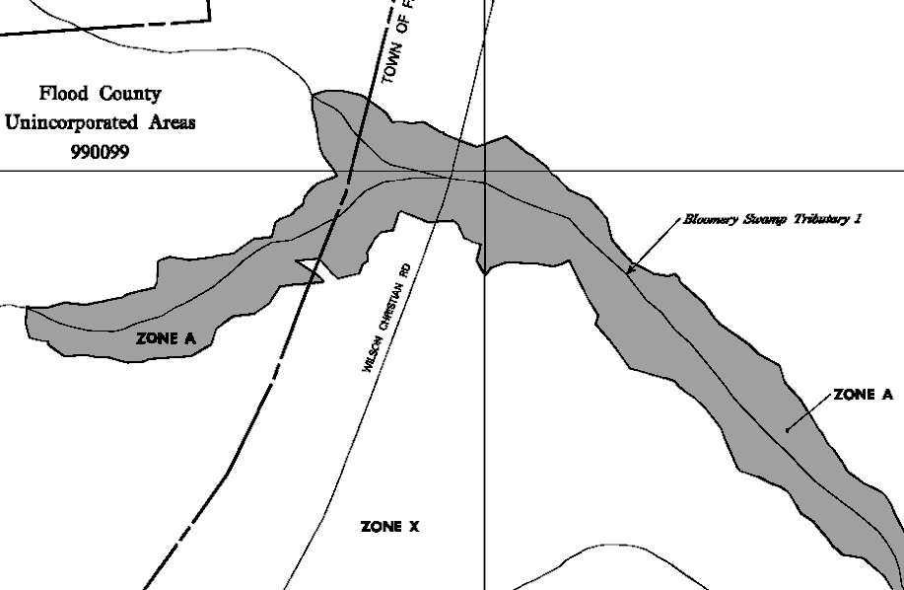
Riverine Zone A Basic Studies
Replaces Unnumbered A Zones
Much more automated approach
Hydrology from Regional Equations
Hydraulic Models Developed
Flood boundaries mapped from model output

Slide 12
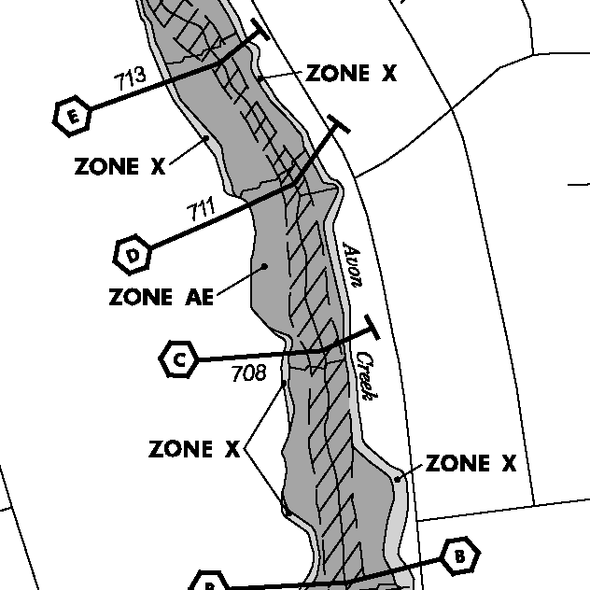
Riverine Zone AE Enhanced Study
Traditional Detail Study
Sections Field Surveyed
All Hydraulic Structures Surveyed
Detailed Hydrologic Analysis
Traditional Mapping
  Floodways
  Floodway Data Table
  Flood Profile

Slide 13
Coastal Study: History of Coastal Floodplain Mapping
NAS Develops Wave Analysis Methodology
Guides & Specifications for Wave Elevation and V Zone Mapping
Runup Methodology Accepted
Primary Frontal Dune
PM No. 50 and Sheltered Waters
NFIP Authorized
PM No. 37
1986 to 1988
1973
1979
1989
2002
2007
1968
1977
1981
1988
1995
2005
2008
H_{b} = 3'
Appendix D
Wetland Vegetation Muddy Bottom Erosion Analysis (540SF)
FEMA Adopts NAS Methodology
Atlantic Ocean and Gulf of Mexico Guidelines Update (Final Draft)
Notes:
Discuss PM50 – why we are doing coastal analysis

Slide 14
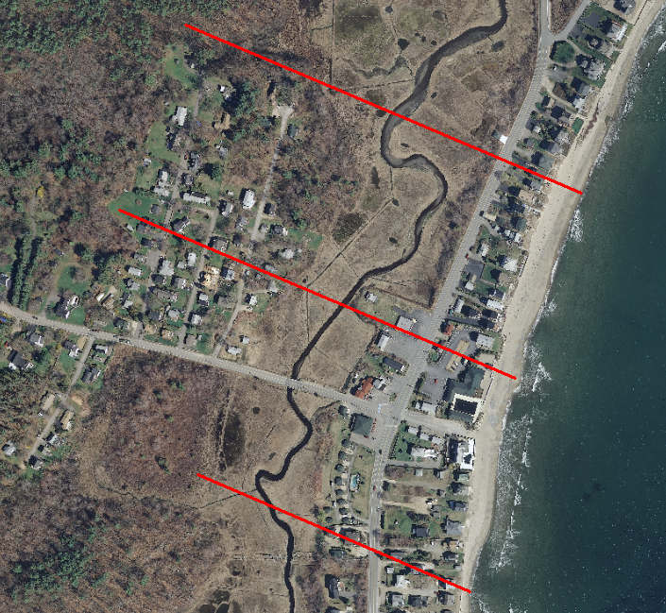
Field Reconnaissance
Observe features that cannot be seen from imagery
  Classify terrain
  Identify raised buildings
  Determine vegetation density
Reality check for model results

Slide 15








Base Flood Elevation on FIRM includes 4 components:
  Storm surge stillwater elevation (SWEL)
  Amount of wave setup
  Wave height above storm surge (stillwater + setup) elevation
  Wave runup above storm surge elevation (where present)

Slide 16
Storm Surge Stillwater Elevation
USACE Tidal Gages
FEMA Update

Slide 17
Wave Setup
Effective studies did not incorporate wave setup

Slide 18
WHAFIS
Accounts for wave dissipation/regeneration
Wave crest elevations => Base Flood Elevations

Slide 19
Wave Runup
  Runup 2.0 for moderate slopes
  TAW method for structures / bluffs
  USACE Shore Protection Manual for vertical walls

Slide 20
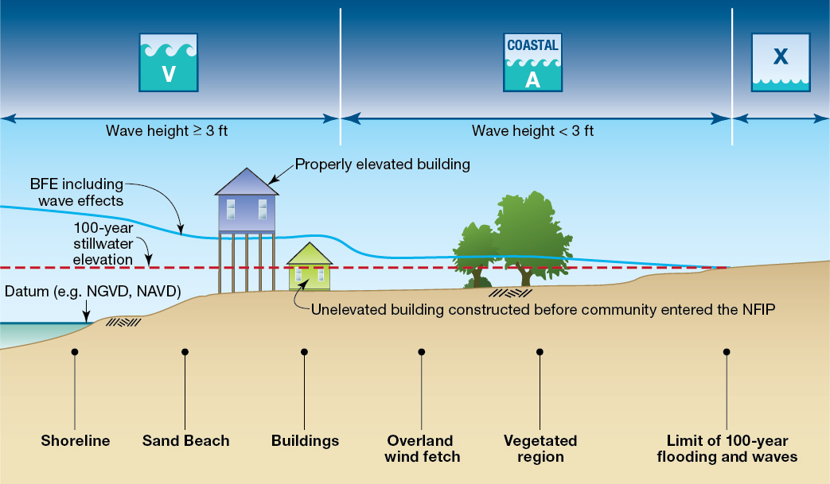
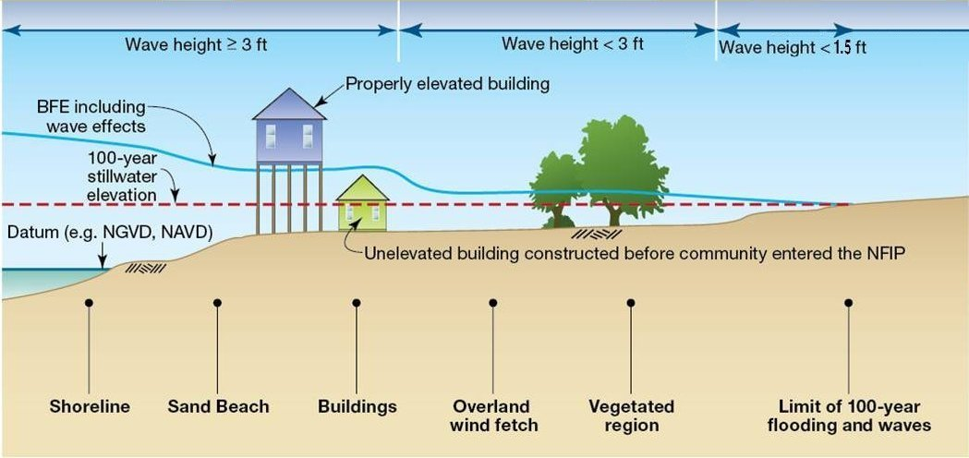
Coastal Hazard Mapping

Slide 21
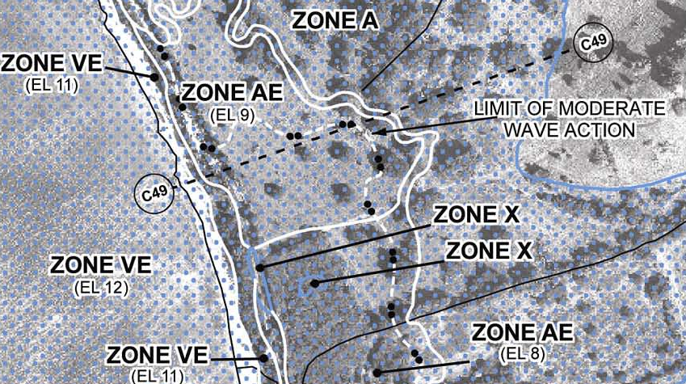
What is LiMWA?
Limit of Moderate Wave Action (LiMWA)
  Areas subject to wave heights greater than 1.5 feet
  Coastal A Zone
“Coastal hazards: How big a wave would it take to demolish a coastal building?”
  http://www.asbpa.org/news/newsroom_09BN0922_coastal_hazards.htm

Slide 22
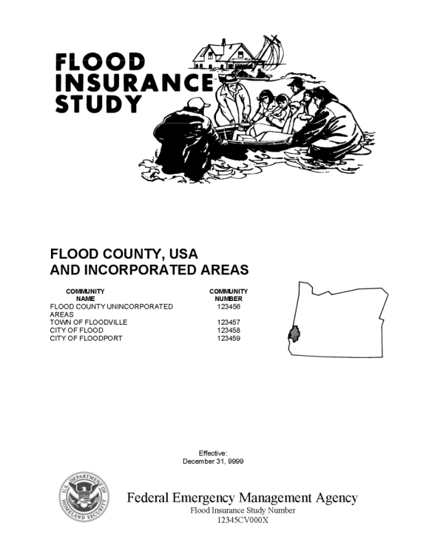
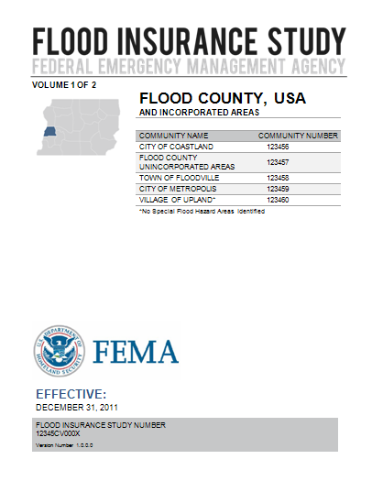
Flood Insurance Study
FIS Reports and DFIRM Maps will continue to fulfill
regulatory requirements and support the NFIP
Reformat FIS Report Document
Refresh branding
Notes:
Fay – Slides 22-25
Distribution through existing mechanisms (MSC).

Slide 23
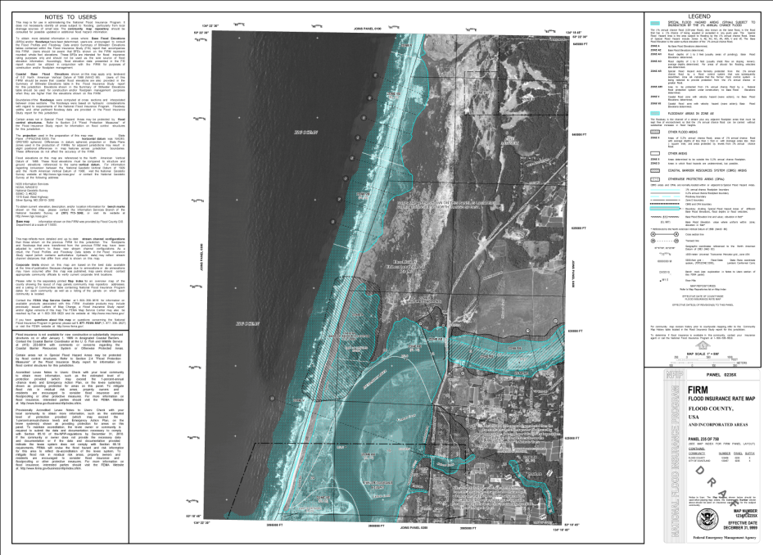
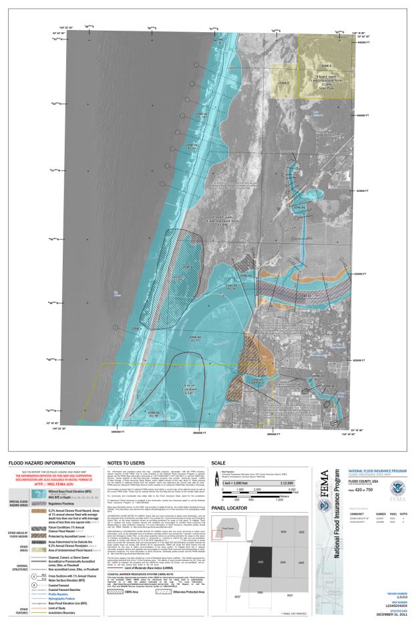
DFIRM Maps
FIS Reports and DFIRM Maps will continue to fulfill
regulatory requirements and support the NFIP
Reformat maps
Improve ease of use
Communicate Flood Insurance Zones more clearly
Updated graphic specifications
Simplify map production
Notes:
Objective: Align FIRM DB with other Regulatory Products and advance data development to promote more automated map making.
--Reduces restudy costs, increases automation, improves communication, clarifies previous guidance

Slide 24
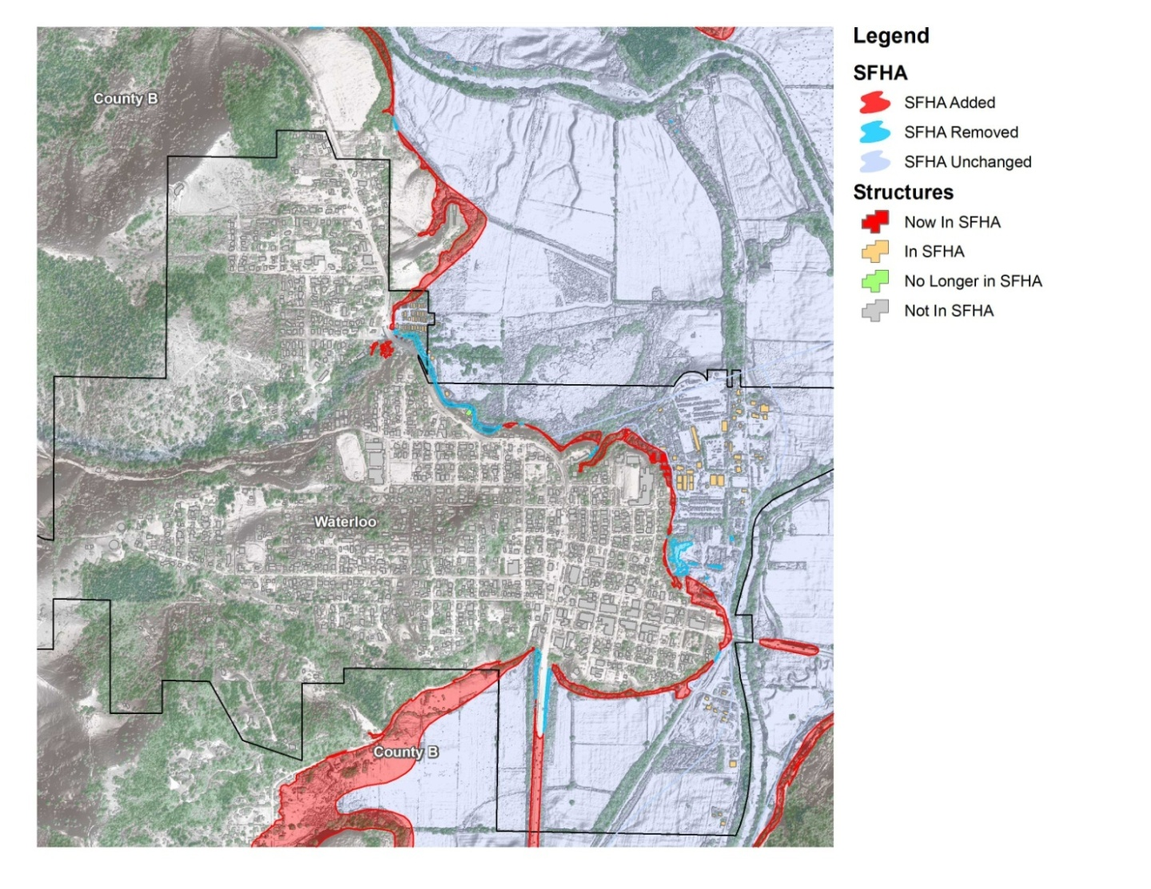
Flood Risk Products
Changes Since Last Map
  Shows areas of change
  Improved outreach
Flood Risk Assessment & National Flood Risk Layer
  Enables communities to understand risk by reference to existing structure loss
Notes:
Changes Since Last Map Product Objective: To enable improved outreach, increase transparency and trust, and to reduce potential delays.
Basic Products - SFHA Changes Highlighted, Identifies Impacted Structures, Study Type
Digital data provided to quickly highlight where the SFHA has changed
If building footprint data is available, structures experiencing a change can be symbolized accordingly; otherwise, use National Datasets to estimate impacted structures
Information on potential structures/population affected is included in the Watershed Flood Risk Report, available at the community level
Study processes are uniquely identified (e.g. detailed versus re-delineation)
Multi-Frequency Depth Grid Product Objective: To allow homeowners to comprehend true risk and make better decisions, and enable Benefit Cost Analysis
Profiles Delivered: 10%, 2%, 1%, 1%+ (confidence interval), 0.5%, and 0.2% Annual Chance
Depth grids will help stakeholders better understand their risk. Highlights the fact that there are areas within the SFHA that experience more than 3 feet of flooding even in the 10% annual chance event.

Slide 25
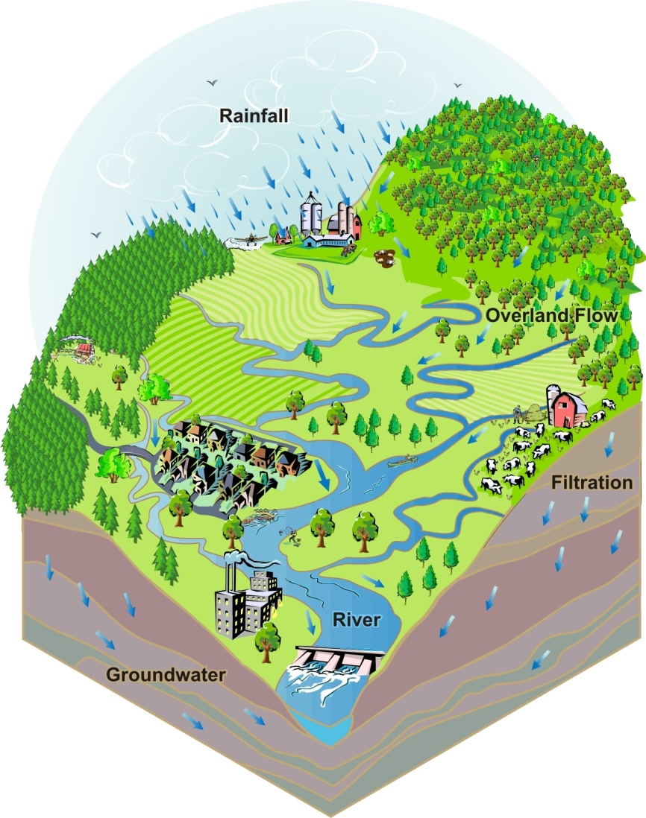

Piscataqua/Salmon Falls Basin Coastal Project
Flood Risk Report
Coastal
Flood Risk Report
Changes Since Last Map
Flood Risk Assessment
Notes:
Risk MAP flood map updates focus on the engineering data supporting the maps; FEMA is working towards identifying, planning, and producing Risk MAP flood map updates at the study level
Users receive a flood risk report spanning entire study area.

Slide 26
NH Coastal Project Timeline
Activities
Project Timeline
Products
Projected Preliminary
May 2013
Projected
Effective
June 2014
Projected
Flood Study Review
April 2013
Discovery
September 2011
Projected CCO
June 2013
Projected LFD
Dec 2013
Notes:
Ivy slides 26-29:
FEMA Planner to discuss where Mitigation Planning comes into play during the Risk MAP schedule (i.e Resilience Meeting)
Coastal Schedule
Prelims –May, 2013
LFD – December 2013
Flood Study Review Meeting ( a couple months before preliminary): After the engineering analysis is completed to present initial mapping results and draft risk assessment products. Presented in work map format
CCO Meeting
Resilience Meeting: Between LFD and effective Date Focus on hazard mitigation plan implementation and available resources. Flood Risk products are again discussed.

Slide 27
Discover the Coastal Communities
Understand local interest, issues, and capabilities of communities
  Status of Mitigation Plans
  Communication of desire, skills, and resources
  Interest in, and resources for, mitigation
  Experience with flood disasters and recovery
  Floodplain administration
  Interest in cost-share
  Mitigation support needs and interests

Slide 28
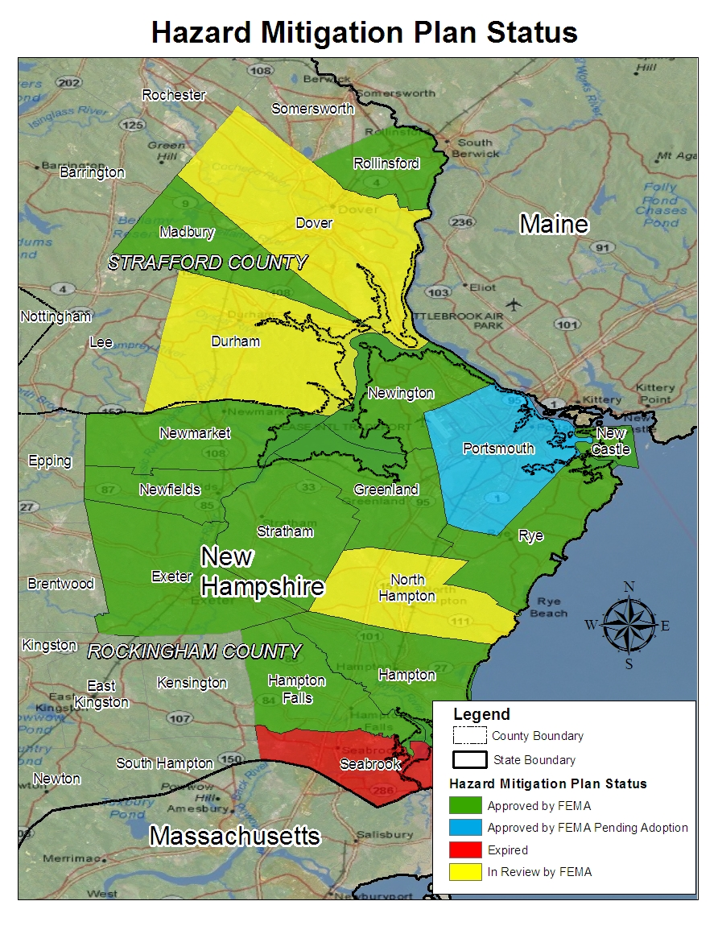
NH Coastal Communities
Community | County | Expiration Date | Plan Review Status
Exeter | Rockingham | 12/15/2011 | Approved
Greenland | Rockingham | 5/11/2012 | Approved
Hampton | Rockingham | 6/29/2016 | Approved
Hampton Falls | Rockingham | 8/7/2013 | Approved
New Castle | Rockingham | 5/12/2013 | Approved
Newfields | Rockingham | 7/16/2014 | Approved
Newington | Rockingham | 5/11/2012 | Approved
Newmarket | Rockingham | 10/4/2011 | Approved
North Hampton | Rockingham | TBD | In Review (rec'd 8/25/11)
Portsmouth | Rockingham | TBD | Approved Pending Adoption (8/17/11)
Rye | Rockingham | 7/13/2016 | Approved
Seabrook | Rockingham | --- | Expired
Stratham | Rockingham | 1/7/2013 | Approved
Dover | Strafford | TBD | In Review (rec'd 8/9/11)
Durham | Strafford | TBD | In Review (rec'd 5/12/11)
Madbury | Strafford | 6/17/2013 | Approved
Rollinsford | Strafford | 8/30/2016 | Approved
Notes:
Mitigation Status of NH Coastal Communities

Slide 29
Discover FEMA Programs
  Flood Mitigation Assistance – annual funding to reduce risk to NFIP-insured structures
  Hazard Mitigation Grant Program – declared disaster funding for long-term hazard mitigation measures
  Pre-Disaster Mitigation Program – annual funding for hazard mitigation planning and projects
  Repetitive Flood Claims - annual funding to reduce risk to NFIP-insured structures with one or more claims
  Severe Repetitive Loss – annual funding to reduce risk to NFIP-insured severe repetitive loss structures
  Community Rating System – proactive communities receive insurance discounts for residents

Slide 30

Communication
Communication, data sharing, and feedback
Role of each community in keeping their communities informed of
  Their flood risk
  Steps they can take to protect themselves and their property
  Study progress
Communication tools available to help communities communicate about risk and projects
Notes:
Laura Keating Slides 30-33
Discuss the importance of regular communication, data sharing, and feedback between FEMA and the communities
Discuss coordination with and related resources available from other Federal Agencies, State agencies, and associations
Highlight the role of each community in keeping their communities informed of their flood risk, steps they can take to protect themselves and their property, and study progress
Describe the communication tools available to help communities communicate about risk
Enhances local capabilities to communicate effectively with constituents about risk
Provides customizable communications plans, key messages, and materials to communities

Slide 31
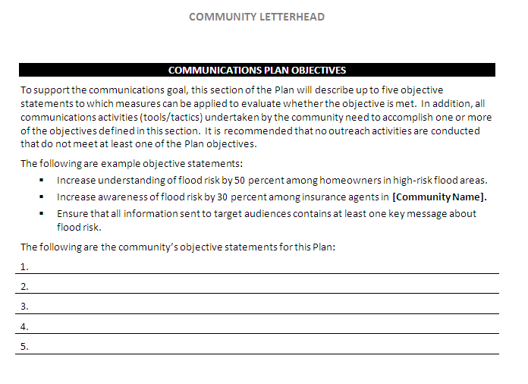
Community Outreach Plan Template
Notes:
Community Outreach Plan Template

Slide 32
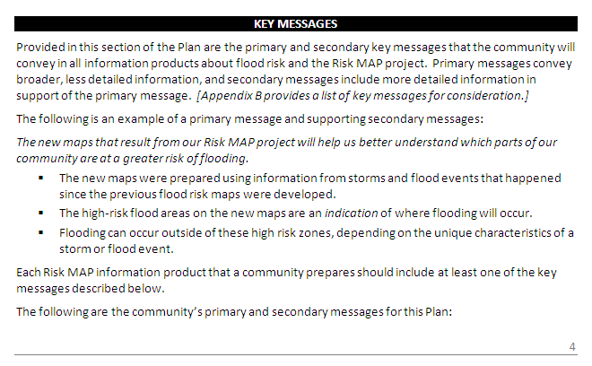
Community Outreach Plan Template
Notes:
Pre-preliminary templates
Post-preliminary templates
Changes since last map

Slide 33
NH Coastal Project Timeline
Activities
Project Timeline
Products
Projected Preliminary
May 2013
Projected
Effective
June 2014
Projected
Flood Study Review
April 2013
Discovery
September 2011
Projected CCO
June 2013
Projected LFD
Dec 2013
Notes:
Laura to talk about upcoming Risk MAP meetings and where additional coordination will occur
Coastal Schedule
Prelims –May, 2013
LFD – December 2013
Flood Study Review Meeting ( a couple months before preliminary): After the engineering analysis is completed to present initial mapping results and draft risk assessment products. Presented in work map format
CCO Meeting
Resilience Meeting: Between LFD and effective Date Focus on hazard mitigation plan implementation and available resources. Flood Risk products are again discussed.

Slide 34
Points of Contact – NH Coastal Project
State Contacts
  Jennifer Gilbert, NFIP State Coordinator, NH OEP
  jennifer.gilbert@nh.gov
  Lance Harbour, State Hazard Mitigation Officer, NH DOS/HSEM
  lance.harbour@dos.nh.gov
STARR Regional Service Center
  Laura Keating, RSC Lead, STARR
  laura.keating@starr-team.com
Coastal NH Project Team Contacts
  Fay Rubin, Project Director, UNH
  fay.rubin@unh.edu
  Brent McCarthy, PE, Senior Associate, AECOM Water
  brent.mccarthy@aecom.com
FEMA Coastal NH Project Contacts
  John Grace, Coastal Engineer, FEMA Region I
  john.grace@dhs.gov
  David Mendelsohn, Post Preliminary Processing, FEMA Region I
  david.mendelsohn@dhs.gov
  Marilyn Hilliard, Senior Planner
  Risk Analysis Branch, Mitigation Division, FEMA Region I
  marilyn.hilliard@dhs.gov
Notes:
Fay – 34-36

Slide 35
General Points of Contact
For general FEMA mapping and LOMC questions contact FEMA’s Map Information Exchange (FMIX): 1-877-FEMA MAP (1-877-336-2627) or email a Map Specialist: FEMAMapSpecialist@riskmapcds.com
Map Service Center (MSC): where you can view effective maps online for free http://www.msc.fema.gov/
To learn more about the National Flood Insurance Program: http://www.floodsmart.gov/floodsmart/ or call 1-888-379-9531

Slide 36
What we would like from you:
Post-event surveys and investigations
Documented areas of repetitive coastal flooding
Areas of significant beach or dune erosion
Coastal protection structures that may impact the floodplain
Topographic data
Areas with identified damage during storm events
Areas where the existing DFIRM is inaccurate
Letters of Map Change (LOMC) in the coastal area
Planned/permitted development
Changes in conveyance
Notes:
Fay to discuss Data request
(mr): add areas of recent or future development to discussion

Slide 37
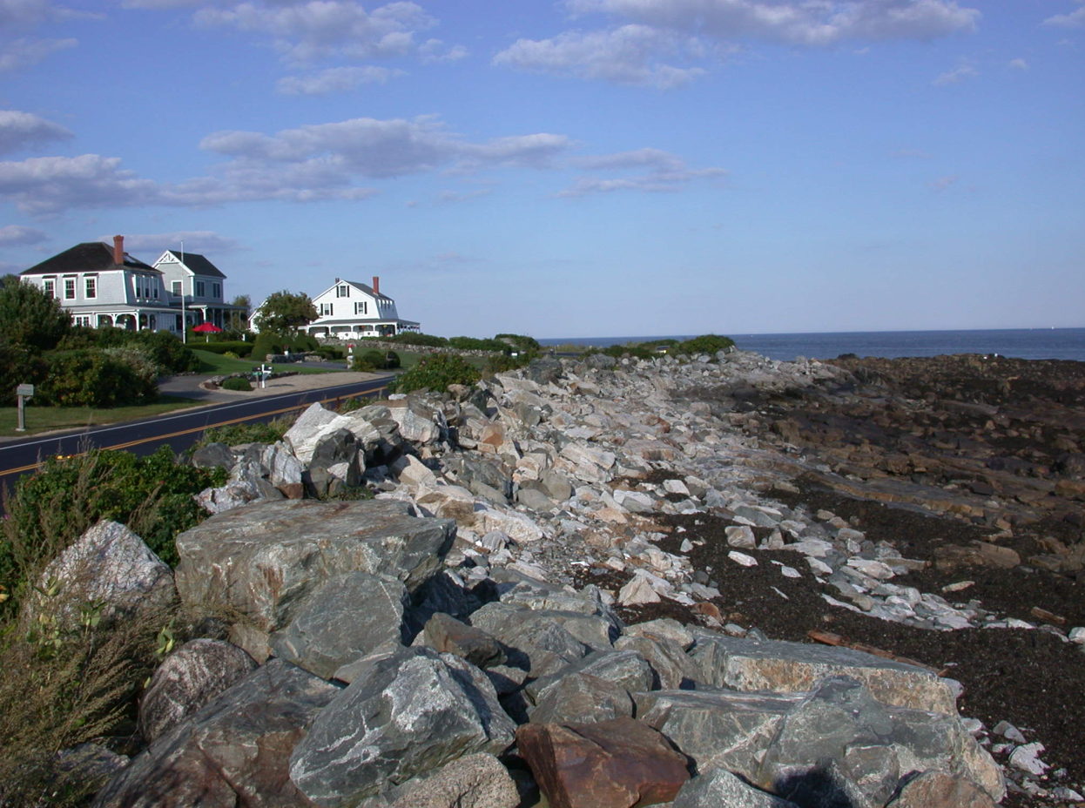
Questions and discussion

Slide 38
Risk MAP Products
HAZUS-MH Analysis
Coastal Depth Grid
Flood Depth Grids for Riverine
Limit of Moderate Wave Action Analysis
Changes Since Last FIRM
Static Sea Level Rise Analysis
Flood Risk Report and Flood Risk Map

