Slide 1
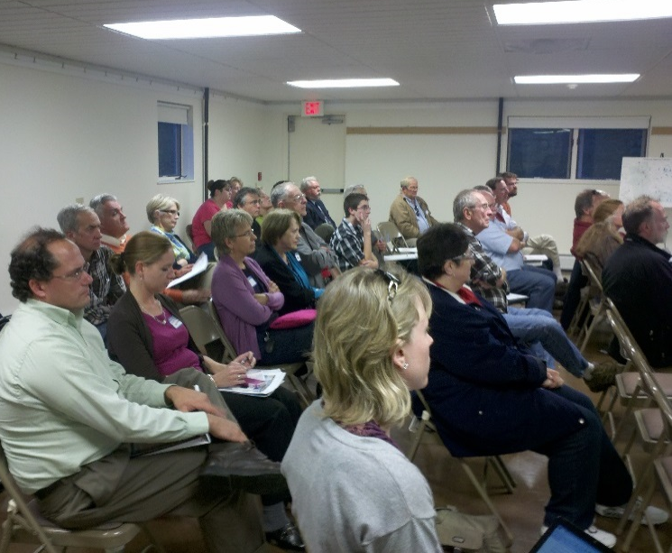
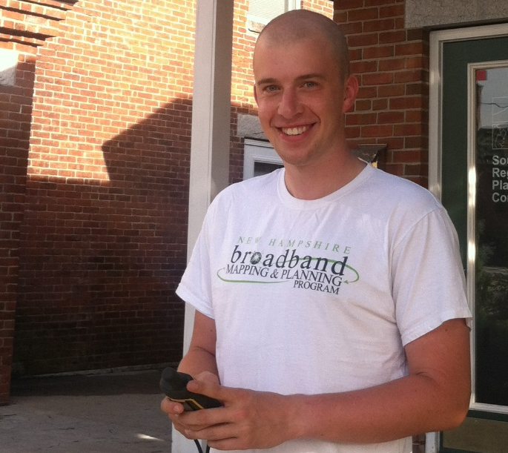
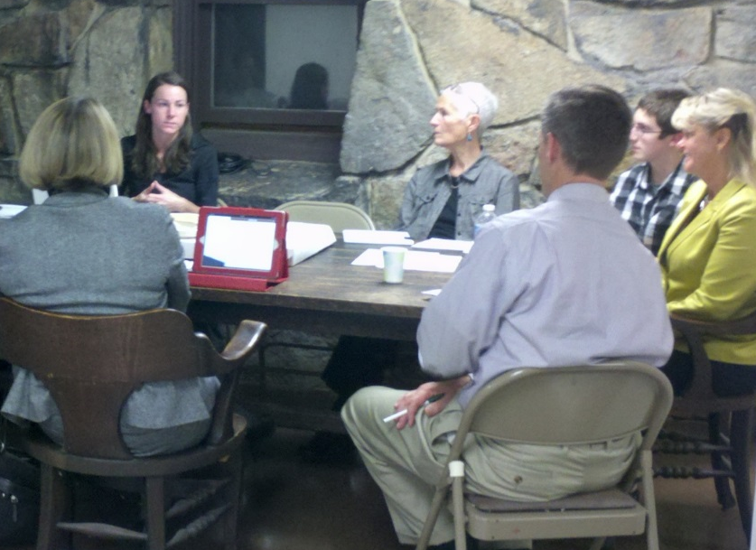


Regional Broadband Planning in New Hampshire
Presentation By:
Tim Murphy and Tara Germond, Southwest Region Planning Commission
Rachel Ruppel, Upper Valley Lake Sunapee Regional Planning Commission
This presentation is funded under grant # 33-50-M09048 from the U.S. Department of Commerce to the University of New Hampshire.

Slide 2


Background
NTIA = National Telecommunications & Information Administration
SBI = State Broadband Initiative
      Announced in 2009
      Nearly $300 M available for states, territories and the District of Colombia
      Purpose:
    “Support the efficient and creative use of broadband technology to better compete in the digital economy.”

Slide 3













Background
UNH, along with partner organizations:
      NH RPCs
      NH DRED
      NH OEP
Developed a comprehensive proposal through the SBI.
NHBMPP = NH Broadband Mapping & Planning Program
          Work began in 2010

Slide 4

NH Broadband Mapping & Planning Program
Focus on improving broadband access & use in NH by:
Assessing broadband availability
Engaging communities & others in broadband planning, capacity building, technical assistance, and training initiatives.

Slide 5
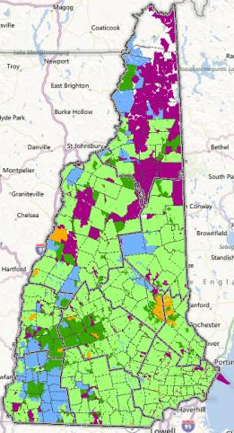
Mapping Broadband Availability
Goal: Map broadband availability by type of technology and speed, to identify areas served, unserved, and underserved in the state.
Based on data submitted by broadband providers in the state.
Data aggregated to census block geography for analysis and display.
Data collected, processed by UNH, submitted to NTIA.

Slide 6
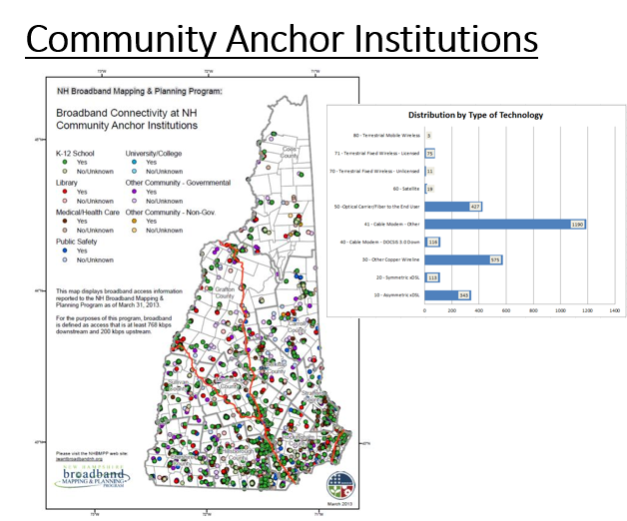
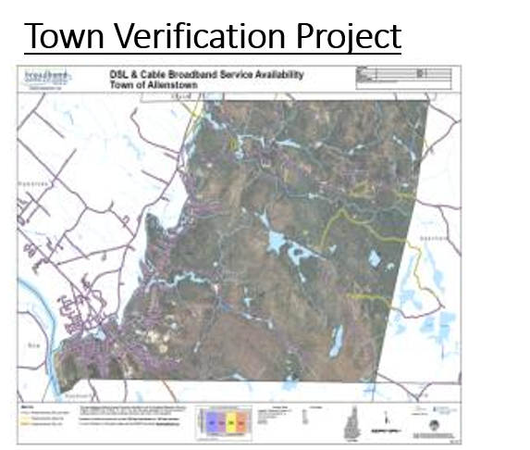
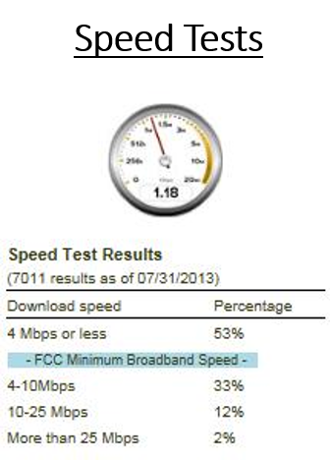
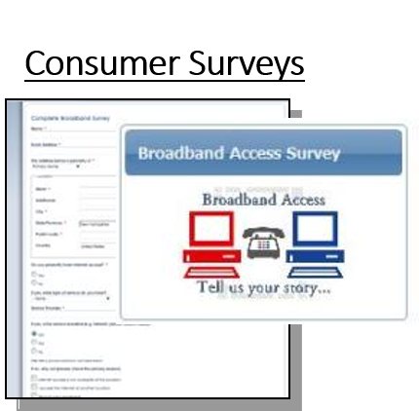
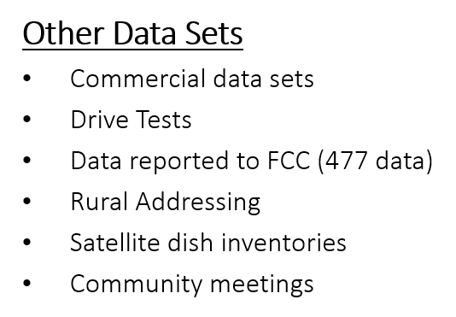
Broadband Availability – Data Validation

Slide 7

Broadband Technical Assistance & Training
Goal: Assess broadband training & technical assistance needs of stakeholder groups.
Design and develop face-to-face and web-based learning modules
Deliver workshops, training and technical assistance to support increased use of broadband adoption and use.

Slide 8
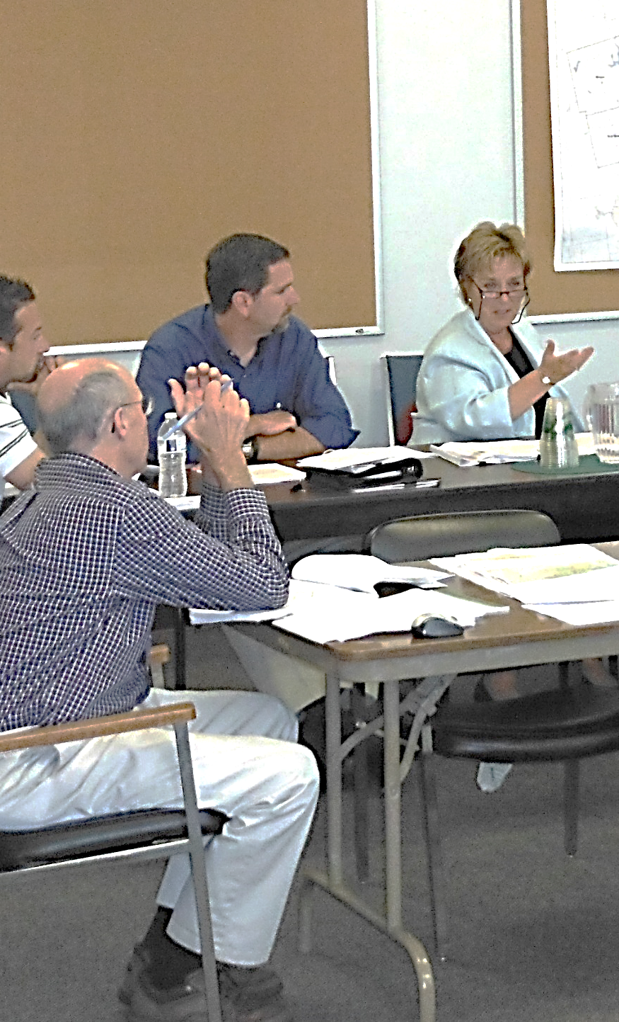
Broadband Capacity Building
Goal: Focused on the development of tools and resources necessary to implement broadband projects within communities across the state.
Developing a Broadband Solutions and Funding Toolkit.
Working with “ready” communities to initiate their broadband plans and to provide assistance with community broadband decision making.

Slide 9

For Further Information:
iwantbroadbandnh.org

Slide 10
REGIONAL BROADBAND
PLANNING PROCESS

Slide 11
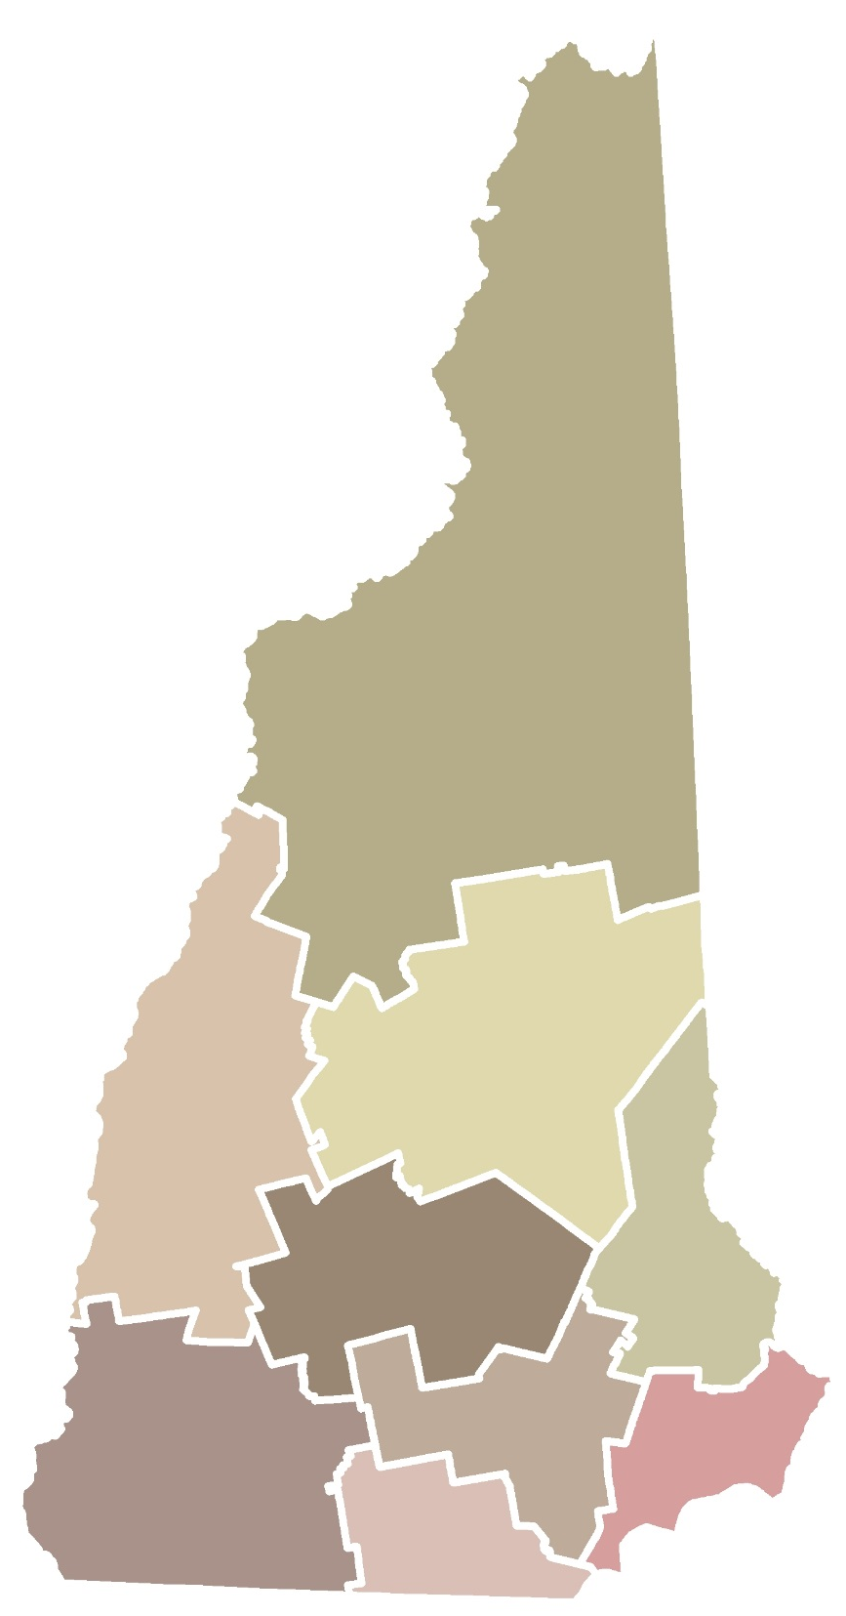
  NH’s Regional Planning Commissions
North Country
Upper Valley Lake Sunapee
Lakes
Strafford
Central NH
Southern NH
Southwest
Rockingham
Nashua

Slide 12
Broadband Stakeholder Group
Business
Public Safety
Service Providers
Medical
Education
Local Government
Real Estate
Media
Info
Technology

Slide 13
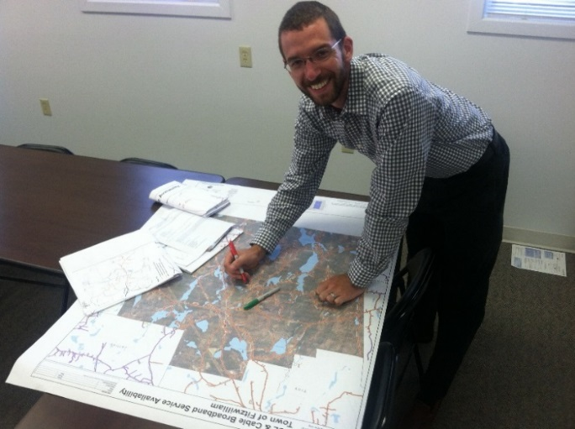
Planning Process
Evaluated Broadband Needs
Identified Challenges to Broadband
Conducted Sector Analysis
Established Regional Vision
Proposed Goals & Objectives
Developed Implementation Strategies

Slide 14

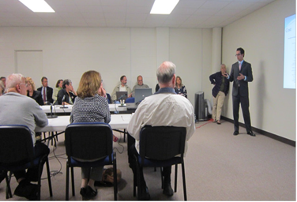
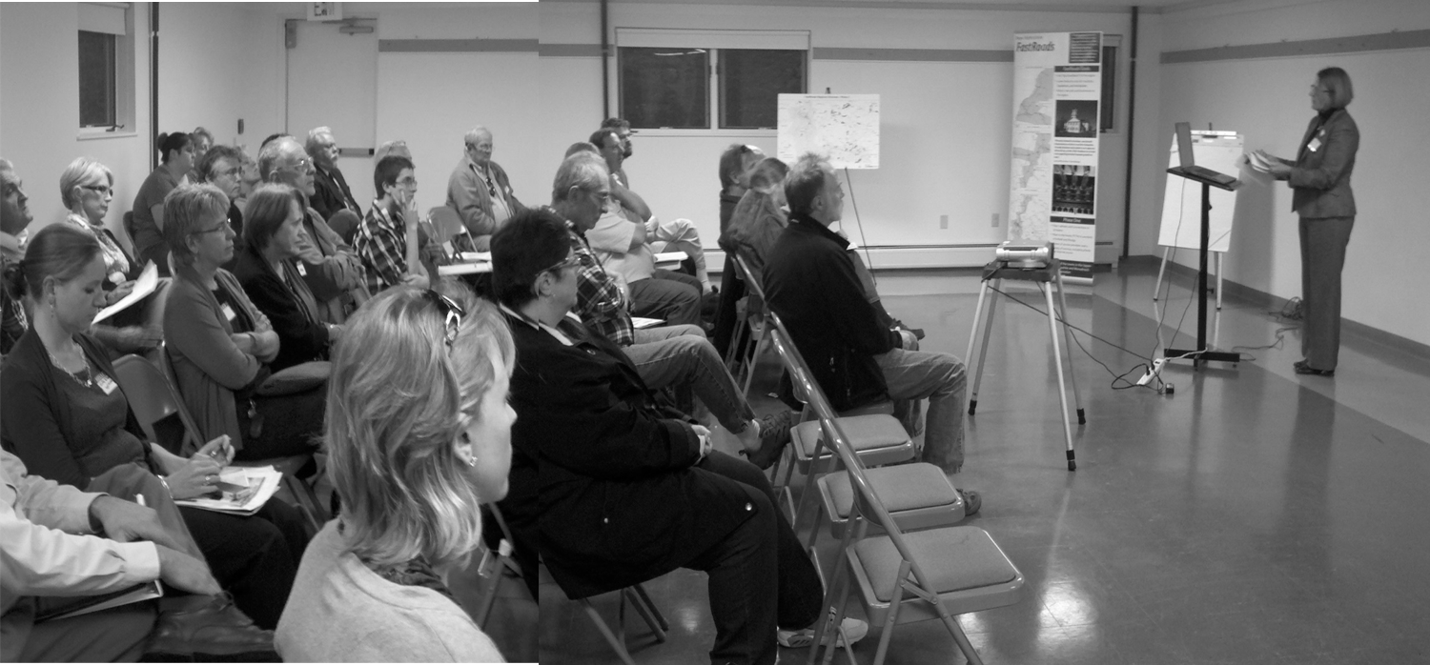
Public Forums and Workshops

Slide 15
Regional Planning Timeline
Q 1 | Q 2 | Q3 | Q4 | Q 1 | Q 2 | Q3 | Q4 | Q 1 | Q 2 | Q3 | Q4 |  | Q 1 | Q 2 | Q3 | Q4
 |  | Form BSG
 |  | Conduct Quarterly BSG Meetings
 |  | Data Collection & Analysis
 |  |  | Evaluate Need / Demand
 |  |  | ID Barriers
 |  |  |  |  |  | Propose Solutions
 |  |  |  |  |  | Forum #1
 |  |  |  |  |  |  | Prepare Draft Plans
 |  |  |  |  |  |  |  |  |  | Forum #2
 |  |  |  |  |  |  |  |  |  |  |  | Finalize Plan
 |  |  |  |  |  |  |  |  |  |  |  |  |  |  | Forum #3
 |  |  |  |  |  |  |  |  |  |  |  |  | Coordinate with OEP
2011
2012
2013
2014

Slide 16
What is Broadband (high-speed Internet)?
Tiers of Service | Download Speed | Upload Speed | Typical Functions / Use
Un-served | < 768 Kbps | < 200 Kbps | Email (client/server-based)
Underserved | 768 Kbps to < 1.5 Mbps | 200 Kbps to < 768 Kbps | Web-based email Limited web browsing Send/receive small documents Single user Internet device
 | 1.5 Mbps to < 3 Mbps | 768 Kbps to <1.5 Mbps | Medium social media use Send/Receive medium-size documents/files Limited streaming content, buffering a concern 1-3 simultaneous Internet devices possible
Served | 3 Mbps to <6 Mbps | 1.5 Mbps to <3 Mbps | Send/Receive medium to large-size documents or files Streaming content, downloading High Definition (HD) content, speed a concern Low quality, small window videoconferencing
 | 6 Mbps to <10 Mbps | 3 Mbps to 6 Mbps | Send/Receive large documents or files (small videos) Streaming HD Virtual Private Network (VPN) access for remote work at speed critical to job function Multi-player online gaming
 | 10 Mbps to <25 Mbps | 6 Mbps to <10 Mbps | HD quality, large frame videoconferencing Remote synchronous education, professional development facilitated concurrently at multiple locations Tele-health applications possible
 | 25+ Mbps | 10+ Mbps | Send/Receive medium to large databases Real-time medical imaging and consultation, remote patient monitoring
Notes:
Comments:
Note key definition of broadband – 768 kbps down and 200 kbps up
But we recognize these speeds are not adequate for many of today’s applications, so for NH purposes, we are proposing a “use case” based definition of served/unserved/unserved areas of the state.
Already revisiting the definition, need to update

Slide 17
Broadband Needs
Access
      Expand broadband availability, especially in
      rural areas.
Choice
      Increase options of service providers &
      technology types.
Quality
      Offer faster speeds / bandwidth.
Reliability
    Ensure that service is available at all times.
Affordability
Provide affordable service options for all
income levels.
Essential
    Recognize broadband as critical infrastructure.

Slide 18




Sector Based Needs

Slide 19
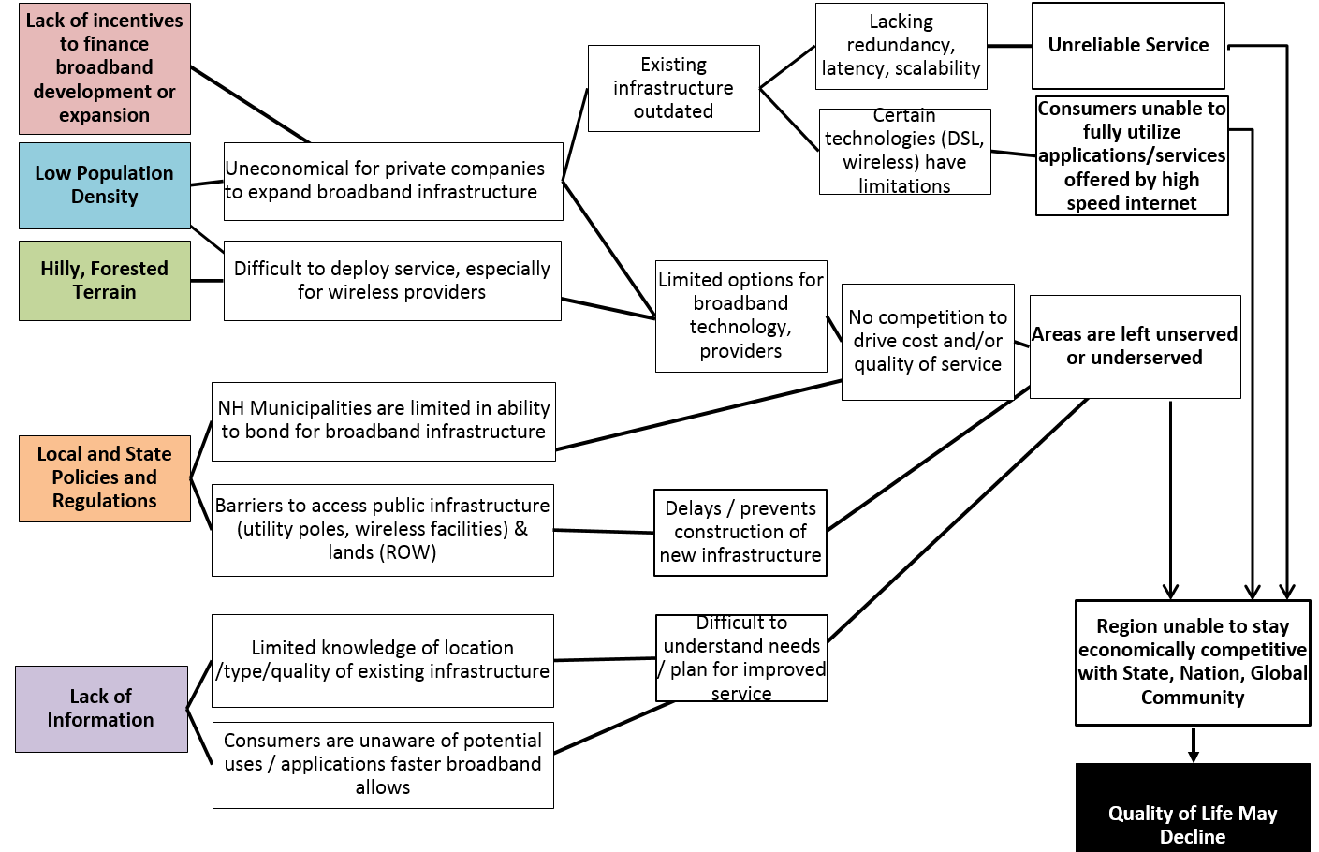
Broadband Challenges

Slide 20
Regional Vision
Recognizing that the universal availability of high capacity broadband is vital to the region’s future and long term prosperity, this Plan is guided by a vision of Southwest New Hampshire where every premises has the ability to access and fully utilize a reliable, affordable and sustainable broadband network.
- Southwest New Hampshire Broadband Vision Statement -

Slide 21
Plan Implementation
Strategies
Goals
Vision

Slide 22


Setting the Vision
Fast, reliable and affordable broadband service through a competitive marketplace throughout all parts of the Upper Valley Lake Sunapee region.
A future with rural regions having equal opportunity to access broadband services as metropolitan areas.

Slide 23
Defining Goals
By the Year 2020,
Affordable 10 Mbps service to all areas.
Work on building “Gigabit Communities.”
A competitive, innovative marketplace.
Work on parity – rural, downtown, metro.

Slide 24



Challenges to Expansion
Population Density
Return on Investment
Hilly Terrain
Financing
Pole Attachments
Leadership
Notes:
Low population density throughout the region
Low return on investment for wired expansion
Hilly terrain inhibits wireless expansion
Limited financing and funding sources
Complex utility pole attachment
State-level leadership very low compared to other northern New England states

Slide 25

Fleshing Out Strategies
Implementation Matrix
What – strategy
When – priority and phasing
How – level of action
Who - partners
Who benefits – sectors affected
Notes:
How do we overcome barriers?
What has worked elsewhere?
Prioritization
What will have the most impact?
2 minutes in an elevator

Slide 26

Top Five Priority Action Areas
Federal Level
Support reform of the federal Connect America Fund to increase the funding coming into New Hampshire.
Notes:
Federal Level – Increase $$

Slide 27
Top Five Priority Action Areas
State Level
Pass state legislation that promotes new options for broadband financing.
Reform state legislation and policy governing utility pole attachments.
Notes:
State level: Increase $$, Decrease Cost of Deployment

Slide 28
Top Five Priority Action Areas
Local/Regional Level
Provide technical assistance to municipalities to update wireless telecom ordinances.
Support inter-municipal or regional coordination on broadband expansion efforts.
Notes:
Local/Regional Level: Decrease cost of deployment and increase local capacity and priorities. Increase opportunity for local fundraising and community finance.

Slide 29
Plan Implementation
Strategies
Goals
Vision

Slide 30
Regional Planning Timeline
Q 1 | Q 2 | Q3 | Q4 | Q 1 | Q 2 | Q3 | Q4 | Q 1 | Q 2 | Q3 | Q4 |  | Q 1 | Q 2 | Q3 | Q4
 |  | Form BSG
 |  | Conduct Quarterly BSG Meetings
 |  | Data Collection & Analysis
 |  |  | Evaluate Need / Demand
 |  |  | ID Barriers
 |  |  |  |  |  | Propose Solutions
 |  |  |  |  |  | Forum #1
 |  |  |  |  |  |  | Prepare Draft Plans
 |  |  |  |  |  |  |  |  |  | Forum #2
 |  |  |  |  |  |  |  |  |  |  |  | Finalize Plan
 |  |  |  |  |  |  |  |  |  |  |  |  |  |  | Forum #3
 |  |  |  |  |  |  |  |  |  |  |  |  | Coordinate with OEP
2011
2012
2013
2014
Notes:
xx
This 3+ year planning effort began in mid-2011.
Regional Broadband Stakeholder Groups have been meeting on a quarterly basis since that time, and more frequently at time as needed.
In addition, annual broadband public forums are being conducted in each of the 9 regions to broaden the planning process to a wider audience and encourage the public’s knowledge of and input to the process.
Draft regional broadband plans will be completed in late 2013, the refined and published during 2014.
Once draft plans are available the process of consolidating the regional plans into a state-level report will begin with completion scheduled towards the end of 2014.

Slide 31
Next Steps
Development of state level planning document.
Resource to municipalities for local planning efforts.
Examples of best practices and case studies.

Slide 32
QUESTIONS & COMMENTS?

