Slide 1
ISP Panel – Last Mile Solutions
Moderated by Carol Miller, Director of Broadband Technology at the Division of Economic Development at the NH Department of Resources and Economic Development

Slide 2
Department of Resources and Economic Development
Jeffrey J Rose, Commissioner
Carmen Lorentz, Director of Division of Economic Development
Business Resource Center DED
Business retention & recruitment, government procurement, energy, employee retention, broadband
Paul Leary, Chief of Communications
Carol Miller, Director of Broadband Technology

Slide 3
Division of Economic Development

Slide 4
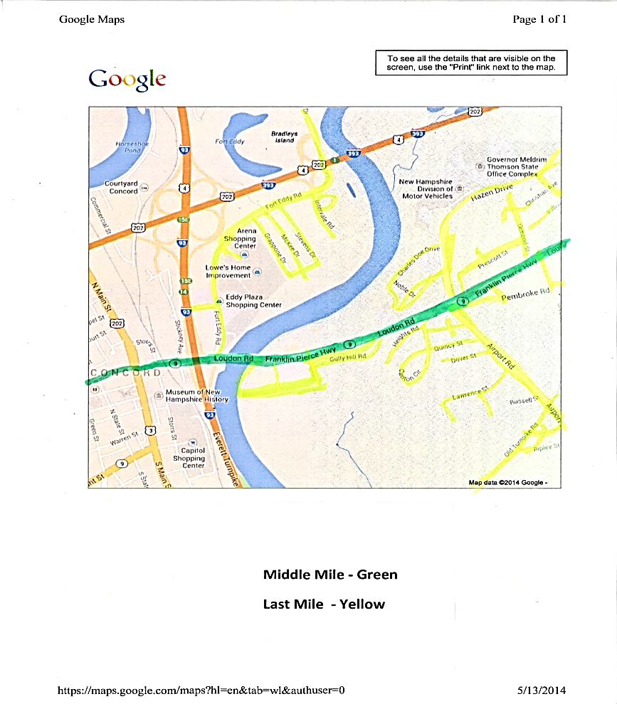
Last Mile

Slide 5
What is the last mile?
Term used by the Telecom Industry
Infrastructure at the Neighborhood Level
Uses Utility Poles, Conduits, Air Waves
Cooper Wire from the Telephone Central Office to your business, organization or home
Coaxial Service Drops carrying cable signal to subscribers
Fiber to the Premise (FTTP) or Fiber to the Home (FTTH)
A fixed location to a wireless customer using wireless spectrum
Towers linking cell phone to cellular networks
Dish to Satellite

Slide 6
Why should you care?
Global Information
Employment Opportunities
Educational Attainment
Access to TeleHealth
E-Government Services
Entertainment
Global Information

Slide 7
Ellen Scarponi, Director of Government Relations and Economic Development

Slide 8
Maura Weston, MM Weston & Associated for AT&T Mobile

Slide 9
Chris Hodgdon, Senior Director Government Affairs for New Hampshire and Maine

Slide 10
Carole Monroe, Executive Director of New Hampshire Fastroads

Slide 11
Wireless and Fiber Solutions
Brian Foucher, President and Owner

Slide 12
Panel Discussion - Question 1
What is your company’s philosophy on partnerships to get broadband to unserved markets?
(Public/Private, Local, State, Federal)

Slide 13
Panel Discussion – Question 2
What do you consider the biggest challenges to your company’s broadband expansion efforts?

Slide 14
Wrap Up – Q&A
For more information on broadband initiatives in NH contact the Division of Economic Development at the New Hampshire Department of Resources and Economic Development
carol.miller@dred.nh.gov

Slide 15
Thanks to Panelists

